Slide 2
Paul D. Vanchiere, MBA
Pediatric Management Institute - Principal Consultant
Greenwood Pediatrics - CFO
ALL Pediatrics - CFO

Slide 3
Today is not a substitute for Legal or Accounting Advice
PMI does not offer legal or accounting services. As such, all information shared should be reviewed with your attorney to ensure compliance with applicable state and federal laws.
Today’s presentation focuses on the operational aspects of practice valuations, mergers and/or acquisitions as a guide to educate you on issues involved.

Slide 4
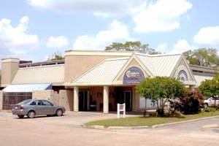

Slide 5
Agenda
Why practice valuations may be needed
01
Review some valuations
02
Walk through an example
03
Things to consider
04

Slide 6
Practice Culture
Shareholder / Partnership Agreement
Practice Valuation
Compensation
Base Pay
Split The Pot

Slide 7
Partner/Owner Compensation
Base Salary
Owner / Partner Total Comp
Based on days per week seeing patients
Be mindful of Social Security Wage Base
Approximately 10-20% higher than employed providers
Must examine margin on each to ensure appropriate
Productivity Bonus
Standard Revenue Generated Model
wRVU
Employed Provider Margin
Vaccine Margin
Split based on equity position or supervision responsibilities
Split based
Equity Position
Volume (wRVU’s, Visits, etc)

Slide 8
Strong Headwinds For Independent Pediatric Practices
Declining Margins
Competing With Hospitals
Reduced Supply Of Pediatricians
Flat Payments
Increasing Costs
Shrinking Margins
Higher salaries with RVU incentives
Debt forgiveness programs
Reduced interest in pediatrics versus other specialties

Slide 9
Moral Injury
Burnout
Moral Injury
Approach
Following a calling rather than a career path
Each hurdle offers a lesson in endurance
Failing to consistently meet patients’ needs has a profound impact on physician wellbeing
Physicians must be treated with respect, autonomy, and the authority to make rational, safe, evidence-based, and financially responsible decisions.
Create a win-win where the wellness of patients correlates with the wellness of providers.
Exhaustion, cynicism, and decreased productivity
Suggests a failure of resourcefulness and resilience
Symptom of something larger
https://www.statnews.com/2018/07/26/physicians-not-burning-out-they-are-suffering-moral-injury/

Slide 10
Tough Marketplace…
Limited qualified buyers
Limited interest
No two practices are similar enough to estimate a “fair” price
Medicaid/Private pay percentage
Lack of standards
Very different from the housing market to find comparable

Slide 11
Plan for the Future
Disability
Death
The
“4 D’s”
Divestiture
Divorce
11

Slide 12
Traditional Valuation Methods
Income Approach
Asset Approach
Market Approach
Determining the value of the practice by converting future economic benefits into a single present amount
Determining the practice's value based on the assets net of liabilities.
Comparable Sales- comparing the practice to similar businesses, business ownership interests, securities or intangible assets.

Slide 13
Discounted Cash Flow (DCF) Analysis
Estimates future cash flows and discounts them back to the present using a required rate of return.
A business is projected to generate $1 million in free cash flows over the next 5 years. Discounted at a 10% rate, the present value of those cash flows is $750,000.
Market Comparison
Compares the subject company to similar publicly traded companies or previous transactions.
A business is valued by comparing EV/EBITDA multiples to 5 similar public companies. The average multiple of those companies is used.
Multiple of Earnings
Applies a multiple to a business's earnings to derive a value. Common earnings multiples include P/E, EV/EBITDA.
A business has EBITDA of $2 million. An 8x multiple yields a valuation of $16 million ($2 million x 8).
Rule-of-Thumb Benchmark
Applies an industry-specific rule-of-thumb multiple to a business metric.
A SaaS company is valued at 5x recurring revenue. If recurring revenue is $10 million, value is $50 million.
Asset-Based Approach
Totals the net value of a business's tangible assets to determine an asset-based value.
A business has $5 million in assets and $2 million in liabilities. Its asset-based value is $3 million ($5 million - $2 million).

Slide 14
Valuation Objective
Establish a fair and mutually agreed upon price to facilitate the transfer of ownership in the practice.
Establish a concrete formula that can be referenced or updated as the need arises.
Eliminate Uncertainty
Set the expectation in advance of the need.
If you wait until stressful time to establish a value, emotions get in the way of a fair deal for both sides.

Slide 15
What Is A “Fair” Price?
Seller Willing To Accept
Purchase Price
Buyer Willing To Pay

Slide 16
Succession Planning 101:
Share
the workload
Too much for partners/owners
Share / Mitigate Individual Risk
One (or both) is hesitant to go “all in” on the investment
When You May Need A Partner
Need capital for expansion
Neither have the capital to add new locations or expand the practice
Equity redemption
One of them want to move on to fulfill their passion in other areas / retire

Slide 17
Exit Strategy Options
Internal Options
This involves an "internal" buy-in or buy-out scenario where a pediatrician becomes a new partner/shareholder in the practice or an existing pediatrician wishes to retire and sell their interest in the practice to the remaining partners/shareholders.
Valuations in such cases generally tend to be lower compared to those offered by private equity-backed investments. Various factors come into play, including the practice's cultural expectations regarding profits and their distribution of profits.

Slide 18
Shut
Down
Succession Plans…
the worst options…
Sell To
Hospital
18

Slide 19
Sell to Hospital
Private Inurement
Medicaid Fraud and Abuse
Applies to tax exempt hospitals – section 501 (c) (3)
Known as the "anti-kickback law"
Defined: No part of a hospital's net earnings may inure to the benefit of any private individual
Prohibits payments, offers, or inducements of any remuneration for referrals
Just because a transaction may be “fair market value” does not necessarily make it “commercially reasonable”
Issue: If acquisition price exceeds fair market value, transaction may be considered a inducement for referrals “Commercially Reasonable”

Slide 20
Sell to Hospital
Purchase of Current Practice
01
Usually Combination Offer
Asset Driven
Future Compensation Package
Base Salary
Benefits
Production (wRVU Incentives)
Limited by “Fair Market Value”
02
Office Building Lease
03

Slide 21
Exit Strategy Options External Options
Hospitals
01
02
03
04
Decreasing in popularity but getting very creative!
Hospitals are no longer as willing to pay substantial amounts to acquire practices due to concerns regarding the costs outweighing the revenue from referrals.
Except for innovative joint-venture arrangements, hospitals are limited by Federal Stark laws, which restrict the amount they can pay to avoid any appearance of inducing referrals to the hospital's services.
Similar to private equity-backed investments or purchases, any pediatrician approached by a hospital for partnership or acquisition should review PMI's guide to ensure they ask the right questions and assess whether the opportunity aligns with their needs, the needs of their practice, and the well- being of their patients.

Slide 23
Sell to Network of Large Competitor
Offers Access to Better Paying Contracts
01
02
After allocating operating expenses, could see net increase in “take home pay” & benefits
Buyer has payment rates far greater than smaller practice can obtain
Net effect is higher compensation for Pediatricians
03
04
05
Usually burdened with higher employee benefit costs
Less headache for seller in the future (HR issues, payroll, etc.)
Loss of autonomy (not as bad as selling to hospital)

Slide 24
Exit Strategy Options External Options
Combined/ Managed Services
01
02
03
04
05
06
Popular in various regions
Usually has multiple specialties
“Strength in numbers” to leverage best locality for payments
Black box analysis to determine “added margin” stemming from increased payment rates and reduction of administrative costs
Normally no cash/equity when transaction occurs
Usually some involvement of private equity lurking in the background

Slide 25
MSO Strategy
Access to higher payment rates
Give up equity in existing practice
Stakeholders should compare the expected annual increase versus the lost equity to determine how many years to “break even”
25

Slide 26
Exit Strategy Options External Options
Private Equity-backed firms
01
02
03
04
05
Relatively new to pediatrics
These organizations have actively pursued opportunities to acquire pediatric practices in recent years.
Private equity-backed firms have their own set of advantages and disadvantages, and careful evaluation on a case-by-case basis is crucial to ensure compatibility with the practice's culture and expected future financial performance.
Valuations in these situations focus on Earnings Before Interest, Taxes, & Amortization (EBITA), often resulting in higher pediatric practice valuations thanks to commonly accepted financial models.
If a practice's estimated EBITA is $200,000, a private equity-backed firm may be willing to pay several multiples of that amount, potentially ranging from 4 to 6 times EBITDA, or even higher in rare cases.
Additional complexities arise with private equity-backed investments, such as long-term plans, future employment contracts, non-compete covenants, and operational issues. PMI's published "Roadmap For Buying/Selling A Pediatric Practice" is recommended as a resource to help practices navigate such opportunities effectively.

Slide 27
How PE-Backed Firms Deliver Profits
Horizontal Strategies
Vertical Strategies
Practice Acquisitions
At Risk Capitated Contracts with state Medicaid programs
Approximately 50% of all US children receive care through Medicaid and/or the Children’s Health Insurance Program (CHIP).
Expanded Services / Location / Market share / Provider Counts
Big money in it…for the states and those who organize such efforts…

Slide 28
Earnings
Before
Interest
Taxes
Depreciation &
Amortization
By considering depreciation and amortization as well as taxes and debt payment costs, EBITDA attempts to represent the cash profit generated by the practice

Slide 29
How PE-Backed Firms Deliver Profits
Buy practice(s) for X multiple of EBITA/EBITDA
Sell in 3-5 years for HIGHER multiple with HIGHER EBITA/EBITDA.

Slide 30
EBITA
MULTIPLE
How PE-Backed Firms Determine The Value
Multiple Determined Whether “Anchor” Practice
Provider Count, Locations, & Revenue Range
Vaccine Inventory
X Week Supply
Seller Pays Outstanding Invoices
Cash on Hand
Balance Accumulated Taxable Income to Seller with Working Capital need to keep practice
30

Slide 31
EBITA
MULTIPLE
Purchase Price
Cash Up
Front
Equity In Future Entity
60 – 100%
0 – 40%
31

Slide 32
How Much At Closing?
Negotiated Upfront Payment
Provider Retention
Negotiated Roll Into Equity
Due Diligence Offsets
May be worth more/less in the future
Some offers may have very high multiple with higher percentage going towards equity
Asset versus Stock Sale
Tax implications are HUGE
Earn out provisions

Slide 33
CPA
vs Lawyer
Need to understand the tax implications
Asset vs. Stock Sale
33

Slide 35
PE Purchase Process (Abbreviated)
01
Practice Solicitation
Basic Financials & Narrative
Brokers Are Essential
08
Accountants structure percentage of stock versus asset sale (tug of war)
02
Firm reviews information
09
Lawyers negotiate
Sale Price/Structure
Employment contracts
03
Firm meets practice
10
Both parties review documents and provide feedback to lawyers
04
Firm submits Letter of Interest or Letter of Intent (Non-Binding)
11
Lawyers Memorialize Each Party’s Understanding
05
Lawyers clarify meaning of LoI
12
Document signing
06
Both parties sign LoI
13
Payment to practice owners/partners
07
Practice Undergoes Financial Colonoscopy (without sedation!)
14
Follow through with commitments

Slide 36
Reality Check (Part I)
01
02
Pediatric practices are very stable/resilient businesses
The need will always be there as long as there are children in the world
03
04
The recurring revenue stream has tremendous financial value
Worth different things to different people
Balance between maximizing profits and maximizing an altruistic career
Should be able to generate $500 - 750k per FTE provider annually (sometimes more)

Slide 37
Goodwill
Goodwill is an intangible asset that arises as a result of the acquisition of one company by another for a premium value.
The value of a company's brand name, solid customer base, good customer relations, good employee relations and any patents or proprietary technology represent goodwill.
Hogwash…
benefits of reputation is what drives practice revenue…
Allocation of “Goodwill” is double-dipping

Slide 38
“
”

Slide 39
Goal of Valuation Formula?
Determine the added benefit of owning a practice.

Slide 40
Mindset
Work as a Pediatrician
Risk/Reward for owning the practice

Slide 41
Scenario
01
Dr. Smith is a 65 year old Pediatrician wants to retire in 2 years
Dr. Johnson is a 45 year old Pediatrician has been there for five years, is good fit, and wants to buy the practice
02
03
1 NP (Full Time)
04
1 NP (Part Time)

Slide 42
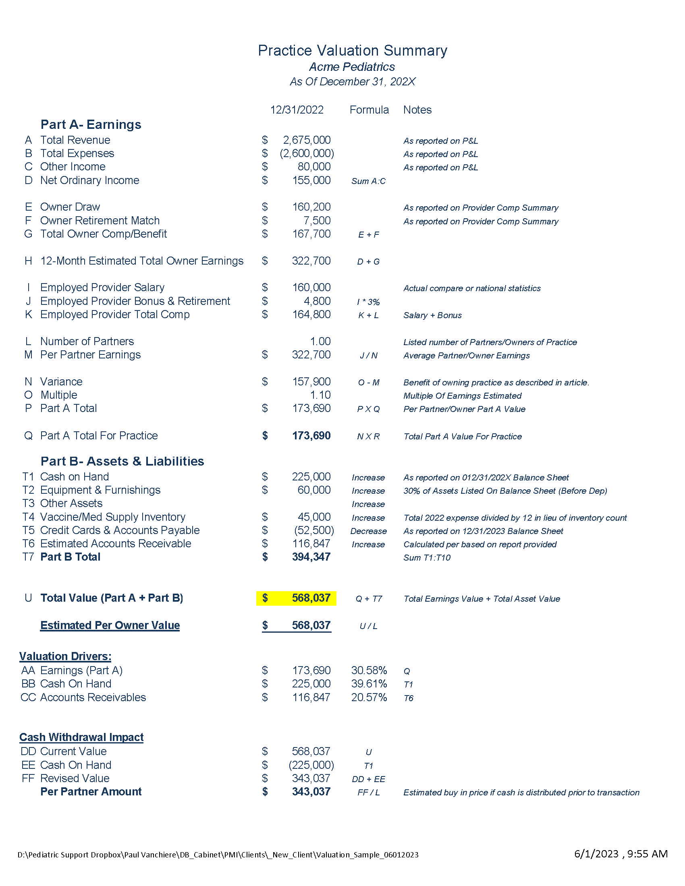
Practice Valuation Summary
Acme Pediatrics
As of December 31,202X

Slide 43
Practice Valuation Summary
Acme Pediatrics
As of December 31,202X

Slide 44
Practice Valuation Summary
Acme Pediatrics
As of December 31,202X

Slide 45
Practice Valuation Summary
Acme Pediatrics
As of December 31,202X

Slide 46
Estimating The A/R Value
Step 1
Determination of Gross collection rate

Slide 47
Estimating The A/R Value
Step 2
Weighted Collectability Based On Balance Age

Slide 48
Estimating The A/R Value
Step 2
Weighted Collectability Based On Balance Age

Slide 49
Estimating The A/R Value
Step 2
Weighted Collectability Based On Balance Age

Slide 50
Internal vs. PE-Backed Value
Internal Valuation
External Valuation
EBITDA | $ 159,500
Multiple | 5
Business Value | $829,500
Part B Total | $394,347
Total Value | $1,223,847
Part A Total | $ 173,690
Part B Total | $394,347
Total Value | $568,037
$655,810 variance = 115% Increase

Slide 51
Reality Check (Part II)
05
06
Internal buyout are at a heavy discount versus the “true” value of the business
More art than science…
07
08
What is the culture of the practice and how does that influence the final formula/value
Partner/owner compensation highly focused on cost allocation or a true “partnership”

Slide 52
How Do You Finance The Buy In?
52
www.PediatricSupport.com

Slide 53
www.PediatricSupport.com

Slide 54
Financing Options
54
www.PediatricSupport.com

Slide 55
How Much Is Too Much To Buy Into A Practice?
Alternative Cost Theory

Slide 56
Token Payment?
Access to profits
Lower buy in/out amount

Slide 57
Key Factors Impacting the Valuation of a Pediatric Practice
Continuation of Patient Volume
2 visits per day at $150 per encounter
=
$60,000 swing in payments per provider per year (200 days)
01
02
Continuation of Current Payment Rates
03
Shift in Payor Mix
04
Local Economy
Building/Rent Expenses along with future liabilities
05
Need to relocate to better location
Interior Updating

Slide 58
Earnings Surveys For Comparison Compensation
Currently Employed Pediatricians
MGMA Physician Compensation Survey
MGMA Cost and Productivity Report
American Medical Group Association (AMGA)
Modern Healthcare's Physician Compensation Report

Slide 59
Adjustments
Taking average shareholder salary for previous 2 or 3 years.
Adjusting Average Shareholder Compensation based on PPE, ERC, or Government COVID funds
Adjusting Average Shareholder Compensation based on whether or not the shareholders may have previously taken lower salaries to fund practice projects that are expected to generate additional earnings in the future.
Adjusting for a variety of nuances in the shareholder compensation formula and other Shareholder Concerns

Slide 60
Considerations
Continued Employment for Dr. Smith
Internally Financed or Require Cash?
Management Responsibilities
Right of First Refusal to Repurchase Practice In Future
Future Compensation
Include Practice Real Estate
Not a good idea to do so
Do Not Intermingle Buyout and Future Salary
Need two separate agreements (Buy/Sell and Employment)
Is it a fair deal for both sides?

Slide 61
What Is The Correct Number Of Partners/Owners?
6 Providers, Two Locations
A
One
B
Two
C
Four
D
Six

Slide 62
What Is The Best Ratio?
Employed Providers : Owners/Partners
Each employed provider should spin off $30 – 70k in additional earnings per provider
Employed Physicians-> 5-10%
Extenders -> 10-15%

Slide 63
Considerations
Ownership position immediate or as paid in?
If financed, should be immediate since liability created between buyer and seller
If cash sale, immediate
If in lieu of bonus(es)- maybe deferred

Slide 64
Common Question/Request
Should the ownership position be proportional to the amount actually paid towards the purchase price?
If price set in advance and financing terms in place, no.
If agree to reestablish the value each year, acceptable.

Slide 65
Financing Issues & Ownership Interest
Agree to purchase price & terms
You receive 100% ownership of car
Purchase Agreement
Subject to lien (if any)
Financing Agreement
Cash Payment
Finance With Ford Credit
Bank Loan

Slide 66
Shareholder/Partnership Considerations
Personal Responsibility for Coding
Disability- Continue to pay until insurance kicks in
Insurability for Life Insurance
Failure to Plan Provision- Discounted if no notice
Spouse Signatures
Pledging of Assets- Prevent Collateralization
Personal Bankruptcy- Allow practice to purchase before third party becomes owner
Personal Guarantees for Current Debt
Consecutive Days Out of Office
Future Plans/Expansion- Finance expansions with “cheap” loan options
Valuation Updated Annually

Slide 67
Dr. Hart wants to buy Dr. Vanchiere’s practice
Price: $400,000
Pay $100k per year for four years
Expected to increase total compensation
$25k in Years 1 - 4
$125k in years 5-10
Year 11, look to sell to next associate (or third party)

Slide 68
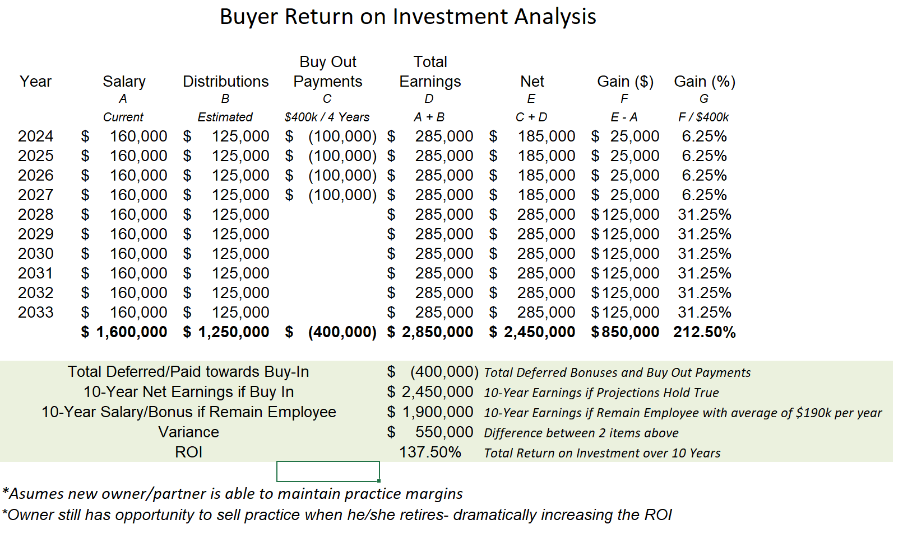
Buyer return on investment analysis 10 Years

Slide 69
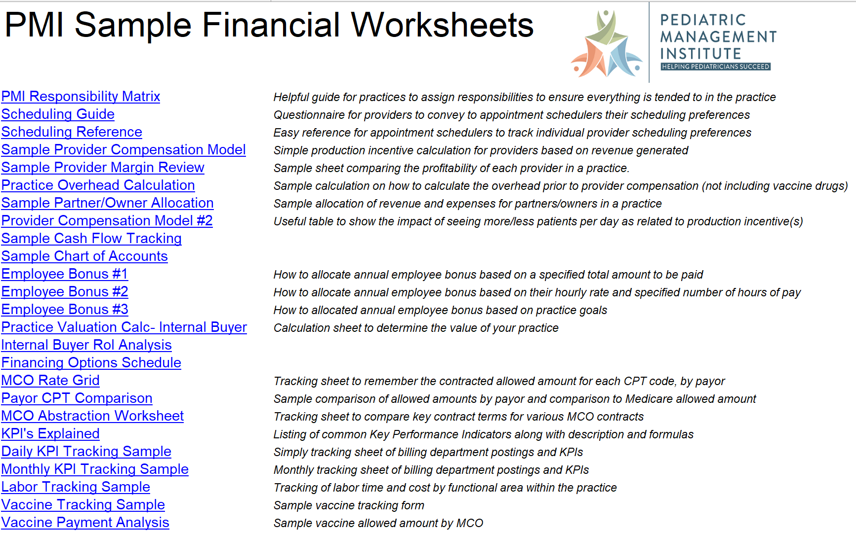
Over 3 Dozen Worksheets PMI Uses Everyday

Slide 70
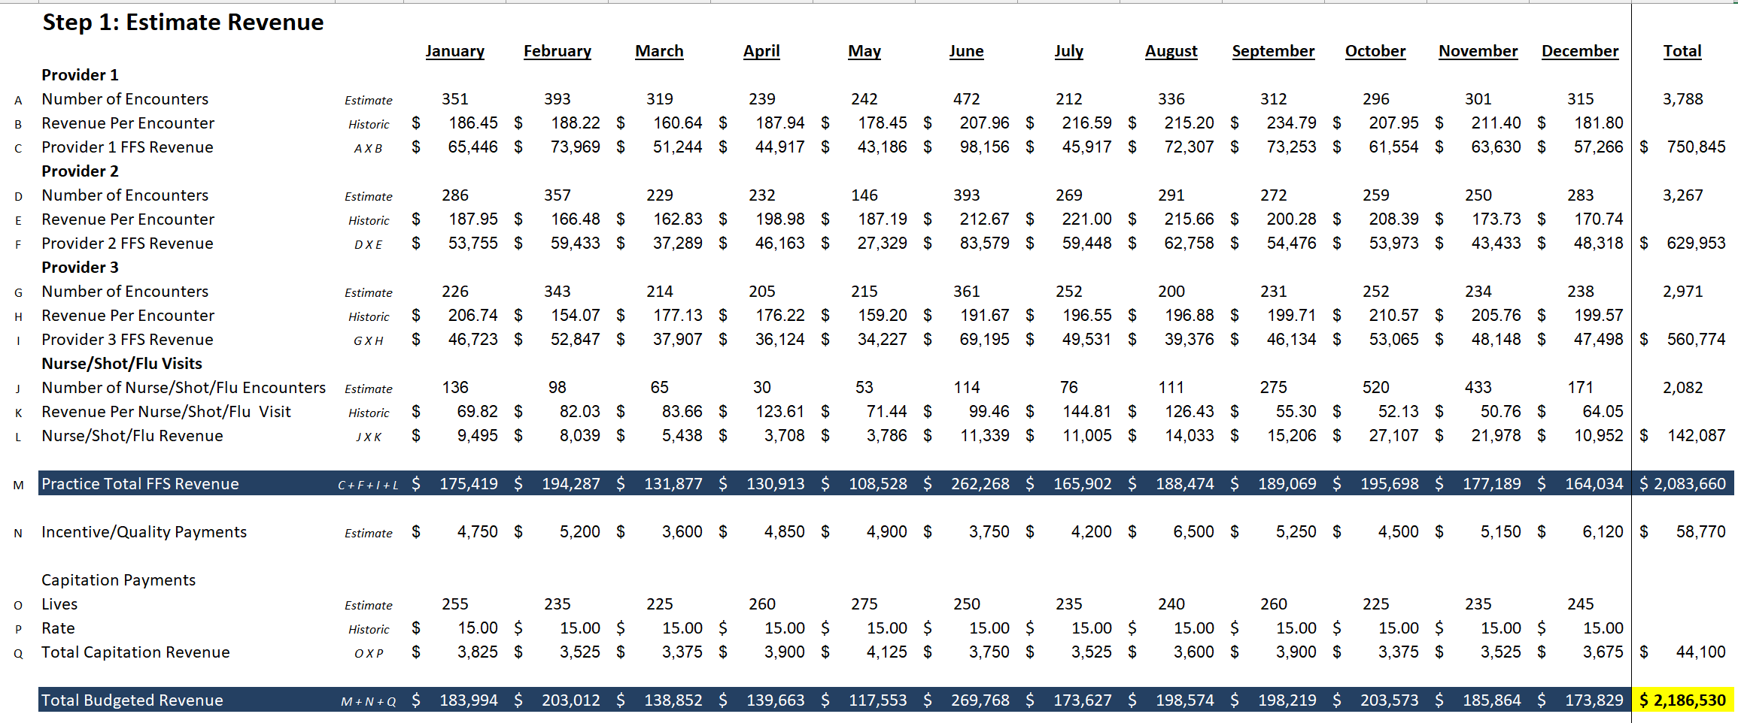
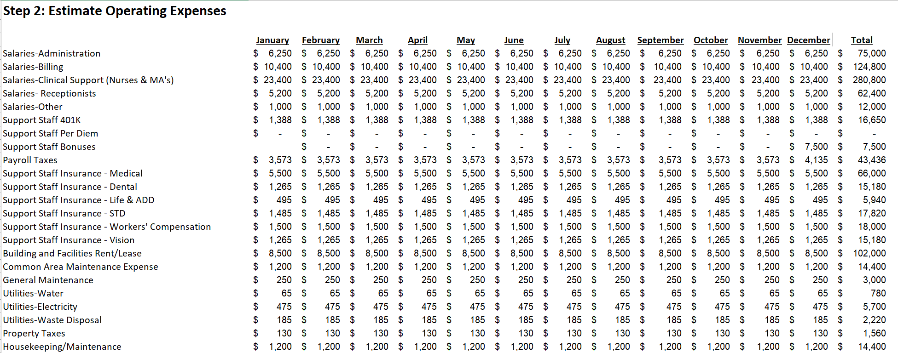
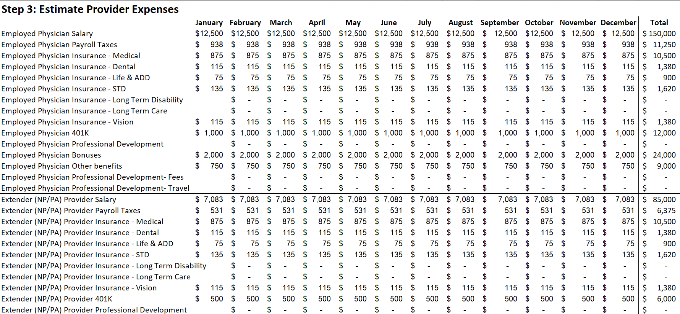
Budgeting- Anticipate The Impact

Slide 71
Alignment What do you want from the practice of medicine? What is the roadmap to get there?
Ask the "why" of the practice and how do you ensure the legacy?
Building a track or road requires “cut and fill”
Process
Partners/Owners discuss
Associates discuss
Create unified vision
Identify gaps and cost to fill
Then move to financial issues, etc.

Slide 72
Attributes Of Successful Practices
Provide the best possible medical for children
Set reasonable expectations
Hold people accountable

Slide 73
Does Your Strategic Plan Set Reasonable Expectations… For everyone involved?
Financially
Operationally

Slide 74
Your Family
Goal Articulation
Family Information and Communication
Estate and Gift Planning
Life Insurance Analysis
Investment Advisory Services
Everyone
Is
Involved
Your Partners
Business Strategy Assessment
Management Talent Assessment
Corporate Structuring
Current Business Valuation
Succession Planning
Your Practice
Shareholder/Partnership Agreement
Disability Planning
Compensation Planning
Stock Transfer / Equity Transfers

Slide 75
Plan For The Future
01
Have you defined your personal goals and a vision for the transfer of ownership and management of the practice?
02
Things to think about…
Do you have an identified successor in place?
03
If applicable, have you resolved the family issues that often accompany leadership and ownership decisions?
04
05
Will there be sufficient liquidity to avoid the forced sale of the business?
Does your plan include a strategy to reduce estate taxes?

Slide 76
Your Homework
If succession will one day require the transfer of assets, have you executed a “buy-sell” agreement that details the process (and practice value/formula) ahead of time?
Is there a detailed contingency plan in case the any of the partners die or becomes unable to continue working sooner than anticipated?
Have you identified and considered alternative corporate structures or stock-transfer techniques that might help the company achieve its succession goals?
Have you determined whether you or anyone else will depend upon the business to meet their retirement cash flow needs?
Have you recently had the business valued and analyzed in the same way potential buyers and competitors would?

Slide 78
Connect With Paulie Paul@PediatricSupport.com
Complimentary Zoom Call Available
Schedule Your Time Today

Slide 79
PE- Comparison Grid What Does The Backend Look Like?
Status quo
Declining margins
PE
Sell to undesirable firm?

Slide 80
Employee vs. Owner/Partner Mindset

Slide 81
Entrepreneurial Mindset

