Slide 1
Concussion: Management Pearls and Practical Tools for Your Practice
Lessons Learned from the Concussion Academy Skills Training
Gerard Gioia, PhD, CNH Division Chief, Neuropsychology
Jeffrey Strelzik, MD, CNH Associate Program Director, Child Neurology
Maya Nair, MD, Capital Area Pediatrics

Slide 2
A few notes about today’s Grand Rounds
All lines are muted throughout the presentation.
Please use the Q&A to ask questions or make comments.
We will be recording the session.
Today’s recording and materials will be posted to the PHN website 3 business days following the presentation. https://pediatrichealthnetwork.org/

Slide 3
Upcoming Grand Rounds:
Trauma Informed Approach to Pediatric COVID-19 Response
When: Tuesday, February 9th from 12:00 to 1:00 pm
Speakers: Binny Chokshi, MD and Danielle Dooley, MD
Register Here

Slide 4



Speakers
Gerard Gioia, PhD
Jeffrey Strelzik, MD
Maya Nair, MD
No conflicts to disclose:
  No financial or business interest, arrangement or affiliation that could be perceived as a real or apparent conflict of interest in the subject (content) of their presentation.
  No unapproved or investigational use of any drugs, commercial products or devices.

Slide 5
Objectives
Review data and lessons learned from our collaborative QI projects: CAST and CAST 2.0
Understand targeted treatment approaches based on your symptom assessment
Highlight practical treatment interventions you can use for persisting problems such as headaches or vestibular issues
Review the Symptom Targeted Academic Management Plan (STAMP) and the CDC’s gradual return to activity materials

Slide 6
Data Review from CAST 2.0

Slide 7
Demographics

Slide 8
Referral
Notes:
Do we need to see all the categories on the x axis? Can this be a verbal overview or highlights?
I think I’ll just cover the highlights. The one on the left is great. It might be good to have the x-axis categories for the bars that are over 50%, if you can do that. Otherwise I’ll cover it virtually.

Slide 9
Triage

Slide 10
Practice Resources

Slide 11
How helpful or could be helpful is this resource?

Slide 12
ACE Evaluation

Slide 13
Symptom Tracking Tool

Slide 14
Do you use specific guidelines or criteria in deciding when to return kids to:

Slide 15

Minimal Or No Meaningful Changes
ICD 10 Codes:
  Concussion without LOC: 81% → 84%
  Concussion with LOC: 3.5% → 2%
  Other: 13% → 14%
Preinjury counseling
Patient went to ED prior to Pediatrician
Patient referred to ED by Pediatrician
Indications for ER Referrals
Reasons for specialist referrals
Medical Clearance Documentation
Notes:
Put an image in because there was a lot of dead space on the slide but if you do not like this please feel free to remove!
Love it!

Slide 16
Evaluation and Treatment

Slide 17
Concussion Management

Slide 18

Concussion Management: Key components (and tools)
1. Initial phone triage, Red Flags and referral to ED.
2. Assessment and diagnosis (Acute Concussion Evaluation (ACE))
3. Management: Use of the ACE Care Plan, Return to school supports
Symptom-based management (PCSI)
Return to school planning and supports (Return to School letter, Gradual Return to School progression, Symptom Targeted Academic Management Plan (STAMP)
4. Return to activity/ plan
Gradual Return to Activity (CDC 4 step progression), using symptoms as guide
5. Medical clearance/Specialty referral
Establish full recovery and medical clearance
Refer for persistent post-concussion symptoms

Slide 19

Clinical Pathway Primary Care
Pre-Injury Education/ Preparation (well child/sports physical)
Initial Contact (Triage Questions – to ED or no to ED)
Initial Office Visit – Diagnosis, Education, Management, Communication
    Return to School
    Active Rehabilitative Management
Follow Up Office Visit – Symptom Monitoring/ Tracking, Management
    [Repeat until recovery or referral]
Recovery Criteria; Referral Criteria
Return to Sport (risk) progression
Concussion Academy Skills Training 2.0 Program 2019-2020
Concussion Academy Skills Training 2.0 Program 2019-2020

Slide 20


Concussion’s Medical Neighborhood (of providers)
Emergency/ Urgent Care Dept
1st Stop
Primary Care
(Medical Home)
Primary Care
Injury
Specialty Care
Athletic Trainers
School Nurses
Concussion Academy Skills Training 2.0 Program 2019-2020

Slide 21
Concussion’s Medical Neighborhood: Initial Contact
Primary Care
Triage Qs/ Red Flags
or
Injury
Emerg Dept
Preparing Parents/ Kids: “It is the standard policy of our practice that when an injury occurs, you call the office/ on-call pediatrician first so we can make an informed decision about next steps (coming into the office or going to the Emergency Department”
Concussion Academy Skills Training 2.0 Program 2019-2020

Slide 22
Primary Care Clinical Pathway- First Office Visit
Event | Action | Tools | Clinical Decision/ Activity
Office Visit 1 - Diagnosis | Assess suspected concussion Establish diagnosis | Acute Concussion Evaluation (ACE) [Symptom Score], Neuro Exam | Using physical exam, symptom report, history: Does patient meet criteria for diagnosis? Was there a definite mechanism of injury? (Y/N) Was there an onset of typical symptoms within 24-48 hours of the injury event? (Y/N) Was there an alternate explanation for the acute onset of symptoms? (N/ Y) [If not acute] Has there been a gradual recovery of symptoms over the first 1-2 weeks? (Y/N) (1,2,3 are critical elements to establish high degree of confidence in diagnosis)

Slide 23
Event | Action | Tools | Clinical Decision/ Activity
Office Visit 1 - Symptom-specific Management | General Recovery Guidance: Provide education, reassurance, symptom-specific supports, PACE | ACE Care Plan | 1. Provide education & reassurance about diagnosis & reinjury risks 2. Early symptom-based management guidance 3. Encourage progressive reintro. of school, social & non-risk physical activity that do not worsen symptoms
 | Return to School: Determine return date, provide symptom profile, supports | ACE Return to School Letter, Gradual Return to School/ STAMP | 1. Provide letter with return date & current symptoms 2. Determine level of return using gradual RTS table 3. Provide suggested symptom-based supports (STAMP)
 | Return to physical activity (Play, Sports/ PE/ Recreation) | ACE Care Plan | 1. If symptomatic: No return to risk activity until medical clearance 2. Therapeutic Exercise: encourage non-risk physical activity that do not worsen symptoms

Slide 24
Return to Activity: Progressive Activities of Controlled Exertion (PACE)
“Use your symptoms as your guide.”

Slide 25

Returning to School
Current evidence indicates that most students can return to school 1-3 days post-injury
Communication with the school & provision of symptom-targeted supports is critical – Return to School letter, STAMP
Assess for specific academic challenges – certain classes or times of the day that worsen symptoms – and require closer management
Managing homework load
Managing tests
Restricting at-risk physical activities (PE, sports, recess)

Slide 26
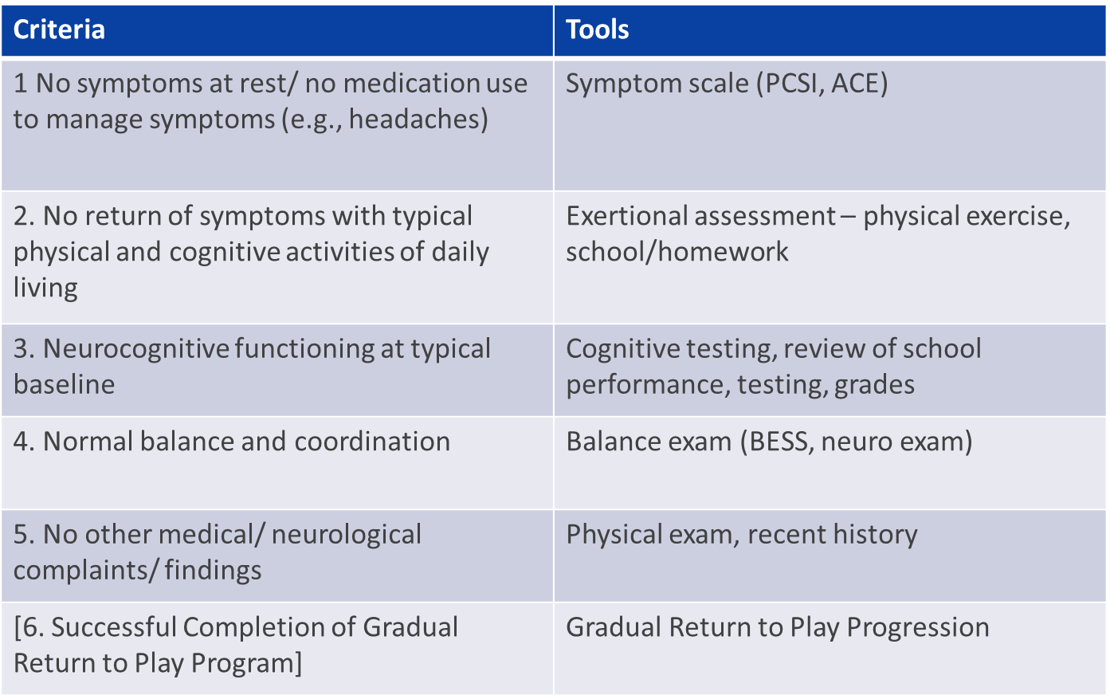

Recovery/ Medical clearance

Slide 27

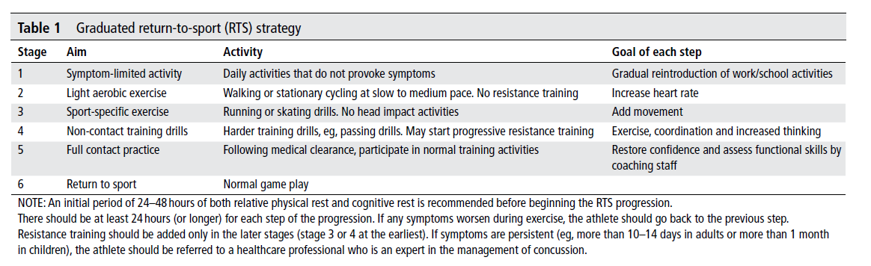
Graduated return-to-sport progression
Berlin, 2016 (McCrory et al., 2016)

Slide 28
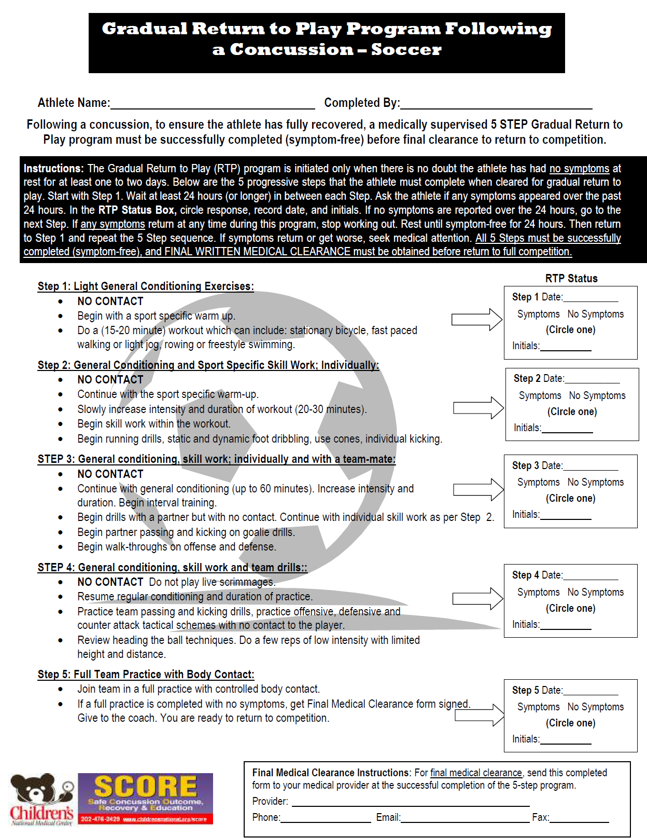


Slide 29
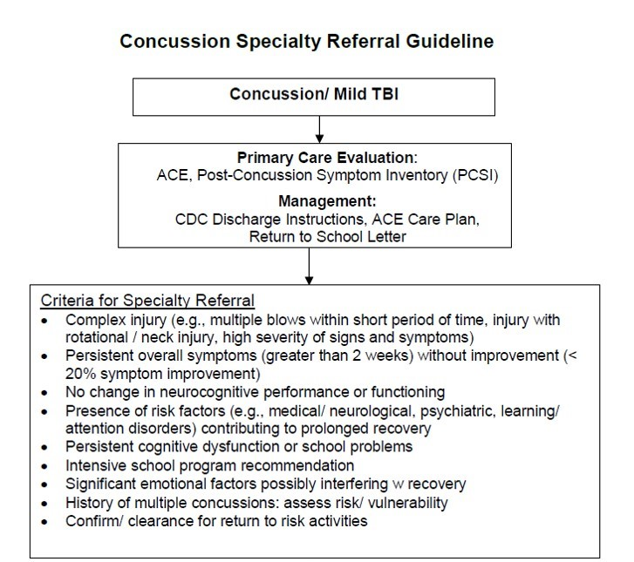



Slide 30

Summary: Six Steps to Primary Concussion Care
Counsel patients to call the primary care office when a suspected injury occurs
Use a standard phone triage process for clinic vs ED
Conduct diagnostic examination: full symptom assessment, physical exam; take patient medical, developmental, social, emotional, school history into account
Provide initial management guidance, including patient/ family education and reassurance; guide early return to activity (physical, school, social)
Track recovery progress with virtual or in-person f/u visits, updating recommendations for school, physical, social activity allowances
Apply criteria for recovery/ medical clearance or specialty referral
Concussion Academy Skills Training 2.0 Program 2019-2020

Slide 31
Concussion Management in the Primary Care Setting: Capital Area Pediatrics
Dr. Maya Nair, MD , FAAP

Slide 32
Patient Education
We have information on our websites, blogs, and pulses
Concussion flyers which are posted in all the exam rooms.
Discuss our concussion care when patients come for their sports physical
We created a triage protocol that will avoid unnecessary ER referrals.

Slide 33
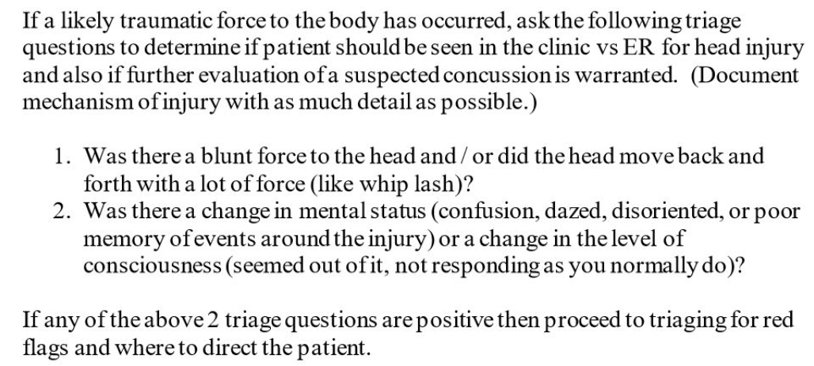
Telephone Triage

Slide 34
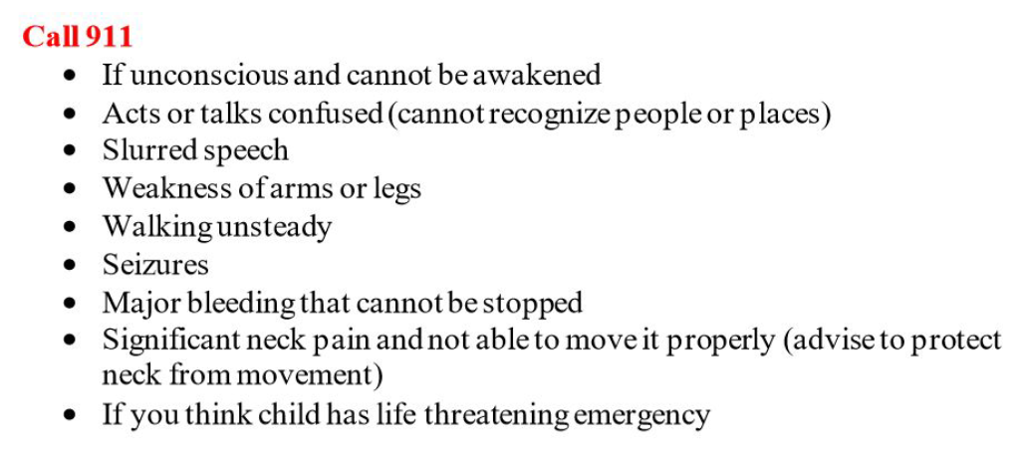
Telephone Triage (continued)

Slide 35
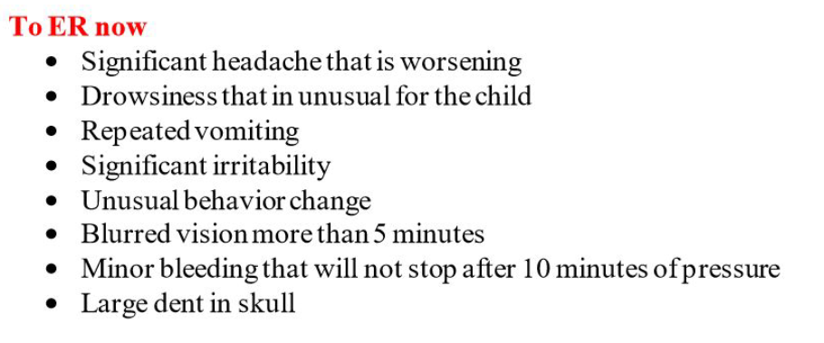
Telephone Triage (continued)

Slide 36
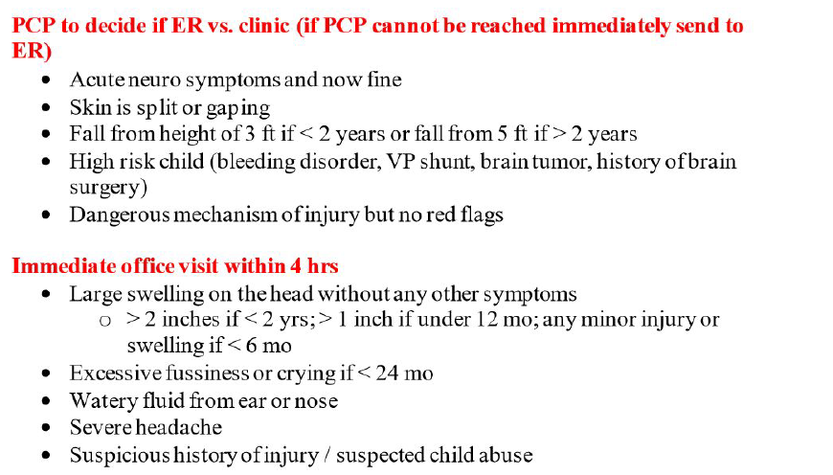
Telephone Triage (continued)

Slide 37
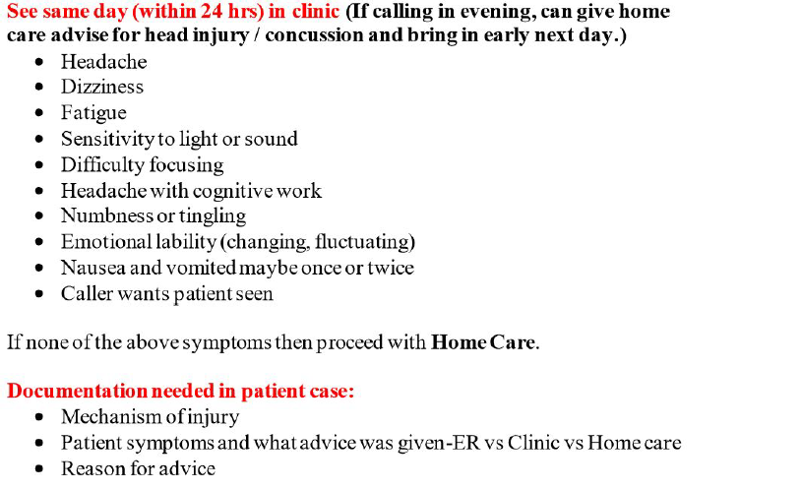
Telephone Triage (continued)

Slide 38
Telephone Triage (continued)

Slide 39
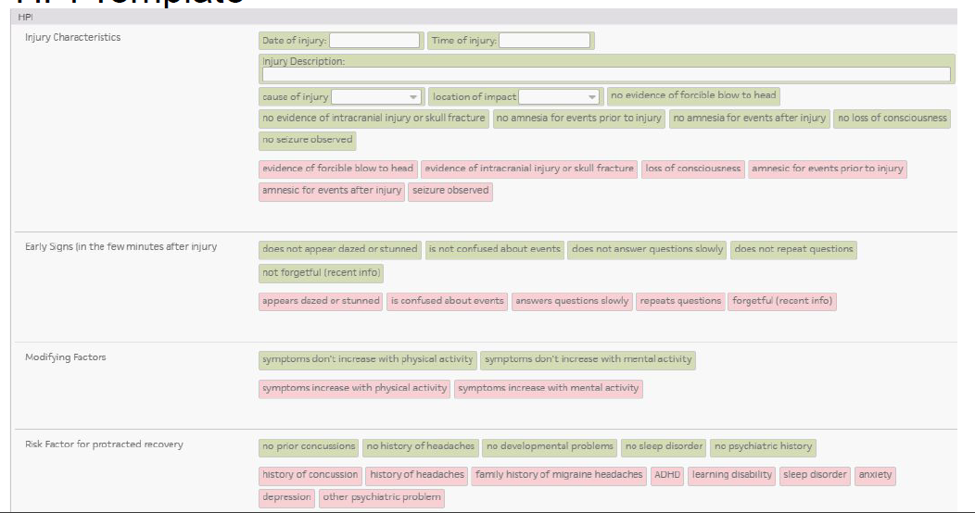
HPI Template

Slide 40
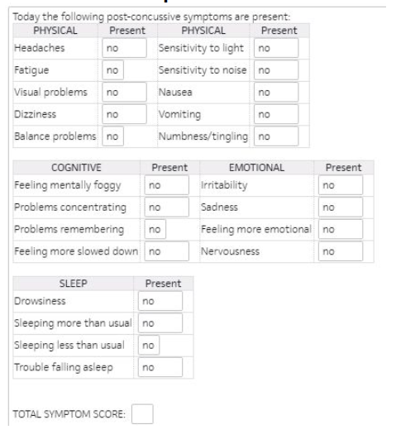
ROS Template

Slide 41
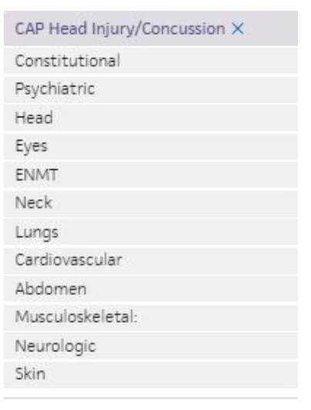

Head Injury PE Template

Slide 42
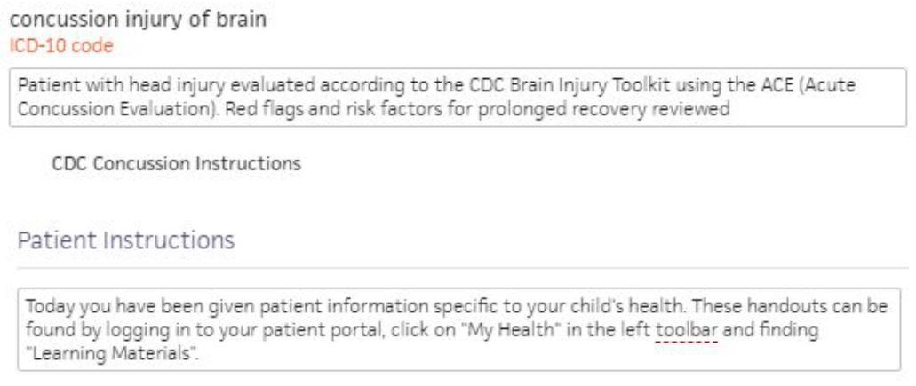
A&P

Slide 43
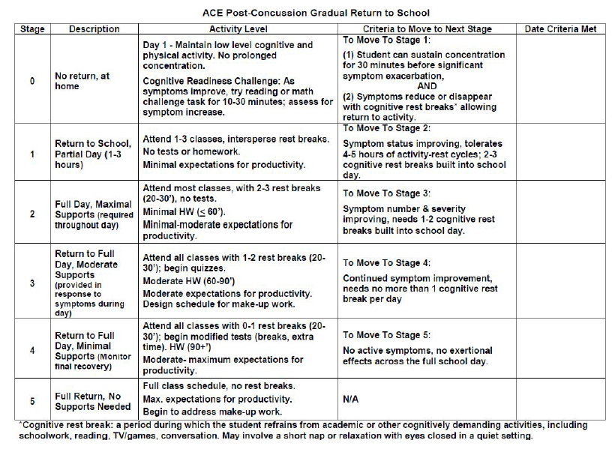

Slide 44
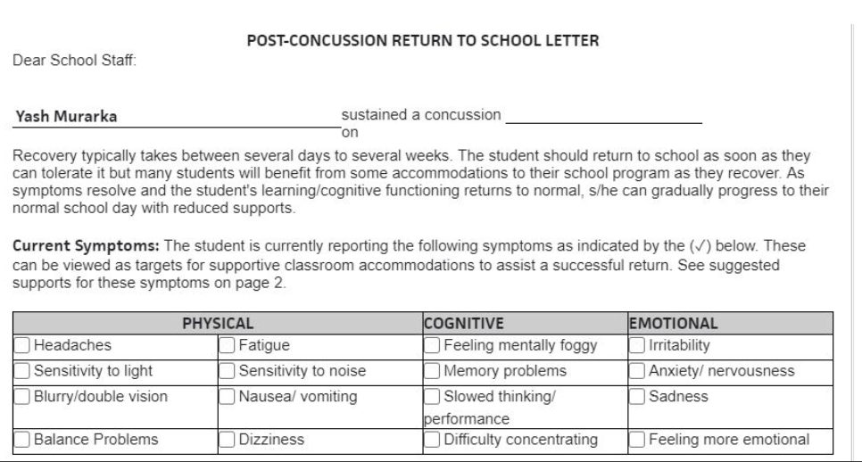
Return to School Letter

Slide 45
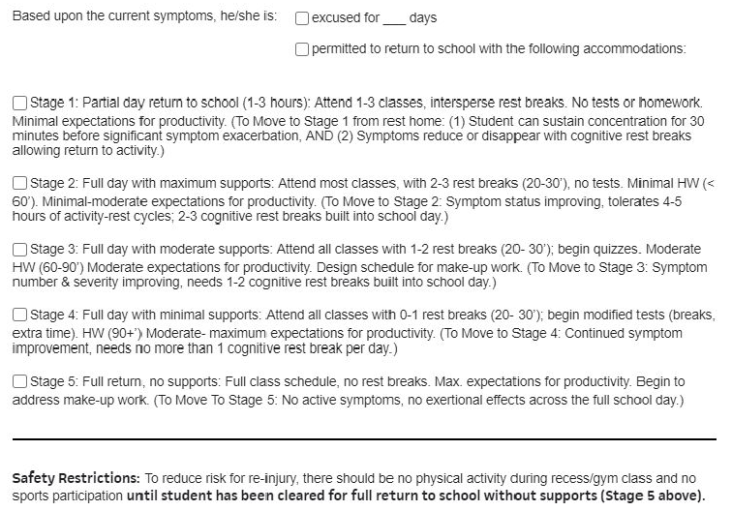
Return to School Letter (continued)

Slide 46
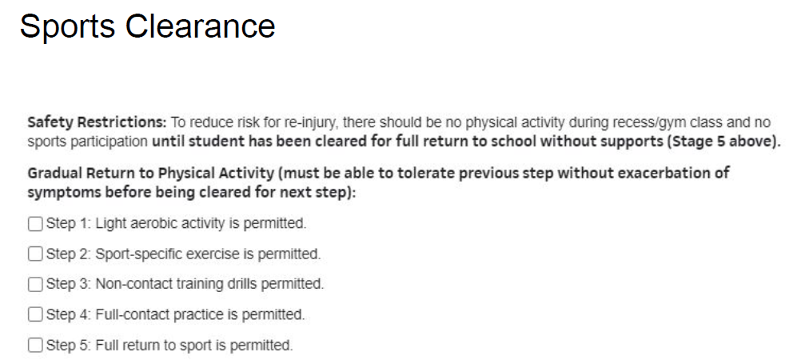
Return to School Letter (continued)

Slide 47
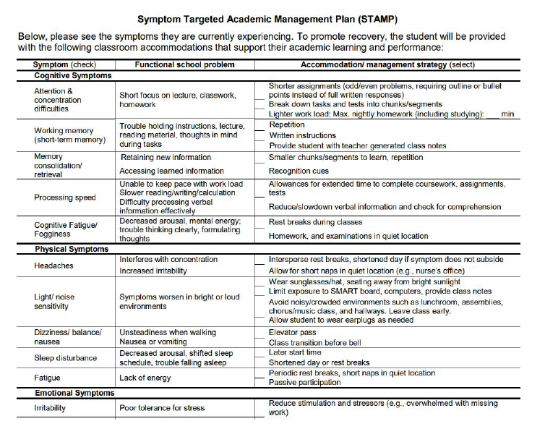

Slide 48
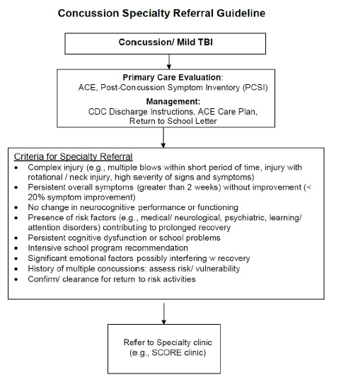
Referral Guidelines

Slide 49
Follow Up
All concussion patients are brought in for follow up
Foll0w up appointment is based on severity of symptoms, but ideally in 2 days
Follow up appointment is made on the date of the visit

Slide 50
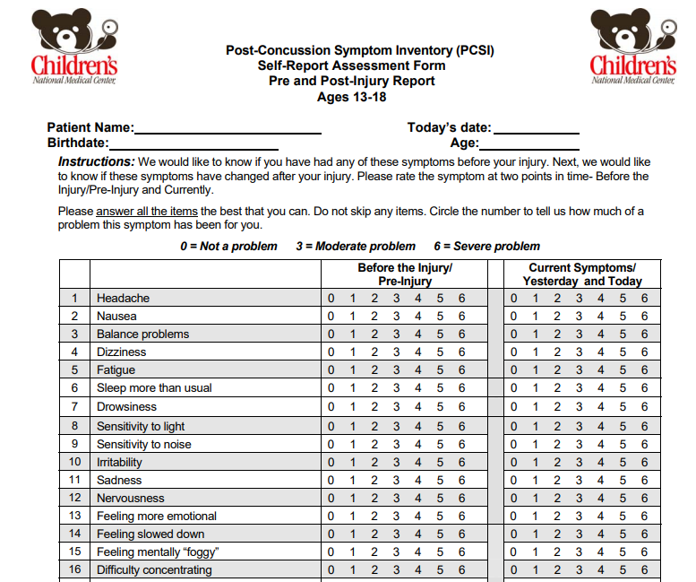
Future Goals
Start using the PCSI form
Train all providers to do the Concussion Neuro Exam

Slide 51
Thank you

Slide 52
Online Treatment Recovery Assistant for Concussion in Kids (OnTRACK) CDC SBIR PHS 2017-2 Technological Tools for Monitoring Children’s Symptoms after TBI
CDC funded study of the use of a concussion management decision support tool
Recruiting 22 primary care providers within the Pediatric Health Network practices to participate in a clinical trial examining the use of a smartphone system to assist concussion management.
Education videos are provided to teach patient, parent & school about concussions, gradual return to school and physical activity, other supports to recovery (sleep hygiene, headache management, stress management, exercise)
Provider directs/oversees OnTRACK app with weekly symptom ratings (Parent, Child)
Symptom scores are tracked, plotted over time, and evidence-based algorithms applied as to whether recovery is typical or atypical, assisting in clinical decision making regarding treatment, providing management recommendations
Provider is alerted via dashboard if symptom progress falls outside of “typical”
Symptom based recommendations are provided, and can be communicated to the patient, parent & school

Slide 53
Interested in learning more?
Contact Gerry Gioia, Principal Investigator:
        ggioia@childrensnational.org
    301-765-5430 (office)
    410-493-5799 (cell)
Study will start in Spring, 2021
Participants will receive further training in concussion management
Recruit 10 patients (5 in control condition, 5 treatment condition)

