Slide 1
Strategies for General Pediatric Office Practices in COVID-19 Pandemic Times Bud Wiedermann, MD, MA Attending in Infectious Diseases Children’s National Hospital Professor of Pediatrics, GWU School of Medicine and Health Sciences March 12, 2020

Slide 3
Participant Activity
Measure your pulse rate now
If we are panicked, how do you think that makes our patients feel?

Slide 4
It is rapidly becoming a cliché, but…..
The situation is changing rapidly!
Most important take-home points today:
Don’t panic
Be safe
Develop a plan
Check at least daily for updates

Slide 5
The Good News (Really!)
Pediatric providers have it (relatively) easy
Children seem to have milder disease
Children seem not to be strong drivers of spread of COVID-19 (few family studies)
Very few outpatient children will even need testing (at the moment)

Slide 6
Some Terms
COVID-19 = the disease
Fever, cough, other respiratory symptoms
SARS-CoV-2 = the virus causing COVID-19
A coronavirus
Several cause the common cold, currently active in our community as usual
SARS 2003 6 month epidemic
MERS 2012 – present
Mostly in Middle Eastern countries
Travel-associated cases in many countries, including US

Slide 7
And don’t forget the flu!
CDC estimates for US as of week ending 2/29/20
34 million illnesses
350,000 hospitalizations
20,000 deaths
https://www.cdc.gov/flu/weekly/index.htm

Slide 8
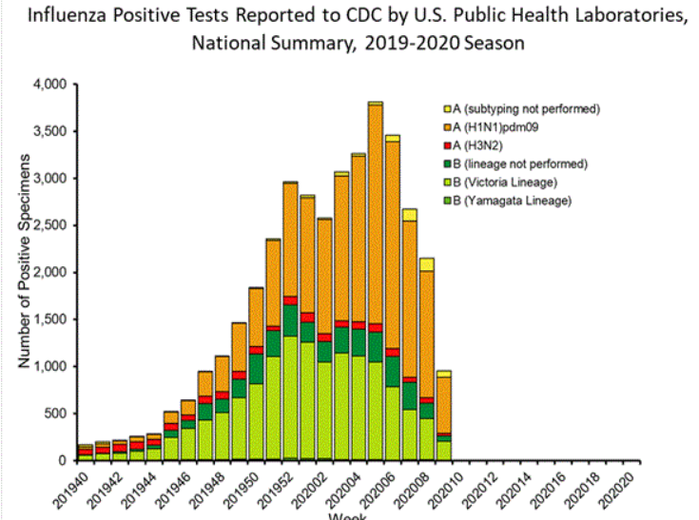

Slide 9
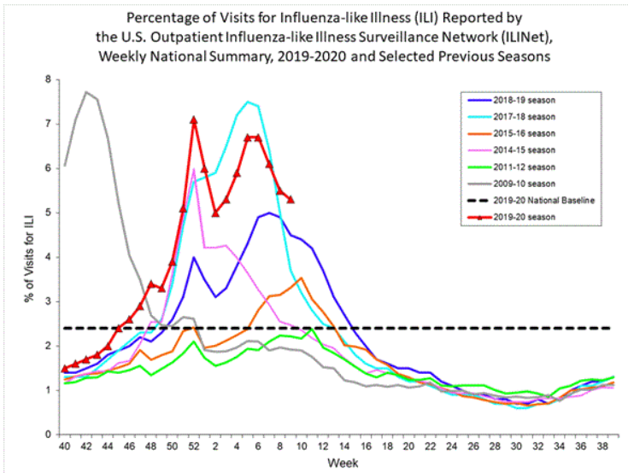

Slide 10
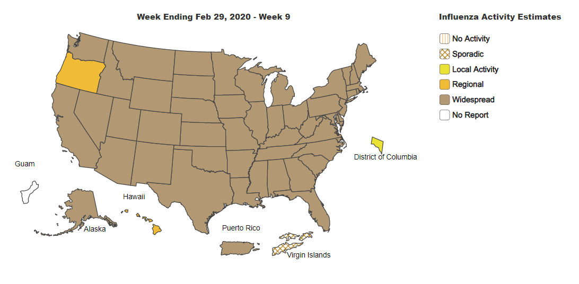

Slide 11
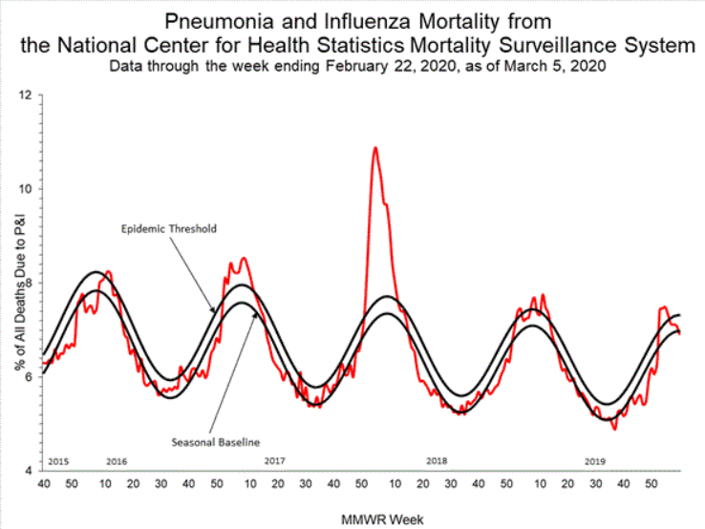

Slide 12
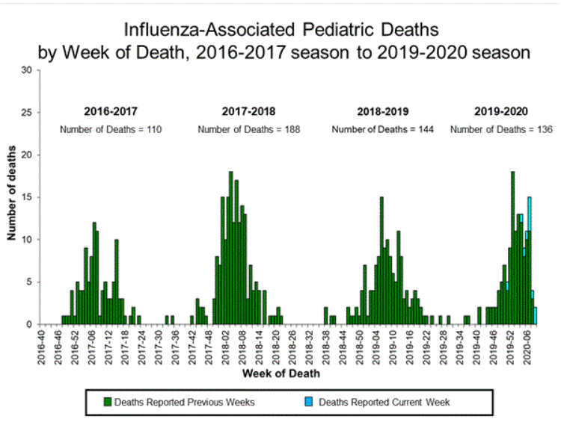

Slide 13
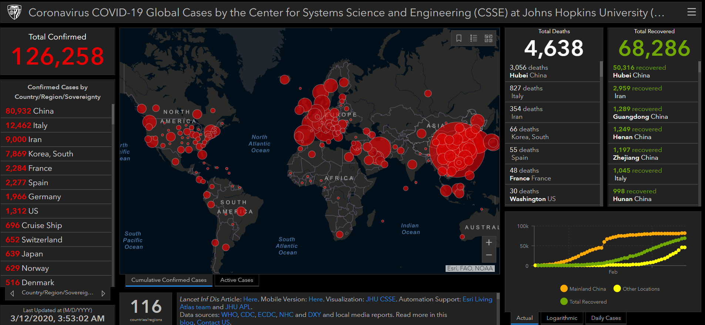
https://gisanddata.maps.arcgis.com/apps/opsdashboard/index.html#/bda7594740fd40299423467b48e9ecf6

Slide 14
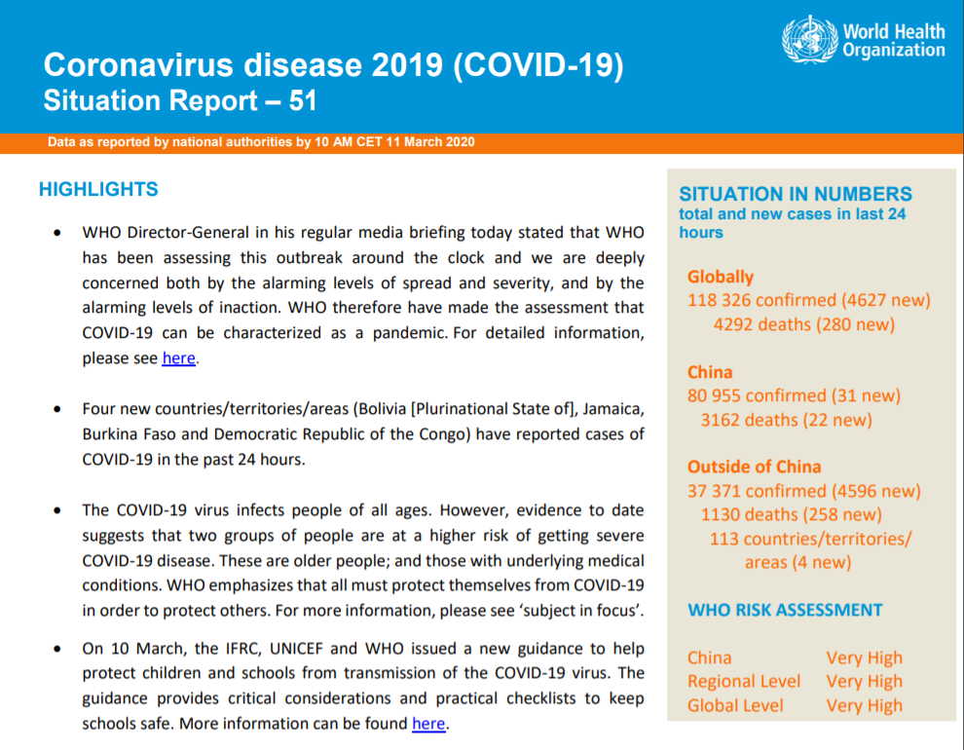
https://www.who.int/emergencies/diseases/novel-coronavirus-2019/situation-reports
Notes:
https://www.who.int/emergencies/diseases/novel-coronavirus-2019/situation-reports

Slide 15
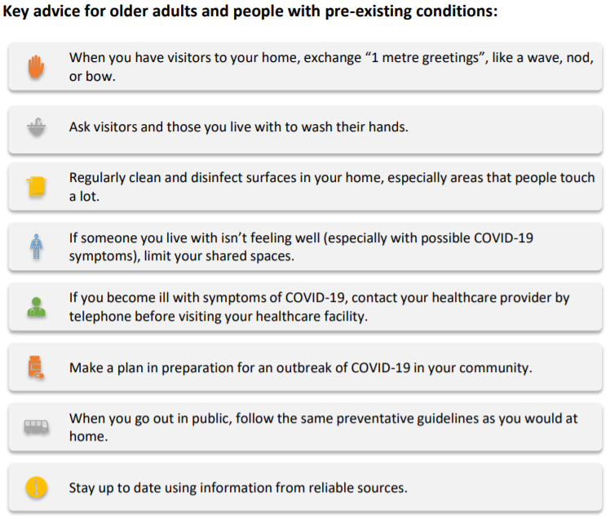

Slide 17
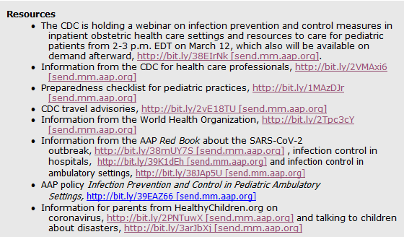
AAP List of Resources
Notes:
https://www.cdc.gov/coronavirus/2019-ncov/downloads/community-mitigation-strategy.pdf

Slide 18
The 1st 72,314 Chinese Cases
JAMA online 2/24/20

Slide 19
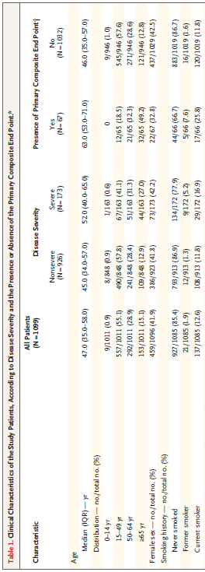
China – Children Under-represented in Illness Groups
NEJM 2/28/20; DOI: 10.1056/NEJMoa2002032
Notes:
Asmit to ICU, mechanical ventilation, or death

Slide 20
Use the Health Department!
Maryland
https://health.maryland.gov/coronavirus
Virginia
http://www.vdh.virginia.gov/surveillance-and-investigation/novel-coronavirus/
DC
https://dchealth.dc.gov/coronavirus

Slide 21
CDC Mitigation Strategies for Healthcare Settings (Minimal to moderate community transmission)
Implement changes to visitor policies
E.g. temperature/symptom checks for visitors
Implement triage before entering facilities
Actively monitor absenteeism and respiratory illness among HCP and patients
Actively monitor PPE supplies
Establish process to evaluate and test
Consider allowing asymptomatic exposed HCW to work while wearing facemask
Begin to cross train HCP for working in other units
https://www.cdc.gov/coronavirus/2019-ncov/downloads/community-mitigation-strategy.pdf

Slide 22
Office Plan
Facility Issues
Phone and office screening and triage
Supplies/Equipment
Human Resources
Appoint a Czar
AKA Kovid Kid (with attribution to Mark Weissman)

Slide 23
Facility Plan
Signage
Outside door
Reception desk
Specific rooms (e.g. “Special Isolation”)
Waiting Room
Are you able to separate sick from well, respiratory from others?
Telemedicine capabilities?
Will you charge for this?
GT modifier for coding
Need medical license in state where patient is

Slide 24
Phone and office screening and triage
Aim to keep children with mild acute respiratory problems out of the office
If they show up, what will you do?
Masks on patient and family recommended
Separate, prioritize
Is this even feasible?
If you do need to see patient (e.g. story sounds like AOM as well)?
Call you from the parking lot
Exam in the car?
Specific plan(s) for high risk patients

Slide 25
Supplies/Equipment
PPE
Need to keep careful track of inventory and supplier
Note N95 recommendations changing rapidly
WHO has never recommended N95 for routine COVID-19 care
Soap, water, sanitizer
Nasal swabs and transport medium

Slide 26
Human Resources
We want to be safe, for our loved ones as well as for our patients who are counting on us to help them through this.
Policy for work
During illness
Exposed but asymptomatic
Any high-risk individuals who should not see acute respiratory patients?
Dedicated team?
Travel policy

Slide 27
The KOVID Kid (or COVID Children)
Someone needs to be in charge of keeping updated
Could be rotating position
Checking all those key web links at least daily
Subscribe to email alerts
Health department
CDC
Chain of communication
You probably all have phone trees for snow days, etc, just expand that use

Slide 28
PPE Good News CDC 3/10/20
Updated PPE recommendations for the care of patients with known or suspected COVID-19: Based on local and regional situational analysis of PPE supplies, facemasks are an acceptable alternative when the supply chain of respirators cannot meet the demand. During this time, available respirators should be prioritized for procedures that are likely to generate respiratory aerosols, which would pose the highest exposure risk to HCP.
Facemasks protect the wearer from splashes and sprays.
Respirators, which filter inspired air, offer respiratory protection.
When the supply chain is restored, facilities with a respiratory protection program should return to use of respirators for patients with known or suspected COVID-19. Facilities that do not currently have a respiratory protection program, but care for patients infected with pathogens for which a respirator is recommended, should implement a respiratory protection program.
Eye protection, gown, and gloves continue to be recommended. If there are shortages of gowns, they should be prioritized for aerosol-generating procedures, care activities where splashes and sprays are anticipated, and high-contact patient care activities that provide opportunities for transfer of pathogens to the hands and clothing of HCP.
https://www.cdc.gov/coronavirus/2019-ncov/infection-control/control-recommendations.html?CDC_AA_refVal=https%3A%2F%2Fwww.cdc.gov%2Fcoronavirus%2F2019-ncov%2Fhcp%2Finfection-control.html

Slide 29
MD DOH Guidance 3/11/20
To the extent possible, providers should use telemedicine or telephonic communications to evaluate patients and avoid unnecessary visits to healthcare facilities.
• Based on the scientific evidence to date about how COVID-19 is transmitted, newly released infection prevention guidance from CDC, and given shortages of N95 respirators, MDH advises that collection of nasopharyngeal (NP) and oropharyngeal (OP) swab specimens for COVID-19 testing using contact and droplet precautions with a surgical mask is appropriate. Eye protection should always be used. Specimen collection may be performed in an examination room with the door closed. Severely ill patients who will be transferred to a higher level of care should not be tested in an outpatient setting. It is critical that outpatient providers continue to ensure that any patients presenting with respiratory symptoms are immediately given a facemask for source control.
• Now that COVID-19 testing is available at commercial and hospital labs, providers should send specimens to these laboratories for testing.
• Advise any patients tested for COVID-19 to isolate themselves at home until results are back. Report any positive results immediately to the health department.
https://content.govdelivery.com/attachments/MDMBP/2020/03/11/file_attachments/1398605/COVID-19ClinicianLetter_3.11.20_FINAL.pdf

Slide 30
DC Health Information Brief for Physicians and NPs
Good Morning, District Healthcare Providers:
DC Health is hosting a COVID-19 Information Brief for the District’s healthcare providers on Friday, March 13, 2020 from 12:00pm – 1:00pm. Physicians, Nurse Practitioners and Doctors of Osteopathy are requested to participate.
Call-in Information
1-650-479-3208
Meeting number (access code): 733 605 450

Slide 31
NP and OP Swabs (CDC)
Synthetic fiber swabs with plastic shafts
Not Ca alginate or wooden shaft swabs
Place swabs into sterile tubes with 2-3 mL viral transport media
NP: insert swab into nostril parallel to palate, leave in place a few seconds
OP: swab posterior pharynx, avoiding the tongue
Notes:
https://www.cdc.gov/coronavirus/2019-ncov/lab/guidelines-clinical-specimens.html?CDC_AA_refVal=https%3A%2F%2Fwww.cdc.gov%2Fcoronavirus%2F2019-ncov%2Fguidelines-clinical-specimens.html

Slide 32
Pediatric Academic Societies 2010 Mindfulness Workshop
Designing and Assessing Reflective Exercises for Mentoring, Feedback Delivery and Promoting Lifelong Learning Across the Continuum of Medical Education

Slide 33
A Toolbox in Reflective Practice
Deborah T. Rana, M.D., Preventive Medicine Residency, University of California San Diego Medical School
Bernhard L. Wiedermann, M.D., M.A., Children’s National Medical Center, GWU School of Medicine, Washington, D.C.
Andrew Mutnick, M.D., Department of Pediatrics, Columbia University College of Physicians and Surgeons, New York, New York
Doreen Balmer, Ph.D., Center for Education Research and Evaluation, Columbia University Medical Center, New York, New York

Slide 34
Characteristics of Mindful Practice
Active observation of oneself, the patient and the problem
Critical curiosity
Courage to see the world as it is rather than as one would have it be
Willing to examine prejudices
Adoption of a beginner’s mind
Humility to tolerate awareness of one’s areas of incompetence
Connection between knower and the known
Compassion based on insight
Presence
Ronald M. Epstein, 1999

Slide 35
Now, Take Your Pulse Again

Slide 38
Q&A Via Chat Box

