Slide 1
The New Right Chart Panel, HEDIS and Registries
Sonya Burroughs, Director CIQN
Stacey Gregory, Quality Assurance Coordinator CIQN

Slide 2
Goals of CIQN’s Population Health Initiative
Improved health of pediatric population through information sharing, data analytics and registry implementation
Facilitation of improvements in patient care and experience through interoperability tools
Reduced costs

Slide 3
EDW (Healthe Intent)
Large Pediatric Essential Health Database
670,000 Unique Patients/Year (22% of all children residing in DC, MD, VA)
3,000,000 Encounters/Year
Cerner, eCW Goldberg, Greenway CP&A, eCW CIQN Community, & McKesson Financials

Slide 4
Source Systems from
Many Vendors
Cloud-based
Platform
Applications for Consuming Data
Cerner Millennium
HealtheAnalytics
eClinicalWorks
Enterprise Data Warehouse
HealtheRegistries
Greenway
HealtheRecord
EPIC
HealtheCare
Dentrix
…
Billing Systems
HR Systems
…
Notes:
(<2 min)
Did you know that Children’s National uses 4 different EHR‘s?
Cerner Millenium is used for inpatient care and outpatient specialists.
eClinicalWorks is used by Goldberg Center as well as the 60 community practices in CIQN.
EPIC is used by Physician Specialists of Virginia.
In addition, there are dozens of other information systems, including billing, HR, financial, lab, pharmacy, and others.
A patient may exist in some or all of these systems. How can we view the complete record for a patient or population across many information systems?
We turn to the cloud! Our information systems feed data into an Enterprise Data Warehouse.
This way, all of the data from all of the systems is in one place.
But that’s a lot of data! How can we keep it all straight?
On top of the data warehouse, there are a several tools that we can use to analyze this collection of data.
One of these tools is HealtheRegistries, which Dr. Jacobs shared with you earlier.
Let’s take a look at how to use some of these tools.

Slide 5
Pediatric Registries
Asthma | Cardiomyopathy | Diabetes
Action Plan Complete Medication Management Lung Function Testing Asthma Control Test Influenza Vaccination—Current Season Tobacco Use Screening and Cessation Tobacco Exposure Screening Outpatient Visit Emergency Department Visit Hospital Visit | Echocardiogram Outpatient Vital Signs Outpatient Electrocardiogram Routine Holter Monitor Routine Labs Blood Pressure Control Blood Pressure > 130/90 mm Hg Body Mass Index Outpatient Visit Emergency Department Visit Hospital Visit | HbA1C Screening HbA1C < 7.5% HbA1C < 9.0% HbA1C > 10.0% Lipid Panel LDL < 100 mg/dL LDL > 130 mg/dL Microalbumin Screening Thyroid Function Screening Celiac Screening Blood Pressure Measurement Blood Pressure > 130/90 mm Hg Body Mass Index Pneumonia Vaccination

Slide 6
Pediatric Registries
IBD | Epilepsy | Sickle Cell
Nutrition Assessment/Counseling Tuberculosis (TB) Testing Hepatitis B Vaccination Varicella Vaccination Eye Exam Adolescent Depression Screening Blood Pressure Measurement Routine Labs Body Mass Index Routine Urinalysis 6 MP and Imuran Labs Methotrexate Labs Contraceptive Education Outpatient Visit High Risk Outpatient Visit Low Risk Emergency Department Visit Hospital Visit Bone Mineral Testing | Brain MRI DMV Notification Diastat Prescription Electroencephalogram Emergency Department Visit Emergency Seizure Action Plan Felbamate Labs Hospital Visit Motor Vehicle Education Outpatient Visit Reproductive Education Routine Labs Surgical Referral | Antibiotic Prophylaxis Blood Pressure < 140/90 mm Hg Chronic Transfusions – Audiology Exam Chronic Transfusions – Ferritin Chronic Transfusions – Labs Chronic Transfusions – Neuro Testing Chronic Transfusions – T2 Level Chronic Transfusions – Viral Testing Eye Exam Genetic Counseling – 12 Years Genetic Counseling – New Condition Hydroxyurea Treatment Hydroxyurea Treatment Education Meningococcal Vaccination Pain Assessment Pain Assessment Follow Up Pneumococcal Vaccination Proteinuria Screening RBC Phenotyping Spirometry Evaluation Stroke Prevention Well Visit

Slide 7
Pediatric Registries
Children with Medical Complexity
1. Critical Medication 2. Care Coordination 3. Transition of Care 4. Advance Directive 5. Durable DNR 6. Pain Intervention 7. Social Determinants of Health 8. Locus of Care 9. Appointment Adherence 10. Home Nursing 11. Emergency Visit 12. Hospital Visit

Slide 8
Pediatric Registries
Well Child
1. Outpatient Blood Pressure Measurement 2. Body Mass Index Percentile 3. Nutrition Assessment or Counseling 4. Physical Activity Assessment or Counseling 5. Screen Time Assessment or Counseling 6. Tobacco Exposure Screening 7. Childhood Immunizations 8. Meningococcal Vaccination 9. Influenza Vaccination - Full Season 10. Influenza Vaccination - Partial Season 11. Influenza Vaccination - Current Season 12. Well-Child Visits in the First 15 Months of Life Well-Child Visits in the First 18 Months of Life (Name and Age Change to Display Name, NOT a New Measure) | 13. Well-Child Visits in the 2nd, 3rd, 4th, 5th, and 6th Years of Life 14. Developmental Questionnaire Assessment Age 1-3 Years 15. Vision Screening 16. Hearing Screening 17. Lead Testing 18. Routine Hemoglobin 19. Domestic Abuse Screening 20. Autism Screening 21. Tdap Vaccination 22. Human Papillomavirus Vaccination 23. Annual Office Visit 24. Adverse Childhood Events (ACE) 25. Dental Care 26. Meningococcal B Vaccination - NEW MEASURE

Slide 9
Pediatric Registries
Well Adolescent
1. Depression Screening 2. Depression Follow Up Plan 3. Outpatient Blood Pressure 4. Body Mass Index 5. Nutrition Assessment or Counseling 6. Physical Activity Assessment or Counseling 7. Screen Time Assessment or Counseling 8. Tobacco Exposure Screening 9. Tobacco Use Screening and Cessation 10. Meningococcal Vaccination 11. Tdap Vaccination 12. Influenza Vaccination - Full Season 13. Influenza Vaccination - Partial Season 14. Influenza Vaccination - Current Season 15. Human Papillomavirus Vaccination | 16. Vision Screening 17. Alcohol Screening and Follow Up 18. Domestic Abuse Screening 19. Illicit Drug Screening 20. STI Screening 21. Chlamydia Screening in Women 22. Hearing Screening 23. Annual Office Visit 24. Adverse Childhood Events (ACE) 25. Dental Care 26. Meningococcal B Vaccination - NEW MEASURE

Slide 10
Pediatric Registries
Autism
1. Well-Child Visits in the First 18 Months of Life 2. Well-Child Visits in the 2nd, 3rd,4th, 5th, and 6th Years of Life 3. Vision Screening 4. Hearing Screening 5. Childhood Immunizations 6. Meningococcal Vaccination 7. Influenza Vaccination - Full Season 8. Influenza Vaccination - Partial Season 9. Influenza Vaccination - Current Season 10. Human Papillomavirus Vaccination 11. Physical Activity Assessment or Counseling 12. Depression Screening 13. Depression Follow Up Plan 14. Genetic Counseling-New Condition | 15. Nutrition Assessment or Counseling 16. Contraceptive Education 17. Dental Care 18. Individualized Education Program (IEP) 19. Speech Therapy 20. ED Visits 21. Hospitalization Stay 22. Neuro Cognitive Assessment 23. Autism Intervention Plan

Slide 11
Future Pediatric Registries:
Scoliosis
Down Syndrome
Cystic Fibrosis

Slide 12
Pediatric Registries
In order to help improve pediatric outcomes in our region, Pediatric Population Health Registry information is now available in eCW
Information from eCW is captured in data warehouse, HealtheIntent, validated and registry data now visible in right chart panel of eCW
New “PopHealth tab” will display information if patient qualifies for registry
Providers able to see if patient achieved or did not achieve measures

Slide 13
Right Chart Panel Demo

Slide 14
HEDIS Dashboard

Slide 15
Measures
Well – Child Visits in the First 15 Months of Life 6
Well – Child Visits 3-6 Years of Life
ChildHood Immunization Status Combination 7
ChildHood Immunization Status Combination 10
Immunizations for Adolescents:
Meningococcal
Tetanus
HPV
Adolescent Well – Care Visits
Depression Screening
Depression Follow – UP

Slide 16
Work in progress
Data & Attribution model to be validated
Practice, Location & Provider names are masked pending validation
Goals shown are placeholders – to be updated once established
Report performance tuning – to improve responsiveness

Slide 17
User Stories / Goals
Manager
Wants to:
See data for their locations – to check on delivery & progress
Identify & prioritize exceptions (good and bad) – to spot what works & target support
See how their area compares to others –to set expectations & find model practice
Drill-in to provider & patient level details – to investigate issues & target action [patient view not implemented yet]
e.g. Practice 5580 which has 10 locations:
Filter by practice
View by Location
Settings can be saved as default and shared with other users

Slide 18
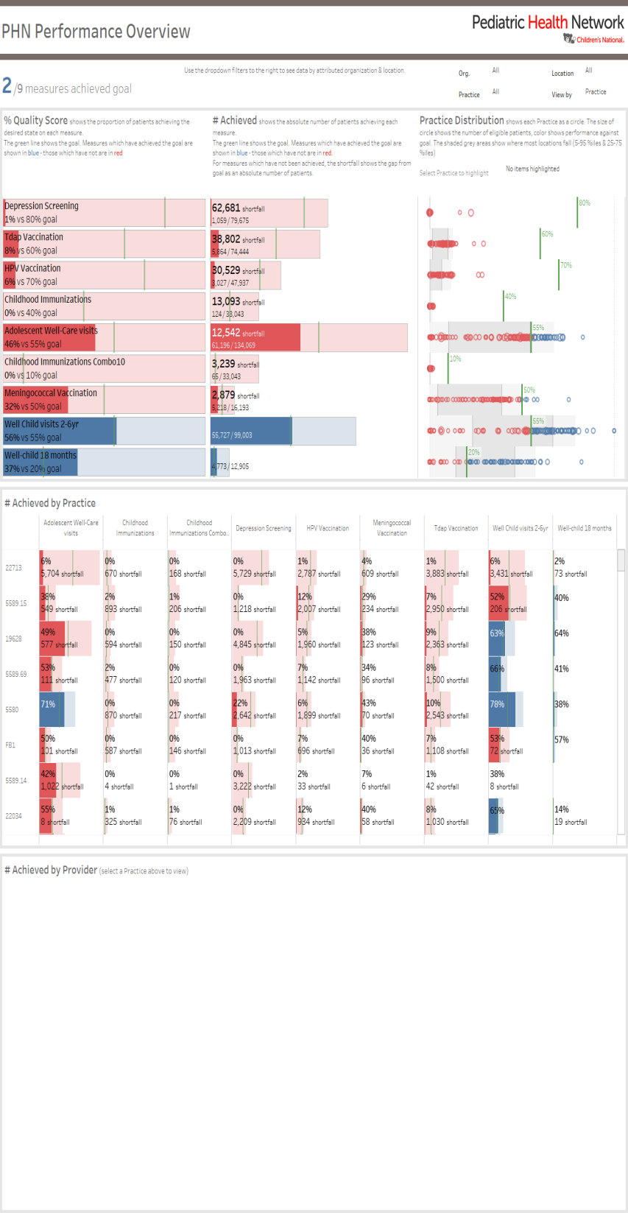
Report Overview
Filters to set scope of report
Overview showing:
% Performance by measure
Numerator/Denominator volume by measure
Performance distribution between practices or locations (as selected above)
Practice / Location detail:
Shows data for all practices or locations (as selected above)
Numerator/Denominator volume by measure
Provider detail:
Not shown until a practice or location is selected above

Slide 19
Manager
Notes:
Showing the same format as before
In the distribution plot – each circle now shows one location
Size shows volume – so we can focus on the larger locations

Slide 20
Practices
Notes:
Same format as the # Achievement plot in center above
One row per location – sorted by total shortfall
One column per measure – sorted alphabetically
Useful to spot pockets of poor performance hidden by aggregate figures
Can drill in to provider – but unlikely to go to the fine detail in most cases

Slide 21
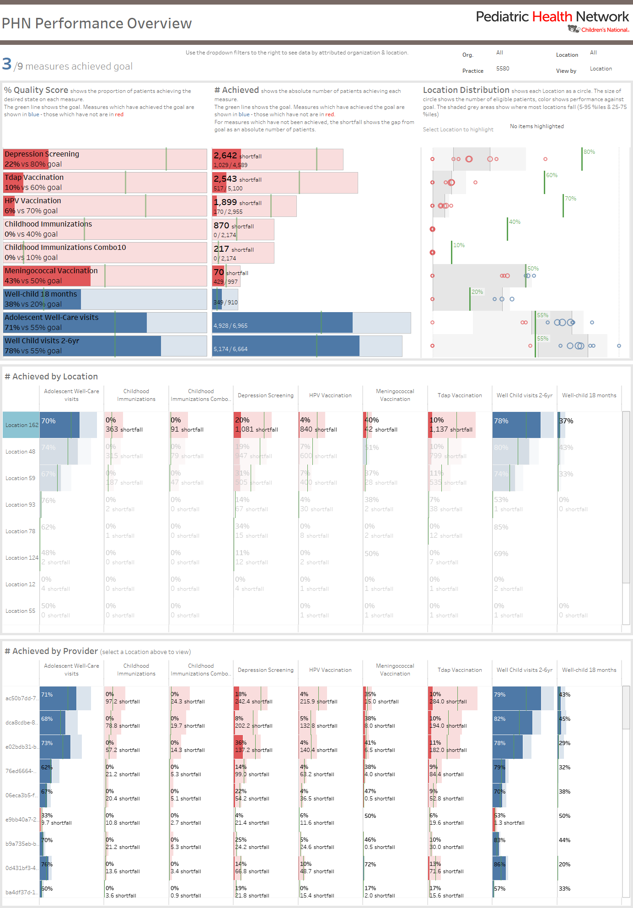
Manager
Notes:
Click on the location to see the providers’ details
Sorting is as above – with rows sorted by shortfall & measures alphabetically

