Slide 1
Interoperability
Farah Saeed
Interoperability Sales and Business Development

Slide 2
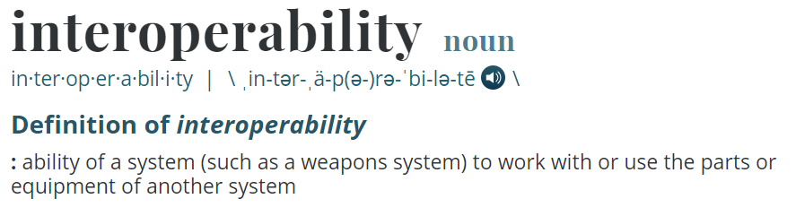
Interoperability
https://www.merriam-webster.com/dictionary/interoperability

Slide 3





Interoperability
Notes:
We’re all here because you have eClinicalWorks in your offices. But that doesn’t necessarily mean that all the data you may need to treat your patients is also all in eClinicalWorks. Your patients may get admitted into a hospital. (click) And in order to get the records from that hospital without calling or faxing or walking over there and searching the files yourself – you need to build an interface. (click) It’s also possible that that patient may see other providers. (click) And in order to get the records from their systems, you need to build interfaces to them as well. And now we hope that you have more than one patient, and its possible that those additional patients may also be (click) admitted to other hospitals or seeing other providers. And maybe these other hospitals and other providers also want to exchange data! (click) As you can see, it can get very complicated very quickly (click) – it is a big challenge to build so many individual point to point integrations. It is a strain on resources of the clients and of the vendors and the associated fees can become burdensome for all parties involved. (click)

Slide 4
Interfaces – Overview
HL7 – PM / Orders & Results
Direct Messaging
HIE CCDA Exchange
Carequality / CommonWell

Slide 5
CCDA Interfaces
What is a CCDA?
CCDA = Consolidated Clinical Document Architecture
Industry standard summary of care document
CCDAs are the primary way in which to send/receive clinical data via interfaces
At a high level, CCDAs contain:
  Problem List
  Allergies
  Meds
  Vitals
  Histories

Slide 6
Direct Interface
Sender
HISP
Vendor HISP
Receiver’s EHR
Sender’s
EHR
John.Smith@ NMA.eclinicaldirectplus.com
Recipient/Sender Sub-Domain Domain

Slide 7
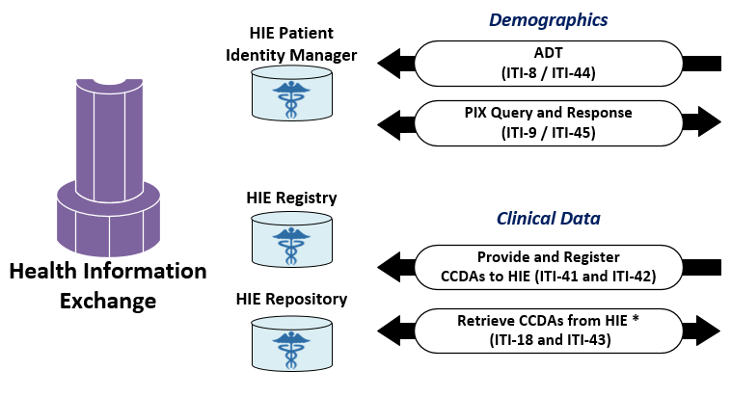

HIE CCDA Exchange

Slide 8
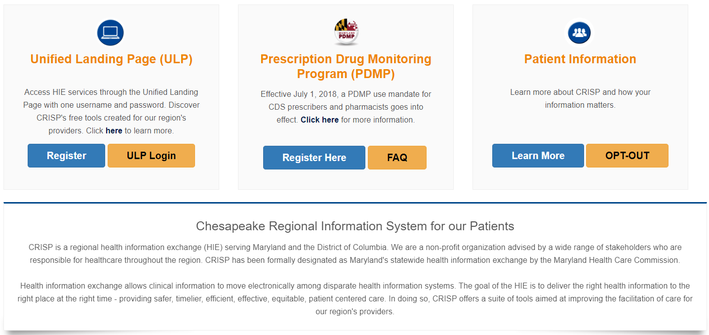

HIE CCDA Exchange

Slide 9


CommonWell and Carequality
Two leading initiatives promoting nationwide data sharing
Notes:
Two nationwide initiatives have taken on this challenge, and they are Carequality and CommonWell. These are third party organizations comprised of different vendors, and they have been set up with the goal simplifying data exchange. There are a few differences between the two, which we will get into shortly, but (click) eClinicalWorks is a member of both – which means that as an eCW client, you can connect to both! So I just want you to keep that in the back of your mind as we go through this session in addition to the note that these integrations are free of cost!

Slide 10
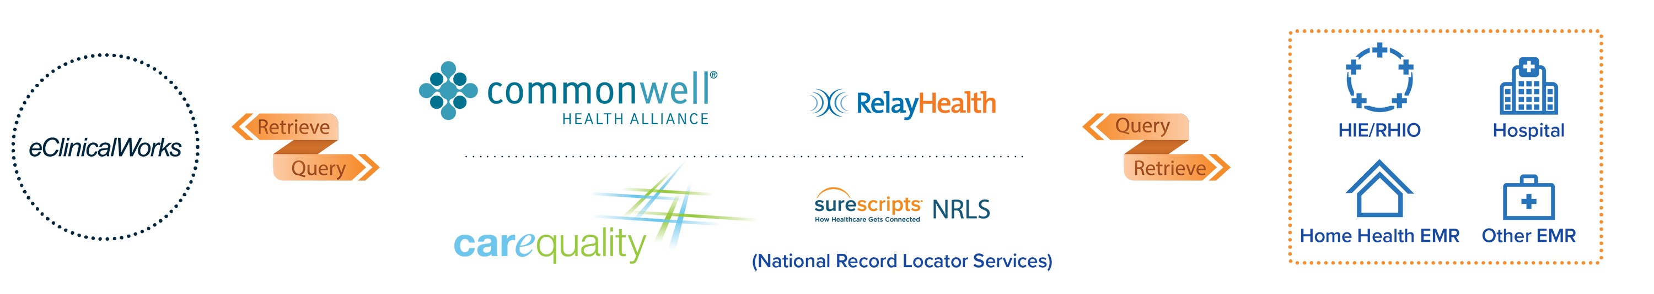
CommonWell and Carequality
Vendor Member
Notes:
So what do Carequality and CommonWell do? Well, they essentially act as middlemen sitting between your eCW practice and all the other EMR, HIE and Hospital systems that you may want to connect with. So with a single connection from your database to either CommonWell, or Carequality, or to both, you will instantly be connected to all the other entities who have also connected – without the work of individual interfaces.

Slide 11


CommonWell Members
Notes:
And who exactly is waiting on the other side? Well these are all of the members of CommonWell. (click) And these ones in green are the EMR systems who are currently Live. Meditech is in Yellow because they should be live in the next month or so. So if any of the large hospitals in your area are on Cerner or Meditech, for example, you could be exchanging patient data with them today!

Slide 12














































Carequality Members
eClinicalWorks
Notes:
Similarly, these are the member organizations of Carequality. (click) And these ones in green are currently live with the services. So if any of the large hospitals in your area are on Epic or NextGen, for example, you could be exchanging patient data with them today!

Slide 13
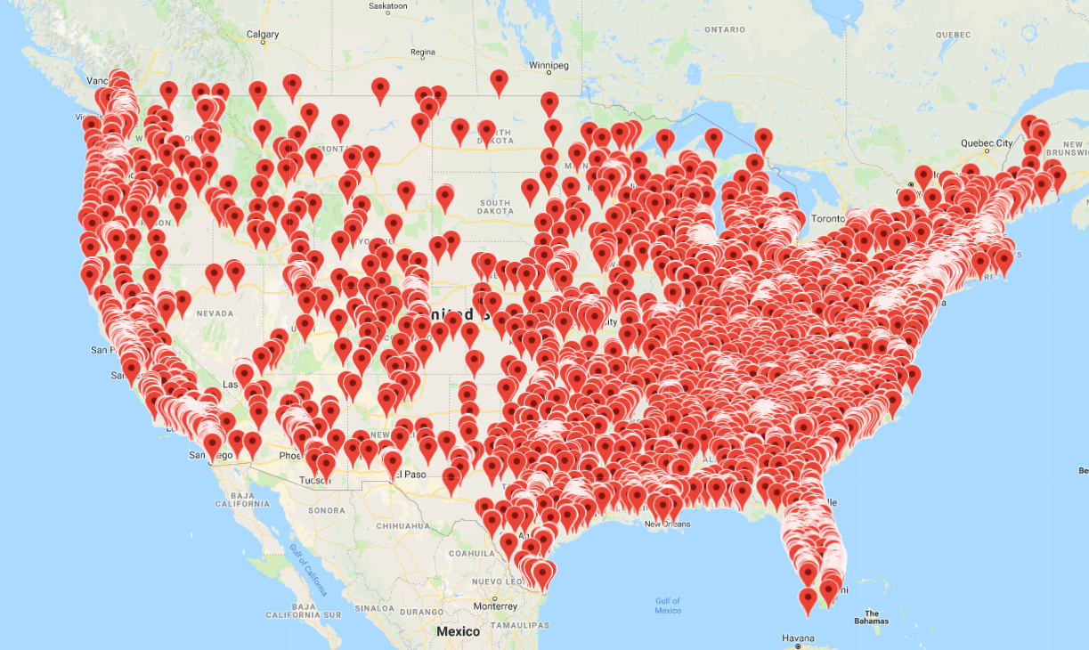
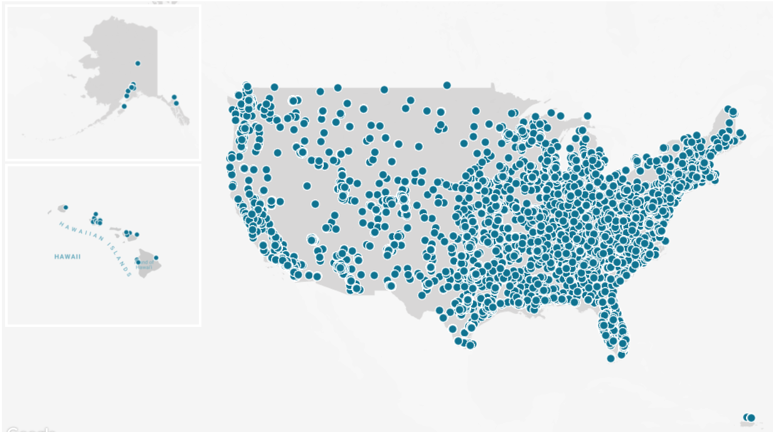
CommonWell and Carequality

Slide 14
What do they do?
On-demand exchange of clinical data
On-demand – Occurs at check-in, no extra clicks
Exchange – Bi-directional
Clinical Data – CCDA
Notes:
So when we say “live on the services” – what exactly do we mean? We keep telling you this data exchange is great – but what exactly is it!? (click) With Carequality and with CommonWell, we do an on-demand exchange of clinical data. Let’s break that down word by word…
(click)
On-demand: When we say on-demand, what we mean is that this exchange happens at the time of check-in. It is triggered by marking a patient as arrived, with no additional clicks to your workflow. What is important to note here is that this is the key difference between Carequality and CommonWell and your more traditional Health Information Exchanges. With a Health Information Exchange (HIE), or a Regional Health Information Organization (RHIO [pronounced “rhee-yo”]), clinical data leaves your EMR every evening and resides on a central server hosted by the HIE or RHIO. With Carequality and with CommonWell, there is no central server of clinical data – clinical data is only exchanged when a patient is checking in to another connected location, and it only flows from one database directly to the other where that patient is being seen.
(click)
Next we have Exchange: So when we say exchange, we mean a bi-directional exchange. It is a requirement for all vendors participating to submit data to the network in order to receive data. Of course, at a patient level, a patient can choose to only send or receive data from a given database, but as a whole, every database must both submit and receive data.
(click)
And finally Clinical Data: When we say clinical data, what we are referring to is a CCDA – a nationwide standard document that is essentially a summary of the progress note. Let’s take a look at what it contains.

Slide 15
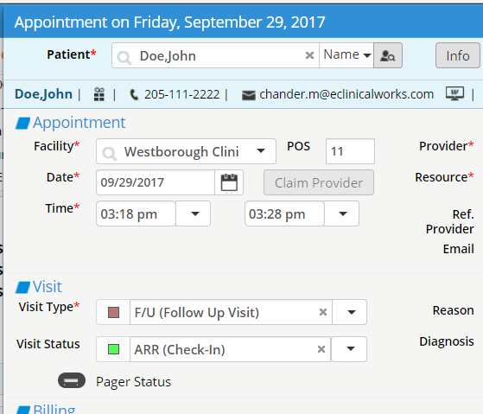
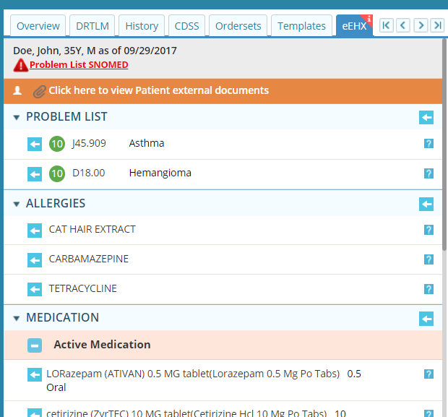
Automated Query
Automatic query upon arrival
Document notification on the Interactive Clinical Wizard
Notes:
So, now that we how data is being exchanges and the consent pre-requirements you need to have in place – let’s see what it actually looks like in the system! When you mark a patient as “Arrived” (click) that will trigger an automatic query on the back-end of the system. This patient’s demographics will be sent out to both CommonWell and Carequality to see what other connected entities this patient has visited. Once we know where the patient has been seen, we immediately and automatically trigger another query to request the CCDA document from that database. This happens seamlessly within seconds all behind the scenes. If data is available (click) it is brought back into the EMR on the Right Chart Panel of your Progress Note under the tab titled “eEHX”. There will be a red flag in the corner to alert the provider that data is available from external sources here on this tab.

Slide 16
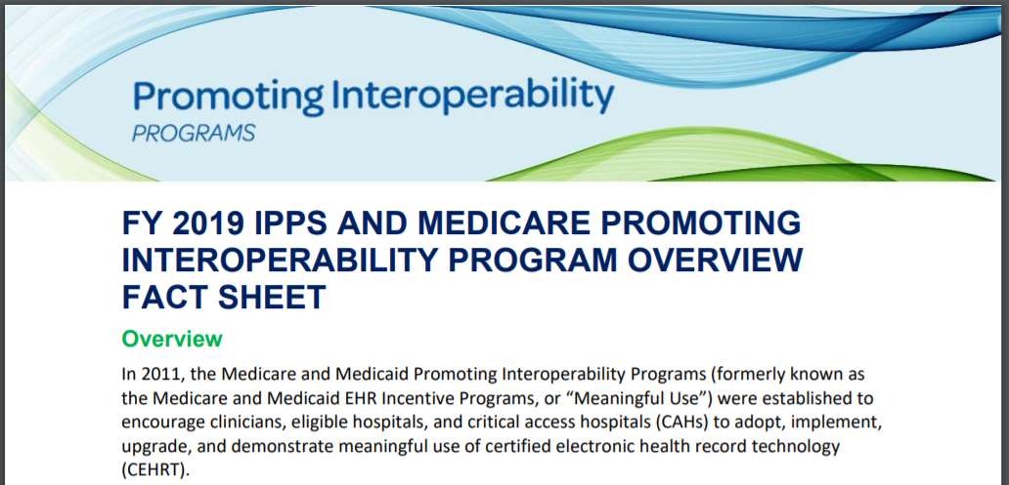
Promoting Interoperability

Slide 17
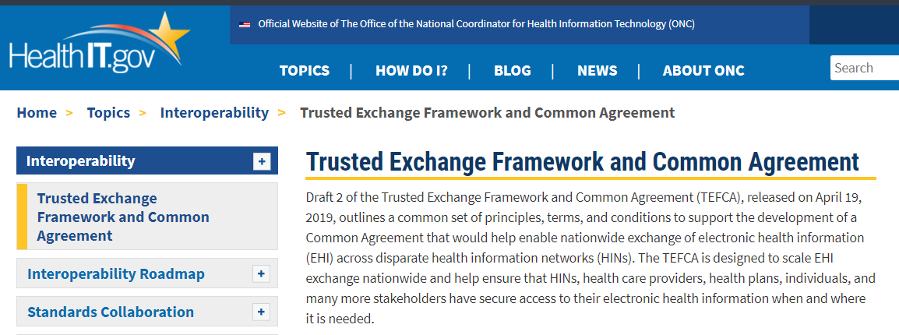
TEFCA

