Slide 1
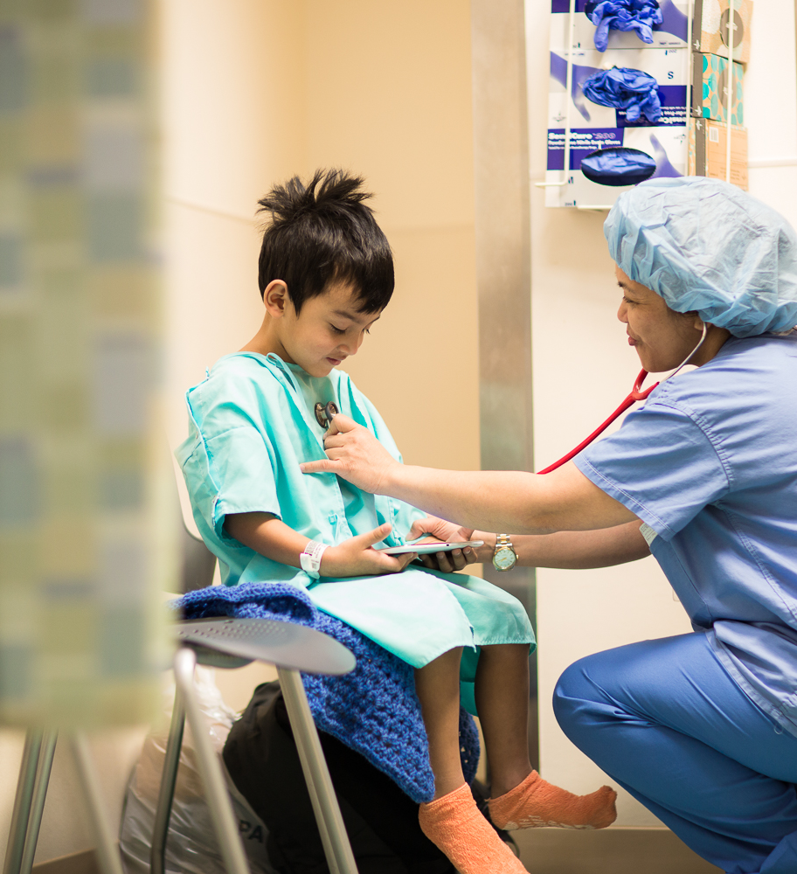
PHN EHR Services User Group:
PRISMA – Interoperability Search Engine
^{Thursday. June 17th}
12:00pm – 12:45 pm
A collaboration between PHN, eClinicalWorks and PHN practices

Slide 2
Notes About Today’s User Group:
All lines are muted throughout the presentation.
Please use the CHAT box to ask questions or make comments.
During the Q&A , please unmute yourself or use the CHAT box
We will be recording the session.
Please turn on your webcam if you have the functionality.
Today’s recordings and materials will be posted to the PHN website following the presentation.
https://pediatrichealthnetwork.org/

Slide 3
Future User Groups: We Want to Hear From You!
Our User Group series is focused on collaborative learning, strengthening and optimizing practices success with eClinicalWorks. If you have topics you would like to see this Fall, please email PHNservices@childrensnational.org
Dates will be announced late summer.

Slide 4
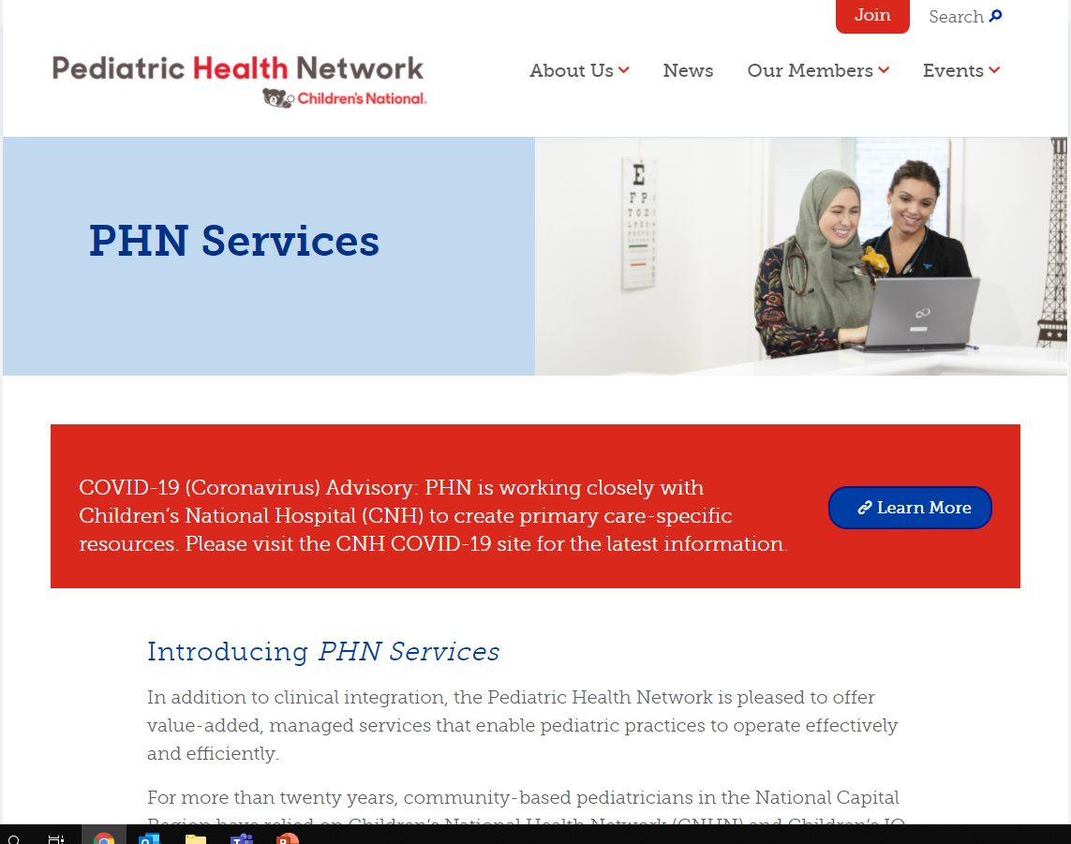
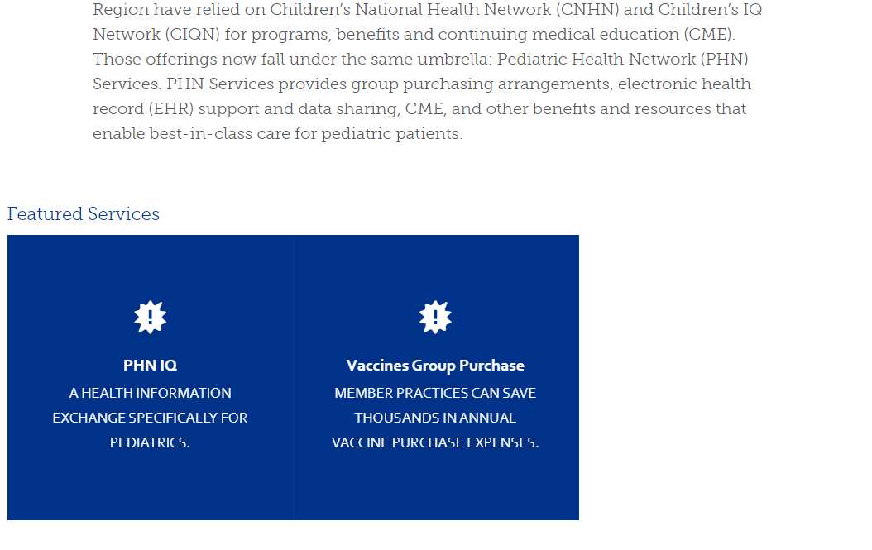
Where to Find PHN^{IQ} Online
Visit https://pediatrichealthnetwork.org/phn-services/ to find all the information you need on PHN EHR Services User Group

Slide 5
Agenda
Time | Item | Speakers
5 mins | Introductions, Updates and Overview | Caroline S. Brozak
25 mins | Prisma Demonstration | Prasad K. Patankar
10 mins | Q&A and Next Steps

Slide 6
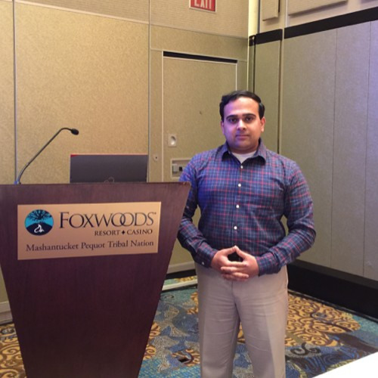
Meet Our Presenter
Prasad K. Patankar
Manager- Business Development & Enterprise Strategy
eClinicalWorks

Slide 7
PRISMA Demonstration
Prasad Patankar
Manager- Business Development
eClincialWorks

Slide 8
Disclaimer
All screenshots in this slide deck are from dummy(fake) patients.
eCW environment being used for this demonstration is a test environment containing fake patients. No PHI information is being shared.

Slide 9
What is Healow Insights PRISMA
‘One patient, one record’ for more effective clinical practice.
Get access to the full spectrum of a patient’s health history available and searchable by providers.
Combines records from specialists, urgent care facilities, hospitals, and PCP’s- whether they use eCW, Cerner, EPIC, or other systems.

Slide 10
What can we do with PRISMA?
Search if the patient was hospitalized.
Get to know if the patient had an EKG outside the practice or any common tests done at the point of care ( Mammogram, Eye Exam, Colonoscopy, other DI’s).
Get to know if the patient had a COVID shot, flu shot, or any other vaccinations.
Search for internal & external medical records in reverse chronological order.
Import external medical records with one button.

Slide 11
Requirements to use PRISMA
V11.52.93.22 or higher version- Improved performance
PRISMA is only available in the browser version at this time.
CommonWell and/or Carequality needs to be activated from Product Activation→ Interoperability

Slide 12
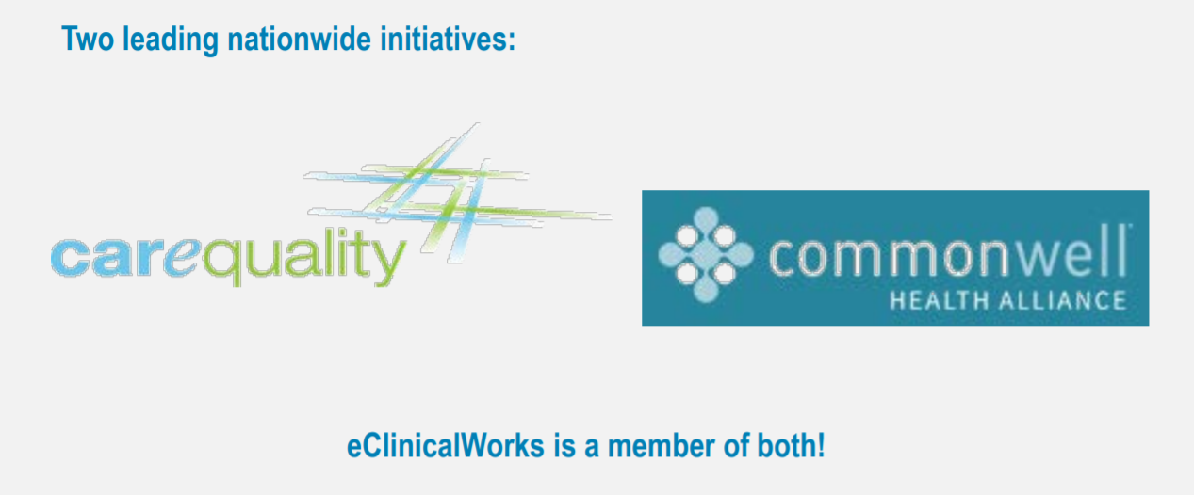
Interoperability Solutions

Slide 13

CommonWell Members

Slide 14
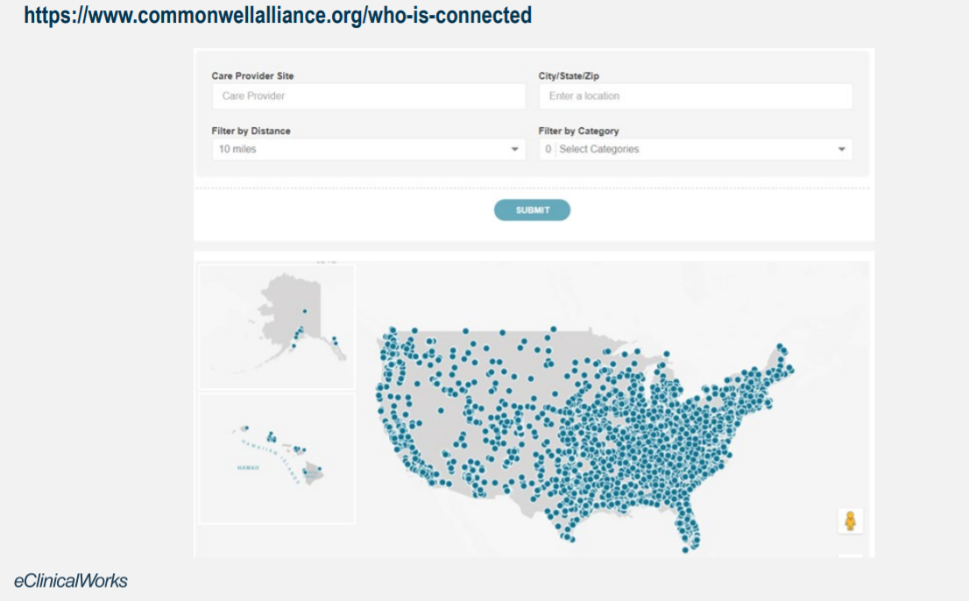
CommonWell Members

Slide 15

Carequality Members

Slide 16
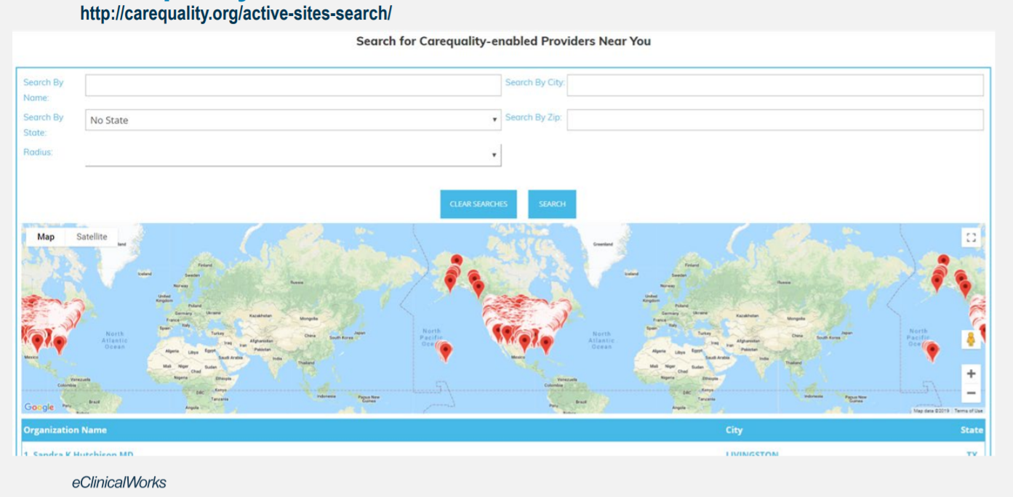
Carequality Members

Slide 17
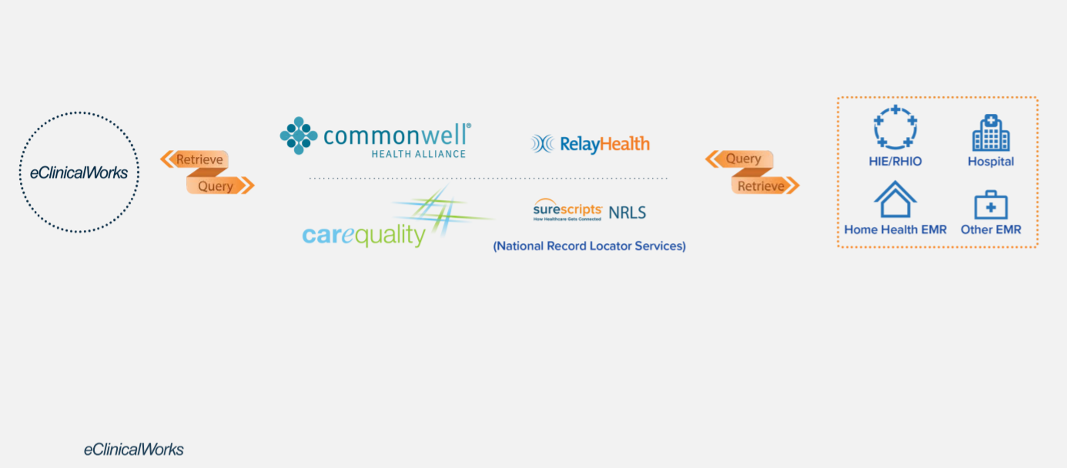
Free Interoperability Solution

Slide 18
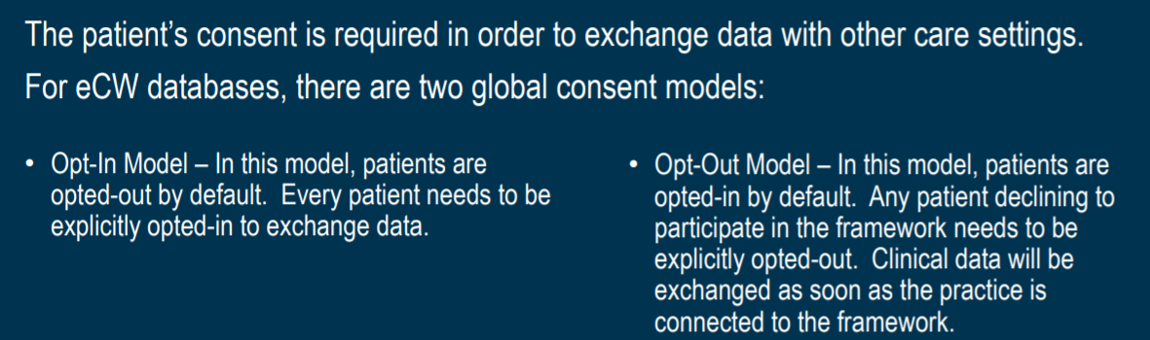
Patient Consent

Slide 19
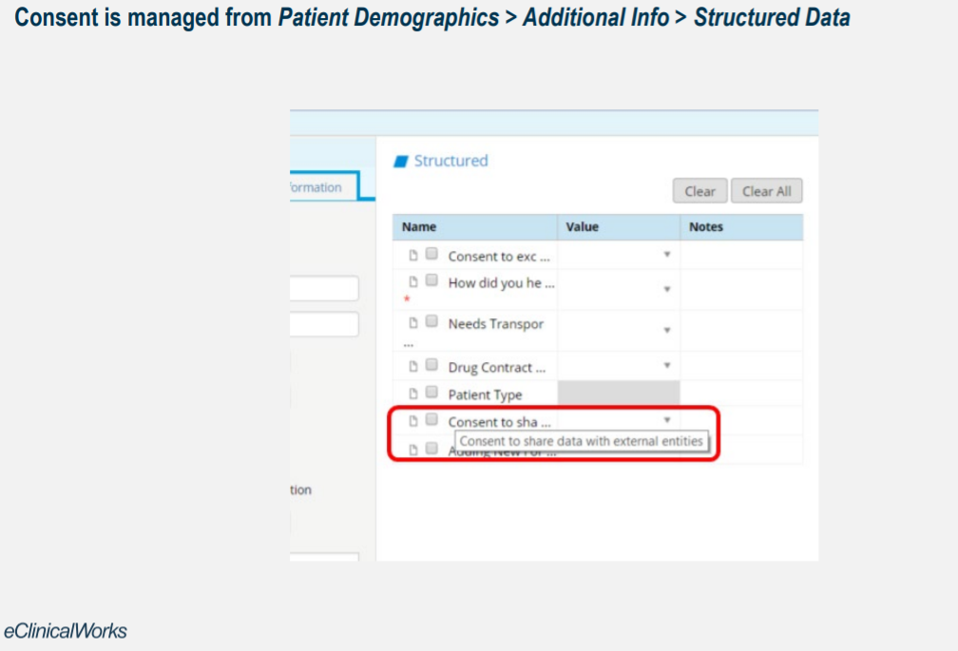
Managing Patient Consent

Slide 20
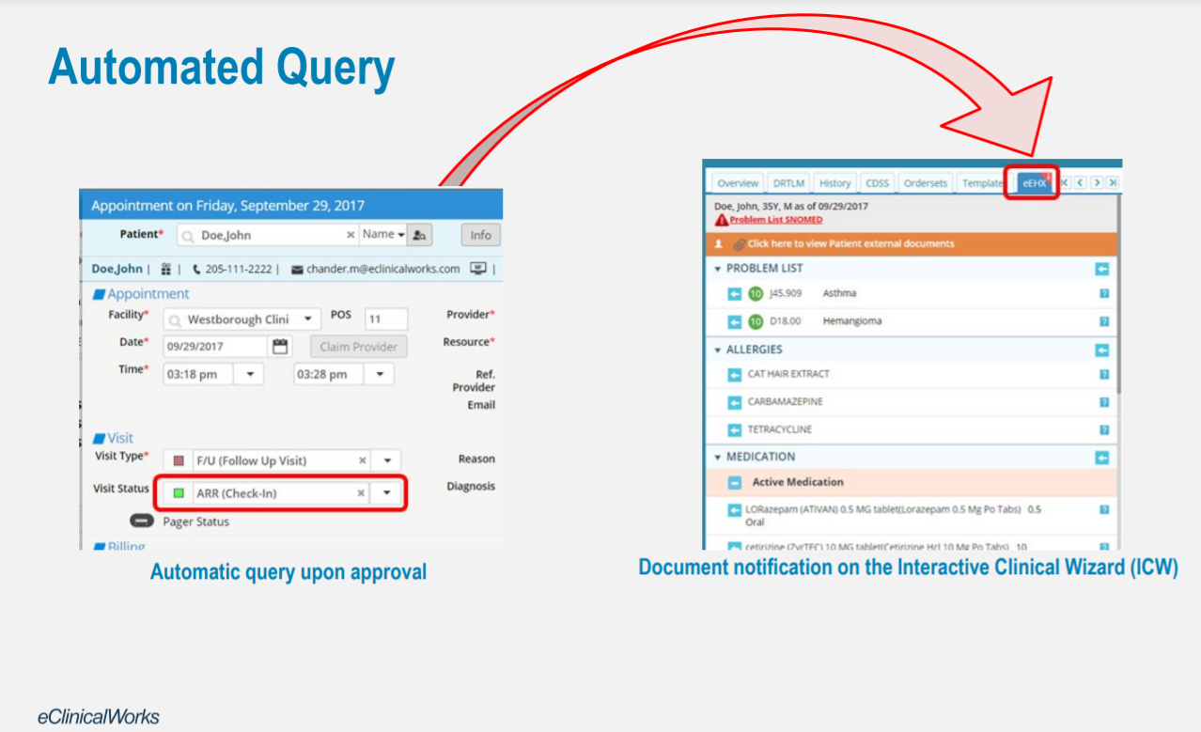

Slide 21
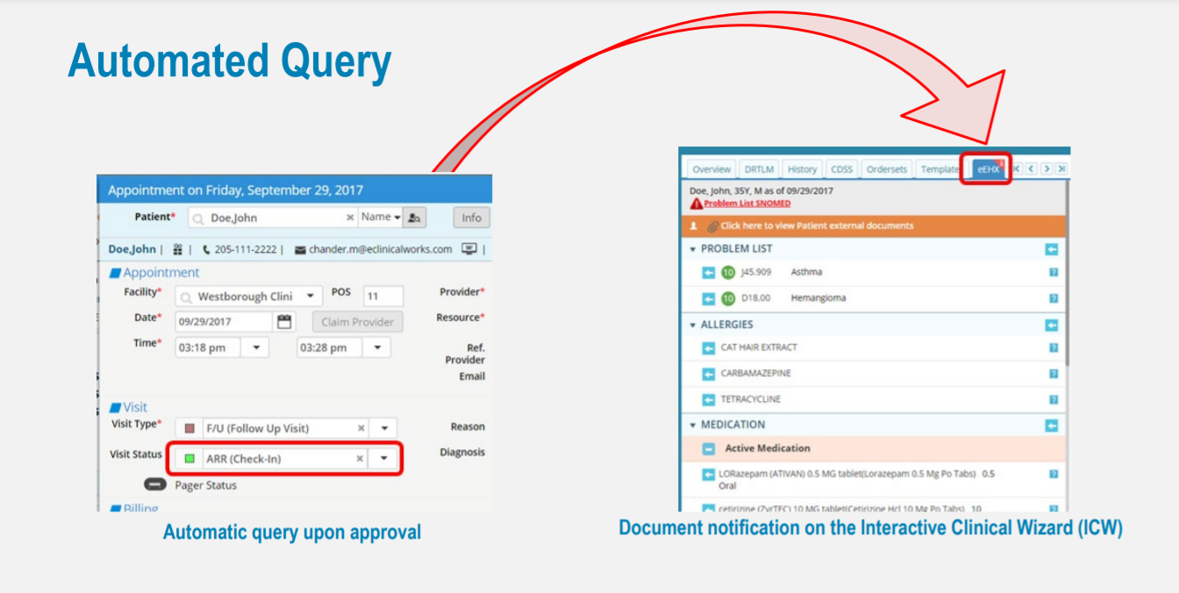
eHX
The eClinicalWorks Electronic Health eXchange (eEHX®) is a comprehensive Health Information Exchange (HIE) solution that facilitates interoperability between clinical systems in a community-wide setting. eEHX provides real-time access to a patient’s longitudinal health record, enhancing clinical decision-making across care settings.

Slide 22
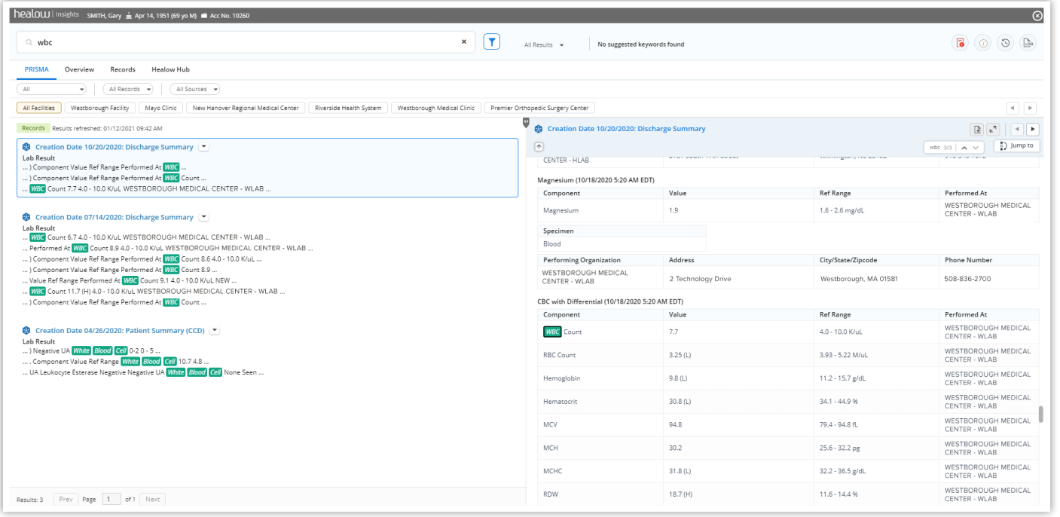
PRISMA- Longitudinal View

Slide 23
How to get PRISMA
eCW will deploy a patch for practices interested.
ODA Activation for PRISMA after receiving confirmation of this patch.
Admin→Product Activation→Interoperability needs to be activated. eClinicalWorks Support can help setup Commonwell and Carequality via a support case if practice needs assistance. No cost associated with this.

Slide 24
Q&A

Slide 25
Thank you for your participation!
To find this webinar recording and more information, visit our website: http://pediatrichealthnetwork.org
Email us at: phnservices@childrensnational.org

