Slide 1

User Group:
Successful Strategies to Improve Patient Engagement Including Healow Text and Healow Pay
^{Thursday. November 18th, 2021}
12:00pm – 12:45 pm
A collaboration between PHN^{IQ}, eClinicalWorks and PHN^{IQ} practices

Slide 2
Notes About Today’s User Group:
All lines are muted throughout the presentation.
Please use the CHAT box to ask questions or make comments.
During the Q&A , please unmute yourself or use the CHAT box
We will be recording the session.
Please turn on your webcam if you have the functionality.
Today’s recordings and materials will be posted to the PHN website following the presentation.
https://pediatrichealthnetwork.org/

Slide 3

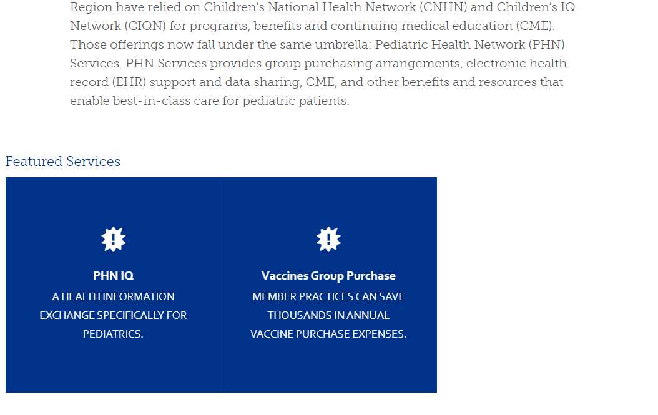
Where to Find Us Online
Visit https://pediatrichealthnetwork.org/phn-services/ to find all the information you need on PHN^{IQ}

Slide 4
Upcoming User Groups :
We would like your feedback!
Please contact Jodi Tunstall - Business Manager for PHN at jtunstall@childrensnational.org with any suggestions or request for next years user group series.

Slide 5
Agenda
Time | Item | Speakers
5 mins | Introductions and Overview | Jodi Tunstall
5 mins | Complimentary EMR Optimization Services | Prasad Patankar
15 mins | Practical Tools to Maximize Patient Engagement - healow check-in/secure lab text/healow Pay | Neha Kankanala
10 mins | Q&A

Slide 6
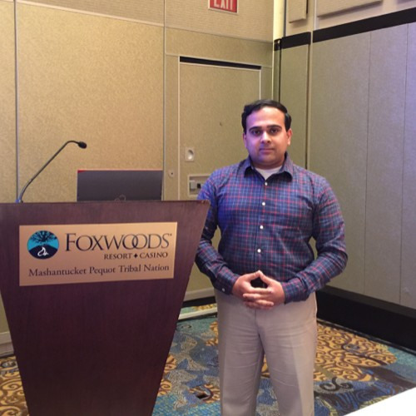

Meet Our Presenters
Prasad K. Patankar
Manager- Business Development & Enterprise Strategy
eClinicalWorks
Neha Kankanala
Patient Engagement Team
eClinicalWorks / healow

Slide 7

Complimentary EMR Optimization Services
Complimentary 4 Hour optimization discovery call focused on
  Clinical Workflows
  Front Office Workflows
Contact your SAM or Business Development Manager

Slide 8
Practical Tools to Increase Patient Engagement
Neha Kankanala
Patient Engagement Team
eClinicalWorks / healow

Slide 9

healow check-in/secure lab text/healow Pay

Slide 10
Q&A

Slide 11
Thank you for your participation!
To find this webinar recording and more information, visit our website: http://pediatrichealthnetwork.org
Email us at: phnservices@childrensnational.org

