Slide 1
Diagnosing and Treating Major Depressive Disorder
June 6, 2022 Laura Willing, MD Department of Psychiatry

Slide 2
Disclosure
Laura Willing, MD has financial interests including stock with Pfizer, Moderna, Sanofi, and Biontech

Slide 3
Outline
Diagnostic Criteria
Differential Diagnosis
Evaluation
Sample Language to use in the office
Treatment Options
When to Refer to Psychiatry
Brief Interventions for the office

Slide 4
Diagnostic Criteria
Depressed or irritable mood
Change in sleep
Anhedonia
Excessive guilt
Decreased energy
Poor concentration
Change in appetite
Psychomotor agitation or retardation
Suicidal thoughts
At least two weeks
Significant Impairment
Not better explained by a medical condition, substance use, bipolar disorder, or psychotic illness

Slide 5
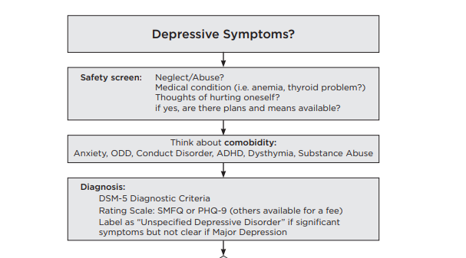
Key Resource: Seattle Children’s
Depression Care Guide
https://www.seattlechildrens.org/globalassets/documents/healthcare-professionals/pal/wa/wa-depression-care-guide.pdf

Slide 6
Differential Diagnosis
Adjustment Disorder
PTSD
Substance Use
Eating Disorder
Bipolar Disorder
Gender Dysphoria
Anxiety Disorder
Medication Induced (steroids, contraceptive hormones)
Medical Illness (Thyroid disease, head injury, seizures, mono, Lyme)
Notes:
ML: I recognize you’re short on time so this could be a teaser but what would be helpful on here for me would be to have 2 bullet points each with high-yield questions you could ask to rule these in or out. You could either include them and go over them or say it’s something we could talk about more in office hours…

Slide 7
Medical Evaluation
Vital Signs
Physical ROS
TSH, CBC, B12, Vitamin D
Urine Drug Screen
Notes:
ML: You could potentially lump this (ie labs, UDS) in with prior slide with the bullet point for medical disease and would also be helpful if you recommend labs/UDS for all patients (definitely not something we typically do in primary care…or at least among my colleagues) or only with patients in whom you suspect one of these medical concerns for some other reason…
And would write out UDS – not something we use often

Slide 8
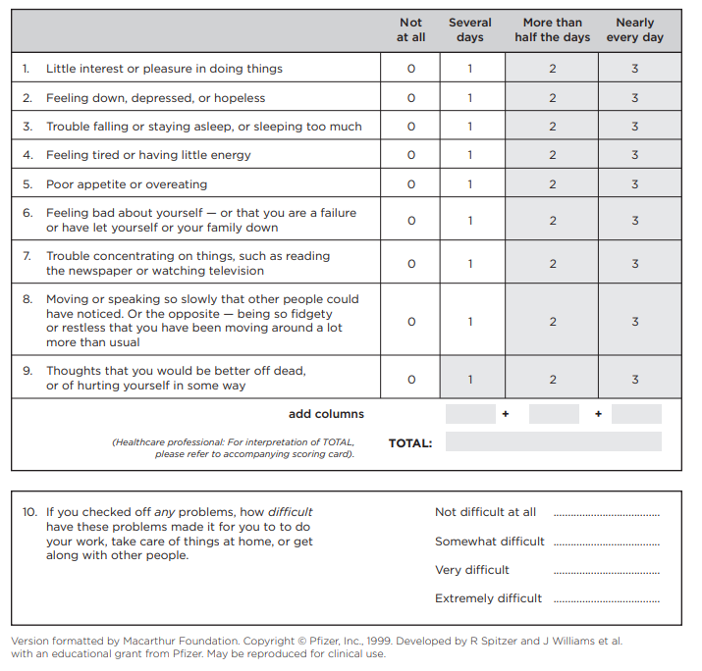
PHQ-9 is a screening tool
1
4
15
20

Slide 9
Sample Language
I have reviewed your forms, and I want to talk about how you have been feeling lately. On this form, you indicated that you are feeling hopeless. Can you tell me more about that?
When people feel down, have low energy, have trouble sleeping, and no longer enjoy activities, they may have depression. Does that sound like it could apply to you?
What do you think is going on? Is there something you are worried about?

Slide 10
Next Steps
Assess
Assess for safety including self injury, harm to others, suicidality and psychosis
Gather
Gather more diagnostic information
Consider
Consider further workup and evaluation
Explore
Explore possible diagnoses including depression
Review
Review treatment options
Make
Make appropriate referrals
Follow up
Follow up regularly
Consider
Consider brief interventions

Slide 11
Psychiatric Evaluation
Ask questions of both the parent and child
You might get different answers!
Family History, Social History, Trauma History, Educational History, Developmental History, Medical History
Ask about the symptoms of depression at each visit, track improvement in symptoms (is sleep improving? Is energy improving?)
Ask about other relevant symptoms (nightmares, anxiety, social relationships)
Evaluate for a history of mania or psychotic symptoms
Evaluate for safety concerns at every visit
Notes:
ML: Wondering if it’s worth pulling a few things out of here to highlight, rather than including whole thing – don’t feel strongly about it. OR as you’re covering this you could say – if you only have 5 minutes, make sure to cover x, y, z (ask questions of both parent and child, eval for mania / psychosis, safety check). Also, I still find it helpful to hear what questions you ask to get at mania/psychosis.

Slide 12
Treatment Options
Psychoeducation – identify strengths, shared decision making
Follow up soon
Refer to Therapy
Pharmacologic Intervention
Brief Intervention
Refer to Psychiatry
Send to ED or Crisis Services

Slide 13
When to Refer to Therapy
Depression symptoms are impairing
Therapy is desired by patient and family
Weekly therapy
Cognitive Behavioral Therapy
Consider Family Therapy
Consider Group Therapy

Slide 14
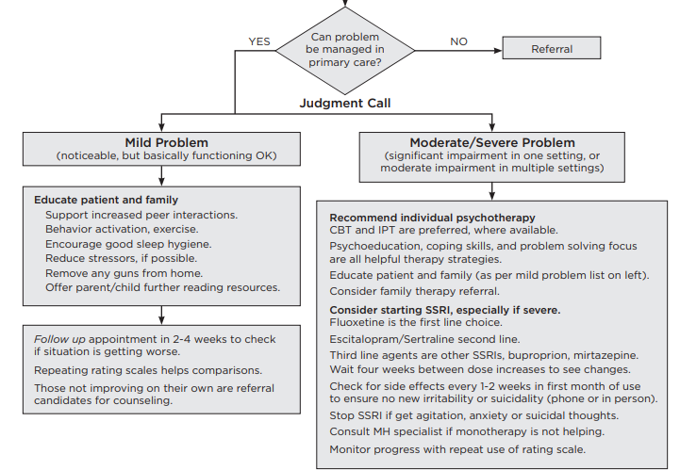
Treatment Algorithm
Seattle Children’s Depression Care Guide
https://www.seattlechildrens.org/globalassets/documents/healthcare-professionals/pal/wa/wa-depression-care-guide.pdf

Slide 15
When to Consider Medication
Moderate to severe depression
Therapy alone has not been helpful
Significant impairment
Serious safety concern
Notes:
ML: how much time do you give to know if therapy has been “helpful” (ballpark or estimate would be helpful); include examples of significant impairment – realize you may be intending to talk about these things and not advocating for more words on a slide – just things that come to mind immediately that would be helpful to me!

Slide 16
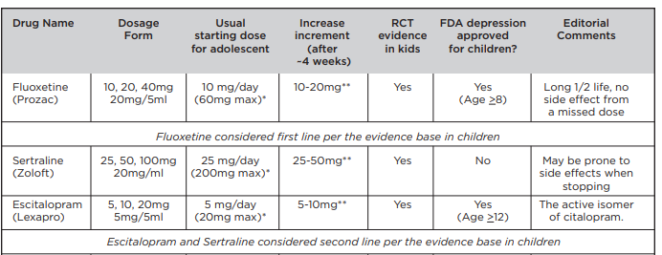
Which Medication?
Seattle Children’s Depression Care Guide
https://www.seattlechildrens.org/globalassets/documents/healthcare-professionals/pal/wa/wa-depression-care-guide.pdf

Slide 17
Which Medication?
SSRI’s are first- and second-line medications
Family History
Fluoxetine
Long half life
Possibly more activating
Sertraline
FDA approved for OCD in pediatric patients (not MDD)
Possibly more sedating
Escitalopram
Narrow therapeutic window
Active enantiomer of citalopram
Pharmacogenomic Testing – FDA issued a warning letter

Slide 18
What do I do when medicine isn’t working?
It takes 4-6 weeks on a given dose to see the full effect of that dose
Consider maximizing the dose
Consider changing to a different medication
Second line pharmacotherapy is a different SSRI
Therapy + Medication

Slide 19
Cross Titration
Consider the half-lives of the medications
Consider the urgency of treatment
Consider the risk of side effects
We will discuss examples of cross titration schedules in upcoming office hours

Slide 20
Side Effects
Activation
GI Distress
Sweating, dizziness, HA
Bleeding
Sexual Dysfunction
Mania
Serotonin Syndrome
FDA Black Box Warning: Suicidal Thoughts

Slide 21
When to Refer to Psychiatry
Severe MDD, suicidal thoughts, psychotic symptoms
Not responding to a second trial of SSRI, or partially responding
Multiple co-morbid diagnoses
Diagnostic clarity
If you are not comfortable

Slide 22
Brief Interventions
Psychoeducation
Reduce Stressors
Sleep hygiene
Safety Plan
Behavioral Activation
Coping Skills
Exercise

Slide 23
Case: 16yo boy seeking a sports physical

Slide 24
16yo boy presents for a sports physical
PHQ-9 is 20 as above (0 for #9)
Mom notes that he won’t be able to play sports if he doesn’t get his grades up, which used to be excellent
He says that he doesn’t care anymore if he plays sports
Mom says that he stays in his room sleeping all the time, not hanging out with friends anymore, and she thinks he is losing weight

Slide 25
With the patient individually,
He denies substance use
Denies any acute stressors (like bullying or a recent breakup)
Denies any history of trauma
He says that he feels “numb and empty” and “who cares?” about sports or school, which he used to enjoy
Denies any safety concerns
He doesn’t think he has depression because “I don’t feel sad”
Denies hallucinations, paranoia
Denies anxiety symptoms

Slide 26
With the mom individually,
She shares that there is a family history of depression, and that she takes an SSRI for depression and anxiety, which she finds helpful
She wonders if her son could have depression too
She denies any concern for mania or substance use with her son
There are no firearms in the home

Slide 27
Plan
You discuss safety planning in the home
You discuss psychoeducation around the diagnosis of depression
Both pt and mom agree to a therapy referral, but want to see if that helps before considering medication
You schedule a follow up appointment to monitor symptoms and discuss behavioral activation and sleep hygiene

Slide 28
Upcoming Office Hours
June 16 (Thursday) at 12:10pm
June 20 (Monday) at 12:10pm
June 30 (Thursday) at 12:10pm

