Slide 1

PHN User Group:
The Pediatric Health Network’s .exe vs. web based
^{Thursday. June 16th, 2022}
12:00pm – 1:00 pm
A collaboration between PHN, eClinicalWorks and PHN practices

Slide 2
Notes About Today’s User Group:
All lines are muted throughout the presentation.
Please use the CHAT box to ask questions or make comments.
During the Q&A , please unmute yourself or use the CHAT box.
We will be recording the session.
Please turn on your webcam if you have the functionality.
Today’s recordings and materials will be posted to the PHN website following the presentation.
https://pediatrichealthnetwork.org/

Slide 3
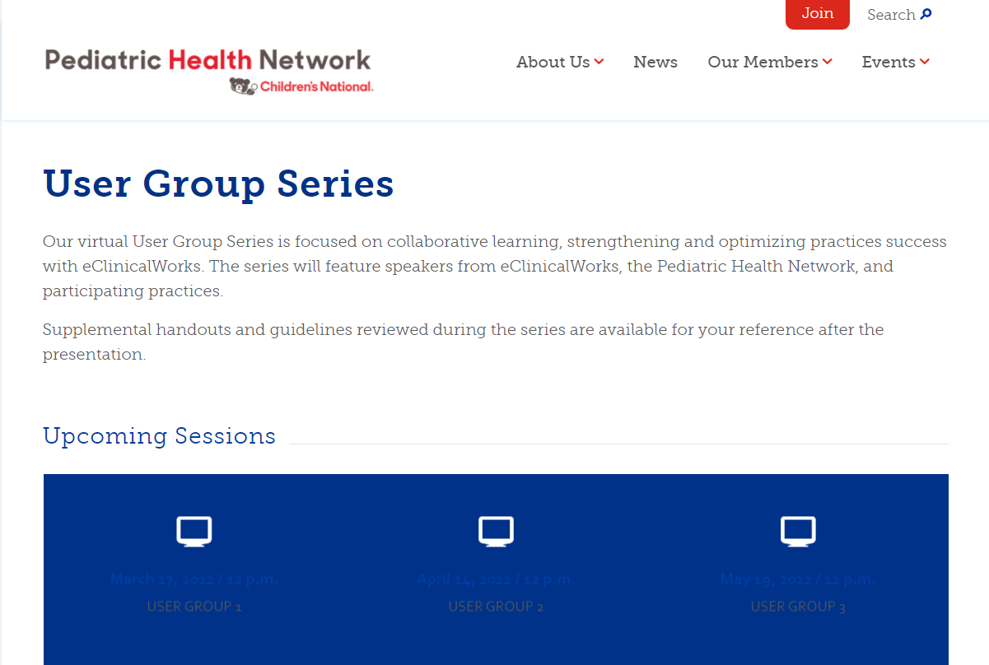
Where to Find Us
Online
Visit https://pediatrichealthnetwork.org/user-group-series/ to find all the information you need on upcoming User Group Sessions as well as recordings from previous sessions.
You can find more information about all the PHN’s offerings here:
https://pediatrichealthnetwork.org/practice-programs-and-services/

Slide 4
Upcoming PHN User Groups :
We would like your feedback!
Please contact Jodi Tunstall - Business Manager for PHN at jtunstall@childrensnational.org with any suggestions or request for our next user group meeting.

Slide 5
Agenda
Time | Item | Speakers
12:00-12:05 | Introduction | Jodi Tunstall
12:05-12:20 | Clinical Rule Engine | Melissa Graves
12:20-12:50 | .exe vs. Web based platform | Dhruv Bhasin
12:50-1:00 | Questions & Open Forum | Jodi Tunstall

Slide 6



Meet Our Presenters
Jodi Tunstall
Business Manager
PHN Services
Melissa Graves CPC, CPEDC
Practice Administrator
Gateway Pediatrics
Dhruv Bhasin
Business Development
eCW

Slide 7
Clinical Rule Engine: BMI at Well Visits
Melissa Graves, CPC, CPEDC
Gateway Pediatrics
Salisbury, MD

Slide 8
Clinical Rule Engine
Activated by Item Key
Uses Logic Coding
Can be tailored by Visit Type

Slide 9
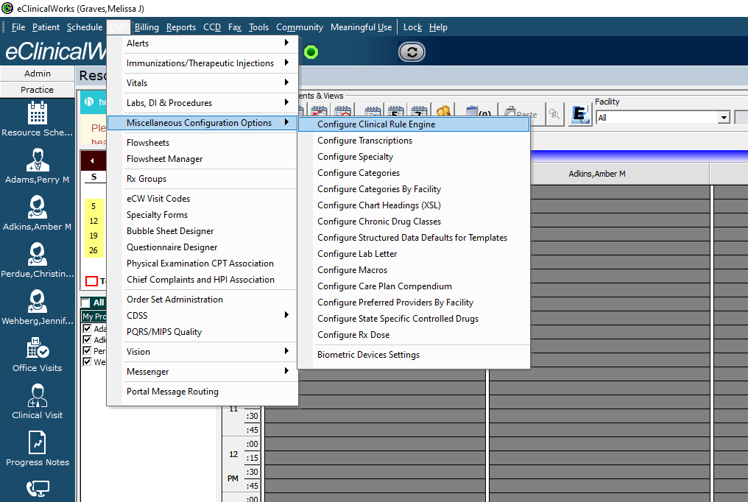
Clinical Rule Engine
EMR > Miscellaneous Configuration Options > Configure Clinical Rules Engine

Slide 10
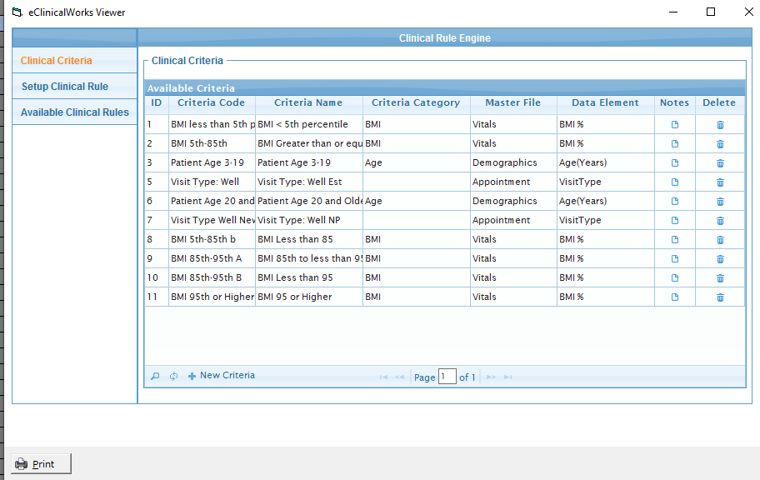
Clinical Rule Engine
Notes:
Three Steps:
Clinical Criteria
Setup Clinical Rule
Available Clinical Rules

Slide 11
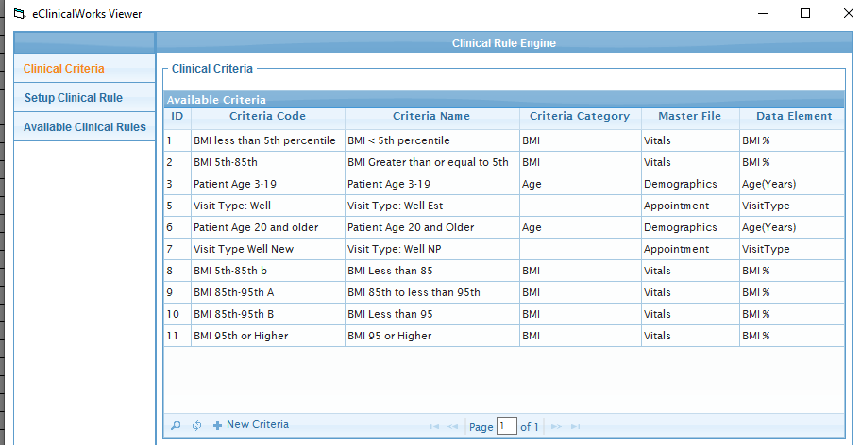
Clinical Rule Engine

Slide 12
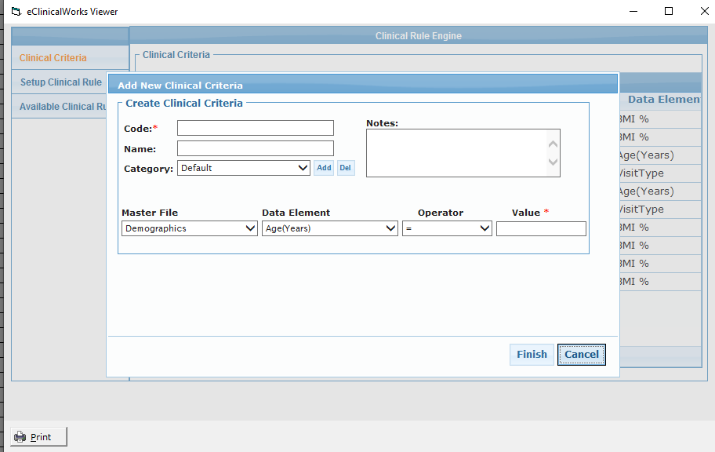
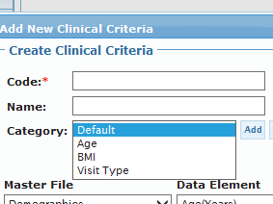
Clinical Rule Engine
Notes:
Code: Enter in your Criteria
Name: Name of your Criteria
Category: Drop Down Menu – Choose BMI
Master File: Drop Down Menu – Choose Vitals
Data Element: Drop Down Menu – Choose BMI %
Operator: Drop Down Menu – Choose = / < / < or = / > / > or =
Value: Type in Appropriate Value

Slide 13
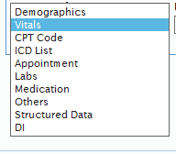
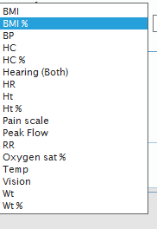

Clinical Rule Engine
Master File Data Element Operator Value
Notes:
Choosing the Master File value will adjust what values populate in the Data Element.
e.g. Under Demographics, the Data Elements would be all demographic fields

Slide 14
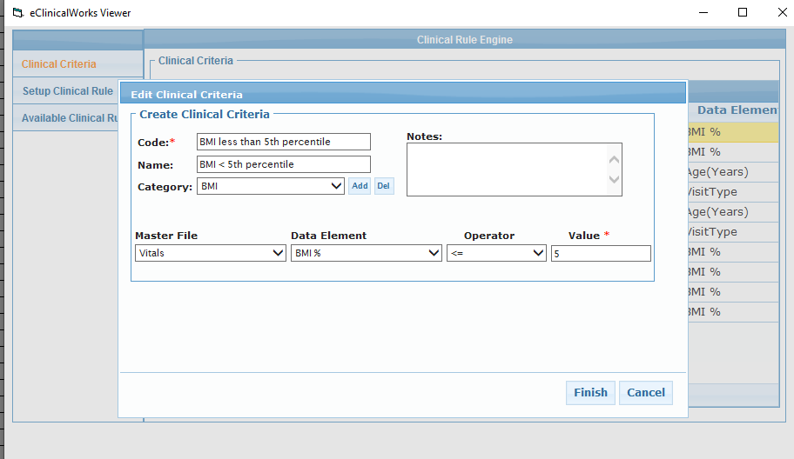
Clinical Rule Engine – BMI < 5th Percentile
1st Clinical Criteria
Notes:
To Build our first Criteria for our Rule of BMI less than the 5th Percentile – we need to focus on the BMI Percentile.

Slide 15
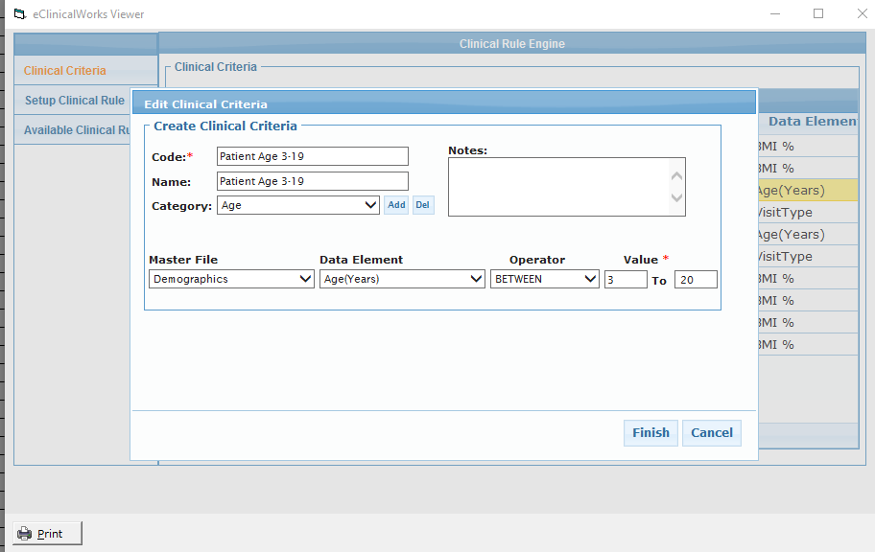
Clinical Rule Engine – BMI < 5th Percentile
2nd Clinical Criteria
Notes:
Next we need our second Criteria of Demographics (Ages between 3-20)

Slide 16
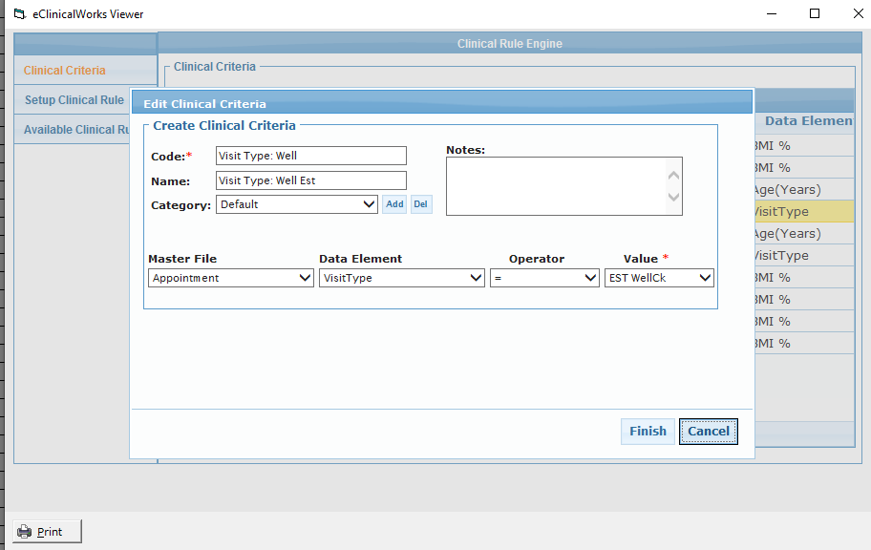
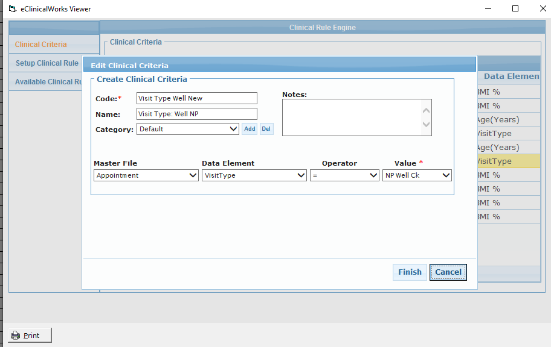
Clinical Rule Engine – BMI < 5th Percentile
3rd Clinical Criteria
4th Clinical Criteria
Notes:
Then we need our Criteria of Visit Type – this may be multiple criteria depending on how you have your Visit Types Set. We have an Established Patient Well and New Patient Well so this means we need to Create 2 Criteria for each visit type.
Value pulls from your Visit Type List

Slide 17
Clinical Rule Engine – BMI < 5th Percentile
1st Clinical Criteria
2nd Clinical Criteria
3rd Clinical Criteria
4th Clinical Criteria
Notes:
This is what your list may look like for Clinical Criteria
I’ve covered my others so you can see the 4 we need for this one Rule.

Slide 18
Clinical Rule Engine – BMI < 5th Percentile
Notes:
Next Step is to choose Setup Clinical Rule

Slide 19
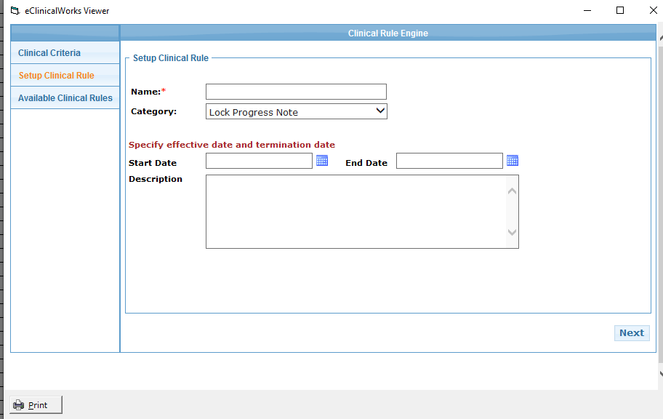
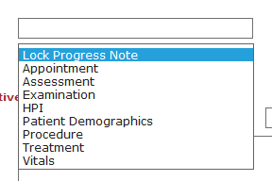
Clinical Rule Engine – BMI < 5th Percentile
      Category:
Notes:
Next Step is to choose Setup Clinical Rule
Category is a Drop Down – I first chose Vitals for my Category but with others I chose Assessment, it doesn’t seem to matter except if you were to filter for Available Clinical Rules, so use what makes sense to you.
Start Date / End Date – you can leave blank
Description – Add what makes sense for you
Fill out and click Next:

Slide 20
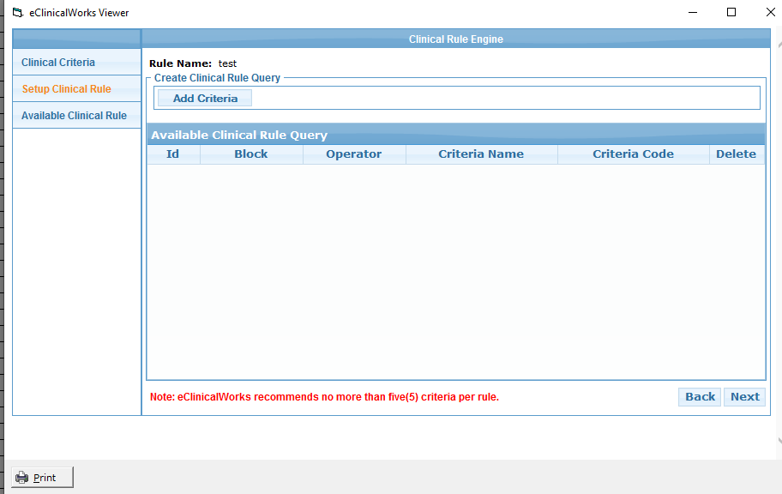
Clinical Rule Engine – BMI < 5th Percentile
Notes:
Blank Rule Engine where you will Add Criteria that we built under “Clinical Criteria”

Slide 21
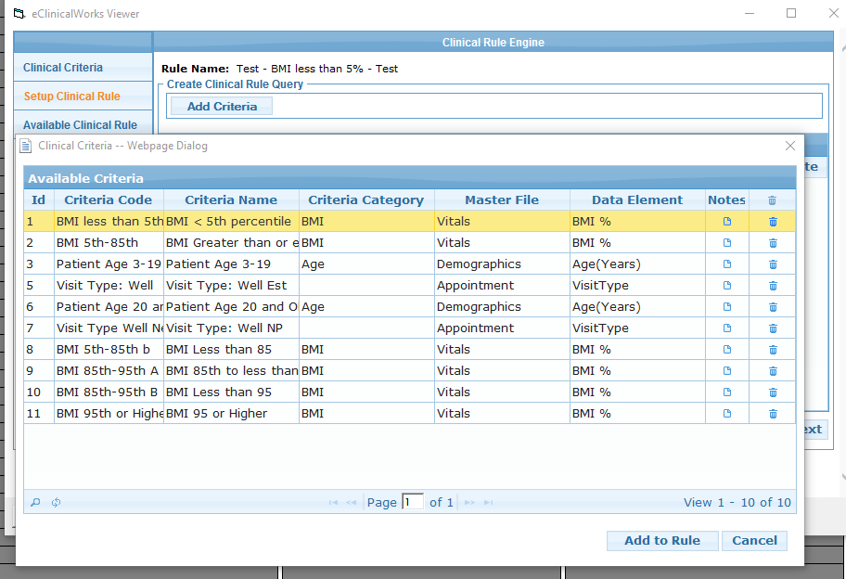
Clinical Rule Engine – BMI < 5th Percentile
Notes:
Blank Rule Engine where you will Add Criteria that we built under “Clinical Criteria”

Slide 22
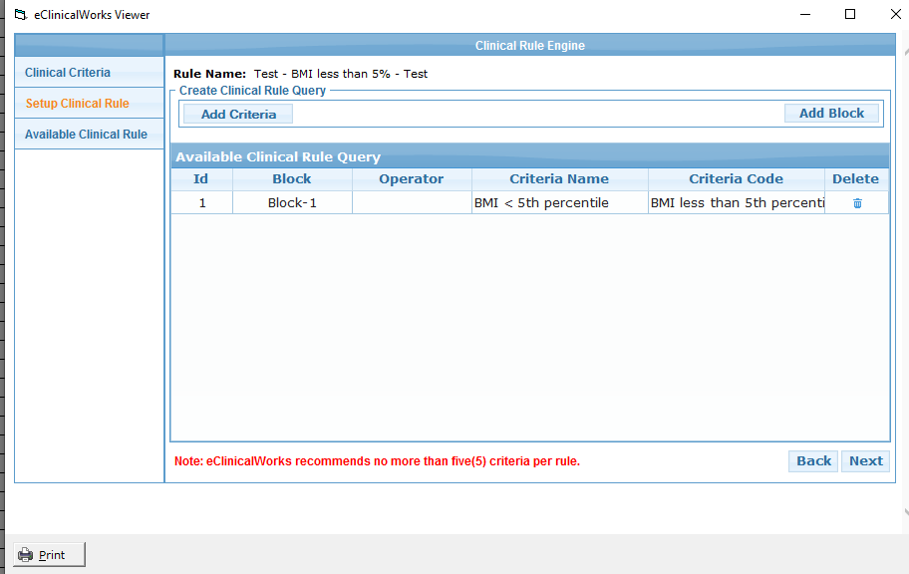
Clinical Rule Engine – BMI < 5th Percentile
Notes:
Now you can see we’ve added our first Criteria, and can add a second or Add a Block
We’re going to add a second Criteria for Age

Slide 23
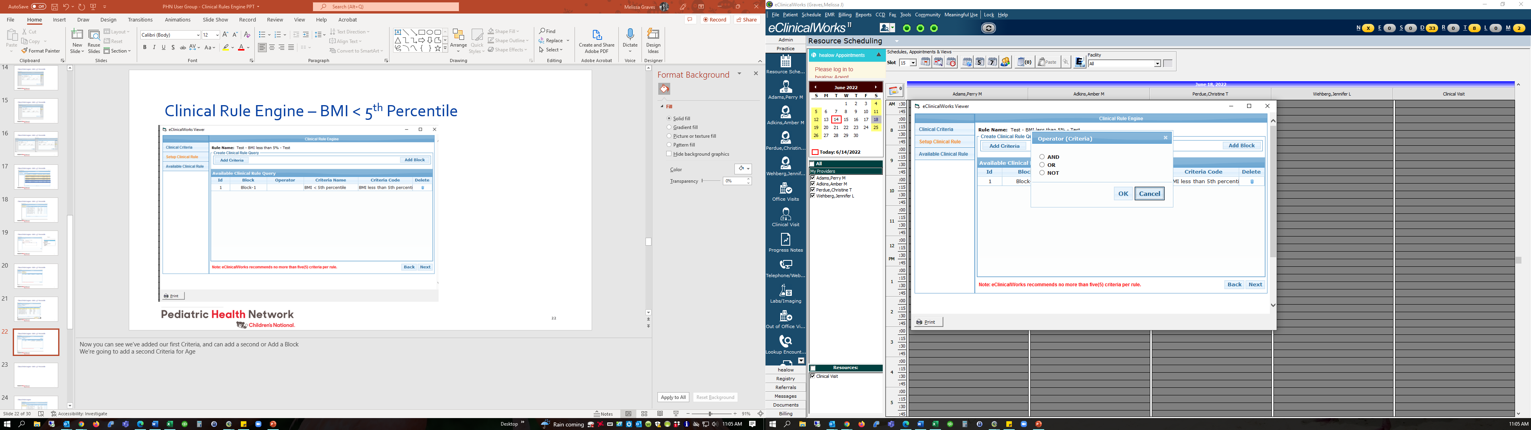
Clinical Rule Engine – BMI < 5th Percentile
Notes:
Clicked “Add Criteria” Choose your Patient Age and this Pop Up comes into view – Choose AND

Slide 24
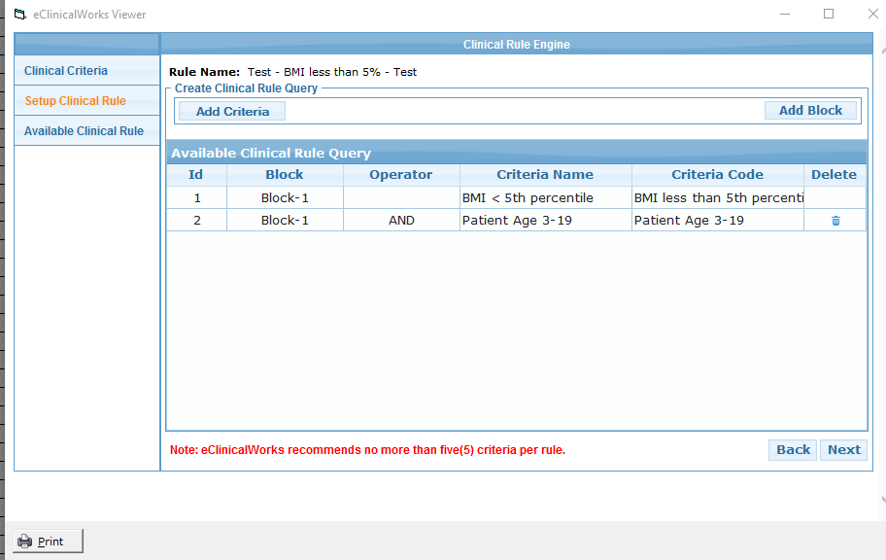
Clinical Rule Engine – BMI < 5th Percentile
Notes:
Shows our 2 Criteria Added.
Because we’re switching to Visit Type, I click Add Block which brings up the Operator Selection Box

Slide 25
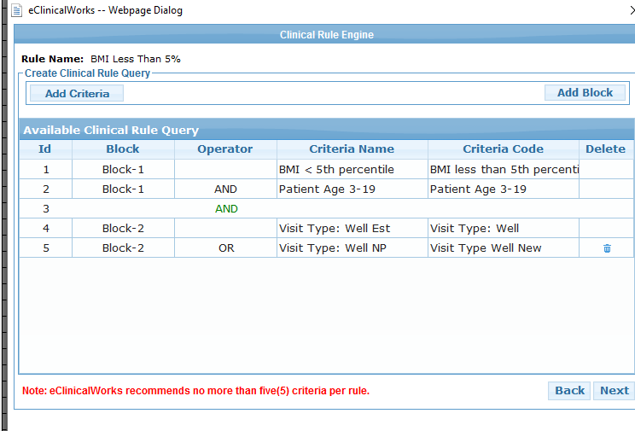
Clinical Rule Engine – BMI < 5th Percentile
Notes:
Then chose our first visit type “Well Est” and then added another Criteria for our second Visit Type with an “Or” Operator.
Hit Next

Slide 26

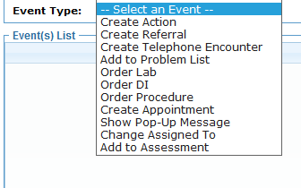
Clinical Rule Engine – BMI < 5th Percentile
Notes:
On this screen you are going to choose and Event Type to occur once your rule is running.
Choose the last one – Add to Assessment

Slide 27
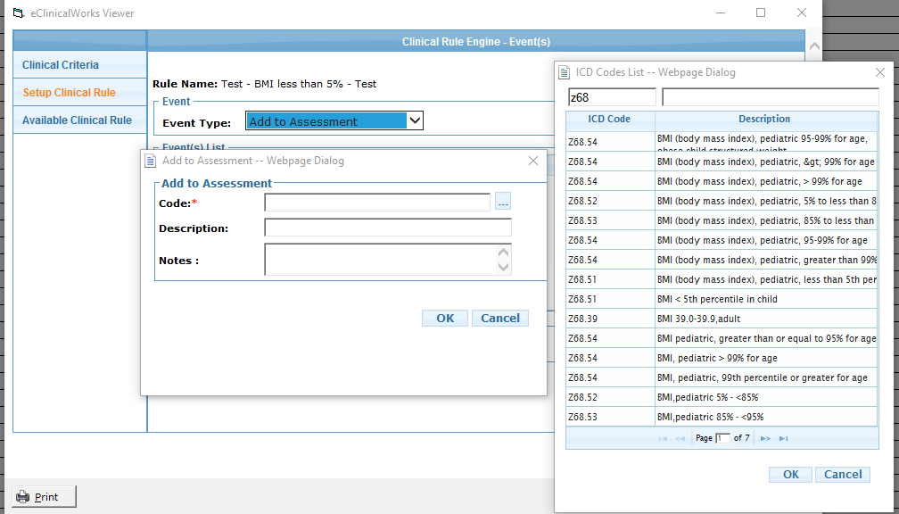
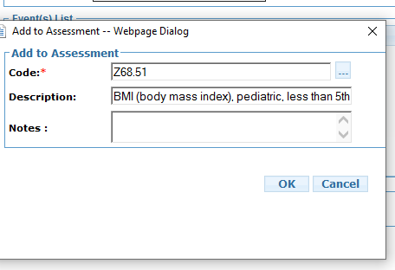
Clinical Rule Engine – BMI < 5th Percentile
Notes:
What are we adding to the assessment? The BMI Z-Code. So Choose your Z68.51 (BMI, Less than 5th percentile)

Slide 28
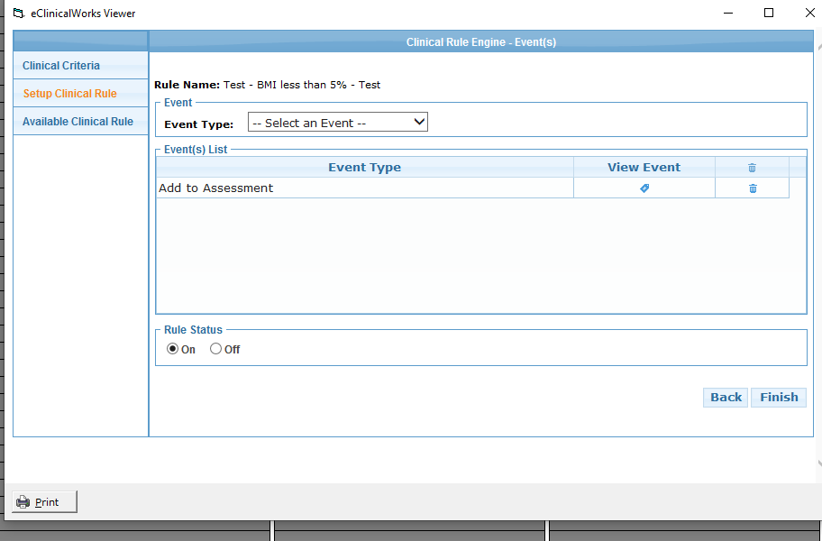
Clinical Rule Engine – BMI < 5th Percentile
Notes:
Make sure rule status is on if you want it to run right away or Off if you want to wait until you have a chance to test it one evening or over a lunch break because once it is on, it will affect all visit types selected.
Hit Finish.

Slide 29
Clinical Rule Engine – Pros & Cons
How does it work in a live environment?
Automation = less errors and saves time
Extra Clicks

Slide 30
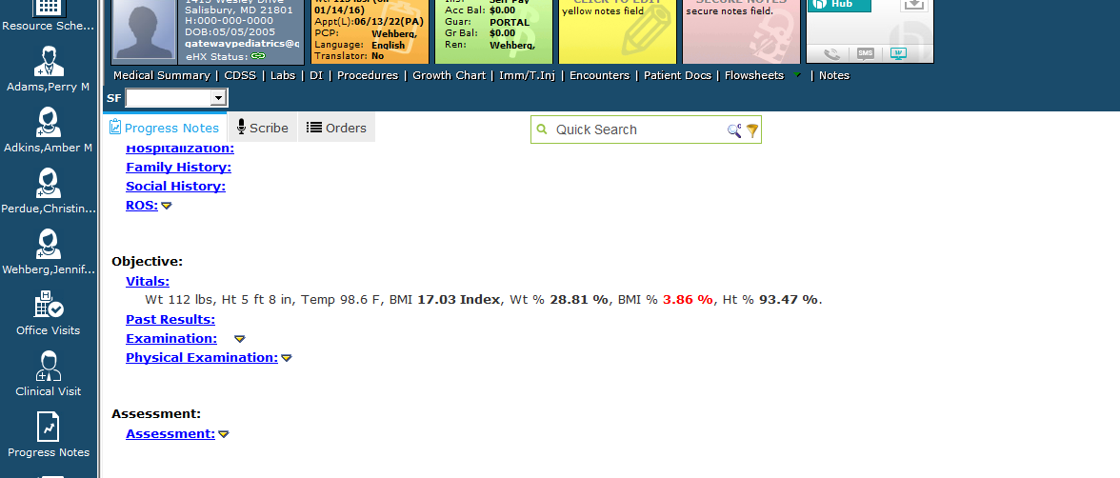
Clinical Rule Engine – BMI < 5th Percentile
Notes:
You can see on our test patient with the vitals of 3.86 percentile BMI. Provider can add their template and finish their note.
NOTHING happens until your provider hits Done in the Billing Screen
The rule does not show until the provider clicks DONE.

Slide 31
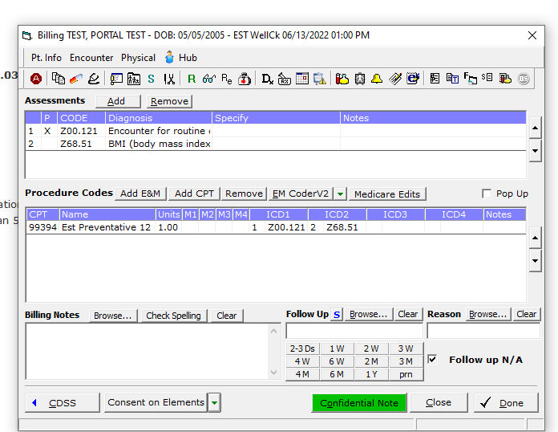
Clinical Rule Engine – BMI < 5th Percentile
Notes:
You can see on our test patient with the vitals of 3.86 percentile BMI. Provider can add their template and finish their note.
NOTHING happens until your provider hits Done in the Billing Screen

Slide 32
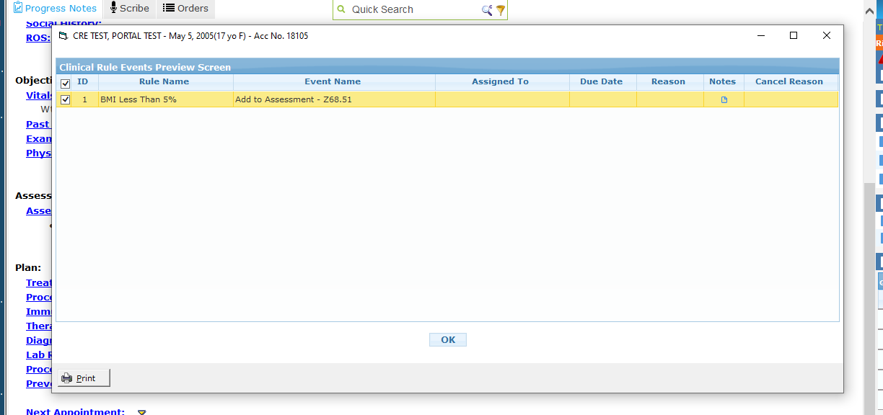
Clinical Rule Engine – BMI < 5th Percentile
Notes:
Once they click DONE this Pop Up will show. They need to click OK

Slide 33
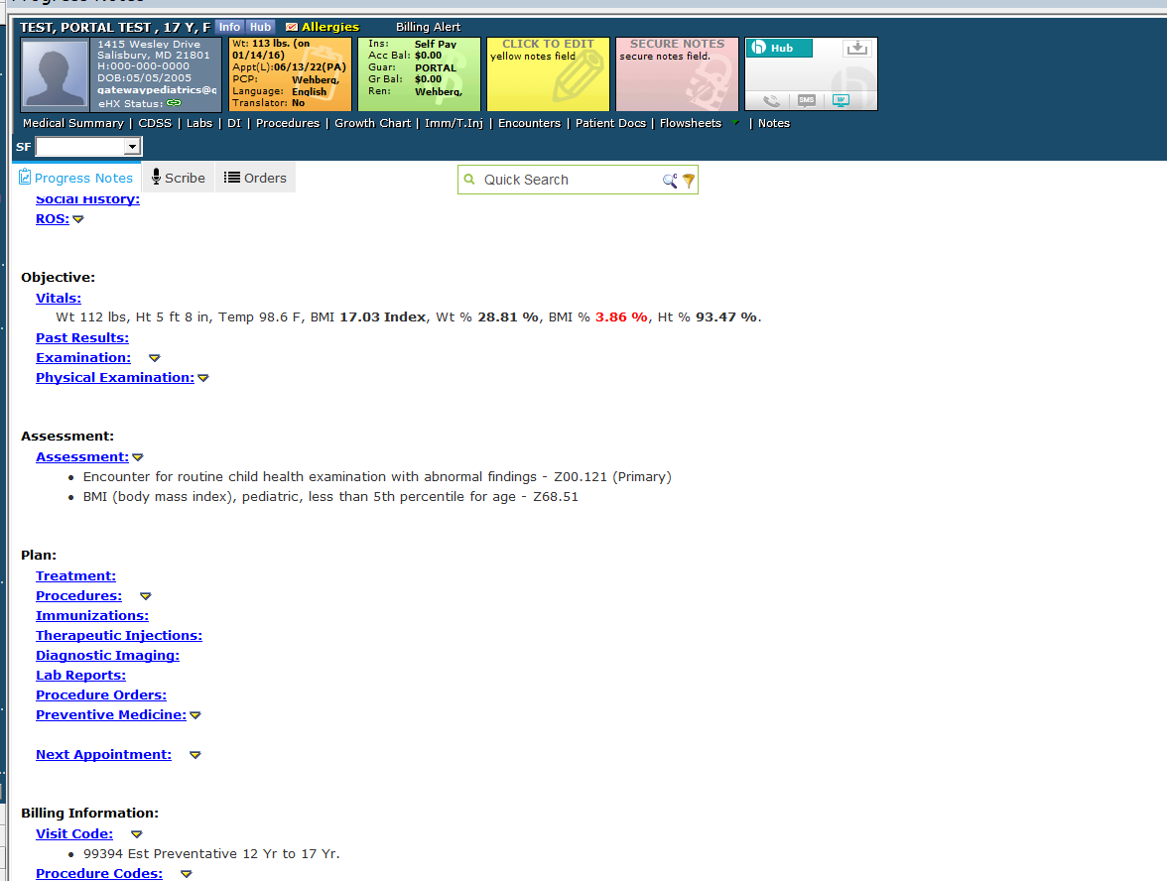
Clinical Rule Engine – BMI < 5th Percentile
Notes:
This will populate the BMI under the assessment.

Slide 34
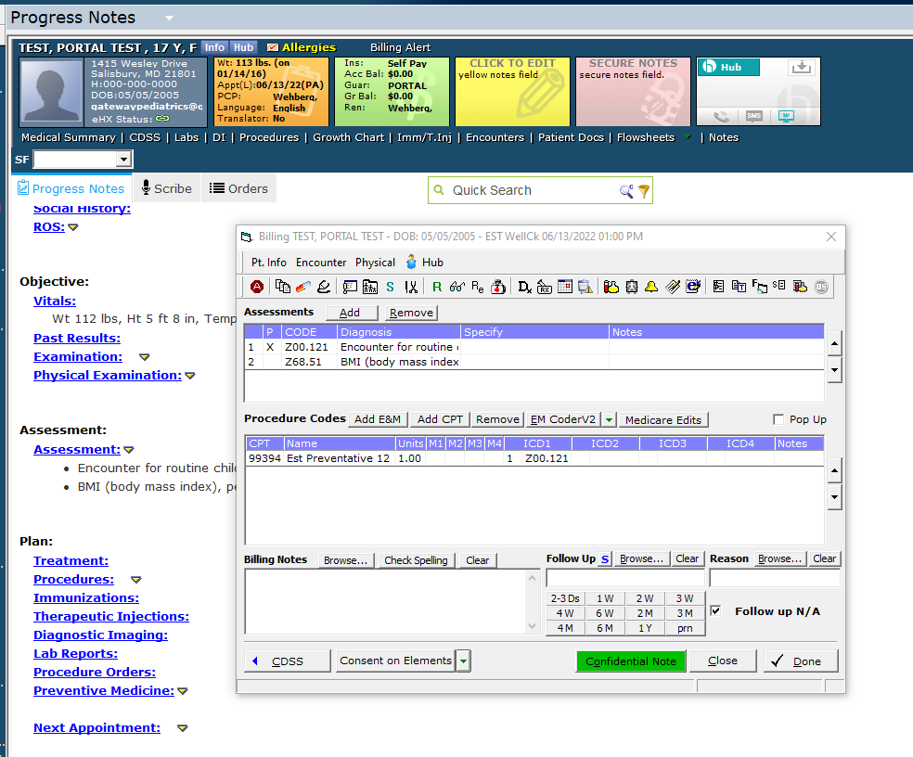
Clinical Rule Engine – LIMITATIONS
Does not assign the BMI Z-Code to the E&M Code.
Either the clinician or staff will need to come back into the Billing Screen and add it or have your coders assign it during claim scrubbing.
Notes:
It DOES NOT assign the BMI to your WCC Code.

Slide 35
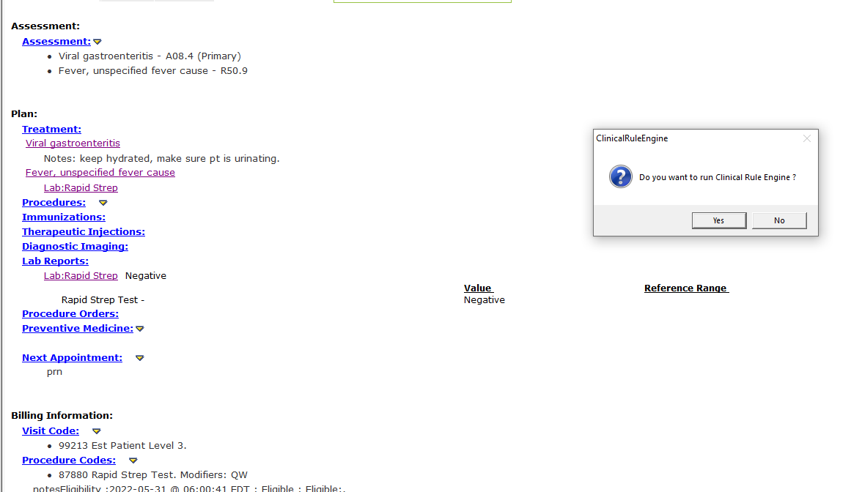

Clinical Rule Engine – LIMITATIONS
No matter your Visit Type Setup in the Clinical Rule Engine, locking ANY note will generate this pop-up:
“Do you want to run the Clinical Rule Engine?”
Notes:
You can see this was a sick office visit. Provider hit “Lock” and this will pop up. Doesn’t matter if you hit yes or no, b/c there’s no Clinical Rule assigned to this visit type, it doesn’t do anything and will immediately bring up the box for locking the note.

Slide 36
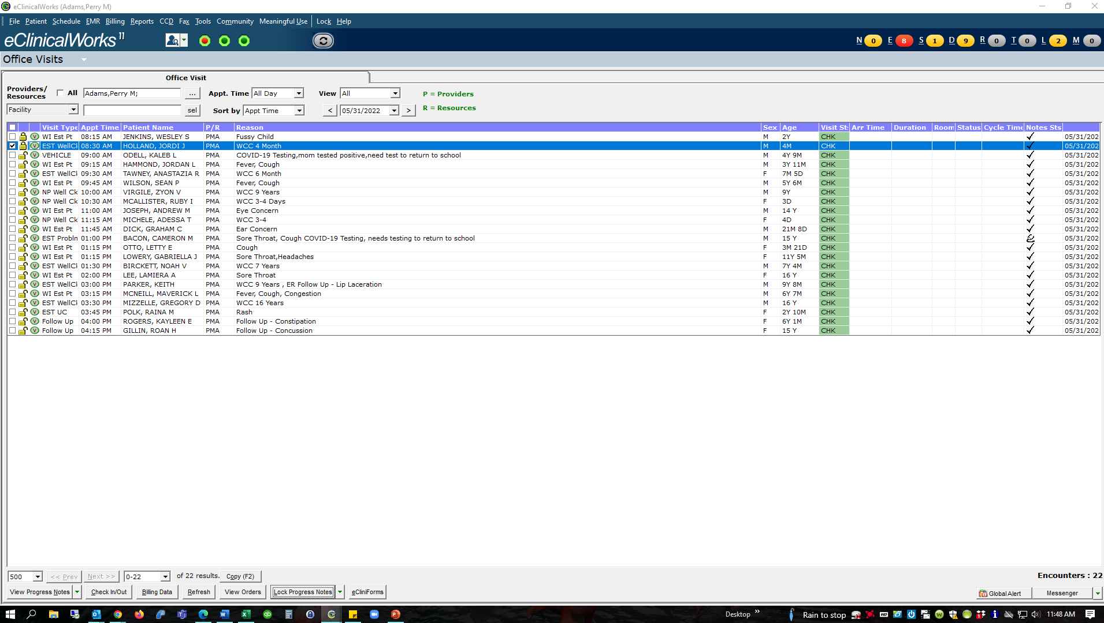
Clinical Rule Engine – LIMITATIONS
Locking from this screen will not generate the Clinical Rule Engine Pop-up
Notes:
Alternately, if you finish your day and want to lock all of your notes at once, the CRE will not run.
That’s really it. The next 3 slides are template for the other BMI Clinical Rules we’ve created. We have yet to tackle the adult BMI codes b/c there are so many and they aren’t percentiles, but the same steps apply.

Slide 37
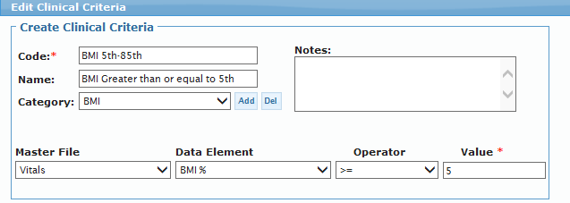
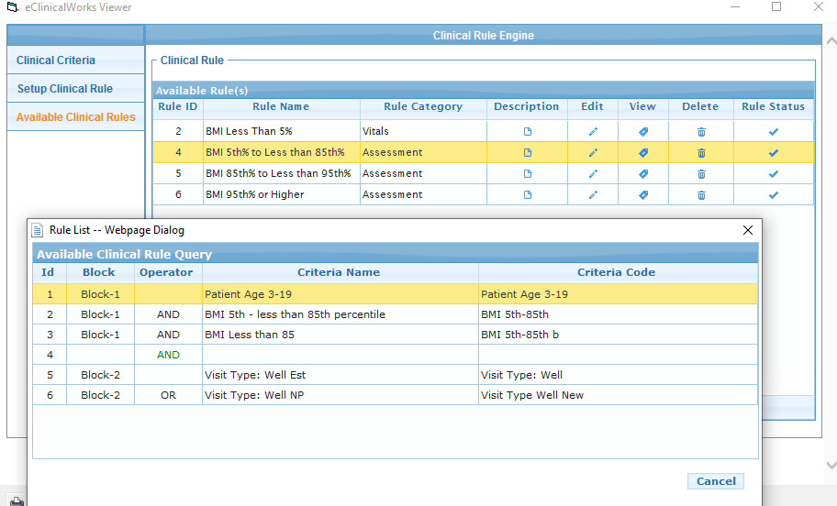
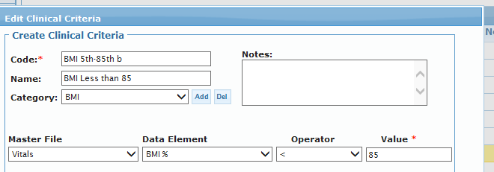
Clinical Rule Engine – Other Rules
BMI 5th to Less than 85th
Notes:
Another example of BMI 5th to Less than 85th

Slide 38
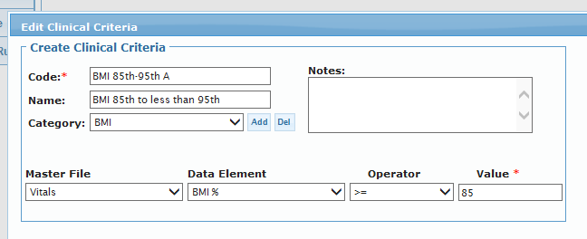
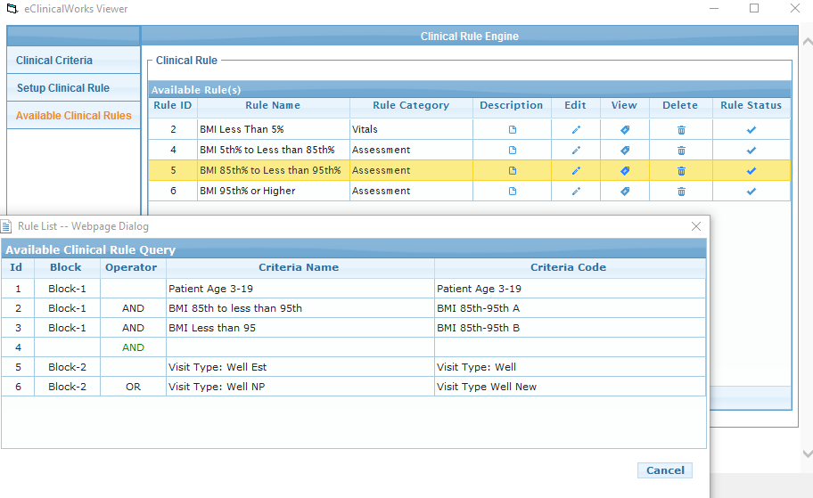

Clinical Rule Engine – Other Rules
BMI 85th to Less than 95th
Notes:
Another example of BMI 85th to 95th

Slide 39
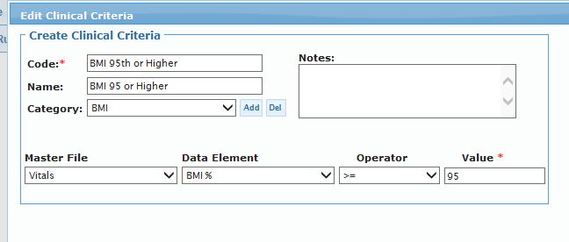
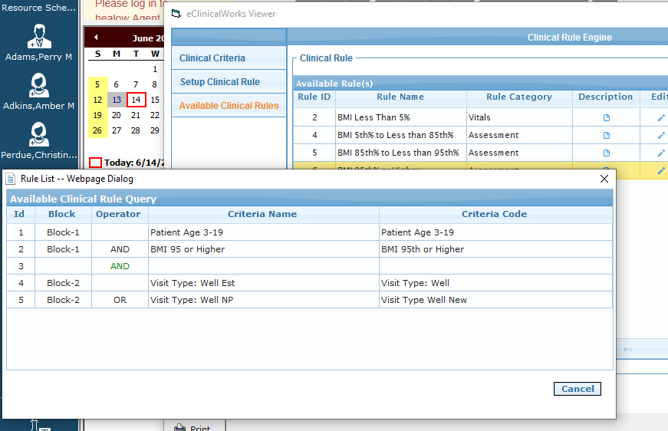
Clinical Rule Engine – Other Rules
BMI 95th or Higher
Notes:
Another example of BMI greater than 95th
That’s it! If you start playing around with the Clinical Rule Engine and find other good uses for it, please let the PHN know or shoot me an email.

Slide 40
Thank you!
If you have questions or find other uses for the
Clinical Rule Engine, please email me:
Melissa Graves gatewayadmin@gatewaypediatrics.com
Notes:
It looks like the Clinical Rules Engine has a lot more to it than just BMI coding. However, there are zero documents on eCW’s helpdesk or university websites (it’s like a super secret feature) so we’re doing this on our own. If you find any other automation uses for the Clinical Rules Engine, please let me or the PHN know!

Slide 41
.exe vs. web based
Dhruv Bhasin
Business Development
eCW

Slide 42
Save the date!
The next PHN User Group will be Thursday July 21th @ 12
Reminders?

Slide 43
Thank you for your participation!
To find this webinar recording and more information, visit our website: http://pediatrichealthnetwork.org
Email us at: phnservices@childrensnational.org

Slide 44
Questions & Open Forum

