Slide 1


25TH ANNUAL
JANUARY 12, 2023

Slide 2


Network News & Community Updates

Slide 3

Community & Network News…
AAP Local Chapter Updates
Training the Next Generation of Pediatricians
Children’s National Behavioral Health Initiative
Pediatric Health Network
BUSINESS OF PEDIATRICS

Slide 4

Training the next generation of pediatricians

Slide 5

Become a Medical Student Preceptor Site!
For 3rd year GW pediatric clerkship students
WHY?
Faculty Appointment at GW School of Medicine and Health Sciences
Teaching CME
Access to GW’s Center of Faculty Excellence: resources for teaching
Board Review Discount
*NEW*Financial Compensation: $200/student/week
Shape the future of our profession by teaching our next generation of physicians!

Slide 6
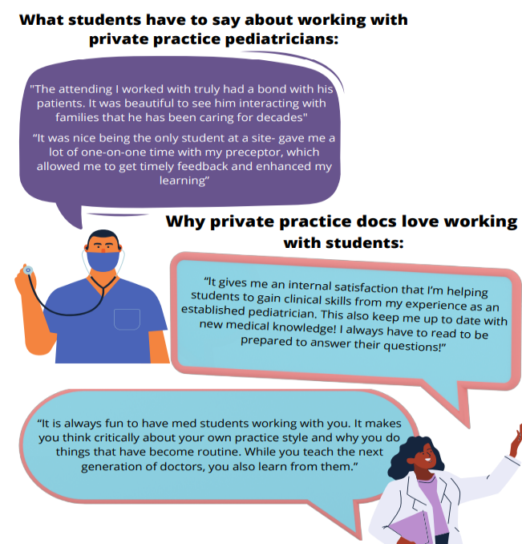
Testimonials

Slide 7
Become a Medical Student Preceptor Site!
For 3rd year GW pediatric clerkship students
For more information:
Craig DeWolfe, MD Med: Director Pediatric Med Stud Education cdewolfe@childrensnational.org
Ariella Slovin, MD Associate Pediatric Clerkship Director for GW aslovin@childrensnational.org
Wilhelmina Bradford: Program Coordinator Children’s Medical Student Education wcbradfo@childrensnational.org
Shape the future of our profession by teaching our next generation of physicians!

Slide 8


Adolescent Medical Specialty Services
(12 - 21 years)
Eating Disorders
Female and Male Reproductive Health
Gender Health (LGBTQ+ medical care)
Monday - Friday with telemedicine options available
Children’s National Shepherd Park
7125 13th Place NW, Washington, DC 20012
202-545-2900
Children’s National Shaw Metro
641 S Street NW, Washington, DC 20001
202-476-2123
Children’s National Friendship Heights
5028 Wisconsin Ave NW, Washington, DC 20016
202-895-3896

Slide 9

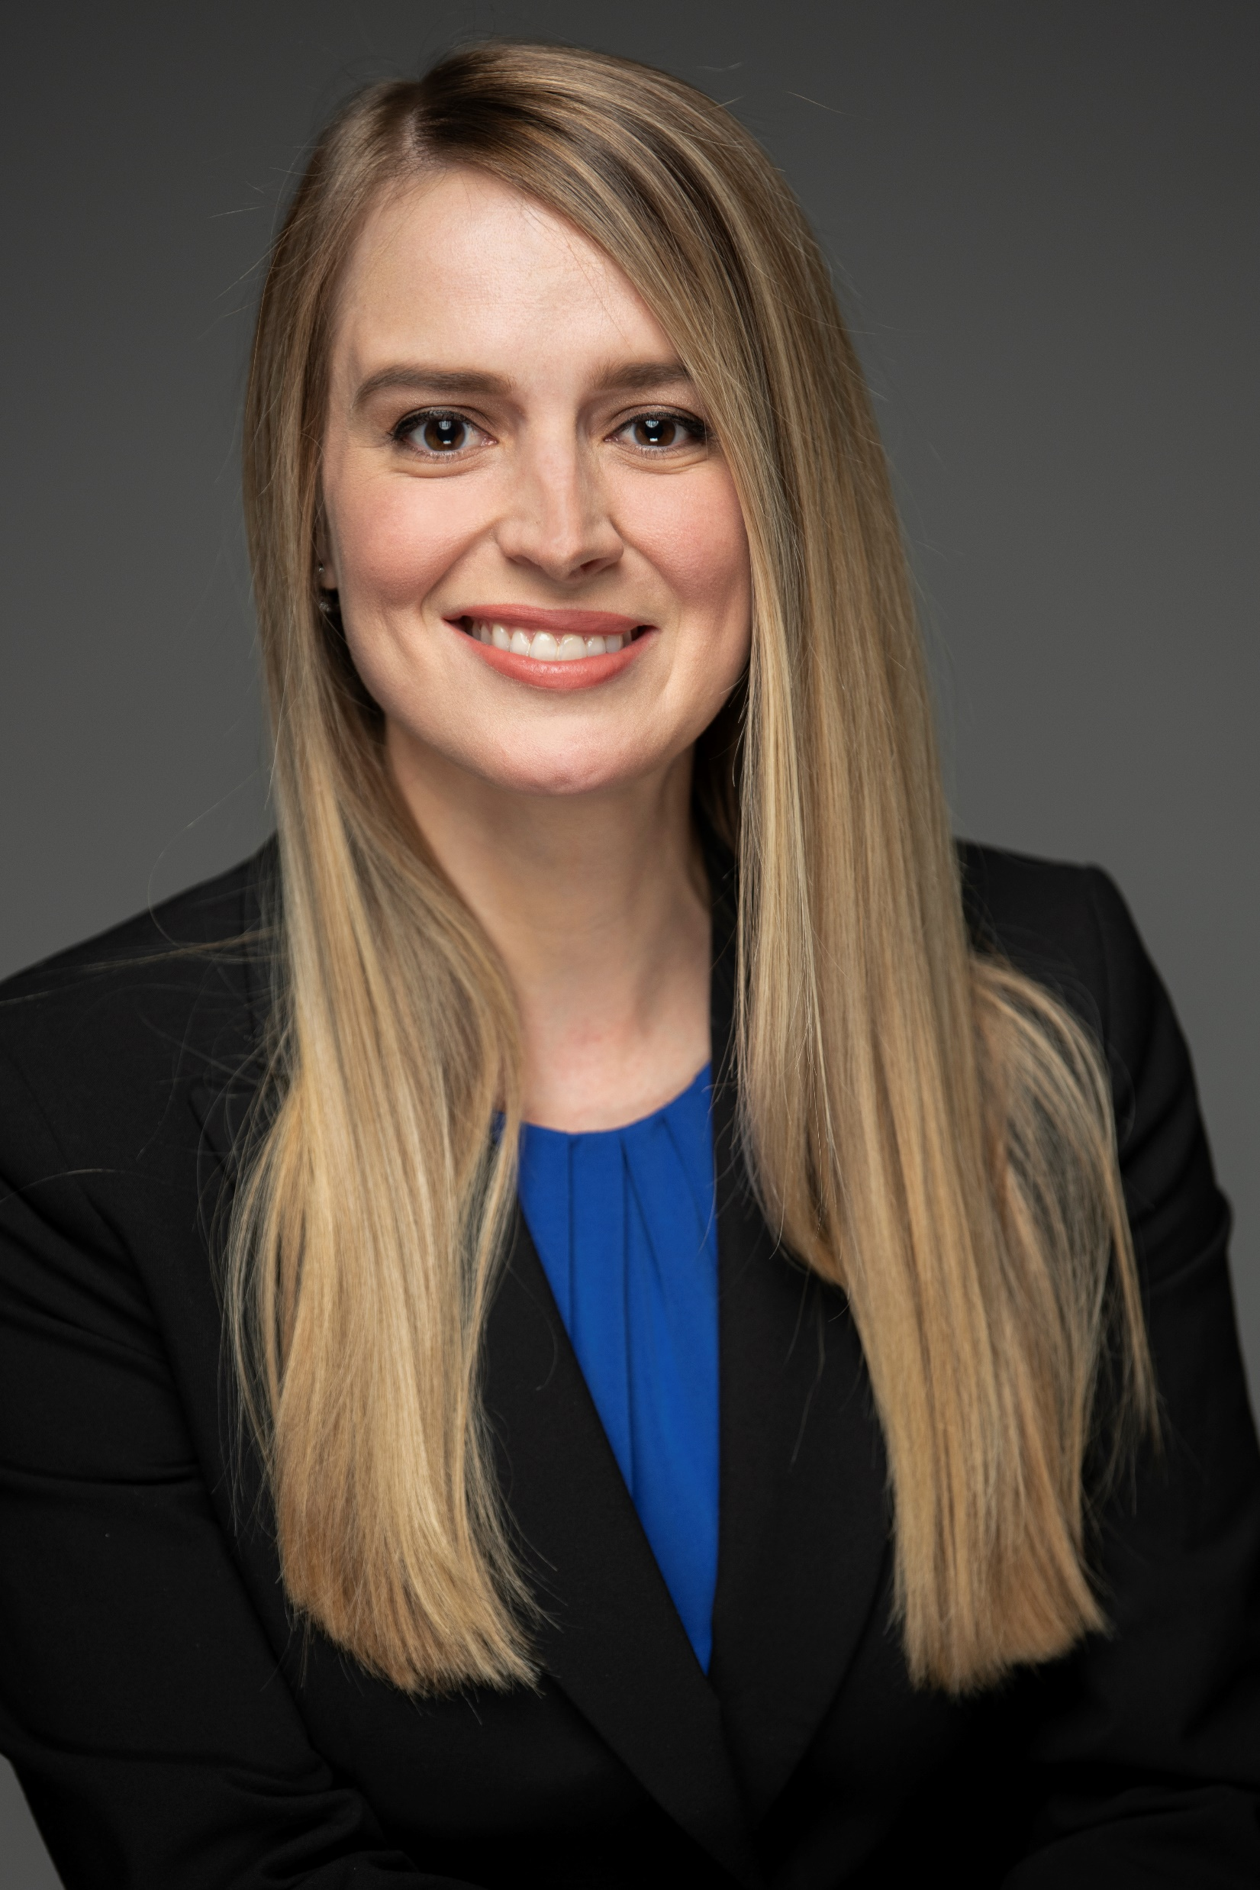
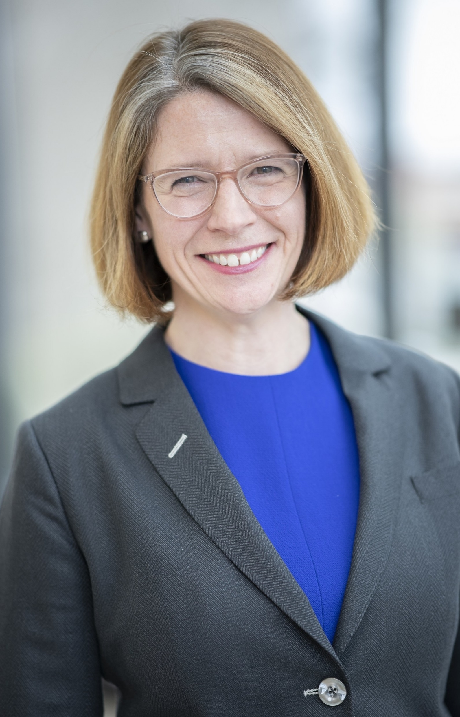
Children’s National
Behavioral Health Initiative
Olivia Soutullo, PhD | Lee Beers, MD, FAAP

Slide 10

Next steps
Develop a comprehensive strategy to address mental and behavioral health needs in our practice network, recognizing there is not a one-size-fits-all solution

Slide 11
Our Approach
Integrated, not siloed
Leverage expertise
Measure impact
Sustainable solutions

Slide 12
Our Priority Areas
Education & Training
Integrated Business Models
Care Management

Slide 13
Our Strategies
Conduct internal and external environmental scans, needs assessment of PHN practices
Develop practice education and support tools
Propose innovative care, education, and business models

Slide 14
Progress to Date: 2022
J. Willard and Alice S. Marriott Foundation gift to Children’s National to support the Behavioral Health Initiative
Currently developing an interdisciplinary, collaborative team from the Pediatric Health Network and Children’s National Hospital with key staff identified to lead initiative
Children’s National is invested in mental and behavioral health and is committed to this work in the years to come
Questions? Email phn@childrensnational.org

Slide 15
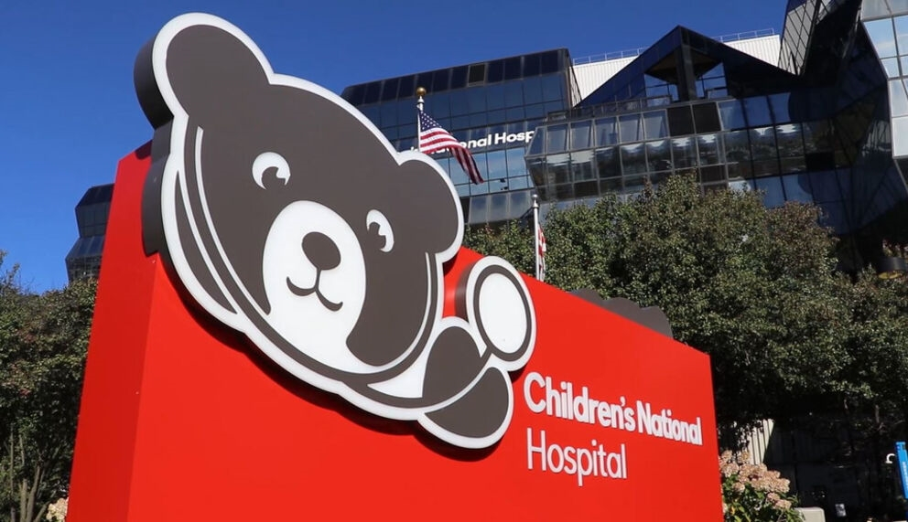
Updates from Children’s National

Slide 16
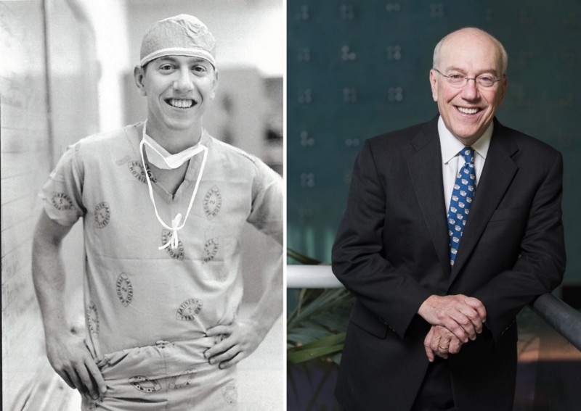
Congratulations & Thank You!
Kurt Newman, MD, President & CEO, Children’s National will be retiring
New CEO search underway
BUSINESS OF PEDIATRICS

Slide 17
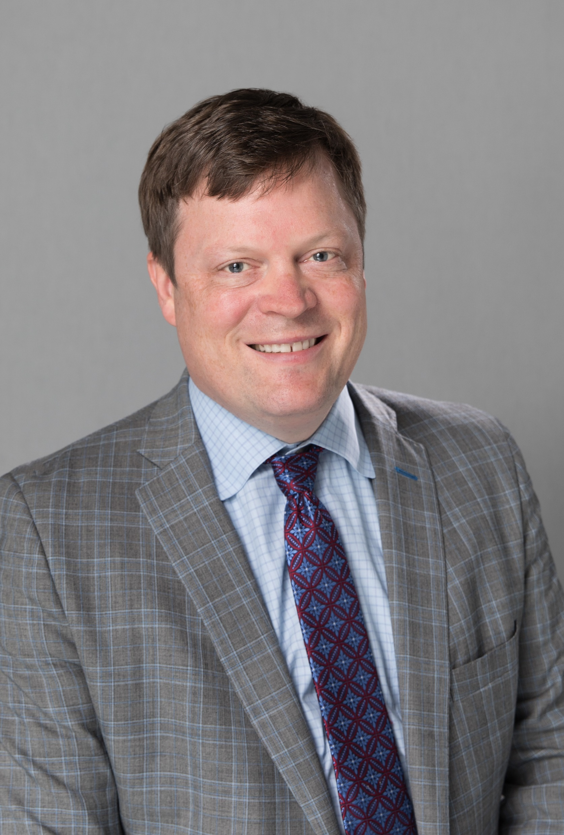
Children’s National launches new center for Community & Population Health
Pediatric Health Network
Goldberg Center for Community Pediatric Health
  General Pediatrics
  Adolescent & Young Adult Medicine
  Child & Adolescent Protection
  Pediatric Dentistry
Children’s National Pediatricians & Associates (Primary Care Practice Group)
Children’s School Services (DC)
Health Services for Children with Special Needs, Inc. (HSCSN) (MCO)
HSC Home Care and Health and Residential Services
Nathaniel Beers, MD, MPA, FAAP
Executive VP, Community & Population Health

Slide 18
25th
ANNIVERSARY
Please join us in celebrating!

Slide 19
25 years helping pediatric practices succeed
Coding for Pediatric Practice Success
Will the Internet Change Healthcare?
Pediatric EMR Challenge(s)
Practice Management Benchmarking
Improving Patient Engagement
Social Media & Pediatric Practices
Vaccine Attacks
Triple/Quadruple Aim
Patient Centered Medical Home
After Hours Urgent Care in Pediatrics
Medical Home Payment Models (good & bad)
Understanding & Succeeding in Value Based Care
Clinically Integrated Networks (CIN) & Pediatrics

Slide 20

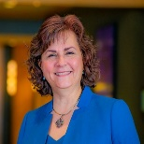
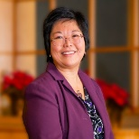

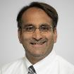
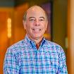
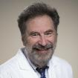
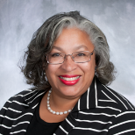
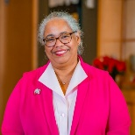
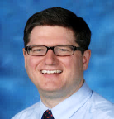
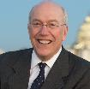
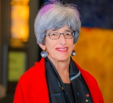
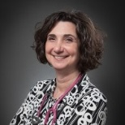

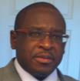
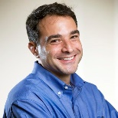
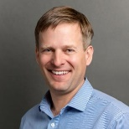

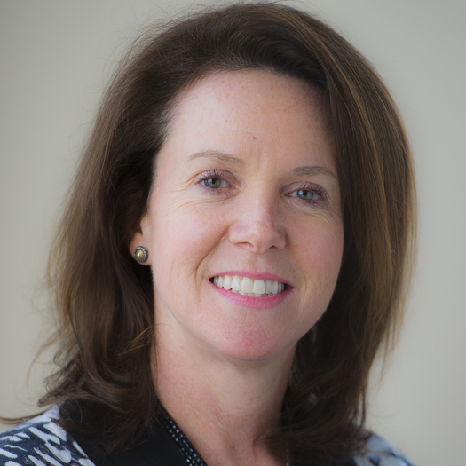
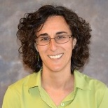
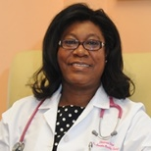
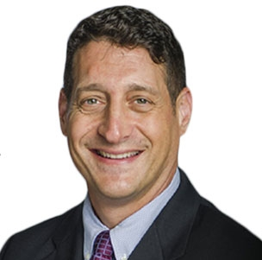

Board of Directors
Community Physicians
Betsy Watts, MD Capital Area Pediatrics Board Chair | Sandy Chung, MD Fairfax Pediatrics
Dianna Abney, MD Cambridge Pediatrics | Jeannine Clark, MD Clark & Pettus-Bellamy Pediatrics
Leah Brasch, MD Friendship Pediatrics | Cynthia Fishman, MD Children First Pediatrics
Michael Caplan, MD ALL Pediatrics | Michael Hopper, MD Pediatric Associates of Alexandria
Susan Chaitovitz, MD The Pediatric Center of Frederick | Annette Satuyi, MD Children’s First LLC
CNH Physicians
Kathleen Kadow, MD Children’s National / Holy Cross Hospital
Ian Leibowitz, MD Children’s National/PSV
Ben Martin, MD Children’s National/PSV
Asha Payne, MD Children’s National
Cara Biddle, MD Children’s National
Marc DiFazio, MD Children’s National
CNH Admin
Rahul Shah, MD Children’s National
Mark Weissman, MD Children’s National
Kurt Newman, MD CEO Children’s National
Aldwin Lindsay Children’s National Treasurer, Non-Director
Mary Anne Hilliard Children’s National Secretary, Non-Director
Nathaniel Beers, MD Children’s National Acct Executive, Non-Director

Slide 21
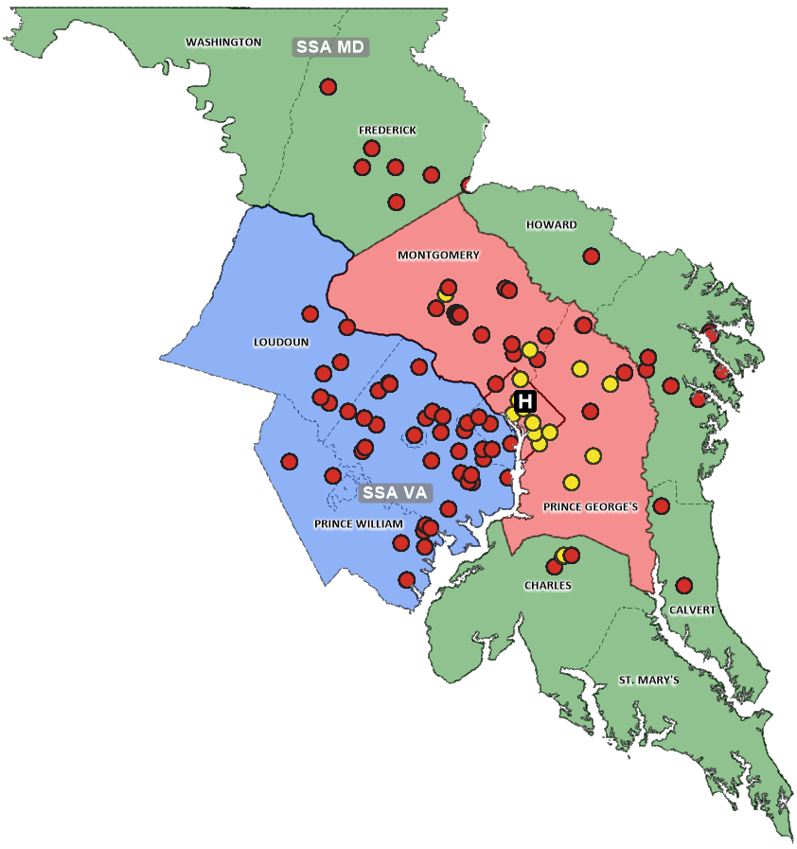
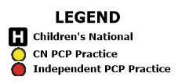
Our region’s largest PEDIATRIC network
Primary Care Physicians
Total Membership
1,555
555
53
Primary Care
Practices
124
Total Network
Locations
Children’s
555
Primary Care
Physicians
1,000+
Specialty Care
Physicians *
Community
Legend
Children’s National Hospital
CN PCP Practice
Independent PCP Practice
*Includes all CN credentialed providers (Attending, Advanced Practice, Allied Doctoral Clinicians) and Pediatric Specialists of Virginia

Slide 22
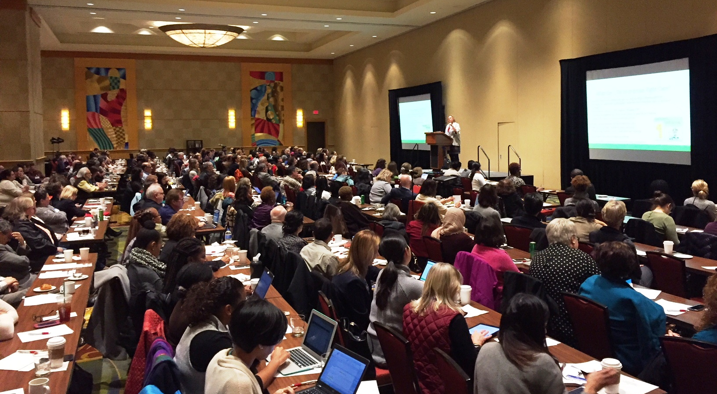
The key to our shared success is YOU!
Thank you for your participation & support over 25 years!

