Slide 1
25TH ANNUAL
JANUARY 12, 2023

Slide 2
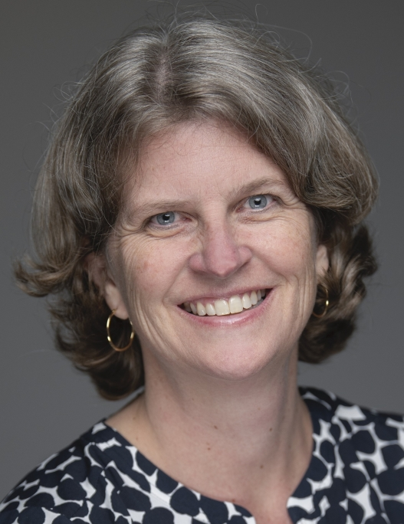
Coding for COVID Care & Immunizations
Cara Biddle, MD
Interim Division Chief, General Pediatrics and Community Health, Children’s National

Slide 3
COVID-19 Vaccine Coding & Practice Management
January 12, 2023

Slide 4
Learning Objectives
Review current COVID-19 vaccine administration and coding guidelines
Discuss current challenges with COVID-19 vaccine administration in our medical homes
Anticipate and prepare for future challenges with COVID-19 vaccine administration

Slide 5
Setting the Stage … What’s in the Fridge at Your Practice?
None of the Above?

Slide 6
Current COVID-19 Vaccine Guidelines
Source:
COVID19-vaccination-schedule-most-people.png (2000×2323) (cdc.gov)

Slide 7
COVID-19 Vaccine Guidelines for People with Moderate to Severe Immunosuppression
Source:
COVID19-vaccination-schedule-immunocompromised.png (2000×2323) (cdc.gov)

Slide 8
Coding for COVID-19 Vaccine: Pfizer-BioNTech
Age Group | Dose # | Vaccine Code | Vaccine Admin Code | Formulation | Vaccine Name
6 mos – 4 yrs | Dose 1 | 91308 | 0081A | tris-sucrose | Pfizer-BioNTech COVID-19 Vaccine
 | Dose 2 | 91308 | 0082A | tris-sucrose | Pfizer-BioNTech COVID-19 Vaccine
 | Bivalent Dose 3 | 91317 | 0173A | tris-sucrose | Pfizer-BioNTech COVID-19 Bivalent
5 yrs – 11 yrs | Dose1 | 91307 | 0071A | tris-sucrose | Pfizer-BioNTech COVID-19 Vaccine
 | Dose 2 | 91307 | 0072A | tris-sucrose | Pfizer-BioNTech COVID-19 Vaccine
 | Dose 3* | 91317 | 0073A | tris-sucrose | Pfizer-BioNTech COVID-19 Vaccine
 | Bivalent Booster | 91315 | 0154A | tris-sucrose | Pfizer-BioNTech COVID-19 Bivalent
12+ years | Dose 1 | 91305 | 0051A | tris-sucrose | Pfizer-BioNTech COVID-19 Vaccine
 | Dose 2 | 91305 | 0052A | tris-sucrose | Pfizer-BioNTech COVID-19 Vaccine
 | Dose 3* | 91305 | 0053A | tris-sucrose | Pfizer-BioNTech COVID-19 Vaccine
 | Bivalent Booster | 91312 | 0124A | tris-sucrose | Pfizer-BioNTech COVID-19 Bivalent
* Individuals with moderate to severe immunosuppression only
Source: https://www.ama-assn.org/find-covid-19-vaccine-codes#

Slide 9
Coding for COVID-19 Vaccine: Moderna
Age Group | Dose # | Vaccine Code | Vaccine Admin Code | Vaccine Name
6 mos – 5 yrs | Dose 1 | 91311 | 0111A | Moderna COVID-19 Vaccine
 | Dose 2 | 91311 | 0112A | Moderna COVID-19 Vaccine
 | Dose 3* | 91311 | 0113A | Moderna COVID-19 Vaccine
 | Bivalent Booster | 91316 | 0164A | Moderna COVID-19 Vaccine, Bivalent
6 yrs – 11 yrs | Dose1 | 91309 | 0091A | Moderna COVID-19 Vaccine
 | Dose 2 | 91309 | 0092A | Moderna COVID-19 Vaccine
 | Dose 3* | 91309 | 0093A | Moderna COVID-19 Vaccine
 | Bivalent Booster | 91314 | 0144A | Moderna COVID-19 Vaccine, Bivalent
12+ years | Dose 1 | 91301 | 0011A | Moderna COVID-19 Vaccine/spikevax
 | Dose 2 | 91301 | 0012A | Moderna COVID-19 Vaccine/spikevax
 | Dose 3* | 91301 | 0013A | Moderna COVID-19 Vaccine/spikevax
 | Bivalent Booster | 91313 | 0134A | Moderna COVID-19 Vaccine, Bivalent
* Individuals with moderate to severe immunosuppression only
Source: https://www.ama-assn.org/find-covid-19-vaccine-codes#

Slide 10
Coding for COVID-19 Vaccine: Novavax
Age Group | Dose # | Vaccine Code | Vaccine Admin Code | Vaccine Name
12+ years | Dose 1 | 91304 | 0041A | Novavax COVID-19 Vaccine
 | Dose 2 | 91304 | 0042A | Novavax COVID-19 Vaccine
Source: https://www.ama-assn.org/find-covid-19-vaccine-codes#

Slide 11
COVID-19 Vaccine Administration in our
Medical Homes
Today’s Challenges

Slide 12
Challenges to Come: Commercialization, Cost
Source: https://www.kff.org/coronavirus-covid-19/issue-brief/how-much-could-covid-19-vaccines-cost-the-u-s-after-commercialization/

