Slide 1
25TH ANNUAL
JANUARY 12, 2023

Slide 2
Value-Based Care in Pediatrics
Claire Boogaard, MD, MPH Medical Director, PHN
General Pediatrician, Children’s National Hospital
Dr. Eduardo Fox, MD
Medical Director, PHN
General Pediatrician, Children’s National Hospital
Mark Weissman, MD
Executive Medical Director, PHN
VP Goldberg Center for Comm. Pediatric Health, at CN

Slide 3
A brief but wonderful journey through value-based care
Business of Pediatrics/ January 2023
Claire Boogaard, MD, MPH; Eduardo Fox, MD; Mark Weissman, MD

Slide 4
Learning objectives
Establish some definitions around value-based care, quality improvement, and provider networks (making sense of the alphabet soup).
Describe the value-based care (VBC) model and its application to pediatrics.
Discuss how VBC affects your patients, your practice, and you.
Describe strategies for improving measure outcomes.
Create greater awareness regarding Pediatric Health Network's current VBC contract measures
Highlight select measures and provide best practices and coding strategies to improve performance

Slide 5
Big Idea
Applying a "value" lens can transform care for our patients and their communities.
And for the healthcare workforce, too.

Slide 6
Today’s Journey
How is VBC built into our health system?
How is value measured and captured?​
How can we improve?
What is value-based care (VBC)?
Does VBC care work?
What does this mean for you?​

Slide 7
Quality Alphabet Soup
PHN
PCMH
P4P
CIN
VBC
NCQA
FFS
IHI
ACO
APM
QI
HEDIS

Slide 8
Value
Satisfaction
Quality (outcomes)
Value
=
Cost
Quality

Slide 9
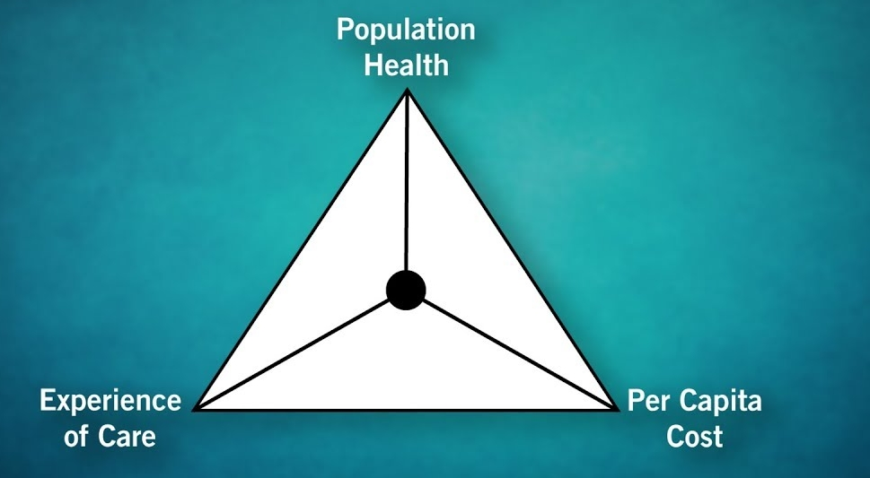
Triple/Quadruple/Quintuple Aim (IHI) A framework to optimize health system performance
Improving population health and clinical outcomes
Reducing costs
Improving patient experience
Improving provider experience
Advancing health equity

Slide 10
Reimbursement Models
Fee for Service
Value-based Care
Compensate for quality
Payments per member, shared savings
Focus on populations
Focus on data, quality measures
Incentivize collaboration
Compensate for quantity/volume
Charge for each service (set by payer)
Prioritizes the individual patient
Not dependent on outcomes
Provider/care silos
Quantity
Quality

Slide 11
How is VBC built into our health system?
How is value measured and captured?​
How can we improve?
What is value-based care (VBC)?
Does VBC care work?
What does this mean for you?​

Slide 12
Care Delivery Models (Value-based)
ACO
CIN
PCMH
Program/contract
Accountable care organizations (ACO)
Group of providers/hospitals join in a program/contract (shared risk/savings)
Coordinated, high-quality care
Joint responsibility for a defined group of patients
Organization Structure
Clinically integrated networks (CIN)
collaboration among different providers/sites to ensure high-quality, coordinated, efficient services for patients
Usually sponsored by a health system and led by physicians
Allows for joint contracting
Approach/Mission
Patient-Centered Medical Home (PCMH)
Comprehensive, high-quality primary care
Committed to QI and patient-centered approach
Focus on QI and partnerships among stakeholders
Improvement in quality, patient experience, staff satisfaction, and cost reduction

Slide 13
Pediatric Accountable Care Networks are Forming & Entering into Risk Across the Nation
PAY FOR
PERFORMANCE
(P4P)
SHARED SAVINGS
SHARED RISK
CAPITATION/ FULL RISK
PROVIDER SPONSORED
HEALTH PLAN
P4P/Shared Savings
Downside Risk Arrangements
Provider Sponsored
Health Plans

Slide 14
How is VBC built into our health system?
How is value measured and captured?​
How can we improve?
What is value-based care (VBC)?
Does VBC care work?
What does this mean for you?​

Slide 15
Does this work? Pediatric Accountable Care Can Impact Costs
Partners for Kids (Ohio)
Founded in 1994 | 300,000 Medicaid lives | Full risk & delegated medical management | Well published
Slower Growth in Medicaid Costs
Impact of Care Management Program
Pre-Enrollment
Post-Enrollment
Per Member Per Month $$$
Avg. Admissions / Patient Days
Between 2008 – 2013, PFK member monthly costs grew at $2.40 per year
Managed Care and Fee For Service costs grew at $6.47 and $16.15
Showed improvement in 3 of 4 network quality initiatives over same time period
Analysis of enrollees in PFK’s care management program between 2013-16
Compared utilization 12-months before enrollment to 12-months after
Weier, Gardner, Conkol, Pajer, & Kelleher. “Partners for Kids Care Coordination: Lessons From the Field.” Pediatrics 2017, 139, S109.
Kelleher, Cooper, Deans, Carr, Brilli, Allen, Gardner. “Cost Saving and Quality of Care in a Pediatric Accountable Care Organization.” Pediatrics 2015; 125;e582.

Slide 16
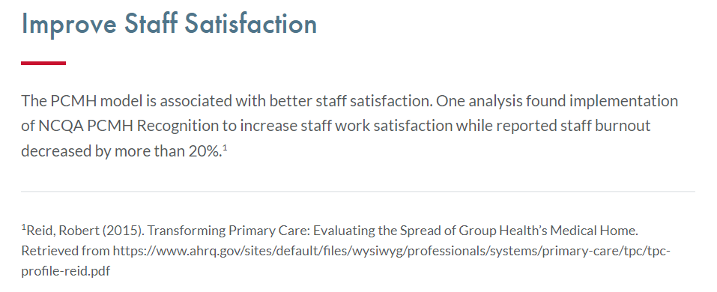
Evidence
Research shows that access to and utilization of a pediatric medical home is associated with the following:
Increased provision of preventive services for children, such as the following:
Increased likelihood of having anticipatory guidance provided⁹
Increased likelihood of being seen by a primary care clinician within the last year⁴
Increased rates of childhood immunizations^{10,11}
Increased rates of well-child visits¹⁰
Increased likelihood to have had height, weight, and blood pressure checked⁹
Decreased amount of outpatient sick visits¹⁴
Decreased rate of inappropriate use of antibiotics^{7,15}
Improved health outcomes and health status¹⁶
https://www.aap.org/en/practice-management/medical-home/medical-home-overview/why-is-medical-home-important/

Slide 17
How is value measured and captured?​
How is VBC built into our health system?
How can we improve?
What is value-based care (VBC)?
Does VBC care work?
What does this mean for you?​

Slide 18
Measuring performance and reporting quality
NCQA (National Committee for Quality Assurance)
Accredits payers (1990’s)
Accredits providers and practices (2008) – PCMH
Maintains HEDIS- validation, compliance audits, evidence-based
HEDIS (Healthcare Effectiveness Data and Information Set)
Metrics set by the NCQA (updated annually)
90 measures across 6 domains of care:
Effectiveness of Care
Access/availability of care
Experience of care
Adult and pediatric measures
Stratification by race and ethnicity for some measures (started 2022)
Social Determinants of Health (SDoH)
Utilization (incl. risk adjusted)
Health plan descriptive information
Measures reported using data systems

Slide 19
How do we capture what we are doing? Value-Based Care IT Infrastructure
Data sources
Clinical data from EHR systems
Claims data from payers
Data management platform
Integration with payor/provider partners
Data mining capabilities to help with modeling/reporting
Decision support capabilities at point of care
Expanded access to patient records across the continuum
Comparative data collection to determine gaps in care delivery process and outcomes (compare to peers)
Data support for focused outreach and care management

Slide 20
Pediatric Health Network
Data Flow
8/16/2022
External EMR Data Sources
eCW
PCC
Office Practicum
Athena
Cerner
PrognoCIS
Payer Data
Aetna
HSCSN
CareFirst
HSCSN
Arcadia
CareFirst
FIGmd
Population Health Management, Data Analytics, & Reporting
Salesforce
Provider Roster
Reporting
Patient Level Data
Outreach
Data to Payers
Care Management
Monitor Quality,
Cost, REL, & Utilization Performance
Gap in Care & Utilization Management
Text Messaging to Close Gaps
Supplemental EMR Data for Quality Measures
Risk Stratification
& Work Queues

Slide 21
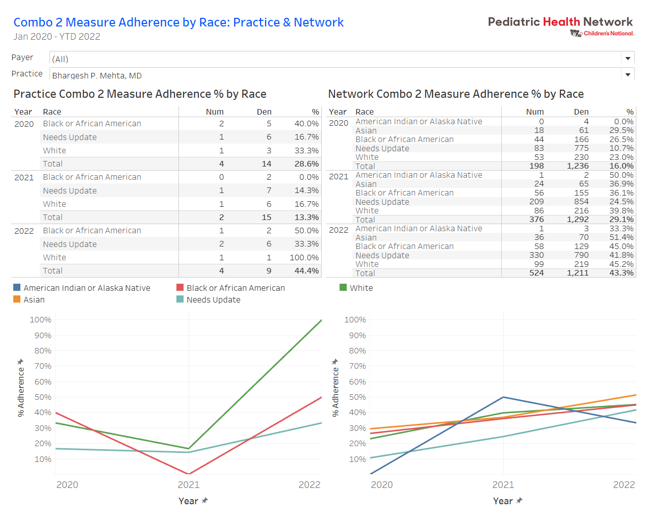

Slide 22
How is VBC built into our health system?
How is value measured and captured?​
How can we improve?
What is value-based care (VBC)?
Does VBC care work?
What does this mean for you?​

Slide 23
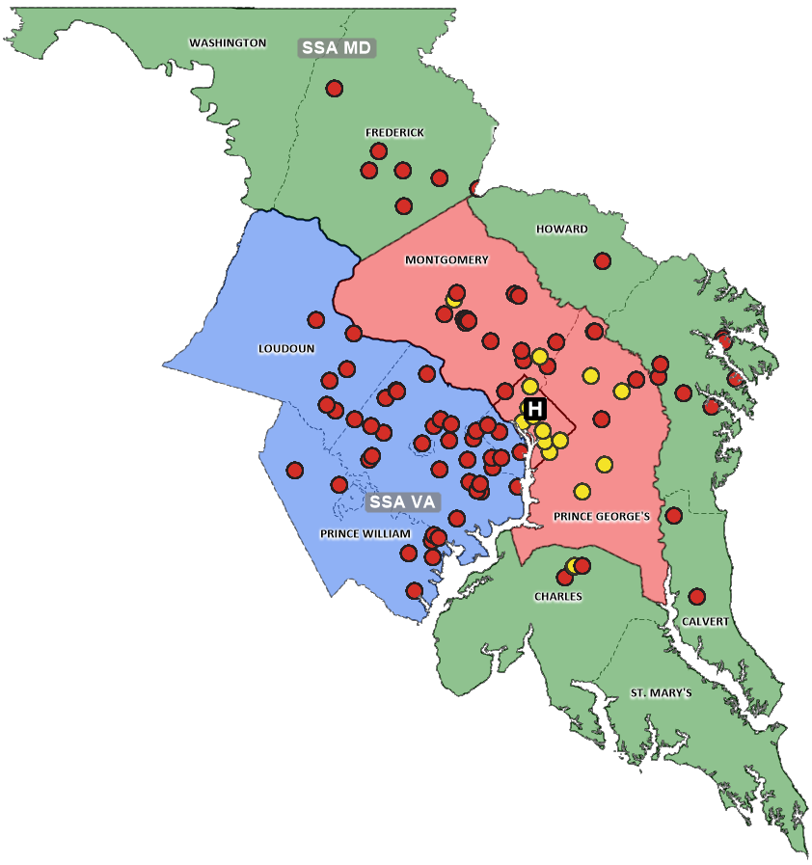
Clinically Integrated Networks: Helping Practice improve Quality Metrics in VBC contracts
Primary Care Physicians
Total Membership
1,555
555
53
Primary Care
Practices
124
Total Network
Locations
Children’s
555
Primary Care
Physicians
1,000+
Specialty Care
Physicians *
Community
Legend
Children’s National Hospital
CN PCP Practice
Independent PCP Practice
*Includes all CN credentialed providers (Attending, Advanced Practice, Allied Doctoral Clinicians) and Pediatric Specialists of Virginia

Slide 24
PHN Development over time
QI Projects
Acne | Concussion Constipation | Asthma School Absenteeism | Adolescent Care Behavioral Health | Depression screening REL, SDoH
CY2019
2020
2021
2022
2023
VBC Contracts
 | First Contract | Second Contract | Third Contract | Additional Contracts ++
HealthEIntent |  | Glasscubes | Arcadia platform: Aetna data eCW data | Arcadia platform: Payer Data Other EMRs Arcadia Outreach Salesforce
Data/ Resources
*As of Q2 2022

Slide 25
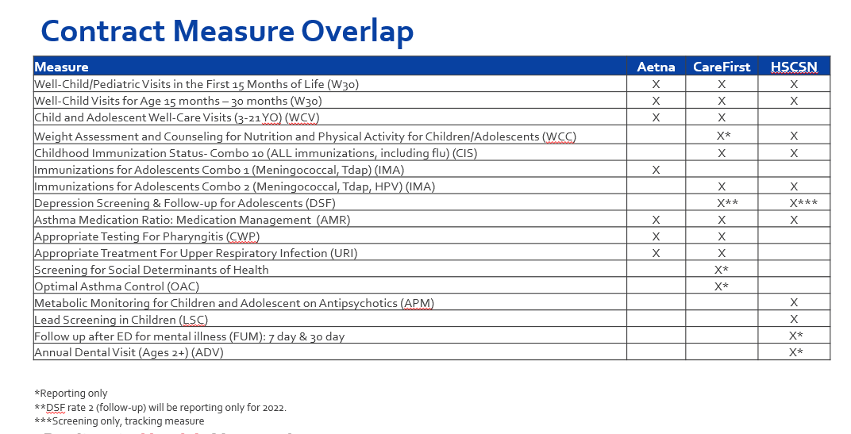
#1
#2
#3

Slide 26
How is VBC built into our health system?
How is value measured and captured?​
How can we improve?
What is value-based care (VBC)?
Does VBC care work?
What does this mean for you?​

Slide 27
How do we improve quality/value of care we deliver? Quality Improvement
Structured approach to measure and improve care and processes
Improvement through small, incremental changes
Elements include stated aims and outcome measures
Essential to achieve the triple aim
Requirement for Maintenance of Certification (MOC)

Slide 28
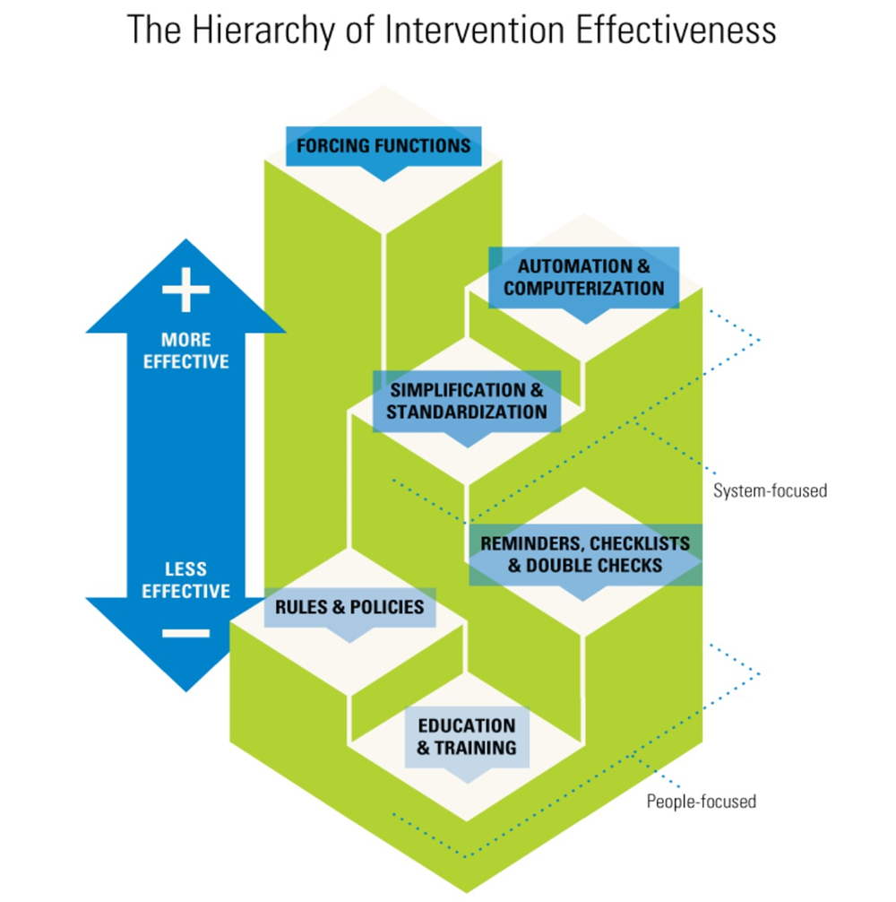
Tips for Improving on these metrics: Hierarchy of Intervention Effectiveness

Slide 30
Presenter information
Claire Boogaard, MD, MPH: cboogaar@childrensnational.org
Eduardo Fox, MD: erfox@childrensnational.org
Mark Weissman, MD: MWEISSMA@childrensnational.org

Slide 31
Thank you for the care you provide to children, families & each other.

