Slide 1

2023 CPG Obesity Guidelines: Application in Primary Care
Nazrat Mirza, MD, SCD
Medical Director, I.D.E.A.L. Pediatric Weight Management Clinic
Children’s National Hospital
Associate Professor Of Pediatrics, GWU

Slide 2

2023 CPG Obesity Guidelines: Application in Primary Care
Susma Vaidya, MD, MPH
Clinical Associate Professor of Pediatrics
George Washington University School of Medicine and Health Sciences
Associate Medical Director, IDEAL Clinic
Children's National Hospital

Slide 3
Financial Disclosure
The presenter has no financial conflicts of interest to disclose

Slide 4
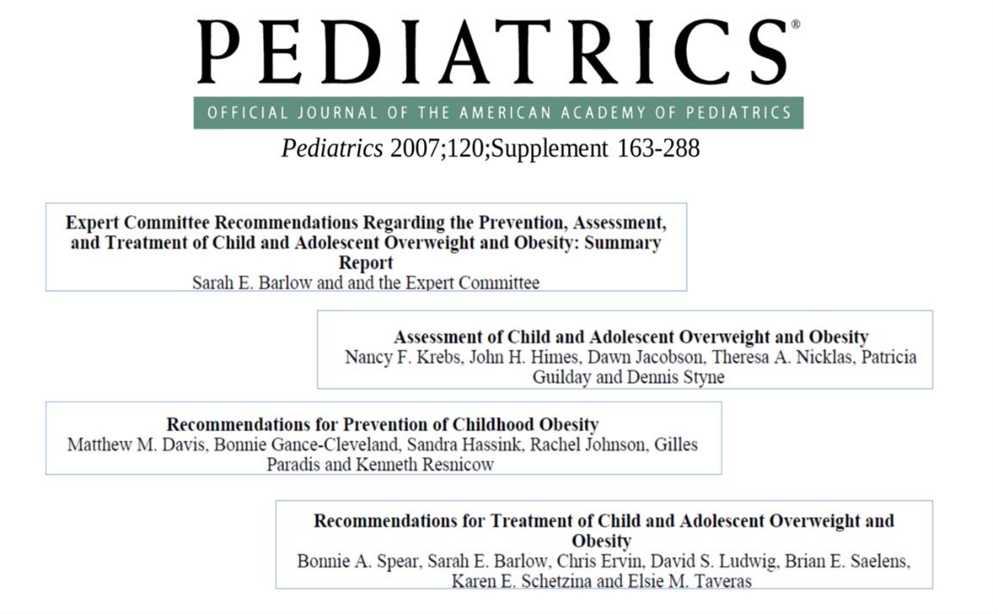
2023 Obesity Clinical Practice Guideline: Why Now?
Last guidelines published 2007
  Literature review not systematic review
In the intervening period, more data available for pediatric obesity
  RCT
  Comparative effectiveness trials
  High quality longitudinal and epidemiological studies
  And pediatric obesity prevalence data

Slide 5
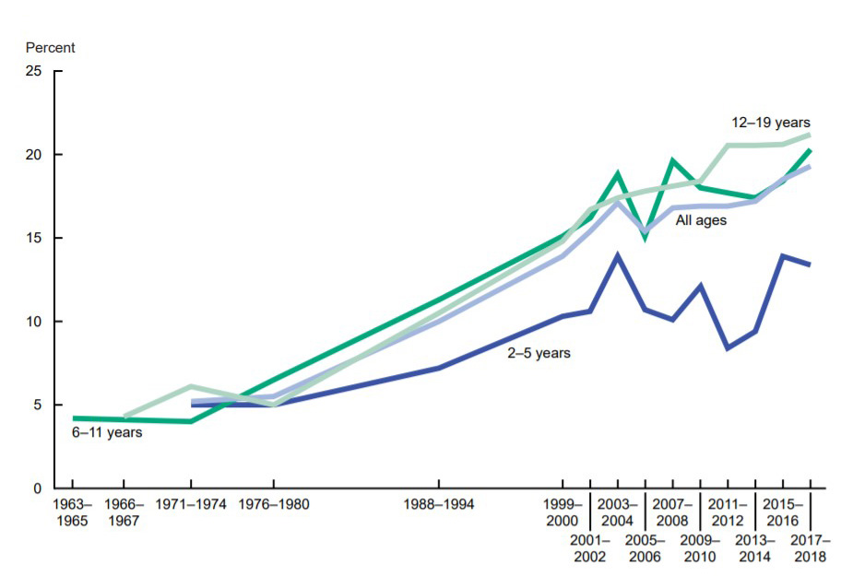
US Prevalence of obesity among 2-19 year old: 19%
Prevalence of 22.4% among 2-19 y old during Covid19 Pandemic
MMWR Morb Mortal Wkly Rep. 2021;70(37):1278-1283. doi: 10.15585/mmwr.mm7037a3
https://www.niddk.nih.gov/health-information/health-statistics/overweight-obesity

Slide 6
4.5 Million Children and Adolescents with Severe Obesity
Higher probability of tracking to adult obesity
Increased risk for CVD, DM, premature death

Slide 7
 | Definition and Classification of Obesity and Severe Obesity in Children
Age | Definition and Classification
 | Obesity Class I | Severe Obesity Class II | Severe Obesity Class III
<2 years | Weight for length ≥97th percentile
2-19 years | BMI ≥95th percentile | BMI ≥35 kg/m² or ≥120% of 95th percentile for age and sex | BMI ≥40 kg/m² or ≥140% of 95th percentile for age and sex

Slide 8
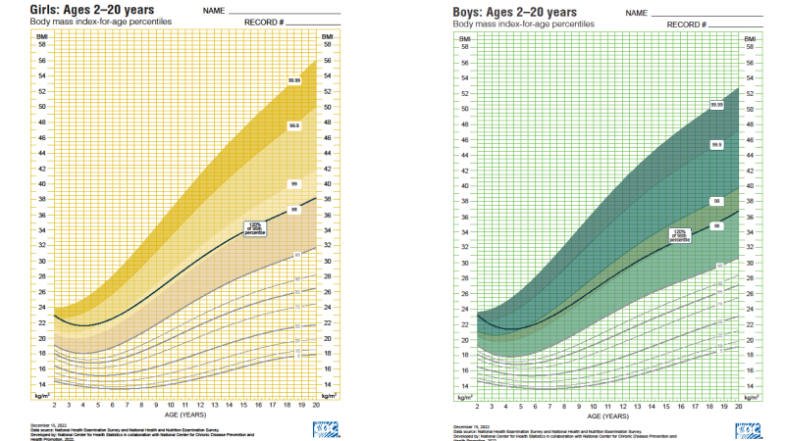
New CDC Growth Charts

Slide 10
2023 CPG Scope of Review: Focused on PHCP as Frontline Provider in Pediatric Obesity Management
Key Question 1
What are clinic-based effective treatments for obesity?
Key Question 2
What is the risk of comorbidities among children with obesity??

Slide 11
New From Previous Recommendations - I
We understand more fully the implications of obesity as a chronic disease
We understand the physiological impacts of social determinants of health (SDoH) on obesity more completely
We know more fully that weight bias and stigma are pervasive and harmful and can be a barrier to treatment

Slide 12
New from Previous Recommendations - II
Offer treatment early and immediately – there is no benefit to watchful waiting
Treat obesity and comorbid conditions concurrently
There are multiple evidence-based strategies that can be used collectively to deliver intensive & tailored obesity treatment
Structured, supervised weight management interventions decrease current & future eating disorder symptoms

Slide 13
CPG 2023 Evaluation and Management:
Whole Child Approach
Underlying genetic, biological, environmental, and social determinants that are risks for obesity are the foundation of evaluation and treatment
-AAP Clinical Practice Guidelines

Slide 14
Obesity is a Complex Chronic Disease
Obesity is often an indicator of structural inequities like unjust food systems, health inequities and environmental & community factors
Genetics, obesity-promoting environments, life experiences combined with inequities and structural barriers to healthy living all contribute to overweight and obesity
Other risk factors…

Slide 15
PHCP in Management of Pediatric Obesity
Obesity is a chronic relapsing chronic disease
Prevalence compared to other common pediatric chronic diseases:
Asthma (0-17 y): 8.3%
ADHD (3-17 y): 9.8%
Obesity (2-19 y): 19% (22.4% Covid19 pandemic)
2023 CPG: evidence-based evaluation and management of pediatric obesity targeted for PHCP
Medical home for the pediatric patient:
  Access
  Prevention and early management of excess weight/adiposity
  Prevention and early detection & management of comorbiditidies (including referral to sub-specialties)
  Access to other local resources (community-based weight management pgms, YMCA, B&G clubs, nutritionist programs, etc)
Given high prevalence & chronicity of pediatric obesity: convenience and feasibility of managing pediatric patients in the medical home vs referral to pediatric weight management clinics
N.B. Clinical Guidelines on Primary Prevention of Obesity are expected to be released by late summer 2023

Slide 16

Evaluation Recommendations
The primary care clinician is well-positioned to:
evaluate for weight-related comorbidities
appropriately initiate treatment
coordinate care with subspecialties
and provide concurrent obesity & comorbidity treatment
-- CPG

Slide 17
Pediatric Obesity Evaluation
Comprehensive, whole child evaluations are an important part of the treatment process
History:
  Medical Hx including pregnancy & birth hx
  Medication hx
  Family Hx & social Hx (SDoH)
  Dietary, Physical Activity, and Screen time Hx
  ROS
  Mental & behavioral health screening
Comprehensive physical exam, including BMI
Assess patient readiness to change
Lab evaluation for dyslipidemia, diabetes/prediabetes, NAFLD. Depending on Hx and PA may include other tests e.g., PCOS
Other studies will depend on hx and PE, e.g., depression, sleep study, X-Ray hips or lower limbs

Slide 18
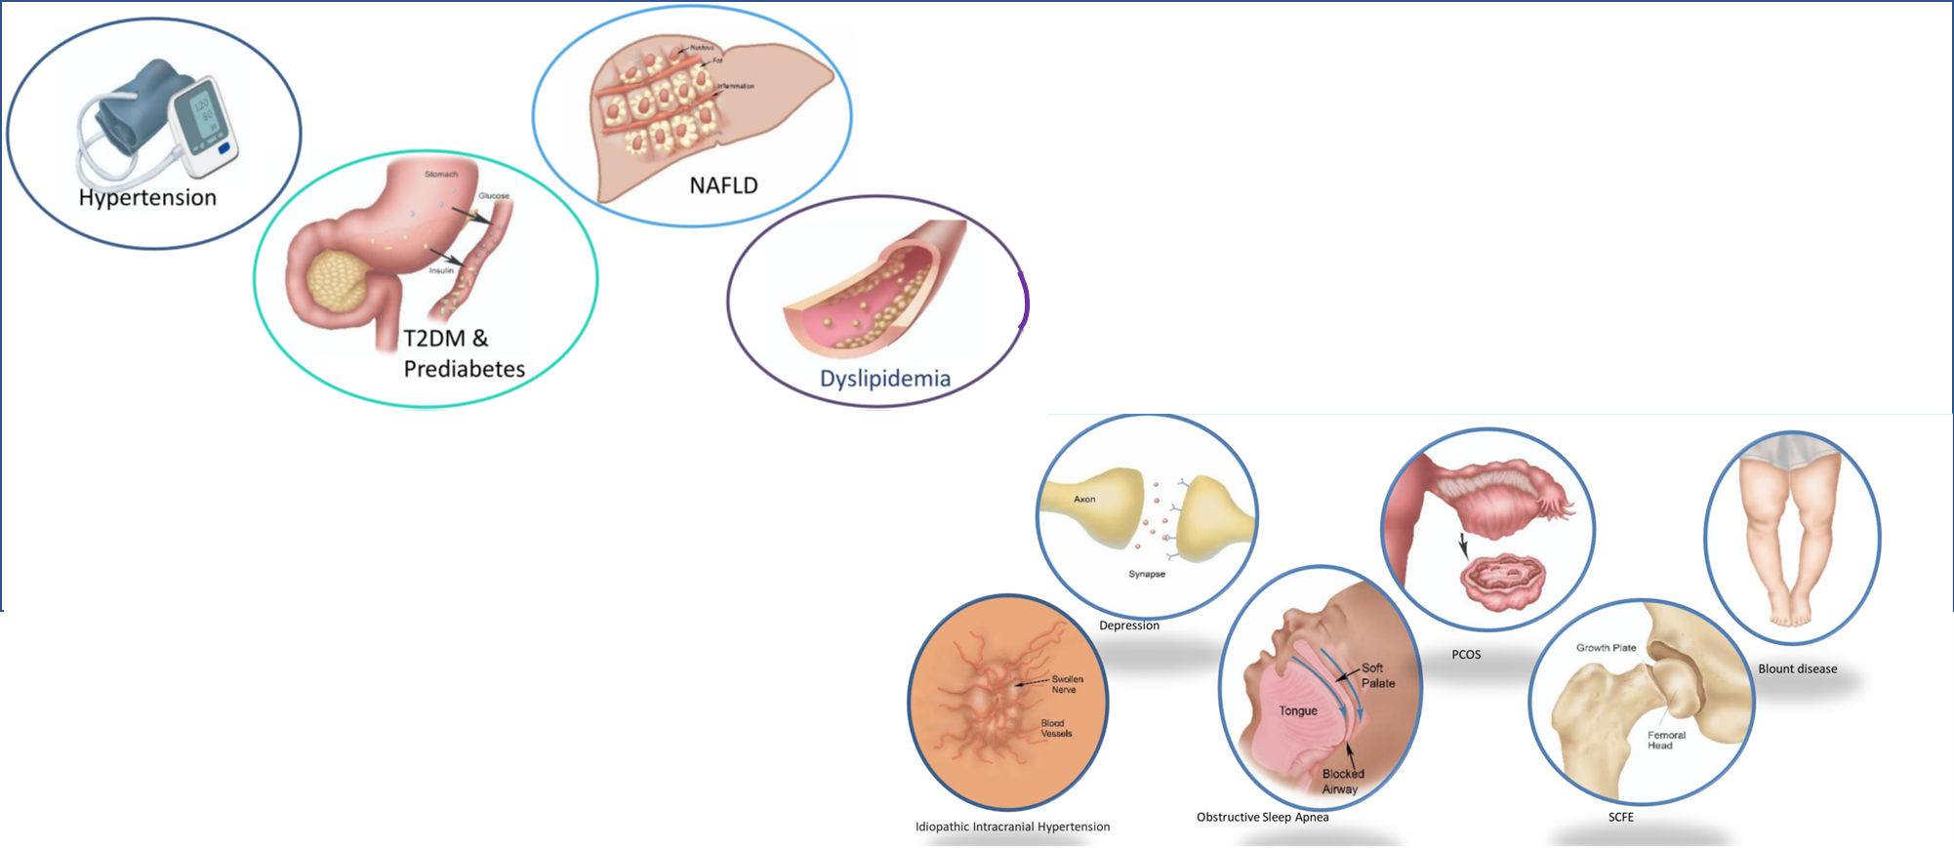
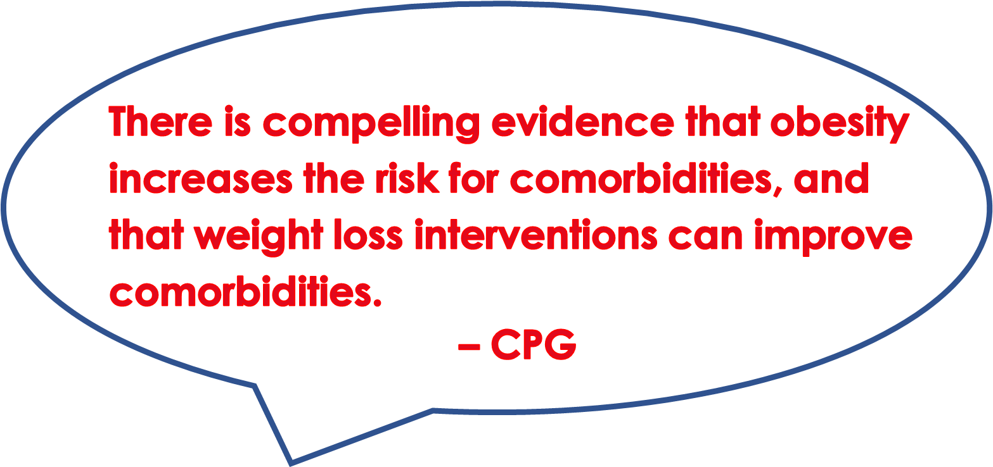
Comorbidities Addressed in the 2023 CPG Include

Slide 19
 | 2023 Recommendation: Lab Evaluation
 | Overweight (BMI ≥85th to <95th %tile) | Obesity (BMI ≥95th %tile)
Children 10 yrs and older | Should evaluate for: Lipid May evaluate in the presence of risk factors for T2DM or NAFLD: Glucose ALT | Should evaluate for: Lipid Glucose ALT
Children 2-9 yrs |  | May evaluate for Lipid
Grade B
Grade B
Grade C
Grade C
Lab Test | Sample
Lipid | Fasting Lipid
Prediabetes and Diabetes Mellitus | Fasting plasma glucose 2-h plasma glucose after 75-g oral glucose tolerance test (OGTT) Or glycosylated hemoglobin (HgA1c)
NAFLD | Alanine transaminase test (ALT)
CPG Recommendation: Evaluate for Hypertension
Measure BP at every visit starting at 3 y of age in children and adolsecents with overweight and obesity
Grade C

Slide 20
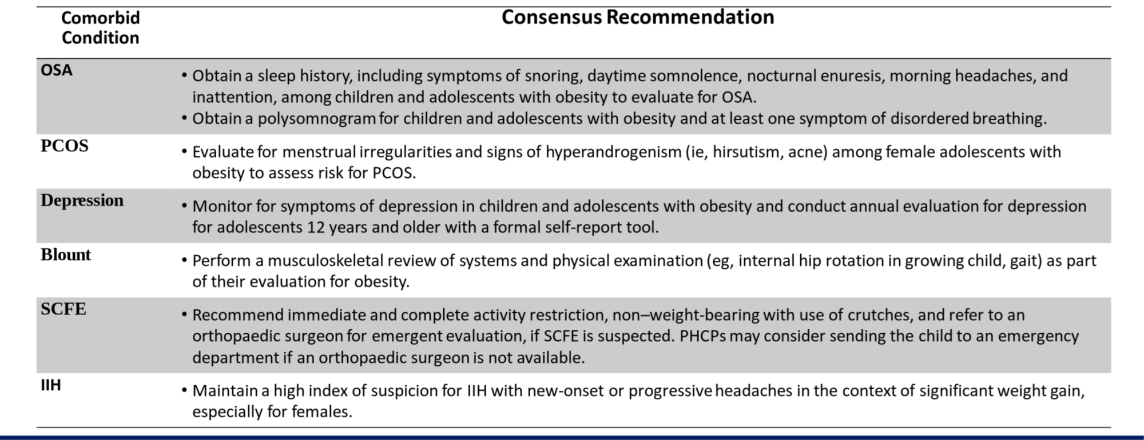
CPG Consensus Recommendations for Other Comorbidities

Slide 21
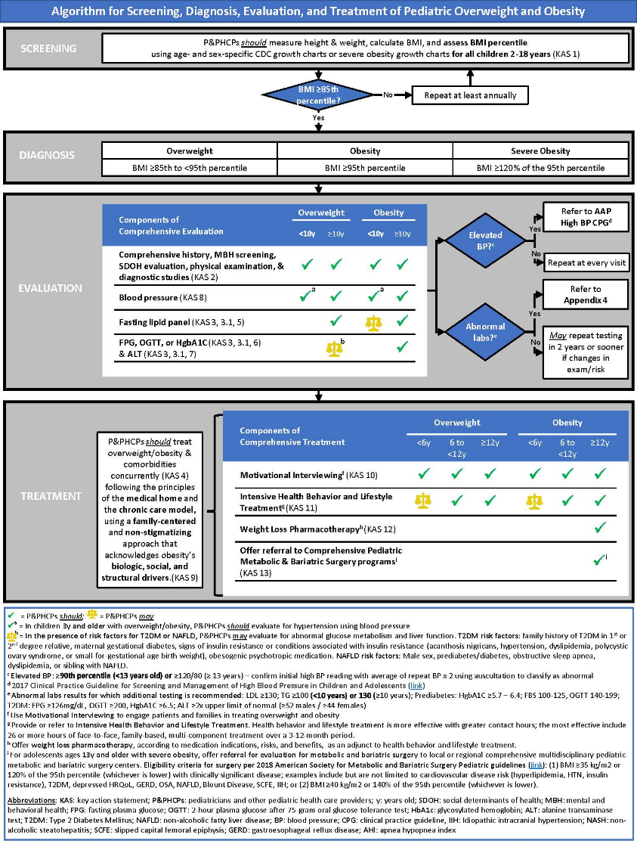
2023 CPG Algorithm for Screening, Diagnosis, Evaluation, and Treatment of Pediatric Overweight and Obesity
CPG Algorithm: evaluation and treatment based on age and weight categories
For comorbidities links are provided to other CPGs

Slide 22
Detailed discussion of treatment of pediatric obesity and comorbidities to be discussed by my colleagues today
Thank you!

Slide 23



June 21, 2023

