Slide 1
A Pharmacotherapeutic Approach to Pediatric Obesity
Susma Vaidya, MD, MPH
Clinical Associate Professor of Pediatrics
George Washington University School of Medicine and Health Sciences
Associate Medical Director, IDEAL Clinic
Children's National Hospital

Slide 2
Financial Disclosure
The presenter has no financial conflicts of interest to disclose.
Off-label use of medications to treat obesity where no approved/affordable alternatives exist will be discussed.

Slide 3
Objectives
Review available pharmacotherapeutic options in pediatric weight management
Review data for efficacy of newer medications
Review the clinical reasoning in choosing a medication
Discuss a clinical scenario in pediatric obesity management

Slide 4
AAP Clinical Practice Guidelines for the Evaluation and Treatment of Children and Adolescents with Obesity
Key Action Statement 12 (Grade B) PHCPs should offer adolescents 12 y and older with obesity:
Pharmacotherapy, according to medication indications, risks, and benefits, as an adjunct to health behavior & lifestyle treatment
Consensus Recommendation: PHCPs may offer children ages 8 y through 11 y of age with obesity :
Pharmacotherapy, according to medication indications, risks, and benefits, as an adjunct to health behavior & lifestyle treatment

Slide 5
No current evidence supports weight loss medication use as monotherapy; thus, PHCPs who prescribe weight loss medication to children should provide or refer to intensive behavioral interventions for patients & families as an adjunct to medication therapy.
-CPG

Slide 6
Off-Label Weight Management Medications
Metformin
Topiramate
Lisdexamfetamine

Slide 7
Metformin
Antidiabetic agent which increases insulin sensitivity and decreases blood glucose production
FDA approved for patients 10 years of age and older with T2DM
Off label uses:
Prediabetes
PCOS
Prevention of weight gain with an atypical antipsychotic

Slide 8
Metformin
Dosing: 250 mg to 500 mg orally once to twice daily, with increase to 2000 to 2500 mg based on age and effect
Needs to be taken with a meal
Can change to ER once a day for better compliance
Adverse effects: bloating, nausea, flatulence, diarrhea
Rare side effects: lactic acidosis, hepatic toxicity
BMI reduction in pediatric populations: minimal
Consider as an adjunct to IHBLT when specific indications present

Slide 9
Topiramate
Unclear mechanism of appetite suppression
FDA approved for ≥2 years of age for epilepsy and ≥12 years of age for headaches
Off label use:
Appetite suppression/weight loss
Dosing: 25 mg to 100 mg daily
Adverse effects: cognitive blunting, somnolence
Potential teratogen: counseling and birth control needed

Slide 10
Lisdexamfetamine
Stimulant
FDA approved for ≥ 6 years of age with ADHD and for binge eating in patients ≥18 years of age
Off label use:
Children and adolescents who exhibit a loss of control with food
Dosing: 10 mg to 70 mg
Adverse effects: mood changes, headaches, increased blood pressure
No evidence available for efficacy in treatment of obesity

Slide 11
FDA Approved Weight Management Medications
Orlistat
Phentermine
Phentermine-topiramate
GLP-1 receptor agonists

Slide 12
Orlistat
Intestinal lipase inhibitor which blocks fat absorption
FDA approved for ≥ 12 years of age with obesity
Dosing: 120 mg orally TID with meals
Adverse effects: steatorrhea, fecal urgency, flatulence, vitamin deficiencies
Rare side effects: liver toxicity
BMI reduction in adolescents: minimal

Slide 13
Phentermine
Sympathomimetic anorectic which is a norepinephrine, serotonin, and dopamine reuptake inhibitor
FDA approved for ≥ 16 years of age for short-course treatment
Contraindication: cardiovascular disease and uncontrolled hypertension
Dosing: 7.5mg, 15 mg, 30 mg, 37.5 mg
Adverse effects: elevated blood pressure, headaches, dry mouth, tachycardia, dizziness
Rare side effects: pulmonary hypertension, valvular heart disease
Efficacy wanes with the development of tolerance

Slide 14
Phentermine-Topiramate
56-week randomized double-blinded trial with 223 enrollees who received lifestyle counseling
10.4 % decrease in BMI compared to placebo in top-dose combination
8.1% decrease in BMI compared with placebo in mid-dose combination
Improved TG and HDL in treated patients
FDA approved for children ≥ 12 years and older
Contraindicated: hyperthyroidism and glaucoma

Slide 15
Dosage Escalation Schedule: Phentermine-Topiramate
Weeks | Daily Dose
2 weeks | 3.75 mg/23 mg
12 weeks | 7.5 mg/46 mg | Increase if at least 3% BMI reduction not achieved
2 weeks | 11.25 mg /69 mg
12 weeks | 15 mg /92 mg | Discontinue if at least 5% BMI reduction not achieved

Slide 16
Phentermine and Topiramate
Adverse effects: Mood disturbance, dizziness, dry mouth, metabolic acidosis, paresthesia
Negative pregnancy test recommended at start and periodically

Slide 17
Glucagon-like-peptide-1 (GLP-1) receptor agonist
Decrease hunger by slowing gastric emptying and targeting satiety in brain
FDA approved in children ≥12 years of age with obesity
Adverse effects: nausea & vomiting
Contraindication
Personal or family history of medullary thyroid carcinoma
Personal history of Multiple Endocrine Neoplasia syndrome type 2 (MEN2)

Slide 18
Liraglutide
56-week randomized double-blind placebo-controlled trial with a 26-week follow-up period with 251 enrollees who received lifestyle counseling
4.6 % decrease in BMI compared to placebo
4.5 kg absolute decrease in body weight
No difference in cardiometabolic variables between placebo and treatment arm

Slide 19
Dosage Escalation Schedule: Liraglutide
Weeks | Daily Dose
1 | 0.6 mg
2 | 1.2 mg
3 | 1.8 mg
4 | 2.4 mg
5 | 3.0 mg | Maintenance dose

Slide 20
Semaglutide
STEP TEENS Study: 68-week double-blind placebo-controlled trial with 200 enrollees who received dietary and physical activity counseling every 2 weeks up to week 20 and then every 4 weeks
16.7% decrease in BMI compared to placebo
15.3 kg absolute change in body weight
44.9% in semaglutide group achieved normal BMI or overweight BMI
Improvement in lipids, waist circumference, ALT, blood pressure, HbA1c

Slide 21
Side Effects: Semaglutide
Most Common: Gastrointestinal side effects
Nausea, diarrhea, vomiting, abdominal pain, GERD
Less common side effects:
Pancreatitis
Cholelithiasis and cholecystitis
Hypoglycemia: Type II DM
Acute kidney Injury (majority in patients with GI s/e leading to severe dehydration)
Hypotension
Rash and urticaria

Slide 22
Dosage Escalation Schedule: Semaglutide
Weeks | Weekly Dose
1-4 | 0.25 mg
5-8 | 0.5 mg
9-12 | 1 mg
13-16 | 1.7 mg
17 and on | 2.4 mg | Maintenance dose

Slide 23
Case Study
17-year-old female presents for weight management.
History:
“Heavy” since early childhood, but gained weight rapidly over the pandemic
Attributes weight gain to large portions and deterioration in quality of foods
Tried to improve eating habits and has lost 10 pounds, but cannot sustain this weight loss
Reports frequent loss of control with food, almost daily
Skips breakfast most days of the week.

Slide 24
Case Study
Past Medical History: insulin resistance, prediabetes, hypertriglyceridemia, fatty liver disease, snoring
Family History: parents with obesity, sibling with obesity, maternal grandmother with diabetes
Medication: none
Social History: lives with parents, siblings, and grandparents
Physical Exam: BMI: 43.6
Positive findings: hyperpigmentation around neck, axillae, stria on abdomen and arms

Slide 25
Treatment Options
Summary: 17-year-old with Class III obesity with acanthosis nigricans, prediabetes, fatty liver, frequent loss of control with food, possible OSA
Treatments:
Family-wide lifestyle modifications
Medications
Metformin
Vyvanse
Semaglutide/liraglutide
Phentermine/topiramate
Bariatric surgery

Slide 26
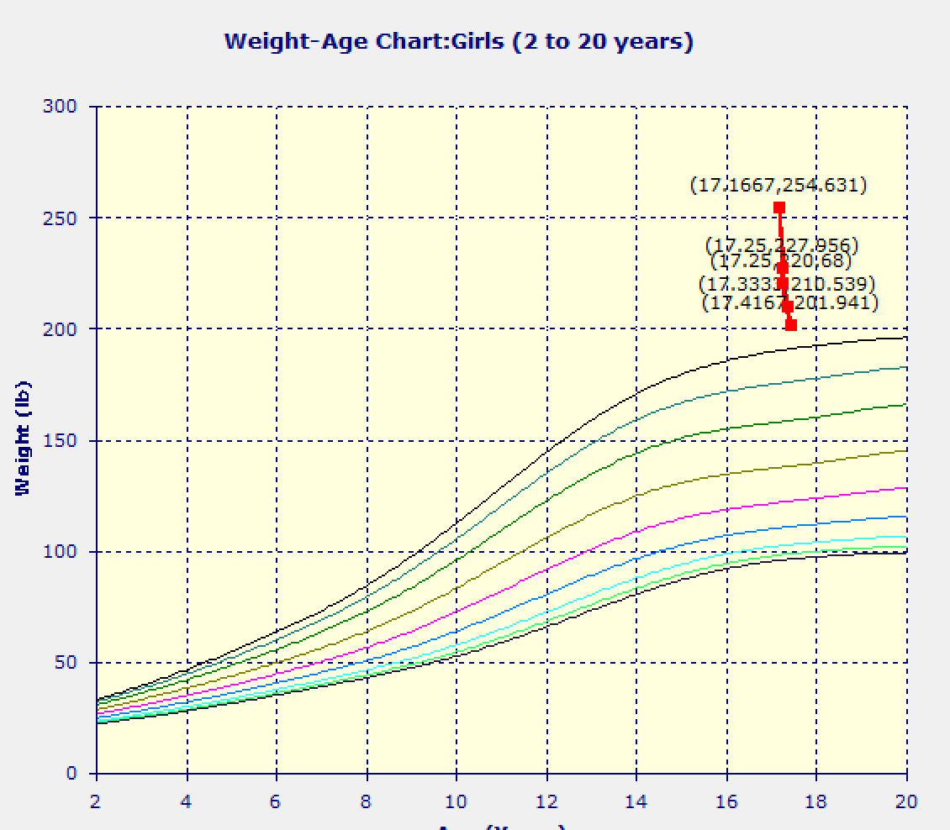
Progress
Weight loss: 53 lbs over 5 months

Slide 27
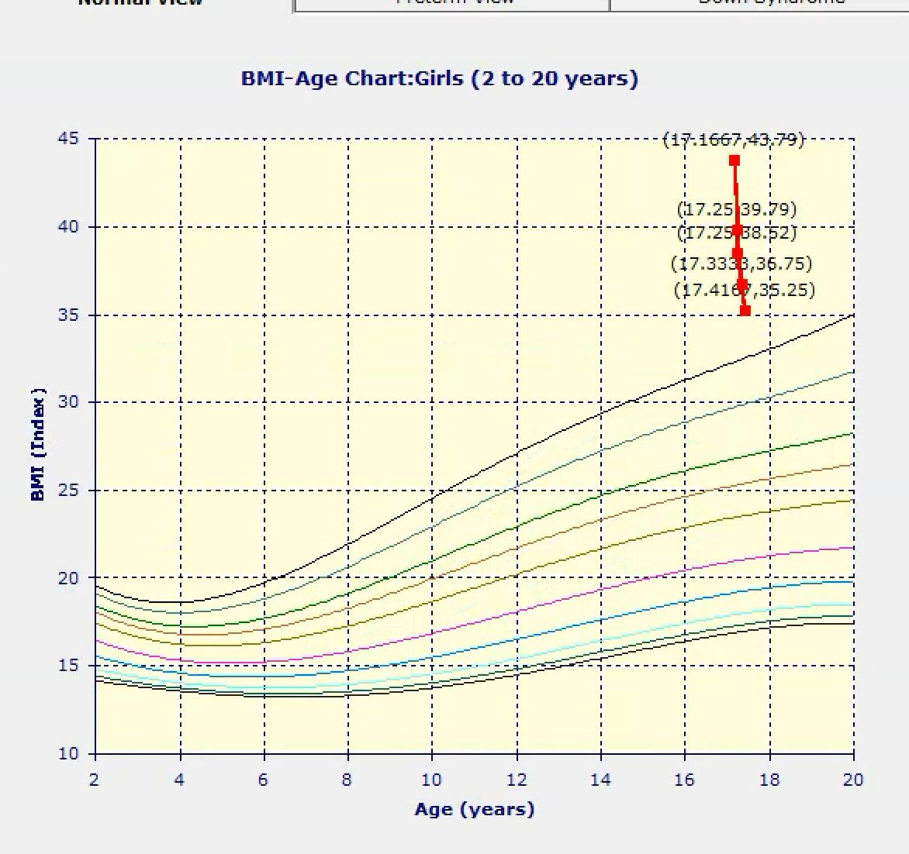
Progress
8.5-point reduction in BMI (19.5% )
Class II Obesity (35.3)

Slide 28
Progress
Current health parameters:
Normal HbA1c
Normal lipid panel
No more snoring
Normal insulin level
Normal ALT

Slide 29
Patient Strengths and Next Steps
Strengths:
Family support
Structured meals
Excellent response to anorexigenic medications
Motivated patient
Next steps:
Continued support for dietary modifications
Increased physical activity
Prepare for relapse
Bariatric surgery

Slide 31
June 21, 2023

