Slide 1
Hidradenitis Suppurativa in Children and Young Adults
Colleen Cotton, MD
Assistant Professor of Dermatology and Pediatrics

Slide 2
Case: 12yo female
Has had several boils under the armpits over the last year
Between episodes has no pain or drainage
Mom also has boils like this that she has never seen a doctor for
BMI >99th percentile

Slide 3
Which of the following is TRUE about this condition?
This disease is caused by sweat gland dysfunction
Poor hygiene contributes to this condition
It is impossible to tell at this point if this is a recurrent infection
Women are more likely than men to develop this in adolescence
Surgery is the most appropriate therapy

Slide 4
Which of the following is TRUE about this condition?
This disease is caused by sweat gland dysfunction
Poor hygiene contributes to this condition
It is impossible to tell at this point if this is a recurrent infection
Women are more likely than men to develop this in adolescence
Surgery is the most appropriate therapy

Slide 5
What is HS?
What it is
What it isn’t
Inflammatory skin condition
Multifactorial
Follicular occlusion
Hormones
Obesity/insulin resistance
Bacterial imbalance
Chronic and progressive with periods of flares
Infection
The result of “poor hygiene”
A disease of sweat glands
An acute disease with periods of recurrence

Slide 6
HS is also a pediatric disease
0.1-2% prevalence overall in the US
0.028% estimated prevalence in pediatrics
0.5% in African American adolescents aged 15-17 years
Over 50% of patients report symptom onset between ages 10-21
Garg et al, J Invest Dermatol 2018
Molina-Leyva and Cuenca-Barrales, Dermatology 2019

Slide 7
Pediatric HS has some different history and epidemiology than adult HS
4:1 female:male
2 year delay
41% family history
Liy Wong, JAMA Dermatol 2021

Slide 8
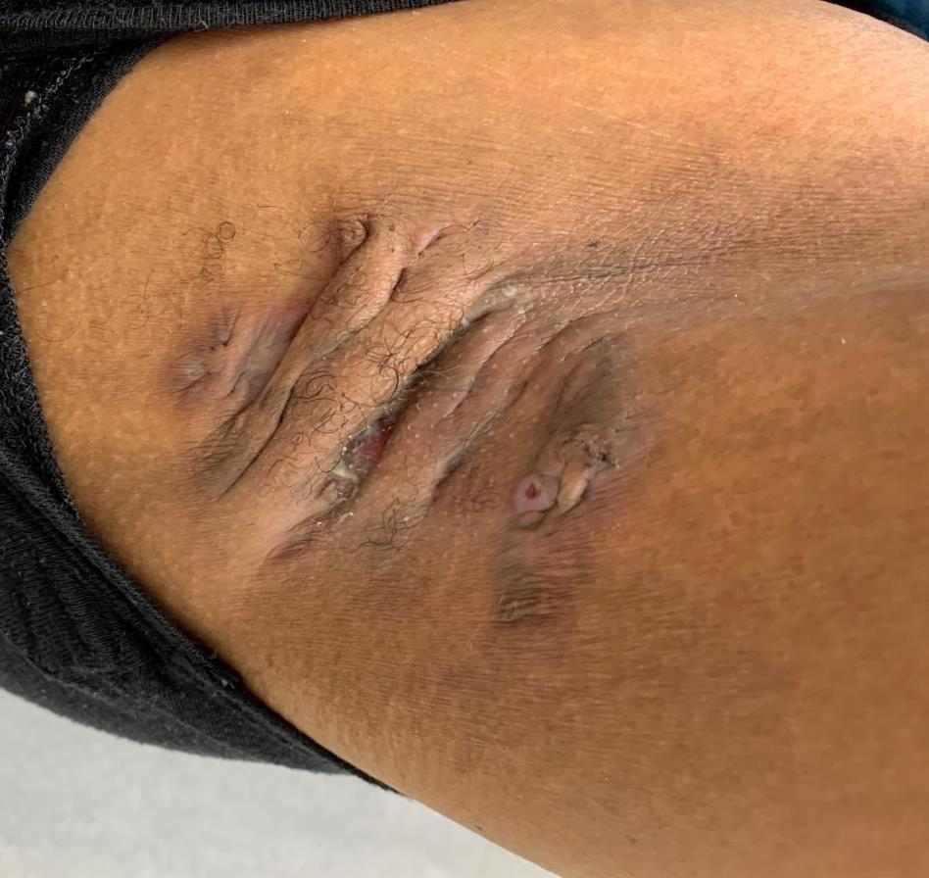
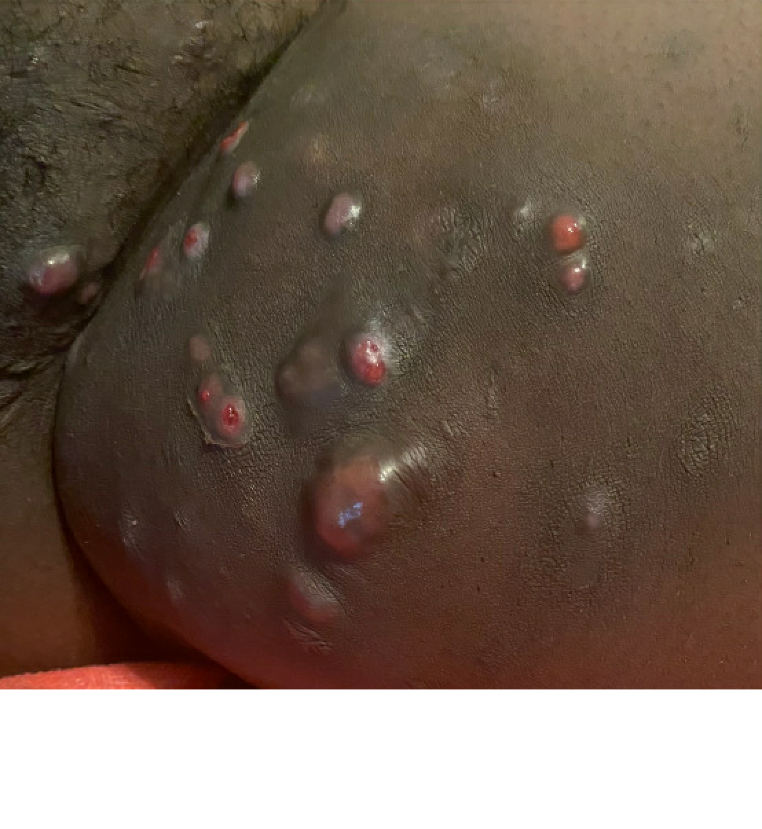
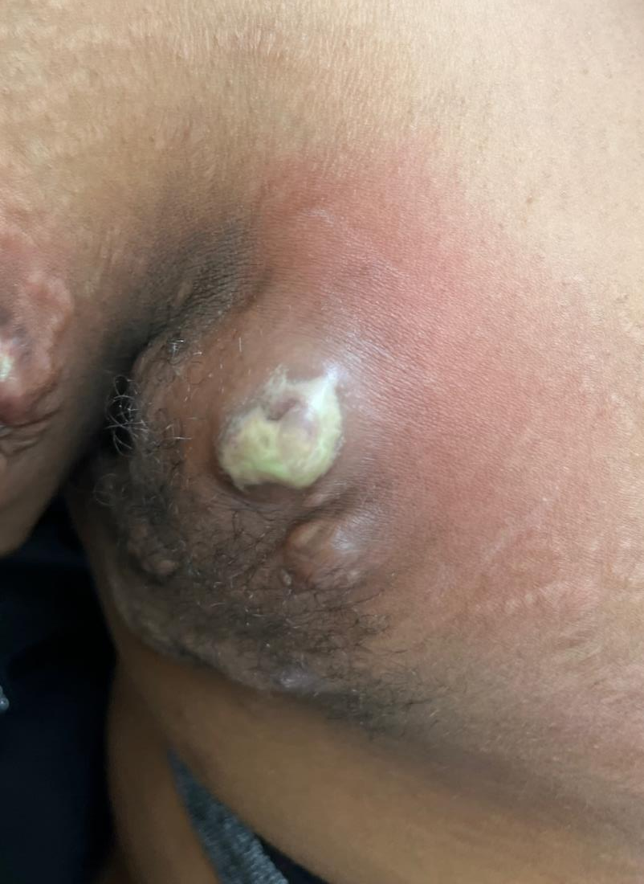
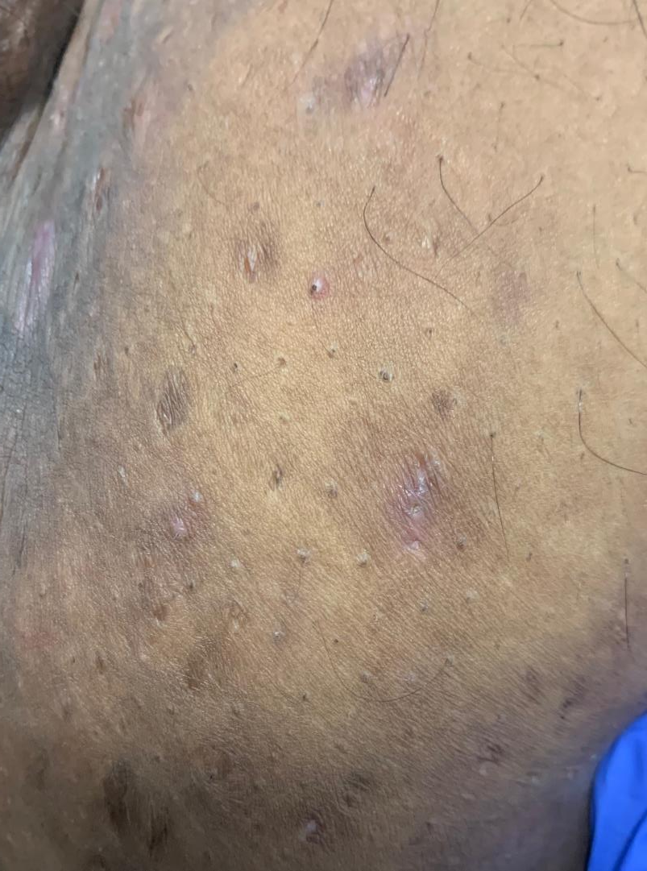
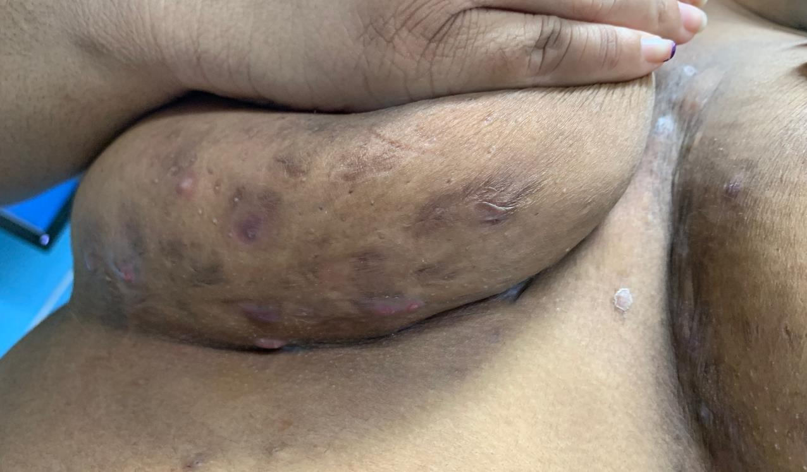
HS has characteristic skin lesions
Open comedones
Inflammatory nodules
Abscesses
Scarring
Sinus tracts

Slide 9
Have you had 2 or more outbreaks of boils in the axilla, groin, buttocks, or under the breasts in the last six months?
96% sensitive in adults!

Slide 10
Pediatric patients may not fulfill diagnostic criteria
Location
Lesion
History
Zouboulis et al, Dermatology 2015
Kittler et al, JAMA Dermatol 2022

Slide 11
Early diagnosis is the key to altering disease trajectory
Window of opportunity
Impairment
Cutaneous damage
Abscess
Nodules
Scar
Scar
accumulation
Papules
Disease onset
Martorell et al. Actas Derm 2016

Slide 12
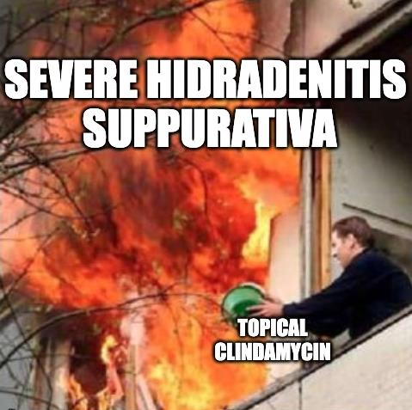
Don’t be this guy

Slide 13
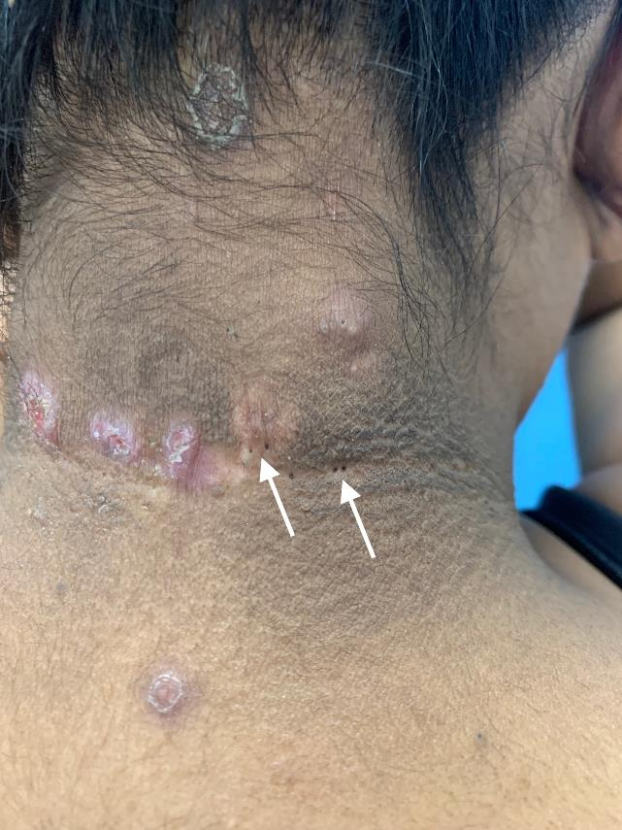
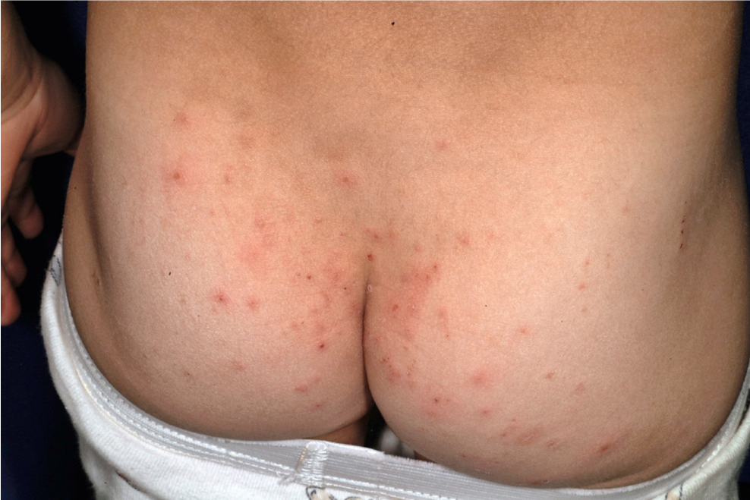
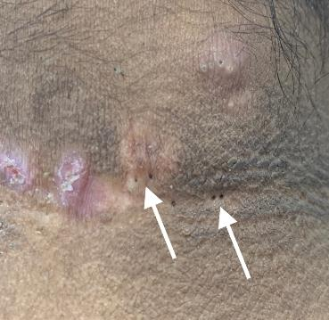
Folliculitis and HS can be difficult to differentiate
Courtesy of Andrea Zaenglein, MD
Courtesy of Sadaf Hussain, MD

Slide 14
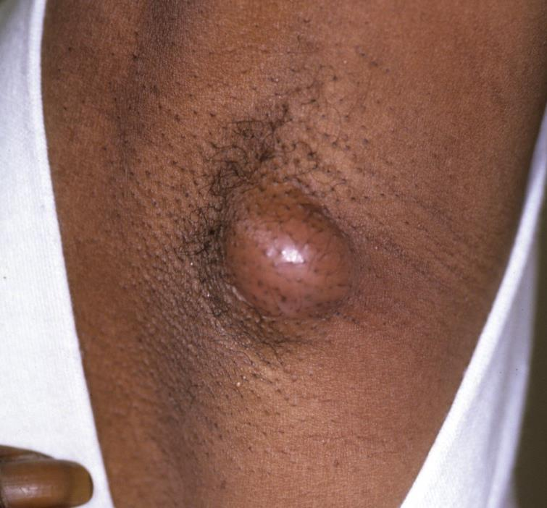
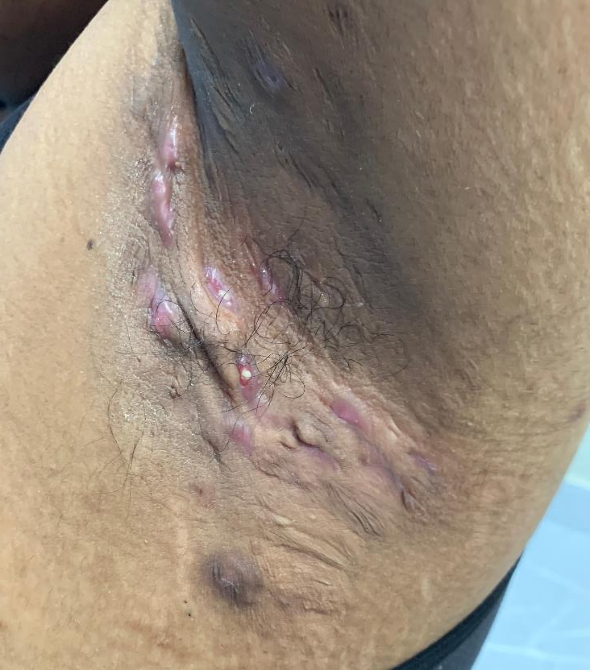
There are clues to help differentiate infection from HS
 | Infection | HS
Location | Random distribution Site of injury | Skin folds (axillae, groin, breasts)
Culture | Staph aureus (MRSA) Less commonly E. coli, Pseudomonas | No growth Multiple organisms Staph is rare
Appearance | Single lesion Pustules | Sinus tracts Scarring Open comedones
Recurrence | Rarely in the same spot | Characteristic

Slide 15
Management of mild HS involves topical therapies and flare plans
Maintenance antimicrobial wash
Chlorhexidine gluconate 4% (Hibiclens)
Benzoyl peroxide wash (5-10%)
Zinc pyrithione (e.g., Head and Shoulders)
Topical antibiotics – clindamycin 1%, comes as gel, lotion, wipes, solution
Consider oral antibiotics for 2-4 weeks for more severe flares – doxycycline
Pain management: ibuprofen, acetaminophen
SAME PLAN WORKS FOR FOLLICULITIS! ☺

Slide 16
Comorbidities are seen in pediatric HS at similar rates to adults
Retrospective study of 481 pediatric patients (Liy-Wong 2021)
No cases of precocious puberty, one case of premature adrenarche
Obesity, overweight and endocrine abnormalities most common
Obesity rates range from 32.5 - 68.7%
At risk for hyperlipidemia, metabolic syndrome, acanthosis nigricans

Slide 17
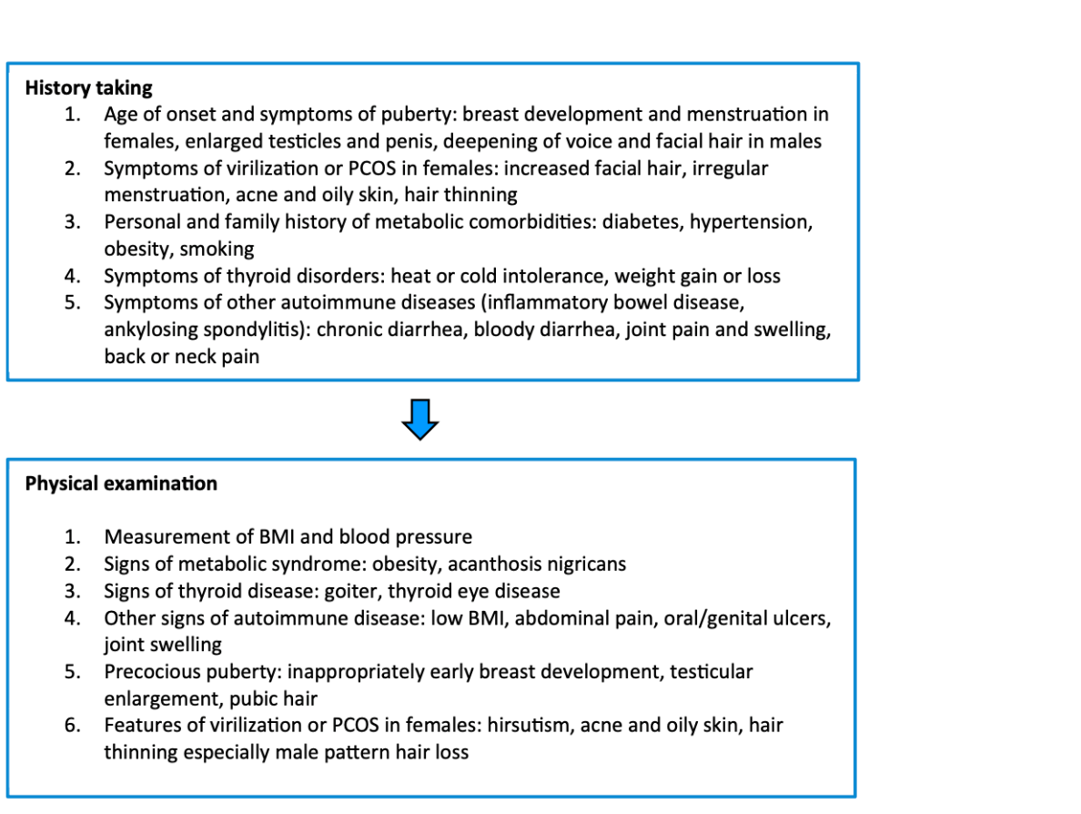
Approach for the workup of comorbidities in pediatric HS patients
Choi et al, JAAD 2022

Slide 18
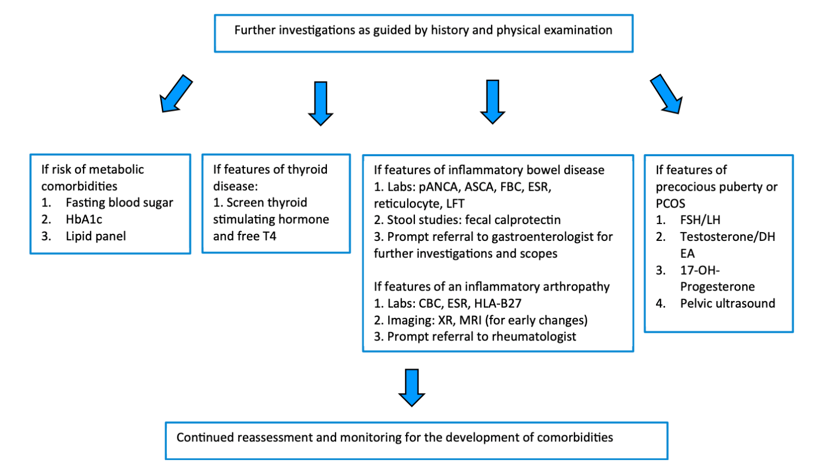
Approach for the workup of comorbidities in pediatric HS patients
Choi et al, JAAD 2022

Slide 19
There are several options that treat HS and common comorbidities at the same time
Metformin 500mg BID
Spironolactone (may require up to 100mg BID dosing, start lower)
Combined oral contraceptive pills
Recommend progestins with greater antiandrogenic activity (norgestimate, drosperinone)
Single case report of liraglutide
Future role for GLP-1 agonists?
TNF-alpha inhibitors

Slide 20
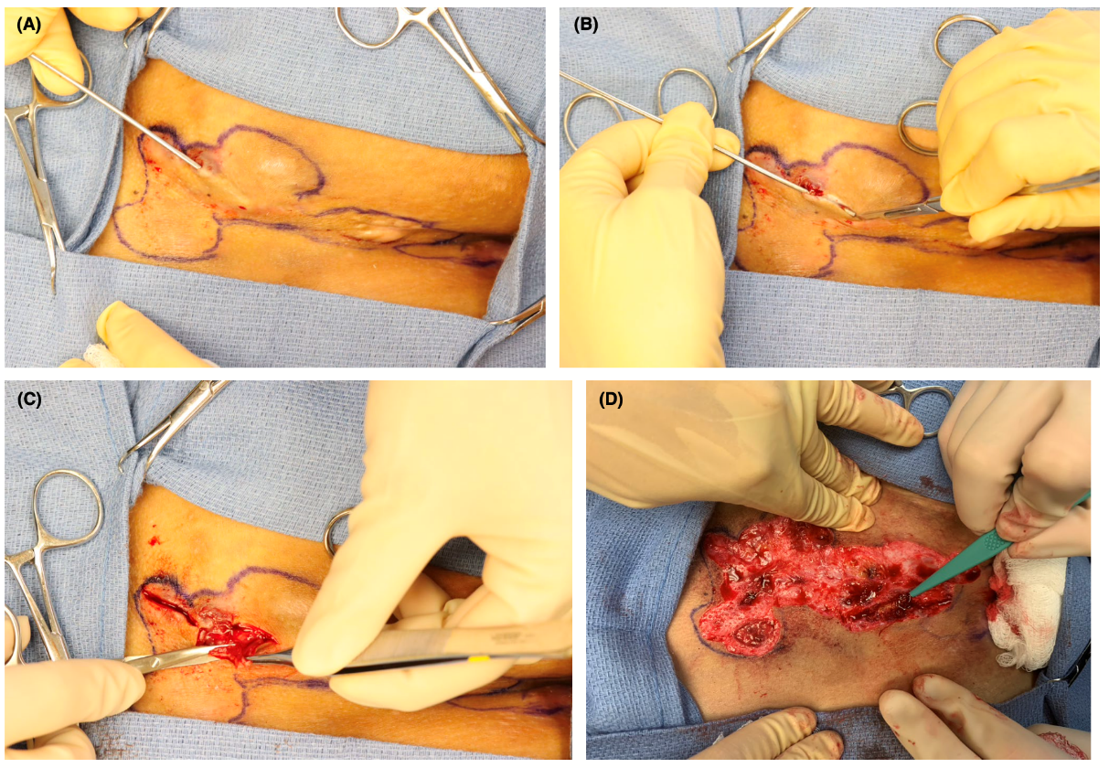
Surgery is also an important part of treatment for HS
Leszczynska et al,
Pediatr Dermatol 2022

Slide 21
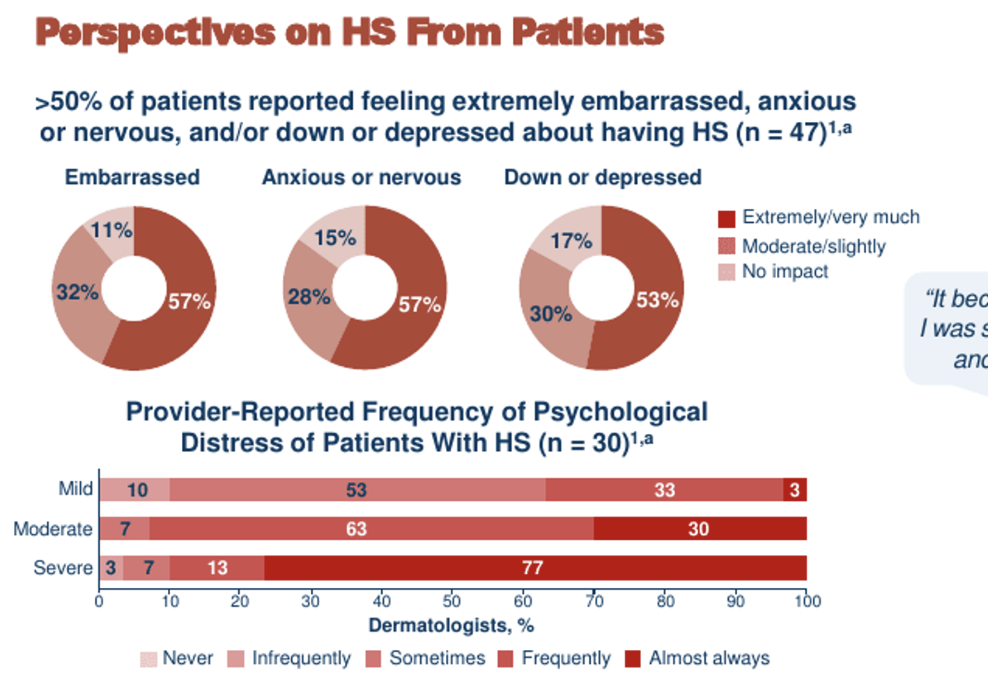
Kirby J et al, EHSF Annual Meeting 2022

Slide 22
Help by dispelling myths patients may have heard
Not an infection, not contagious
Not a problem with your immune system being “weak”
Better hygiene will not stop HS
Losing weight will not cure HS

Slide 23
Talk to parents about school
You as the physician have a lot of power!
Educational letters for school
HS Connect: Letter from parent
IAHSN: Letters from physician and parent
Notes for sitting out of PE or sports
504 Plans or homebound services

Slide 24
Direct patients and parents to support groups
Facebook groups
HS Connect
Hope for HS
HS Heroes
HS Foundation

Slide 25
Take Home Points
HS is also a pediatric disease
Early diagnosis is key to altering disease trajectory
Comorbidities are seen in pediatric HS at a similar rate to adults
Advocate for your patients to get them appropriate therapy early

Slide 26
Thank You!
ccotton@childrensnational.org
@pedsdermMD

Slide 27
June 21, 2023

