Slide 1
IHBLT - Intensive Health Behavior and Lifestyle Treatment What does that look like in clinical practice?
Alicia Tucker, MD, FAAP, ABOM
IDEAL Clinic Pediatrician-Children’s National Hospital
Assistant Professor of Pediatrics
The George Washington University School of Medicine & Health Sciences
Director, Prevention Cardiology Elective
Director, FLiP Student Navigator Program

Slide 2
Take home messages from the CPG
We understand more fully the implications of obesity as a chronic disease
We understand the physiological impacts of social determinants of health on obesity more completely
We know more fully that weight bias and stigma is pervasive and harmful and can be a barrier to treatment
Offer treatment early and immediately – there is no benefit to watchful waiting
Treat obesity and comorbid conditions concurrently
There are multiple evidence-based strategies that can be used collectively to deliver intensive & tailored obesity treatment
Structured, supervised weight management interventions decrease current & future eating disorder symptoms

Slide 3
A mother brings in her 11 year old daughter A for a yearly check-up. Their family has just moved to town, and this is their first clinic visit. VS: HR - 80 beats/min, BP - 118/64, Height – 145cm (50%-ile), weight – 65kg (>97%-ile), BMI – 30.9kg/m² (99th percentile) Looking at the chart: PMH: Asthma Medications: Albuterol PRN NKDA Surgery: None Hospitalizations: None Family History: Hypertension and high cholesterol Social History: Lives at home w/ both parents

Slide 4
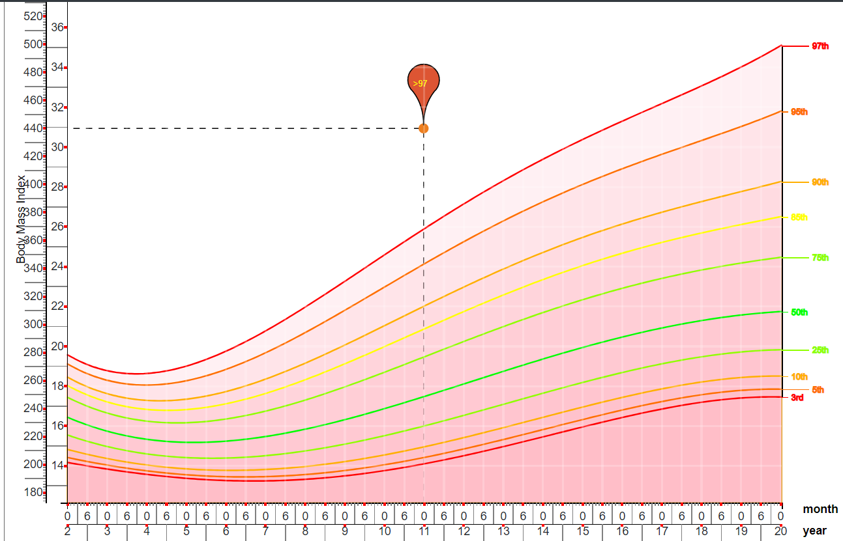
First – How do you feel about the BMI?
BMI=
Weight/Height ²

Slide 5
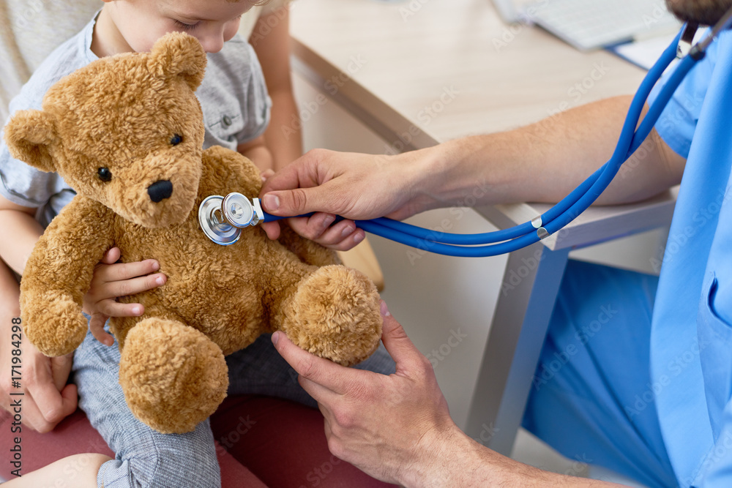
Back to the exam room… A has class 1 obesity based on BMI
Just like any encounter, ask if they have any concerns first…
-maybe they bring it up
-maybe something else is going on that eclipses that concern
For new patients gauge if this is something that has come up before
Starting the conversation…
Ask permission
Avoid stigmatizing terms like “fat” and “obese”
Mention it as a routine part of care
Example:
This is just one dot on my growth chart so I don’t know if this number has gone up, down, or stayed the same from her last check up. Can I ask you some more questions about the pattern of her weight gain?

Slide 6
It can be challenging to bring up! Make sure YOU feel comfortable bringing it up in a non-judgmental/non-stigmatizing way, that’s the most important first step
It can be difficult to talk about weight and address it in kids
Multiple contributors to weight
Weight stigma
Embedded in multiple food environments
Developmental stage of child
And so on…
For most patient’s the initial discussion can avoid speaking specifically about weight if you or the family are not comfortable with that discussion…
Make sure questions about eating/drinking patterns and physical activity are EQUAL for ALL PATIENTS

Slide 7
Mom says that she has always been “big” but they have noticed a lot of weight gain this past year with their recent move and a lot of changes at home.
Additional Pertinent History:
Birth History – Mother reports GDM, birth weight 9lbs 2oz; breast fed well as an infant, no NICU stay
Development – Normal development, met all milestones, does well in school, on honor roll
Fam Hx – Mother reports she and As father are “overweight”, dad takes cholesterol medication. Paternal grandfather had an MI at 56
Social Hx – Lives with both parents and brother, father lost his job last year and took another job in this area so they recently had to move, mom now looking for work here - on your office food insecurity screener they identify “sometimes food runs out before I get money to buy more”
In 5th grade, on honor roll
No structured activities, states she enjoys art and would like to take art class. Little physical activity.
Mental Health – PHQ9 screener = 4 (indicated feeling down/depressed several days (1), overeating more than half the days (2), trouble concentrating several days (1)
ROS - +knee pain after running in PE, occasional headaches (mild afternoon headaches, no red flag symptoms)

Slide 8
What jumps out?
Like most of our patients there are MULTIPLE contributors to obesity
Biological – family history (genetic), gestational diabetes
Socioeconomic – food insecurity
Behavioral – depression, over-eating and sedentary behavior
DO NO HARM
Eating disorders and obesity have a bi-directional impact and should be screened for in all patients where eating behaviors and weight are being discussed

Slide 9
Binge Eating Disorder Screener - 7
Eating Disorder Screen for Primary Care (ESP)
Are you satisfied with your eating patterns?
Do you ever eat in secret?
Does your weight affect the way you feel about yourself?
Have any members of your family suffered with an eating disorder?
Do you currently suffer with, or have you ever suffered in the past, with an eating disorder?
• A ‘no’ to question 1 is classified as an abnormal response
• A ‘yes’ to questions 2-5 is classified as an abnormal response
• Any abnormal response indicates that the client needs further assessment

Slide 10
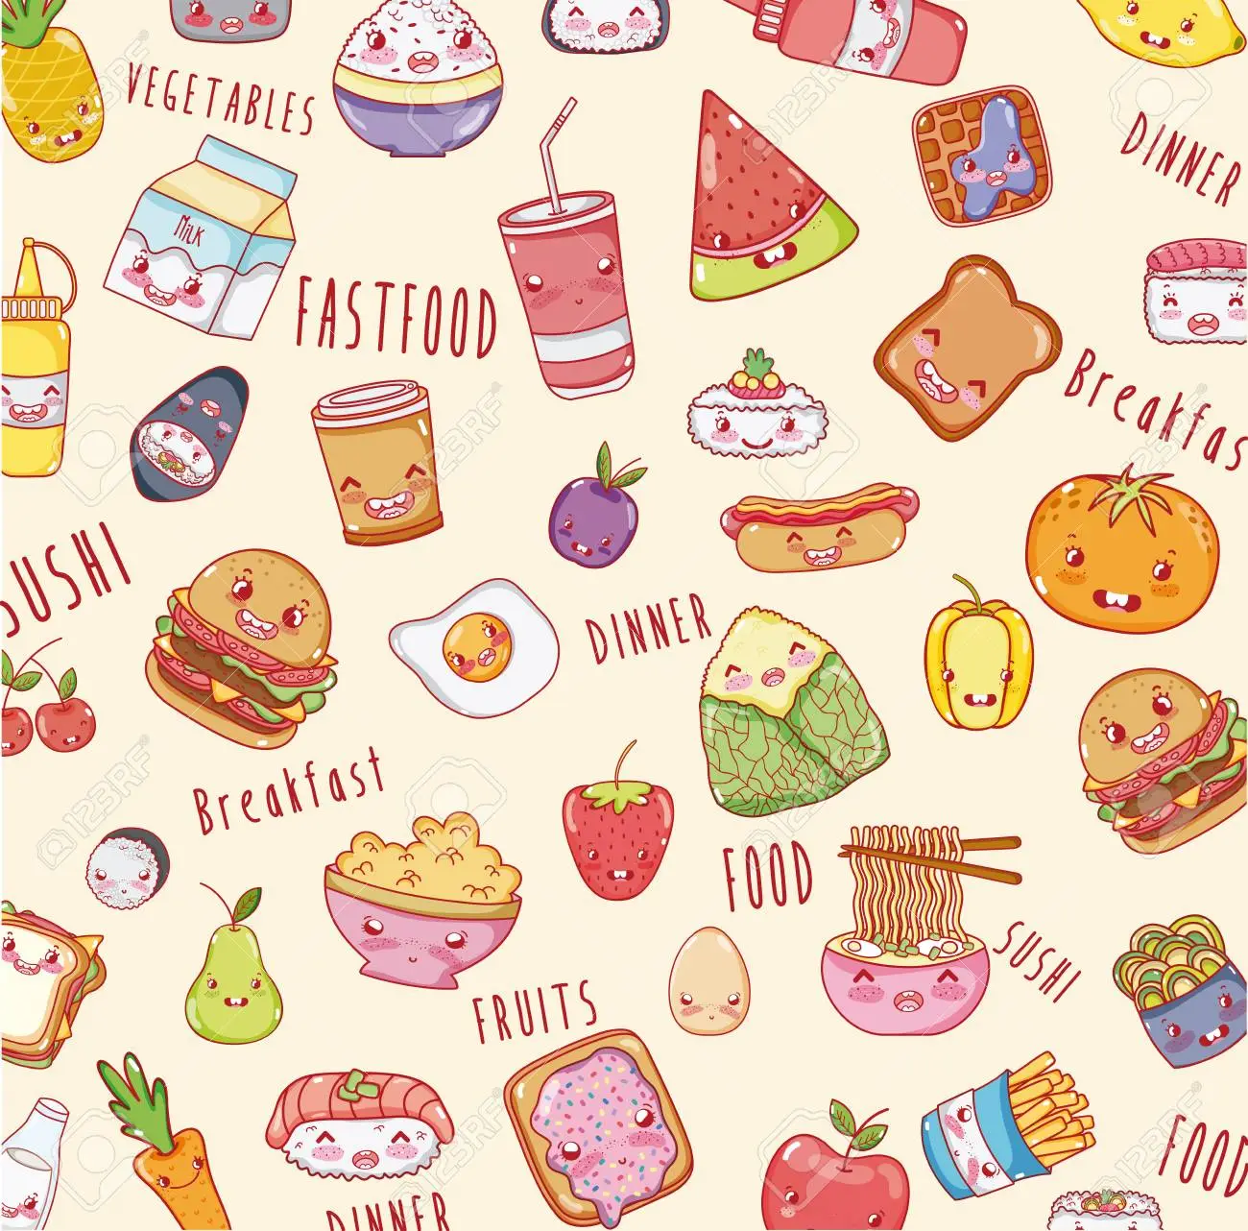
A answers “yes” to Question 2 – eating in secret The rest of the answers are negative When you ask more questions about this she denies eating very large amounts of food or restricting her eating. But does not like to eat in front of others, has been teased at school, and at home hides while she eats snacks so her mom doesn’t make comments

Slide 11
Where to go from there…
You have identified acute concerns regarding mild depression, school bullying, and disordered eating behaviors
Referral to mental health resources is practice dependent but addressing her mental health is the first step in treating depression which is driving disordered eating
We also noted food insecurity on screening, you were also able to provide the families with local food access resources to supplement their groceries
“I want to talk about some healthy eating habits that I want you to try, these are things I would ask anyone to do in any size body. Plan to have a late lunch or healthy snack right when you get home after school until you feel comfortable eating in the cafeteria. Let’s also try to find some ways to help move your body after school or on the weekend, fun movement is a great way to boost your mood and increase your energy”
“But most importantly, I would like you to talk to a psychologist about how you’ve been feeling”

Slide 12
What does that mean???

Slide 13
Fast forward 6 months VS: HR - 85 beats/min, BP - 115/65, Height – 152cm (50%-ile), weight – 70kg (>97%-ile), BMI – 30.3kg/m² (99th percentile)
Interval Hx:
A was able to start seeing a psychologist and is receiving treatment for depression
She joined the basketball team over the winter and has made new friends
Her mother found a job and they no longer worry about finances
On your office screener her PHQ9 score was 1, ED screens were negative, and FI screen was negative
HOWEVER – A has continued gained weight
She is frustrated because she is more active and has been exercising outside of basketball practice in hopes of losing weight without any success and would like help with weight loss
Her mother is open to learning how to make changes to help her daughter in a safe way

Slide 15
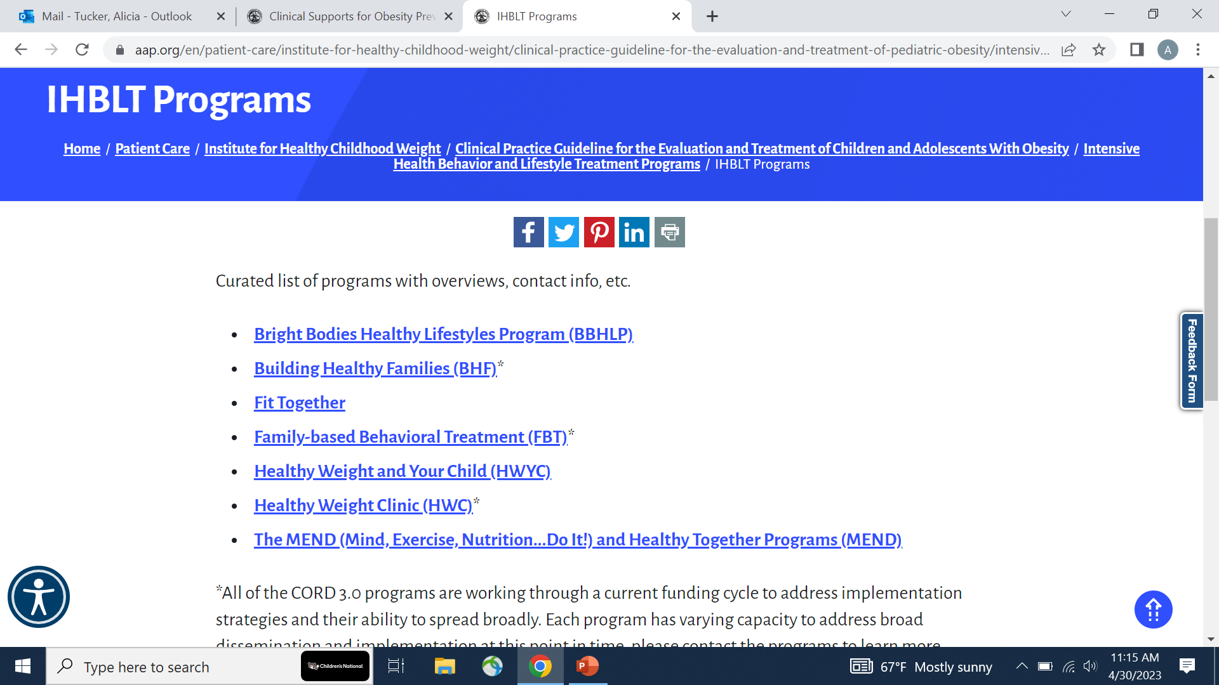
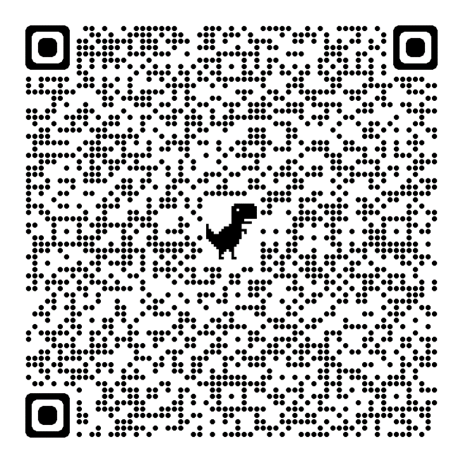
Parks and Rec partner
YMCA partner
Modules that can be purchased to implement in clinic or community setting

Slide 16
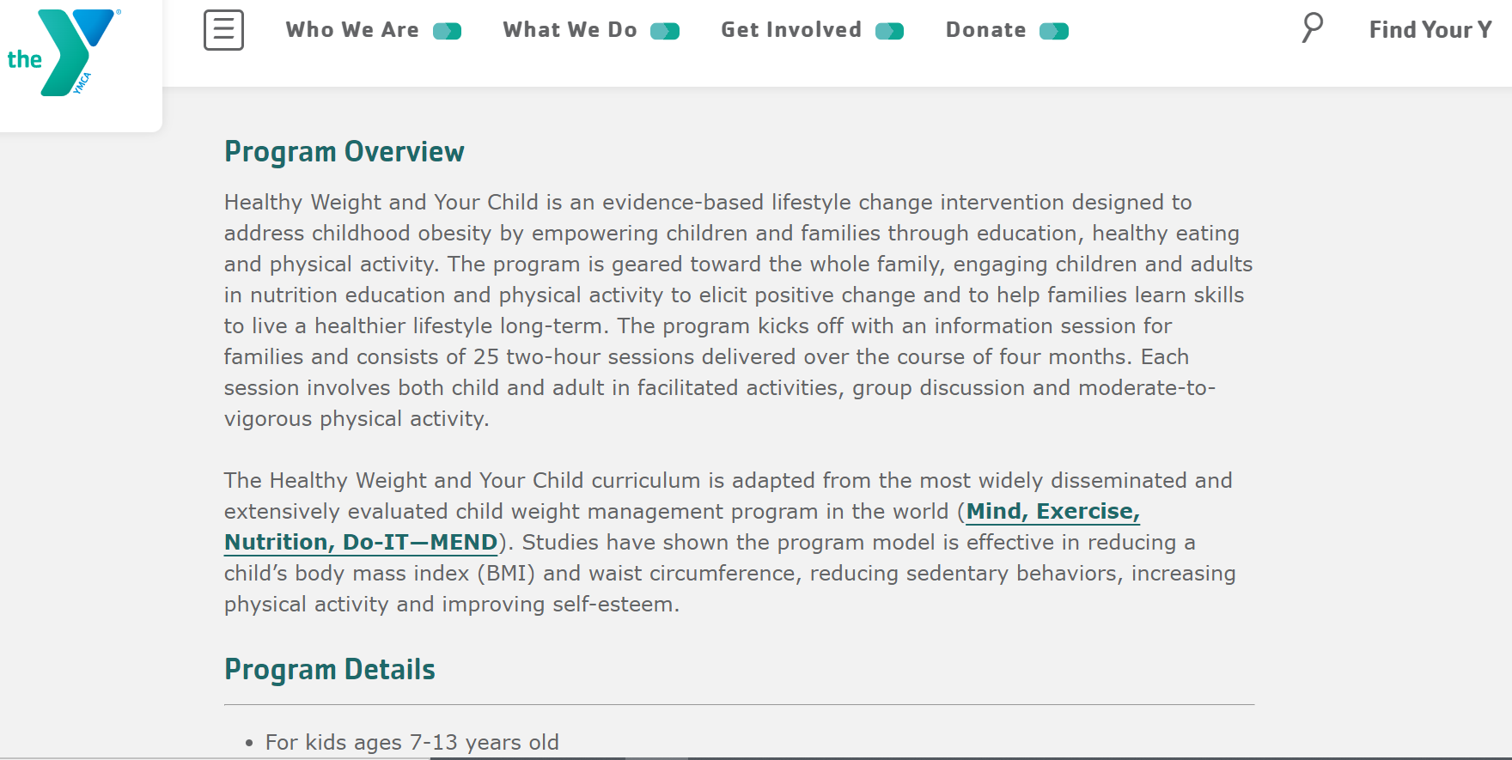
So what might this look like…
No MEND program at YMCA’s near here? Maybe help start one?

Slide 17
What do we have here?
YMCA of Metropolitan Washington https://www.ymcadc.org/culinary-and-nutrition-education/ | Culinary and nutrition education is part of DC Health’s SNAP-Education program. THey provide culinary and nutrition education for SNAP-eligible DC residents. Classes are 4 weeks long – households receive 2 free bags of home-delivered produce during the program | SNAP eligible residents | Free for participants
YMCA of Metropolitan Washington https://www.ymcadc.org/dietetic-counseling/ | Nutrition Counseling - one-on-one counseling w/ a registered dietician nutritionist to create a personalized nutrition care plan. | All | Sliding scale package
Healthy Living by Giant | Giant offers classes, RD support, podcast, and online resources https://giantfood.com/pages/health-and-wellness-podcast Also available on your favorite podcast app – just search Healthy Living by Giant. | Anyone | Free
Common Threads: Cooking for Life Website: Free Virtual On-Demand Nutrition Lessons - Common Threads | Small bites courses (PreK-2nd, 3rd-5th, middle school) and family cooking courses. Available to everyone. Must register to join | Students and families | $: Free
Martha’s Table Maycroft NW DC 1474 Columbia Rd NW, Washington DC 20009 | Provides 23 lbs of free fresh produce and healthy shelf-stable foods (per enrolled student) and offers nutrition education, recipe samples, cooking demonstrations, music and more. Education program open to all. Application required. |  | $: Free
Healthy Habits HSC Pediatric Center Call or email at 202-557-1851 rwinston@hschealth.org Or 202-999-0565 dmarkovitz@hschealth.org | Free virtual 10 week family centered program focuses on nutrition education, fitness, and family communication | Families | Free

Slide 18
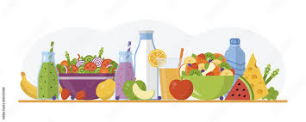
Children’s National General Nutrition Dietician Services Contact List
Diabetes Care Complex (main hospital) . . . . . . . . . . . . . .. . . . . . . . 202-476-5631
CHC Shaw . . . . . . . . . . . . . . . . . . . . . . . . . . . . . . . . . . . . . . . . . . . . . . 202-476-2123 (Option 3)
PG County ROC . . . . . . . . . . . . . . . . . . . . .. . . . . . . . . . . . . . . . . . . . . 301-276-9100
Montgomery County ROC .............................................................. 301-765-5400
Annapolis ROC . . . . . . . . . . . . . . . . . . . . .. . . . . . . . . . . . . . . . . . . . . .410-266-6582
Howard County ROC. . . . . . . . . . . . . . . . . . . . . . . . . . . . . . . . . . . . . ..301-847-2900

Slide 19
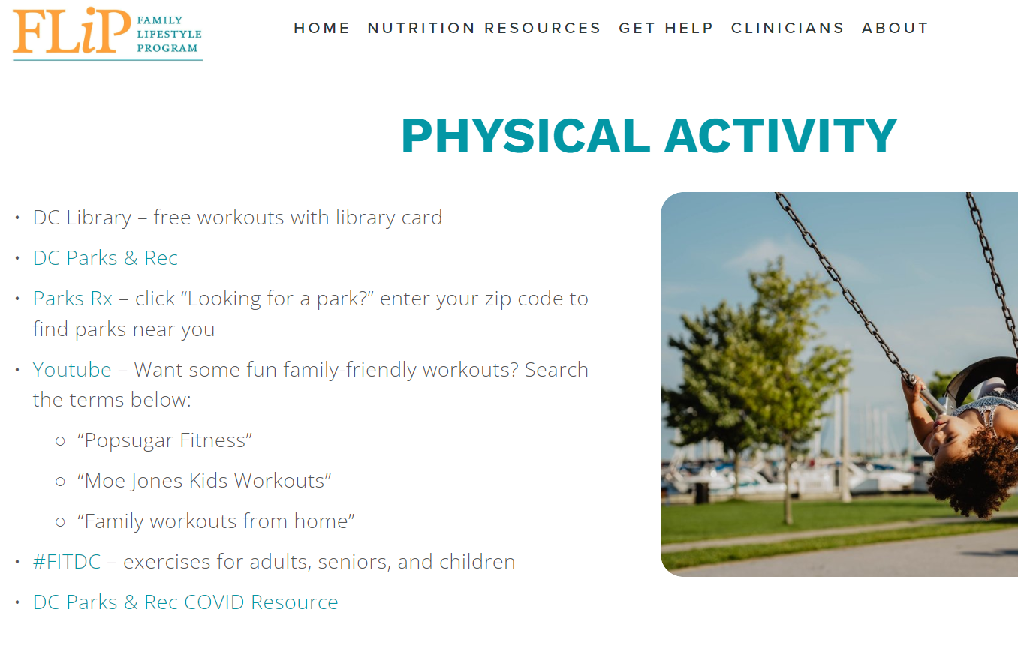
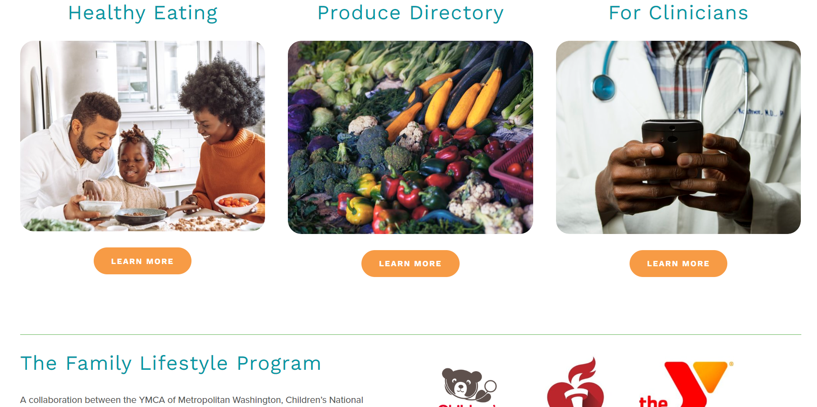
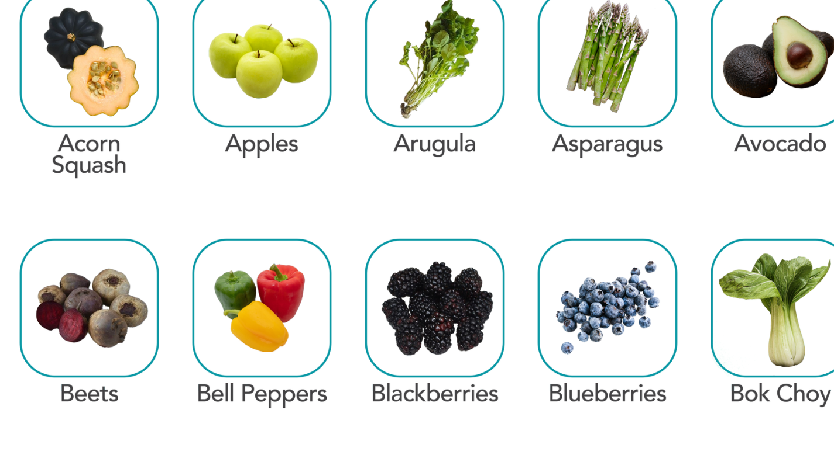
https://flipdc.org/

Slide 20
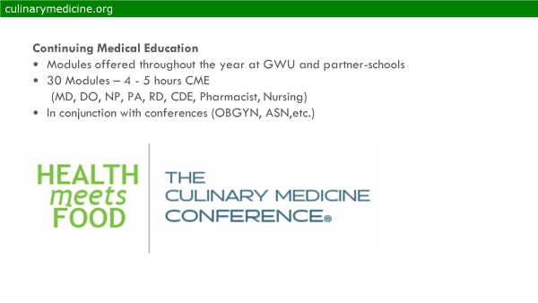

Slide 21
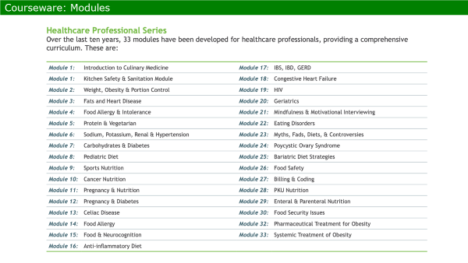

Slide 22
In practice IHBLT will be different for every patient with their medical home serving as a guide
For many patients a combination of health care visits and community-based programming may be key
A and her mother feel like they are in a stable place to afford healthy food and would like to learn more about nutrition to help A lose weight
You give them the number for the YMCA and Children’s National General Nutrition as an option to schedule with a dietician
You also plan to follow up with them once a month to help support them in making changes

Slide 23
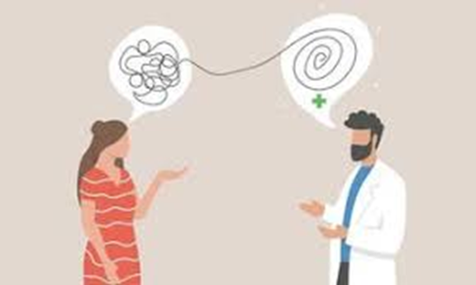
Motivational Interviewing
The medical home continues to serve the role as care
coordinator; your counseling can support these other more
Intensive efforts
Express Empathy
I was hoping we could discuss how things went with the dietician. I will plan to re-check her cholesterol after 6 months of diet changes. I know that for most of my patients they usually find that some of the dietician’s recommendations work for them and others don’t, could we discuss how you feel things went for you?
2. Develop Discrepancy
So it sounds like you’re mom and the dietician came up with some much healthier breakfast food ideas but you didn’t feel like she understood your busy after school schedule. As an athlete how do you feel about the type of fuel your putting in your body before practice?
3. Roll with Resistance It sounds like you feel that chips are easy to carry in your backpack and you’re not ready to give them up completely. But have you considered cutting back to only 2 days/week instead of all 5? What other snack options does your family keep in the house?
4. Support Self-Efficacy Since you want to have good energy for basketball and we want to help find foods with less cholesterol could you just have chips after school Friday and chose one of these options to bring with you to practice?

Slide 24
Why is this patient centered approach so important?
In one study of 2500 women recruited from a weight loss support group:
-69% reported experiencing stigmatization by a doctor
-52% reported this happened more than once
-Doctors were 2nd leading source of stigmatization
Puhl& Brownell, 2006

Slide 25
In Summary
Ask questions
-Ask permission to discuss weight
-Avoid stigmatizing terms (fat, obese) - preference for unhealthy weight or elevated BMI
-Use Motivational Interviewing (MI) techniques
-Focus on behaviors, not weight
-Focus on health, not appearance
-Consider having a few different programs that you refer patients to for support with a variety of health behavior goals based on their individual needs

Slide 26
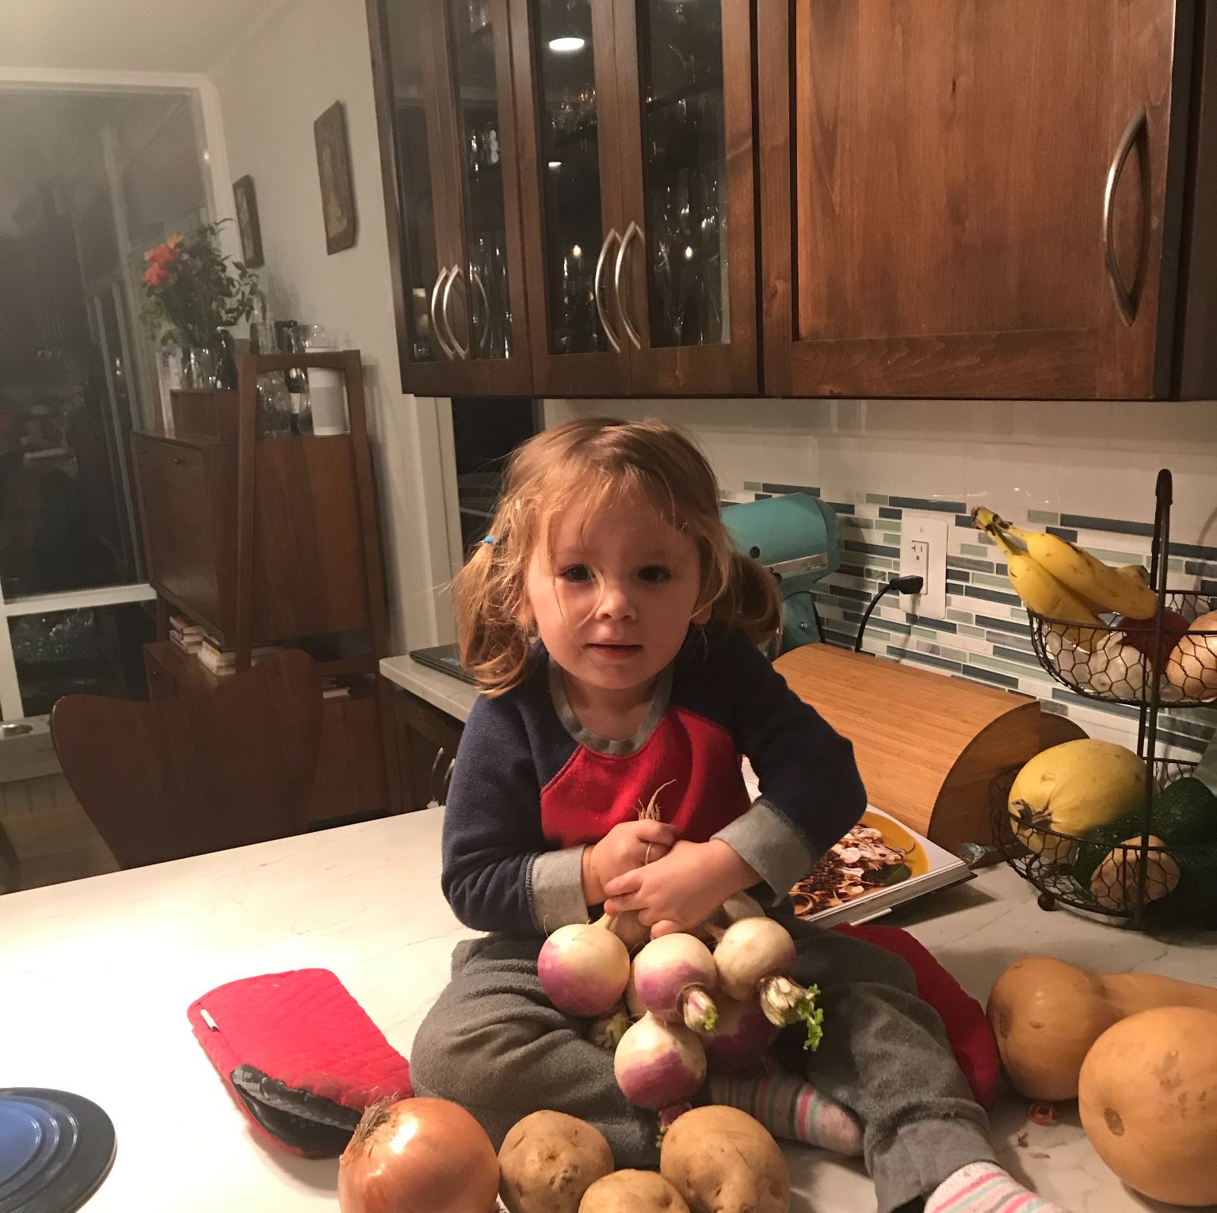
Thank you
Questions?

Slide 27
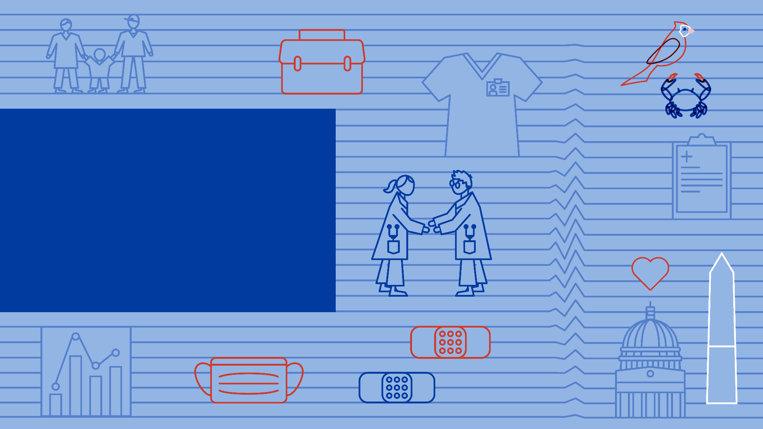
June 21, 2023

