Slide 1
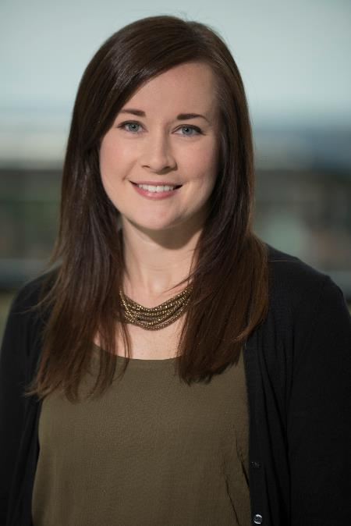
Motivational Interviewing: Tools for Helping Youth with Obesity
Molly Basch, PhD & Sarah Hornack, PhD
Licensed Clinical Psychologists
Departments of Adolescent Medicine & Psychology

Slide 2
Conflict of Interest
Presenters have no conflicts of interest to report.

Slide 3
Objectives
Define Motivational Interviewing (MI)​
Highlight research​ evidence
​Discuss key facets of the approach​
Present brief model for MI

Slide 4
Motivational Interviewing (MI)
According to Miller & Rollnick, this practice is “a collaborative conversation style for strengthening a person’s own motivation and commitment to change”
The spirit of MI: ​
Autonomy​
Collaboration​
Evocation​

Slide 5
MI Research Support
Resnicow et al. (2016) found that brief MI offered by pediatricians led to clinically meaningful reductions in BMI
4 MD visits, 6 RD visits over 2 years
Another trial found that pediatricians' acquisition of MI skills was associated with increased exercise, weight loss, and reduced screen time (Walpole et al., 2012)
Many pediatricians desire training, and recent training is associated with increased self-efficacy and perceived effectiveness of MI (Kraftt et al., 2018)

Slide 6
Primary MI Principles
Express Empathy
Provide a secure and caring interpersonal context
Considered a key component of psychotherapy
2. Develop Discrepancy
Reflect on and magnify the discrepancy between a person’s values and goals and their current behavior

Slide 7
Primary MI Principles
3. Roll with Resistance
Stop: Pause and consider the situation
Drop: Let go of current approach
Roll: Express understanding of youth/family point of view and emphasize personal choice
4. Support Self-Efficacy
Actual behavior change happens when the behavior is seen as important and the individual feels able to make the change

Slide 8
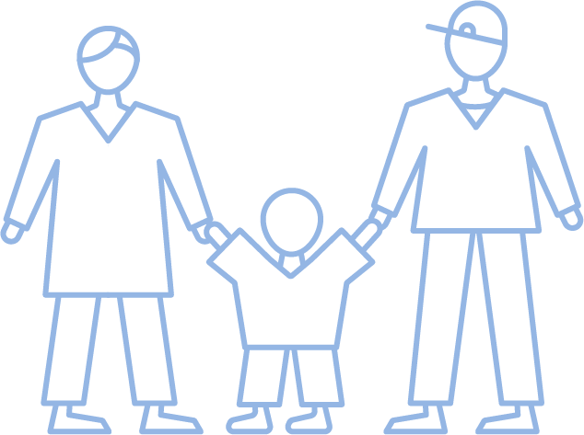
Group Reflection: word cloud
What feelings does pediatric obesity treatment in primary care bring out for you?

Slide 9
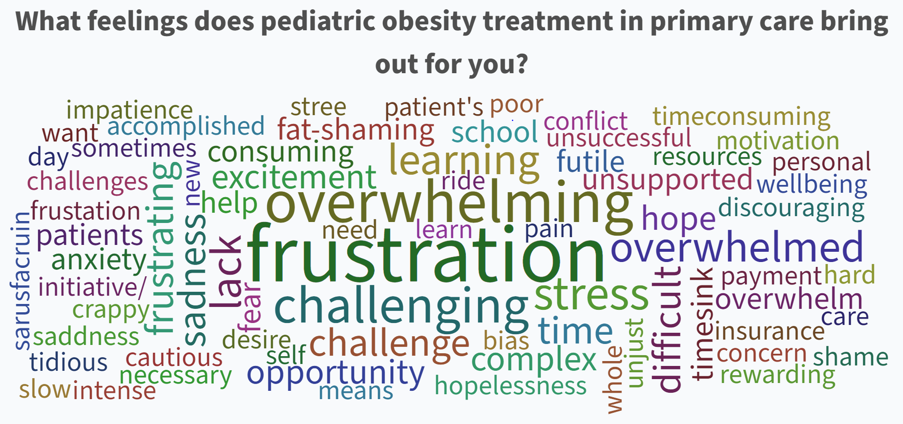

Slide 10
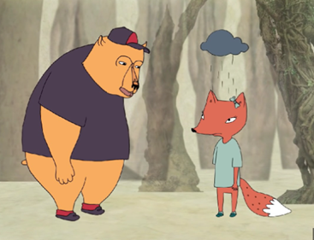
The Importance of Empathy
Brene Brown on empathy (3 min. video):
https://www.youtube.com/watch?v=1Evwgu369Jw

Slide 11
Practical MI Tool - FliP
Developed for implementation in primary care by the Family Lifestyle Program
15-minute intervention tool

Slide 12
Weight-related language tips
Least preferred terms: fat, morbidly or extremely obese, obese, large, chubby
More preferred terms: weight, unhealthy weight, high BMI, plus size (girls)
Be sensitive to individual differences: What words would you feel most comfortable with as we talk about your/your child's weight today?

Slide 13
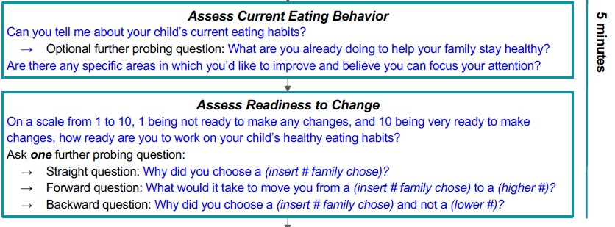
*May substitute in ratings on importance and confidence

Slide 15
Recognizing Autonomy & Building Commitment
If the family is not ready for major change, you may suggest:
Making a very small change
Thinking about change
Coming back for another session

Slide 16
Thank you!
Questions?
Sarah Hornack, PhD
shornack@childrensnational.org,
Molly Basch, PhD
mbasch@childrensnational.org

Slide 17
References
Resnicow, K, Harris, D, Wasserman, R, et al. (2016). Advances in Motivational Interviewing for pediatric obesity: Results of the BMI2 Trial and Future Directions. Pediatri Clin North Am., 63(3), 539-562. ​
Walpole, B, Dettmer, E, Morrongiello, BA, et al. (2012). Motivational Interviewing to enhance self-efficacy and promote weight loss in overweight and obese adolescents: A randomized controlled trial. J Pediatr Psychol, 38(9), 944-953.
Kraftt, C, Pat Frintner, M, Goodman, AB, et al. (2018). Pediatrician-Perceived Preparedness in Motivational Interviewing (MI) and Perceived Effectiveness in Counseling Children with Obesity [Poster]. Pediatric Academic Societies Annual Meeting. Pediatrician-Perceived Preparedness in Motivational Interviewing (MI) and Perceived Effectiveness in Counseling Children with Obesity (aap.org)
Naar-King, S., & Suarez, M. (2021). Motivational interviewing with adolescents and young adults. The Guilford Press.
Wood, A. (2020). Motivational interviewing workbook: Exercises to decide what you want and how to get there. Rockbridge Press.
Daniel J. Fischer & Theresa B. Moyers (2014) Is There an Association Between Empathic Speech and Change Talk in Motivational Interviewing Sessions?, Alcohol Treat Q, 32(1), 3-18. DOI: 10.1080/07347324.2014.856225

Slide 18
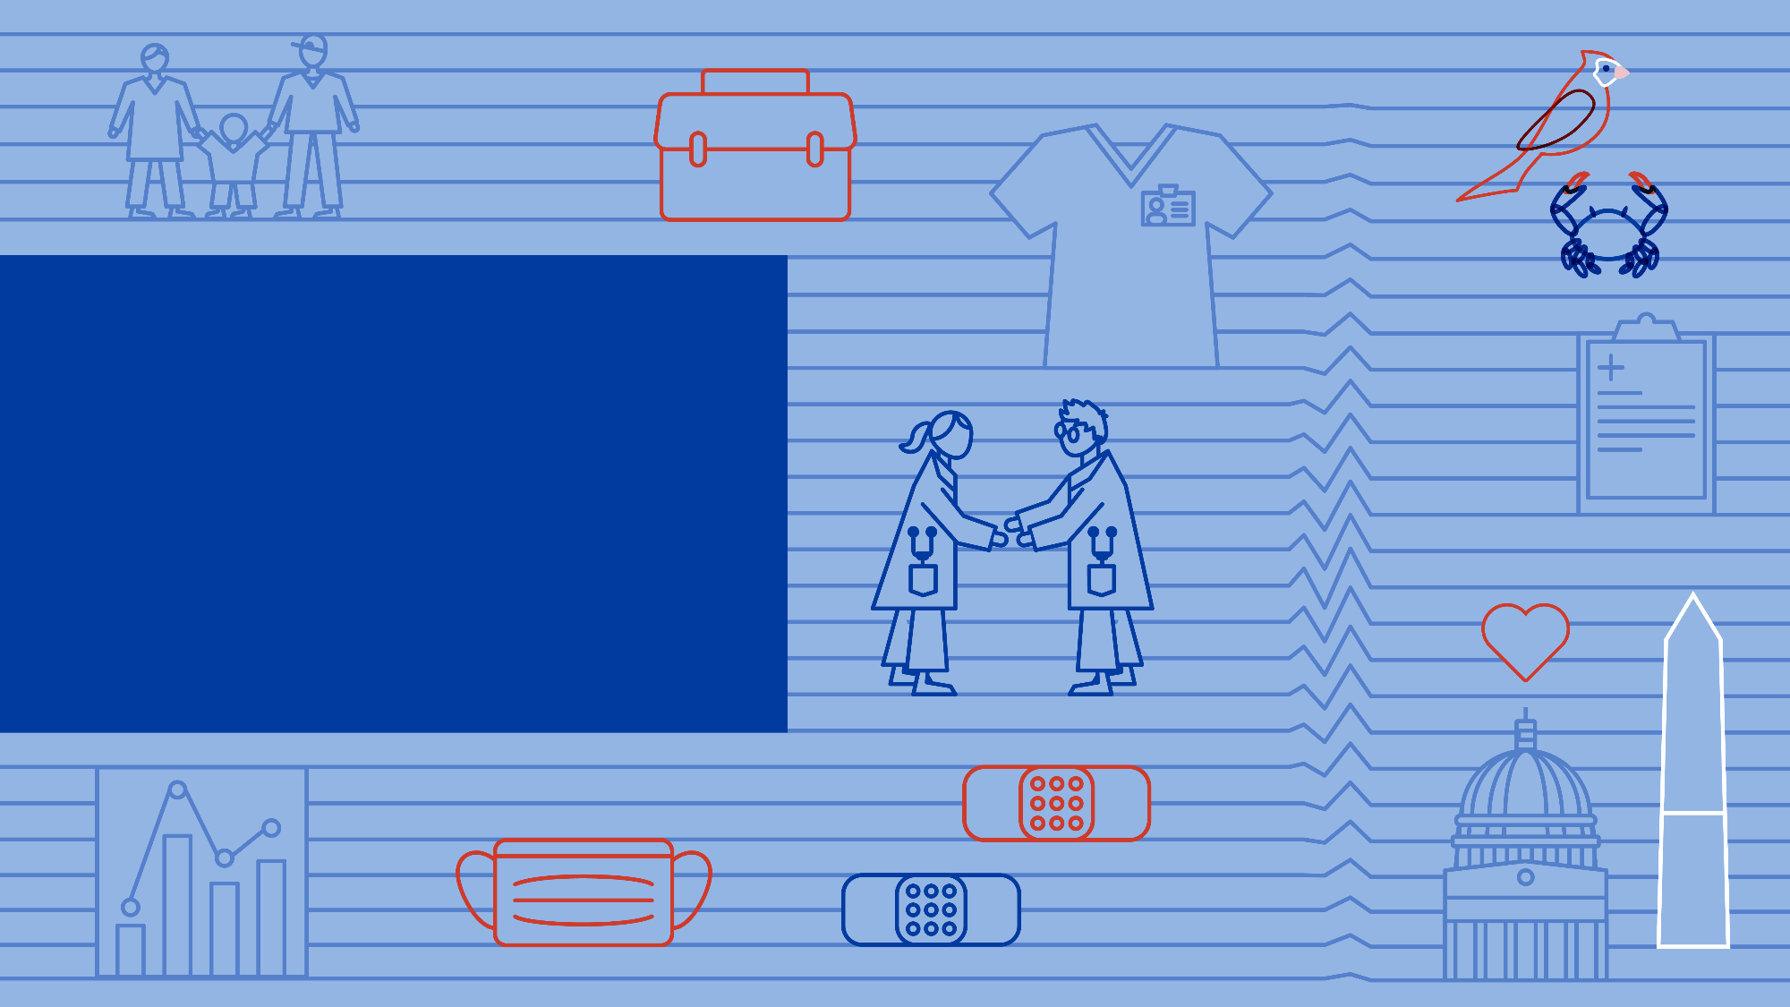
June 21, 2023

