Slide 1
Slipped Capital Femoral Epiphysis and Blount's Disease
Syed Imraan Ahmed Md, FAAOS
Pediatric Orthopedic Surgeon
Children's National Medical Center – DC

Slide 2
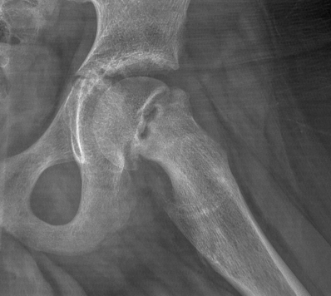
Slipped Capital Femoral Epiphysis SCFE

Slide 3
Ice cream is good…

Slide 4
Until it slides off the cone…

Slide 5
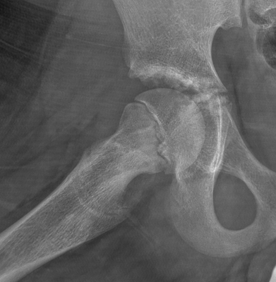
The femoral head is also good…

Slide 6
Until it slides off the neck…

Slide 7
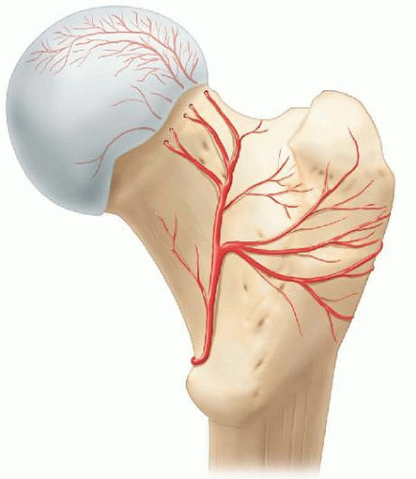
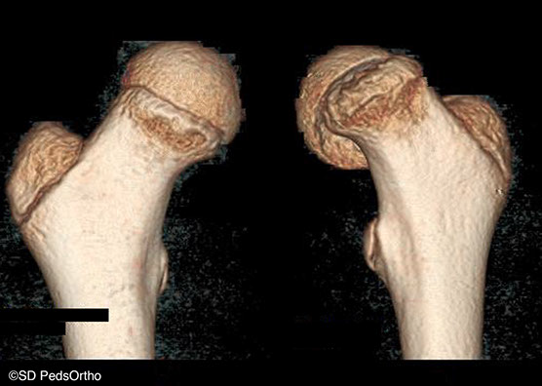
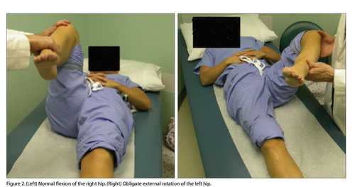
This is bad because….
Avascular necrosis
Impingement
Altered joint motion
Resulting in …
Pain
Arthritis
Limp
Abductor weakness
https://doi.org/10.3928/0090-4481-20060201-10

Slide 8
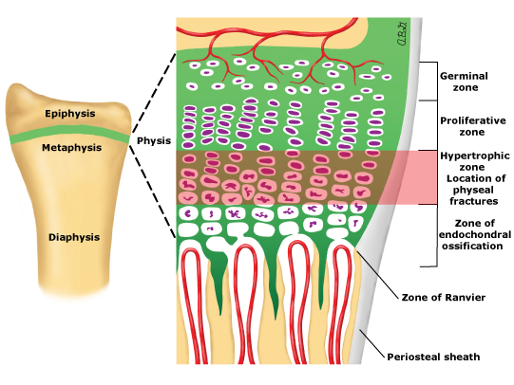
The Physis Fails
Fatigue: obesity
Molecular Level
Endocrinopathy
Hypothyroid
Growth Hormone deficiency
Renal Osteodystrophy
Pan-hypopituitarism

Slide 9
How not to miss?
Late Elementary to High School kid (10-16 yo)
Afebrile
Groin pain (distal thigh/knee pain)
Range of motion asymmetry: may externally rotate with flexion
Limp
Protect Weightbearing (crutch/wheelchair)
Order AP Pelvis and bilateral Frog XR
Coordinate with Ortho or ER
https://doi.org/10.3928/0090-4481-20060201-10

Slide 10
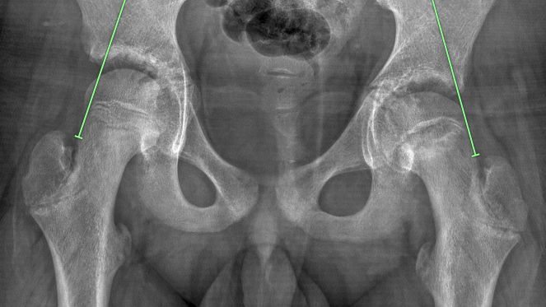
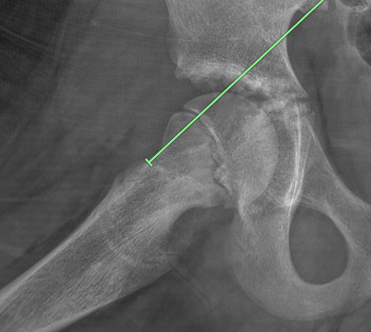
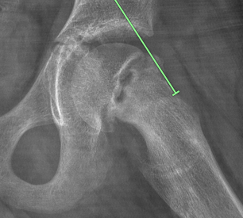
Left Klein’s Line Abnormal

Slide 11
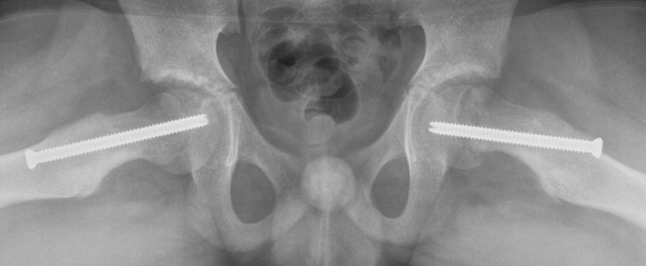
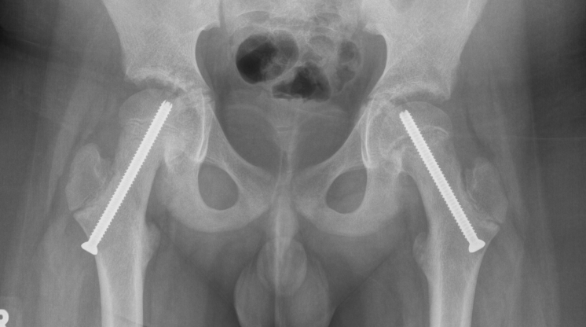

Slide 12
Differential of hip pain/limp by age:
Infant – transient synovitis, septic hip, hip instability (dysplasia)
Elementary – Legg Calve Perthes
Adolescent – SCFE
Other sources of hip pain/limp:
Trauma or overuse injuries
FAI (femoro acetabular impingement)
AVN (avascular necrosis)
Limb length difference

Slide 13
SCFE Summary
Presentation: Adolescent with limp, groin pain, distal thigh/knee pain
Exam: limited internal rotation, pain with motion
Imaging: AP and Frog Pelvis
MR rarely if XR unclear but SCFE highly suspected
Management:
Wheelchair or crutches
Discuss with Orthopedic Surgeon and/or send to the ER
Consult: Age, gender, obesity status, endocrinopathy status, laterality, symptom characteristic/duration, weight bearing or not, and imaging findings.

Slide 14
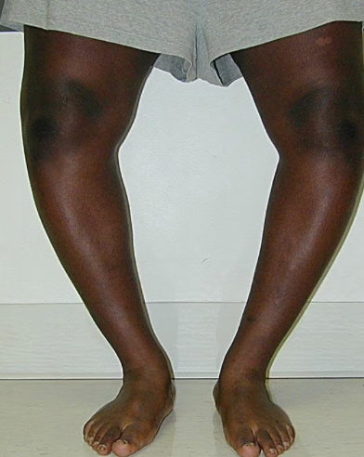
Blount’s Disease
Image: emedicine.medscape Dr. Standard

Slide 15
Blount’s Disease
Possible Consequences of Blount’s
Progressive
Joint destruction
Arthritis/Pain
Deformity: limb length difference, internal rotation, genu vara
Lateral knee ligament instability

Slide 16
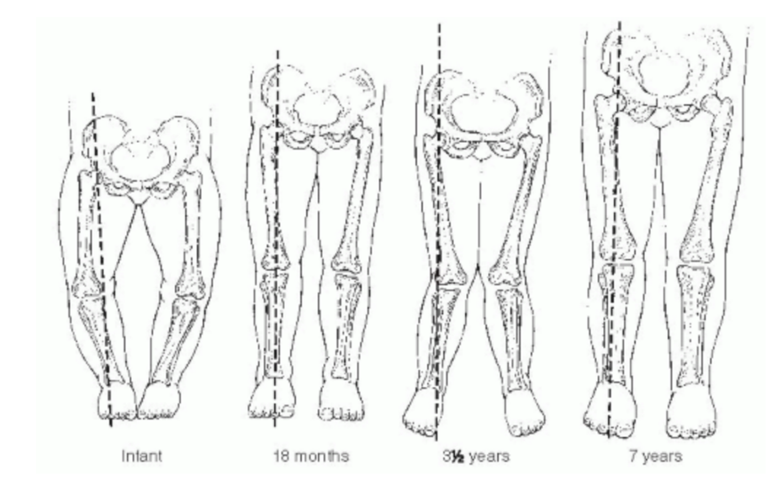
By 2 years you shouldn’t be bow legged.
Work up:
Hip to Ankle Alignment AP XR

Slide 17
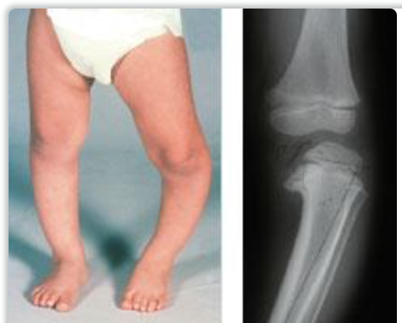
Flavors
Early Onset (2-4 years)
Bilateral
Metaphyseal Beaking, possible physeal bar
Immature: deformity progression/remodeling potential
Late Onset (Adolescent)
Unilateral
Deformity: mainly tibia, some femur
XR Differential:
Rickets, tumor, trauma
From OrthoInfo - TSRH
Image emedicine.medscape – Dr. Standard

Slide 18
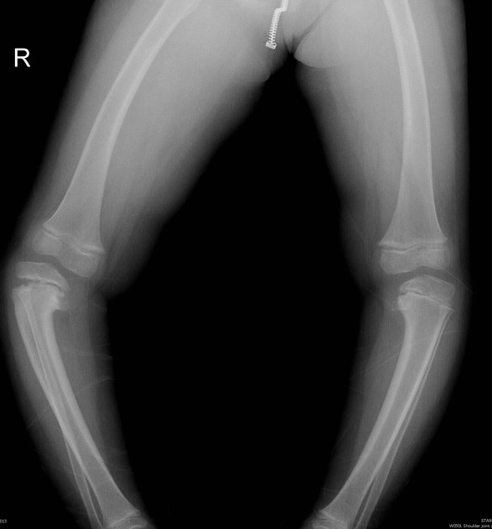
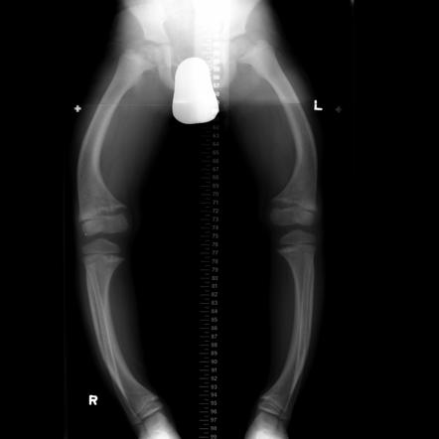
Blount’s vs Ricket
Fakhry MahmoudEEbouda,
Radiopaedia.org, rID: 38684
Angela Byrne,
Radiopaedia.org, rID: 8116

Slide 19
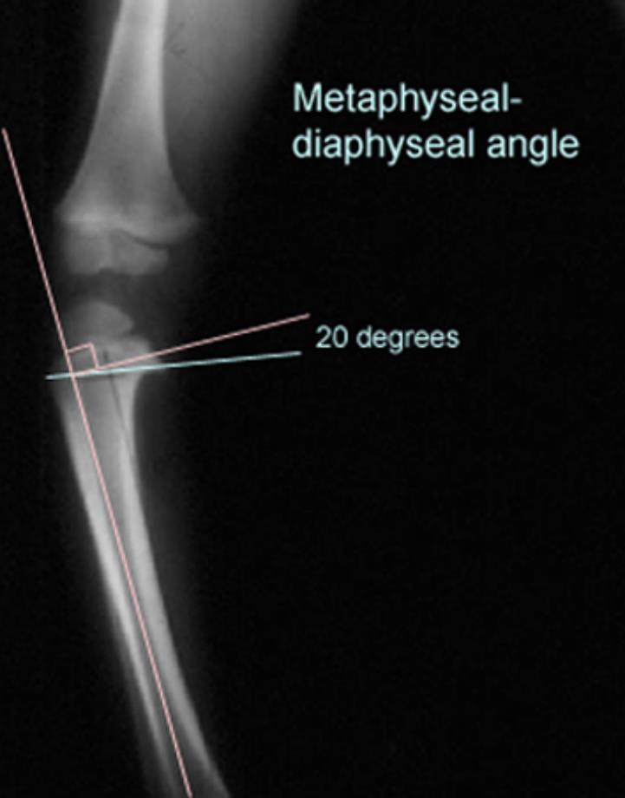
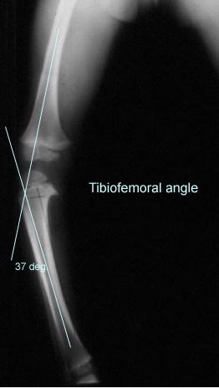
Abnormal
Tibia MD > 16 deg
Femur MD: Tibia MD < 1
Treatment Consideration
Healthy Physis Minimal Deformity
Healthy Physis with Deformity
Medial collapse/physeal bar
Limb Length Difference
Skeletally Mature

Slide 20
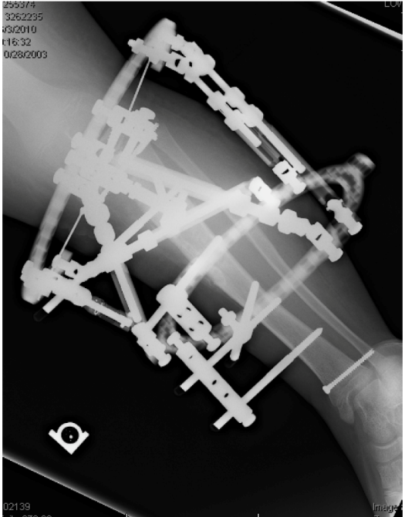
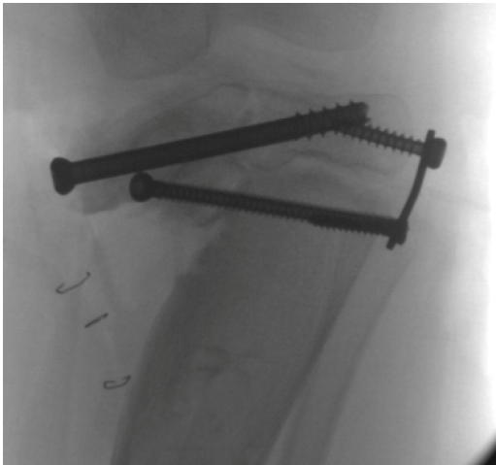
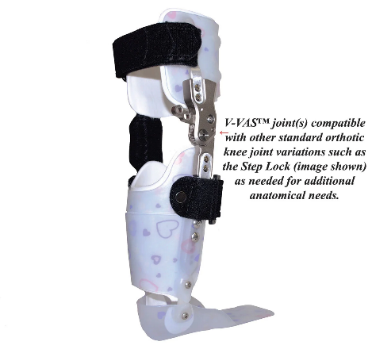
What does Ortho do?
Address limb length
Prevent further deformity
Correct deformity
Surgery before age 4
Brace < age 3
Robbins Children 2021

Slide 21
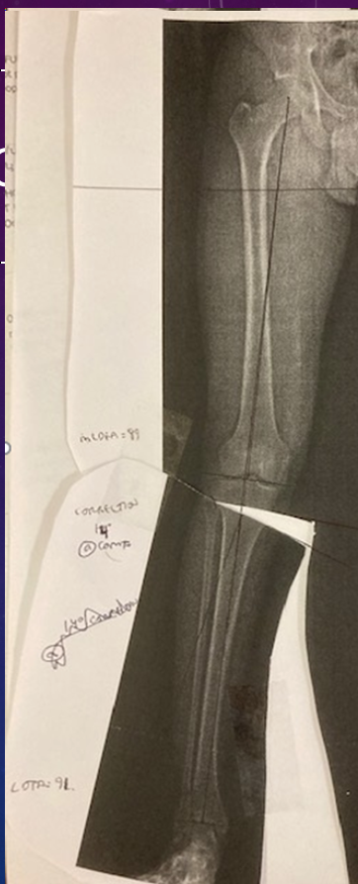
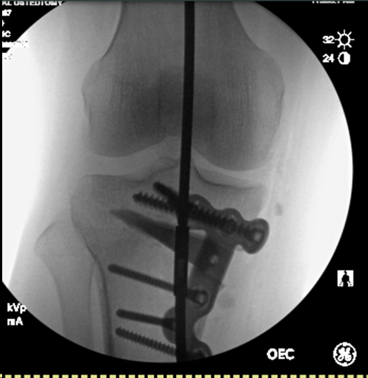
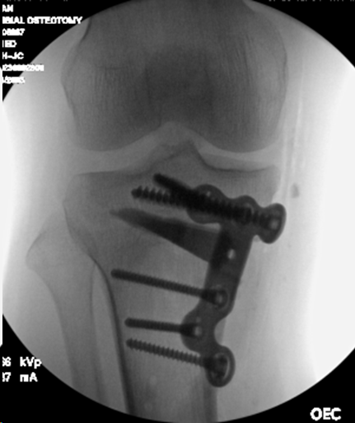
19 yo/m

Slide 22
Summary
Genu vara should resolve by around 1.5-2 years.
Warning signs: worsening, obvious deformity, asymmetry, pain, lateral joint thrust
Hip to Ankle AP XR for diagnosis

Slide 23
The End Questions/Comments: sahmed@childrensnational.org

Slide 24
June 21, 2023

