Slide 1
The Combined Dyslipidemia of (Central) Obesity …about more than preventing heart disease
Michele Mietus-Snyder, MD
Preventive Cardiologist

Slide 2
Quick Poll…
On a standard fasting lipid profile, focusing on reported TG, HDL-c & LDL-c,
the combined dyslipidemia of central obesity presents as
Elevated TG and low HDL-c (defining, with central obesity, the metabolic syndrome)
Elevated TG, low HDL-c, and elevated LDL-c
Elevated LDL-c and elevated TG
Elevated LDL-c and low HDL-c
Only elevated TG or elevated LDL-c or low HDL-c
All of the above

Slide 3
Goals
Review definitions & prevalence of combined dyslipidemia
What does this dyslipidemia tell us?
Consider current and future treatment strategies

Slide 4
What exactly is Combined Dyslipidemia?
Disordered packaging &/or clean-up of essential fats aka lipids
What is measured in a fasting lipid profile?
TC, TG, & how much of the total cholesterol is inside HDL particles
TC =Total
Cholesterol
BUT an HDL Particle, & all lipoproteins, carry more than Cholesterol
TG =Total Triglycerides
Cholesterol & cholesterol esters
Triglyceride
Phospholipids
Apolipoproteins

Slide 5
TC, TG and HDL-c are measured the rest of the Lipid Profile is Calculated
TOTAL CHOLESTEROL = LDL-c** + HDL-c + VLDL-c*
*VLDL-c ~
non-HDL-CHOLESTEROL = TC – HDL-c, accurate in fasting or non-fasting state
( = LDLc + VLDL-c; but you need a fasting TG to sort them out)
We became cholesterol-centric before the obesity epidemic, when fasting TG were normally cleared to < 50 mg/dl
∴ VLDL-c ~10 mg/dL
v
FASTING TRIGLYCERIDES / 5 when TG < 400 mg/dL….
**and then LDL-c = TC – (VLDL-c + HDL-c)

Slide 6
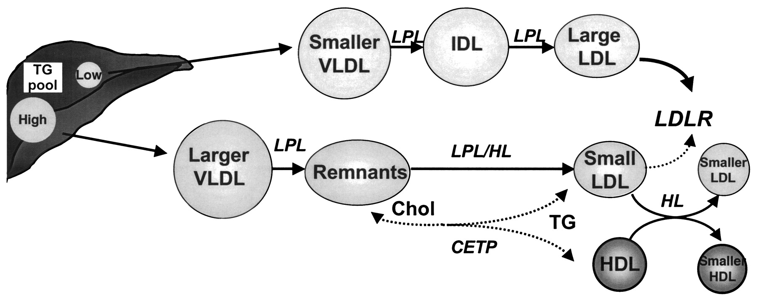
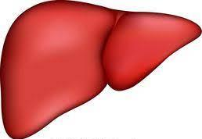
In an Insulin Sensitive Metabolism, TC = Mostly LDL-c + (~ ½ as much HDL-c & very little VLDL-c)
pre
HDL
Lge
HDL
HL
Stable Lge HDL-P
= Higher HDL-c
LOW
TG POOL
More Cholesterol, Less TG,
Well Cleared by LDLR
Less TG to package
Transient
LDL-R
Larger
VLDL
TG rich
Less LDL-c
TG ∴Lp Content & Size are Under Influence of Insulin

Slide 7
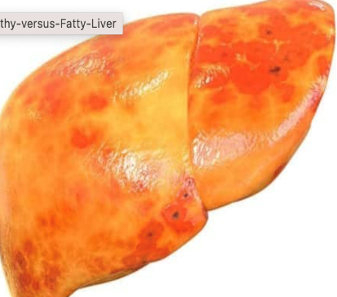
TG Clearance in Insulin Resistance Changes Everything, Driving Atherogenic Combined Dyslipidemia
pre
HDL
Lge
HDL
HL
High HDL-c
Insulin Sensitive
LOW
TG POOL
Transient
Larger
VLDL
Larger
VLDL
Less LDL-c
TG rich
HIGH
TG POOL
Insulin
Resistant
TG rich
Insulin
Resistant
MORE LDL-P
Not well cleared,
More non-HDL-c
More TG to package
More VLDL-c
Unstable,
Lower HDL-c

Slide 8
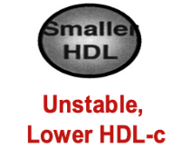
Typically, Combined Dyslipidemia = High TG, Low HDL-c with variable LDL-c (seldom > 160 mg/dl), but a high burden of smLDL-P
Larger
TG-rich
VLDL
& & (and increased non-HDL-c)
However, in an affected child, over time, you may see almost any variation of changes in the parameters of the lipid profile
except for very elevated LDL-c (> 160) in isolation
SO if dyslipidemia is associated with increased central adiposity, a positive Fm Hx T2DM, combined hyperlipidemia &/or central adiposity, it is likely a combined dyslipidemia

Slide 9
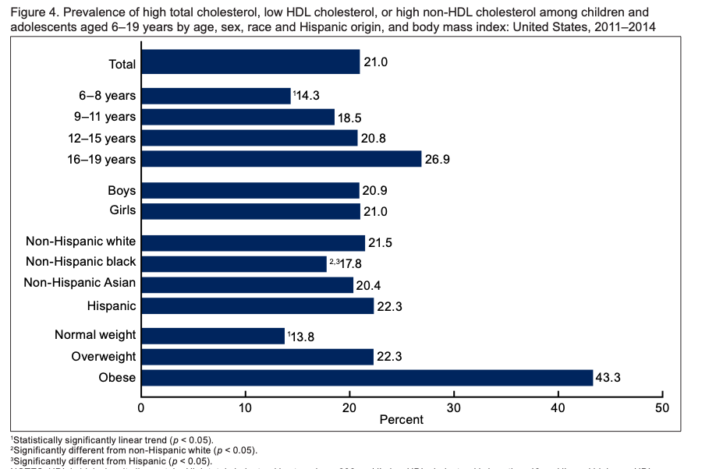
1 in 5 US youth are Dyslipidemic – 43.3% with obesity
Source: CDC/NCHS, National Health and Nutrition Examination Survey, 2011–2014 Using conservative thresholds: TC > 200, non-HDL-c > 145, (> 95th %ile) & HDL-c < 40 (<10th %ile)

Slide 10
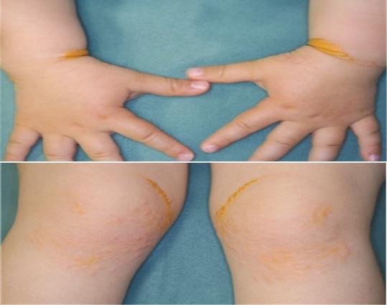
Familial Hypercholesterolemia – High LDL-c & large LDL-P
HoFH is rare – 1 in 160-300,000
Lipid deposits often visible
Rapid atherosclerotic heart disease
LDL-c > 600 mg/dL
Early and aggressive LDL-c lowering indicated
HeFH is not rare, affecting 1 in 500 – still << 1% of youth
Silent for 3-4 decades
LDL-c >160 mg/dL up to high 200’s, depending on the genetic cause (LDLR, apoB binding defect, PCSK9)
Adjunct lipid-lowering medication may be indicated – based on constellation of risk factors

Slide 11
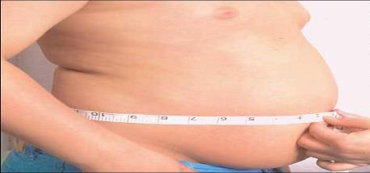
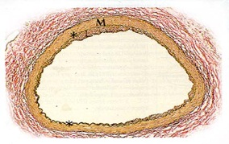
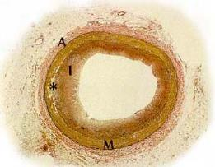
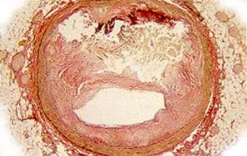
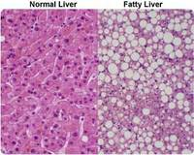
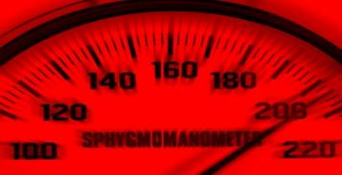
Combined Dyslipidemia – effectively the Metabolic Syndrome
Central weight distribution
Waist to Height Ratio > 0.5
As or more sensitive than BMI for risk prediction
Combined Dyslipidemia
High TG & low HDL-c
The 1st Pediatric Predictor of Adult ASCVD
Morrison, Princeton LRC F/U Study , 2012
Hypertension Hyperinsulinism
Often silent More common than
hyperglycemia
in youth

Slide 12
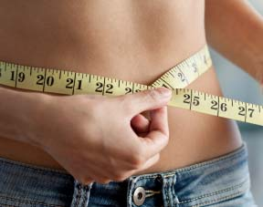
Multivariate Model for LDL-P in 2384 6th graders
2/3 of LDL-P variation predicted by waist circumference,
TG/HDL-c, nonHDL-c & HOMA-IR
TG/HDL-c > 2.5
(> 2.0 in F
& AA M)
TG/HDL-c < 2.0
LDL-c 130 mg/dl
WC:Ht
> 0.4 - 0.5
WC:Ht > 0.5
12
Mietus-Snyder et al, J Peds. 2013;163:355

Slide 13
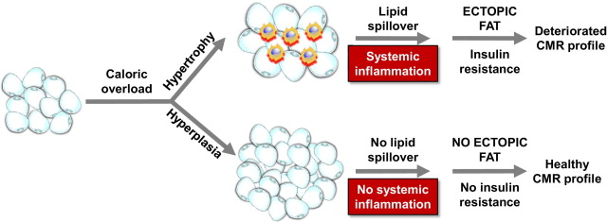
Cardiometabolic Risk, a Partial Lipodystrophy
Decreased capacity for adipocyte differentiation & proliferation to meet the
storage demands of excess calories

Slide 14
Normal Subq Adipose Tissue Overridden Sooner in Some
419 healthy young adults at range of BMI had fat biopsies
Impaired Subq adipogenesis & adipocyte hypertrophy at lower total body fat for those with + FHx T2DM
Positive family history T2DM, n =166
No family history T2DM, n = 253
Smith and Kahn. J Int Med. 2016

Slide 15
Lipids are Metabolic Signposts of Systemic Cardiometabolic Risk
The TG/HDL-c ratio strongly predicts insulin resistance in adults and youth
Demonstrated in a diverse SWAN cohort of 3302 American women (age 40’s) over 3.5 yrs
Yu W et al. Study of Women’s Health Across the Nation. BMJ 2022
And evident in 404 Korean preadolescents with obesity followed over 2 yrs
You-Xiang C and Lin Z. BMC Public Health 2023
TG, HDL-c and sm LDL-P were the strongest predictors of T2DM in 26, 836 healthy women over 12 yrs in Women’s Health Study (excluding HbA1c > 6.0%)
Mora S et al. Diabetes. 2010
LPIR (a lipid phenotype score weighted for small LDL-P) is as strong a predictor as HbA1c of T2DM in WHS over 20 yrs
Harada P et al. J Clin Lipidology. 2017

Slide 16
2011 Lipid Screening Guidelines Incorporate Cardiometabolic Risk because these factors predict more atherogenic smLDL-P
Criteria | Moderate Risk | High Risk = + Fm Hx CVD [ASVD in Parent or Grandparent Men < 55 yr; Women <65 yr]
BMI | >95th < 97th percentile | > 97% percentile
Hypertension | HBP w/o RX | HBP (>99% + 5 mm Hg) w/ RX
Cigarette smoking | ----- | Current smoker
HDL-C | < 40 mg/dl | -----
Inflammatory medical conditions | Kawasaki disease w/ regressed coronary artery aneurysms | KD with current aneurysms 2020 add-in: MIS-C
 | Chronic inflammatory disease (JRA, SLE) | Type 1 and 2 DM
 | HIV | Post orthotopic Heart Tx
 | Nephrotic Syndrome | CKD/post renal transplant

Slide 17
WHEN Adjunct Lipid-Lowering Therapy is Indicated
Pediatrics 2011 Dec;128 Suppl 5:S213-56
PEDIATRIC THRESHOLDS | ACCEPTABLE < 75th HDL-c > 50th | BORDERLINE 75th-95th HDL-c 10th-50th | ABNORMAL > 95th HDL-c < 10th
TC | <170 | 170−199 | >200
LDL-c | <110 | 110−129 | >130*
Non-HDL-c | <120 | 120−144 | >145
TG | 0−9y: <75 10−19y: <90 | 75−99 90−129 | >100 >130
HDL-c | >45 M >50 F | 40−45 | <40
*PEDI LDL-c PharmaThresholds
~99th %ile
> 190
or
> 160 + risk
(1 HIGH or 2 MOD)
or
>130 + + risk
(2 HIGH or
1 HIGH & 2 MOD)
LDL-c <95th %ile for children in general, <75th %ile in those with diabetes Target TG < 75th %ile

Slide 18
Two 12 year olds with the same TC & LDL-c but TG changes everything
CASE 1: BMI 88th %ile; athletic; + family history of late CVD,
WHR 0.48, Normal fasting TG = 50
TC = LDL-c + HDL-c + VLDL-c
195 55
CASE 2; BMI 98th %ile; sedentary; + family history early CVD & DM2
WHR 0.58, fasting TG = 200
TC = LDL-c + HDL-c + VLDL-c
195 25
Non-HDL-c
135
TG/HDL-c <1
130
10
Non-HDL-c
170
TG/HDL-c = 8
130
40
On the basis of LDL = 130 mg/dL +/- elevated TG 6 month trial of lifestyle therapy

Slide 19
Another 12 yo at the cusp of defined thresholds…
CASE 3: BMI 85th %ile; normal activity; + family history T2DM, no known CVD
WHR 0.50, fasting TG = 115
TC = LDL-c + HDL-c + VLDL-c
195 43
Non-HDL-c
153
TG/HDL-c = 2.7
129
23
Consider common triggers for the combined dyslipidemia phenotype
An “all American” diet, rich in processed CHO, fiber poor, inadequate fruits, veggies & fish
Physiologic insulin resistance of peripubertal years
Bursts of accelerated weight gain (even within normal weight range)
Use of 2nd generation psychotropic medications
and in older girls, estrogen-containing OCP
Redouble heart healthy counseling before this crosses over to high risk

Slide 20
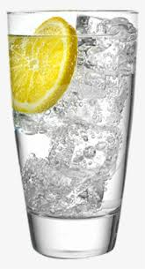
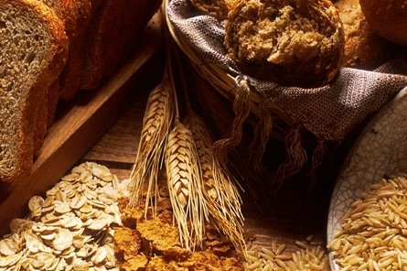
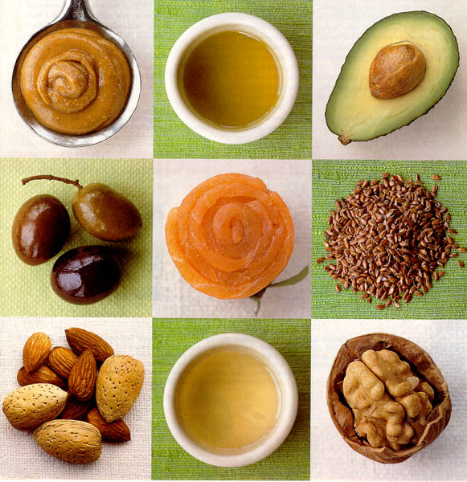
Heart healthy “CHILD Diet” is Plant Centered Breastfeeding through at least 12 mo, as possible – transition to low fat, unflavored milk as the only caloried beverage – o/w kcals from food. Drink water!
CHO UPGRADES
Avoid SSB (aka fast sugar)
Counsel teens to avoid ETOH!
Increase Fiber Intake = low GI
- more veggies & whole fruits
- more whole grains
FAT UPGRADES
Avoid Trans Fats
Limit Saturated Fats (8-10%)
Favor MUFA & PUFA
Increase esp. omega 3 PUFA
- more fish
- walnuts, flax & chia seeds
PLUS ONE HOUR MVPA/day!

Slide 21
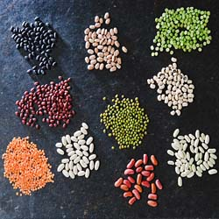
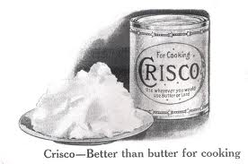
and Protein Upgrades
It would be safe for most Americans to cut back on dietary protein overall – usually 2-2.5x RDI
Protein & other macronutrient upgrades Overlap
More cold water fish intake = more omega 3 PUFA
Aim for lean & unprocessed meats = less SFA
Think “Flexitarian”- more plant protein = more fiber
Dietary cholesterol (eggs) have conflicting evidence
- variable LDL-c response;
- consensus is limit to ~1 a day
- may be particularly important in T2DM
In nature, foods aren’t delivered in a vacuum
– keeping food REAL avoids processed proteins
& delivers a balance of nutrients -
better tuned to both our own and our
biome’s metabolism

Slide 22
Adjunct Nutraceutical Therapy for TG Lowering
Omega 3 Fatty Acid Marine Fish Oil Supplements
Lovaza ($$$) - Ultra-concentrated 90% bioactive DHA + EPA; Vascepa ($$$$) – just EPA
2 gm/d bioactive omega 3 for TG lowering
OTC preps with 90% purity are available & more affordable
For vegans: pure DHA (algal sourced)
Both DHA & EPA achieve TG-lowering and increase LDL-P size
pre-post 8 wk, n=42 | Lovaza (4 g/d) | Placebo | p
TC (mg/dl) | -1.7 (5) | -3.0 (5) | .83
Triglycerides (mg/dl) | -52 (16) | -16 (16) | .04
LDL-c (mg/dl) | + 8 (3) | 0 (3) | .14
Gidding, J Peds 2014:165:497-503
~ one oz of salmon so a 3 oz filet twice a week ~ one gel cap daily.
Fish intake in meta-analysis associates with ↓ CVD; jury still out for omega 3 alone

Slide 23
What happened after 6 mo Trial of Lifestyle?
12 yo #1; BMI still 88th %ile; athletic; no family history of CVD, WHR 0.48 (stable)
still normal fasting TG = 45 (↓10%)
TC = LDL-c + HDL-c + VLDL-c
185 122 55 8
(↓5%) (↓6%) (no δ ) (↓20%)
12 yo #2; BMI 96th %ile (↓2% ile); walking more; + FHx history DM2 & CVD, WHR 0.55 (↓.03),
Improved fasting TG = 150 (↓25%)
TC = LDL-c + HDL-c + VLDL-c
205 143 32 30
(↑5%) (↑10%) (↑28%) (↓25%)
Non-HDL-c
130 (↓4%)
TG/HDL-c <<1
Continue Lifestyle Therapy; check lipids again age 17
Non-HDL-c
173 (↓1%)
TG/HDL-c = 4.7 (↓41%!)
Continue redoubled Lifestyle; discuss adjunct Rx; follow q 6 mo
12 yo #3; BMI 82th %ile (↓2% ile); joined a soccer team; no family history of CVD, WHR 0.48 (↓.02), normalized fasting TG = 82 (↓29%)
TC = LDL-c + HDL-c + VLDL-c
194 129 49 16
(↓1%) (no δ) (↑14%) (↓30%)
Non-HDL-c
136 (↓11%)
TG/HDL-c = 1.7 (↓37%!)
Continue Lifestyle Therapy; check lipids again age 17

Slide 24
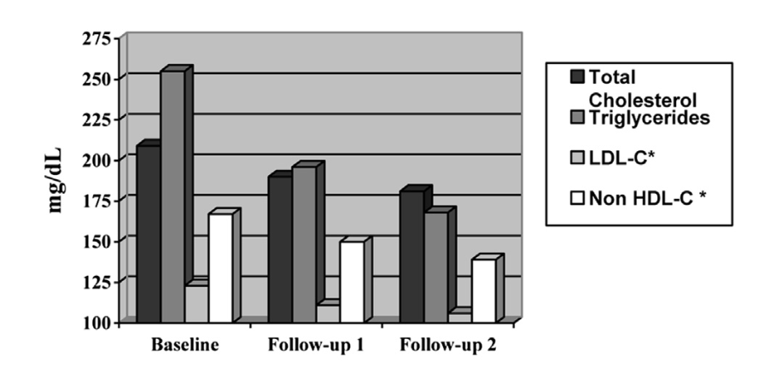
Combined Hyperlipidemia Responds to Lifestyle
In 55 adolescents with combined dyslipidemia and obesity, lifestyle improved lipids
over 9 mo average F/U, in association with a modest change in BMI (-0.67 kg/M²)
(no change in HDL-c)
Pratt and Kavey 2014, J Clin Lipidology

Slide 25
The Bar is Set High for Pediatric Adjunct Statin Therapy
But when crossed:
Statins are proven effective in lowering LDL-c and LDL-P
Pleiotropic anti-inflammatory effects are credited with some TG lowering
Very safe in youth for liver and muscle side effects
Even in the presence of NAFLD
BUT the potential for increased lifelong T2DM risk needs to be better understood
Statin ASCVD prevention benefits outweigh risk of T2DM in adults
Children could potentially have a longer lifelong exposure

Slide 26
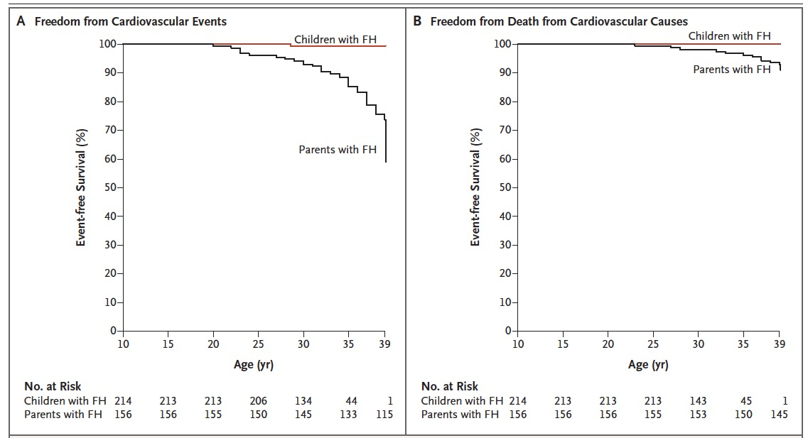
Early & Sustained Statin Rx Improves 20 yr outcomes in FH
Luirink et al, NEJM, 2019

Slide 27
The Dyslipidemia of Obesity in Teens Study
NHLBI Pediatric Heart Network RCT of Pitavastatin
Primary Aim
Superimposed on evidence-based nutrition and activity counseling:
To compare the effect of pitavastatin versus placebo on vascular health (arterial stiffness and CIMT) in 100 adolescents with excess adiposity (body mass index ≥85th percentile) and combined dyslipidemia
Secondary Aims
To compare the effect of pitavastatin versus placebo on safety measures
To compare the effect of pitavastatin versus placebo on lipid phenotype
Enrollment just closed in April 2023 and analyses are underway – we will know more soon!

Slide 28
In Summary
Combined dyslipidemia is prevalent
It is an early indicator of insulin resistant metabolism with systemic, but preventable consequences
It responds to underutilized insulin sensitizing lifestyle behaviors
Statins may be indicated when lifestyle proves inadequate
Thank you for your attention and care of our region’s children!

Slide 29
June 21, 2023

