Slide 1
Prediabetes and Type 2 Diabetes in Children
Elizabeth Estrada, MD
Director, Type 2 Diabetes Program
Children's National Hospital
Clinical Professor of Pediatrics

Slide 2
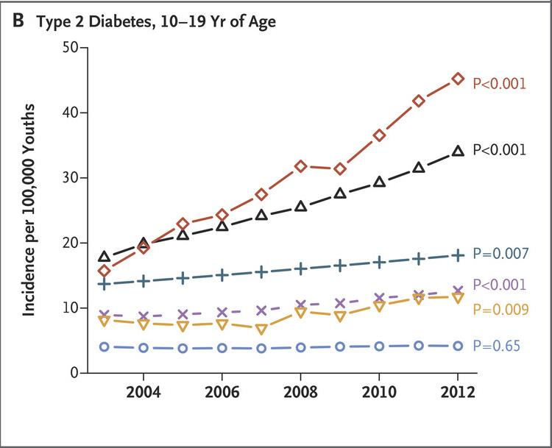
Incidence of Type 2 Diabetes in Youth
N Engl J Med 2017;376:1419-1429
More than 4-fold increase projected in the next decades
N.A.
A.A.
HISP.

Slide 3
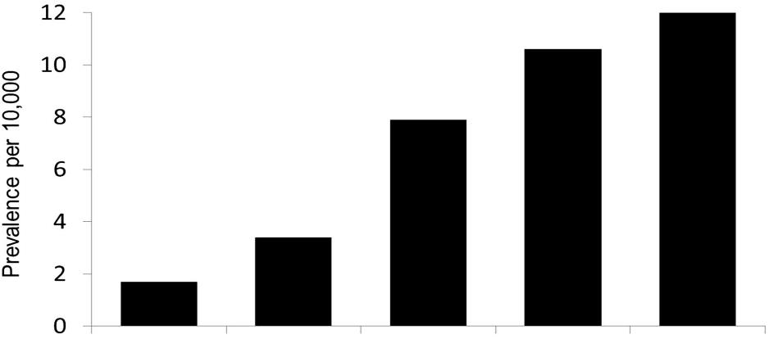
Disparity in Prevalence of Type 2 Diabetes in Youth
SEARCH for Diabetes in Youth study
Nadeau et al. Dia Care 2016;39:1635
Prevalence by Race/Ethnicity
Type 1 diabetes 19.3 per 10,000
Type 2 diabetes 10 per 10/000 in African American
Ages 10–19 years
2009
Hispanic
American Indian
Non-Hispanic White
African American
Asian Pacific Islander

Slide 4
New-Onset Type 2 Diabetes: Pandemic effect B. Marks et al. Horm Res in Paediatrics, 2021
Number of new cases almost tripled
Higher proportion of Non- Hispanic Black and publicly insured
Increased severity of initial presentation (DKA, HHS)
Type 2 diabetes: before pandemic 24% of all newly diagnosed, increased to 43.7%

Slide 5
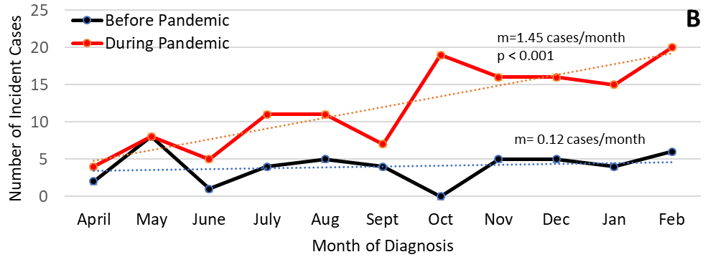
Children’s National Data 2020-2021: Pandemic Effect on Type 2 Diabetes New Cases B. Marks et al. Horm Res in Paediatrics, 2021
Type 2
Type 1

Slide 6
Prediabetes

Slide 7
Prediabetes: Prevalence
Andes et al. JAMA Pediatr. 2020;174(2):e194498.
Cross-sectional analysis NHANES 2005-2016:
About 1 of 5 adolescents have prediabetes
Increased from 1.8% in 1988-1994
Higher in males and non-Hispanic Blacks

Slide 8
Prediabetes
1 in 4 progress to type 2 diabetes within 2 years
Increased risk for CVD

Slide 9
Pathophysiology
Genes
Obesity
Lifestyle
High fat diet
Puberty
Insulin
Resistance
β-cell
Function
Pre-diabetes
Diabetes

Slide 10
Screening Guidelines: Risk-based BMI ≥85%, >9 years or Tanner 2
ADA Position Stataement. Diab Care 2018; 41(12)
One or more additional risk factors
Maternal diabetes during the child's gestation
Family history of type 2 diabetes in first- or second-degree relative
High risk race/ethnicity:
Native American, African American, Latino, Asian American, Pacific Islander
Signs or conditions associated with insulin resistance
Acanthosis nigricans
HTN
Dyslipidemia
PCOS
SGA

Slide 11
Screening Labs: Interpretation
Diabetes Care 2018 Jan; 41(Supp 1): S13-S27
Test | Pre-Diabetes |  | Diabetes
 | Impaired fasting glucose (IFG) | Impaired glucose tolerance (IGT)
Fasting Glucose | 100-126 mg/dl |  | ≥126 mg/dl
2-hr OGTT |  | 140-200 mg/dl | ≥200 mg/dl
Random Glucose |  |  | >200 mg/dl plus symptoms
HbA1C | 5.7-6.4% |  | ≥6.5%

Slide 12
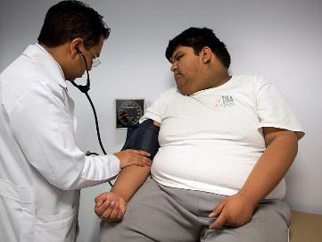
Presentation
Asymptomatic
Vaginitis, UTI
Obesity – Consider weight loss prior to diagnosis
Acanthosis nigricans
Polyuria, polydipsia, weight loss
DKA or HHS, more frequent in Blacks

Slide 13
Management

Slide 14
Management
Lifestyle changes
BG monitoring
Medications

Slide 15
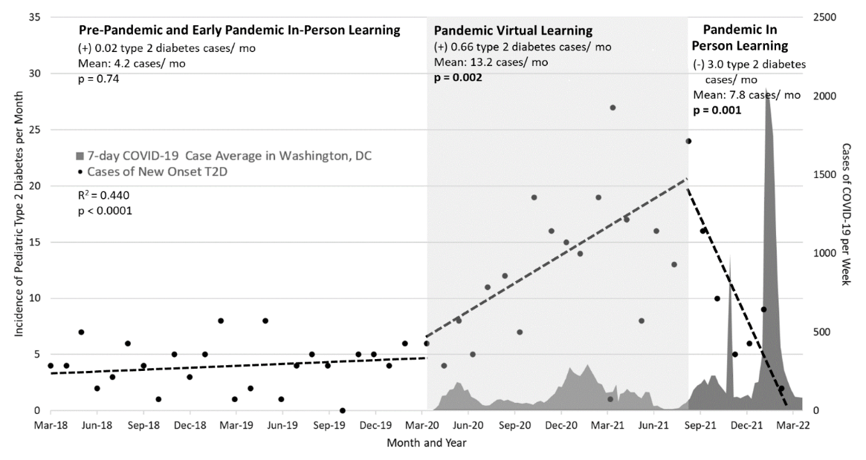
Increase in Type 2 Diabetes New Cases During COVID-19 Virtual Learning - Children’s National Data Grundman, J et al. ISPAD, October 2022, Abu Dhabi
Pre-pandemic in-person learning: 4.2 cases/month
217% during virtual learning: 13.2 cases/month
Declined with return to in-person learning: 7.8 cases/month
Disproportionate impact on underserved communities
NHB 4.2 times
Hispanics 2.1 times
COVID-19 infection rates at diagnosis were low (2.5%). No correlation with diabetes incidence

Slide 16
Weight loss goal 7-10%
Management
Insulin
Resistance
Lifestyle changes
Weight management
Pre-diabetes
? Metformin
Metformin, GLP-1 analogs, insulin
Other oral meds
Bariatric surgery
Diabetes

Slide 17
Medications
Oral medications:
Metformin
SGLT-2 inhibitors (glycosuria)
Exenatide oral
Dipeptidyl peptidase 4 (DPP-4) inhibitors
Thiazolidinediones (TZDs)
Sulfonylurea
Colesevelam (Welchol)
Alpha-glucosidase inhibitors
Injectable:
Glucagon like peptide -1 (GLP-1) receptor agonists
Liraglutide (Victoza, daily)
Exenatide (Bydeuron, weekly)
Dulaglutide (Trulicity, weekly)
GLP-1/GIP receptor agonists (Trepizatide weekly)
Insulin

Slide 18
N Engl J Med 2012; 366:2247-2256
Hypothesis:
Early initiation of therapy to reduce insulin resistance during puberty will be beneficial in youth with T2DM
Treatment arms:
Metformin
Metformin + rosiglitazone
Metformin + intensive lifestyle
Outcomes:
Time to loss of glycemic control (treatment failure)

Slide 19
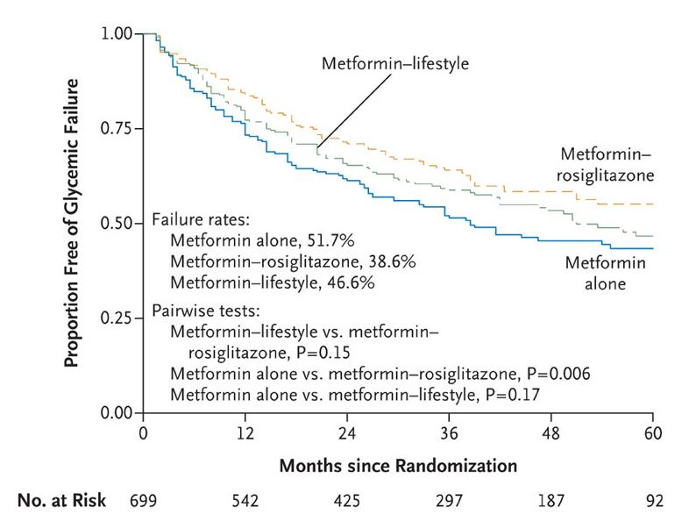
Survival from Glycemic Failure
TODAY Study
45.6% loss glycemic control with on a median time of 11 months
Addition of rosiglitazone, but not intensive lifestyle, was superior to metformin alone
Monotherapy with metformin was associated with durable glycemic control in approximately half of subjects

Slide 20
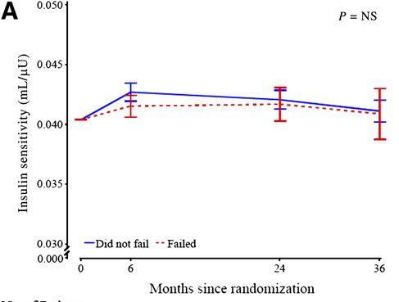
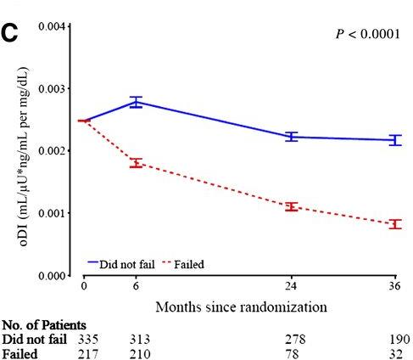
OGTT-Derived Measures All 3 treatment groups
β-cell loss is progressive and rapid
Loss of β-cell function is the primary predictor of failure of glycemic control
TODAY Study Group Dia Care 2013;36:1749

Slide 21
Metformin
GI side effects
Dose 2000 mg daily (BID or QD-ER)
Weekly increments of 500 mg
Discontinue metformin before radiological studies with contrast, during severe illness or surgery – risk of lactic acidosis
Early loss of glycemic control if used as monotherapy
50% treatment failure within 1y

Slide 22
Metformin – Mechanism (?)
Reduces hepatic glucose production
Mild increase insulin sensitivity
No change in insulin secretion
Does not cause hypoglycemia

Slide 23
Incretins: GLP-1, GIP
GLP-1 - Glucagon-like peptide 1
GIP - Glucose-dependent insulinotropic polypeptide
“Incretins" link the absorption of nutrients from the GI tract with pancreatic hormone secretion: insulin, glucagon
Released after ingestion and absorption of glucose, protein, and fat

Slide 24
Once-Weekly Dulaglutide for the Treatment of Youths with Type 2 Diabetes
Arslanian, et al - NEJM June 2022
Double-blind, placebo-controlled, patients on metformin or basal insulin,
26-week trial, randomized and 26-week open-label extension
Once-weekly injections placebo, dulaglutide 0.75 mg, or 1.5 mg
Figure 1. Change in the Glycated Hemoglobin Level, a Glycated Hemoglobin Level of Less Than 7.0%, and Changes in the Fasting Blood Glucose Concentration and Body-Mass Index (BMI) at Week 26.
Shown are the change from baseline at week 26 in the glycated hemoglobin level, the primary end point (Panel A); the percentage of participants with a glycated hemoglobin level of less than 7.0% at week 26 (Panel B);

Slide 25
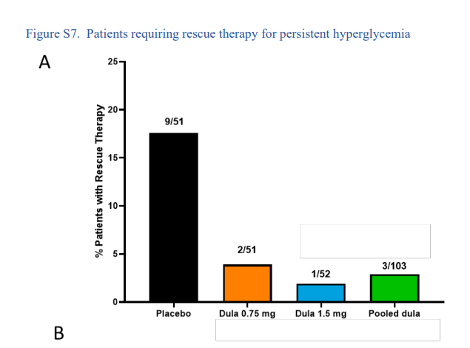
Once-Weekly Dulaglutide for the Treatment of Youth with Type 2 Diabetes Arslanian, et al - NEJM June 2022
Improvements in glycemic control with dulaglutide persisted through 52 weeks
Compared to TODAY trial, dulaglutide therapy appear to be potentially promising

Slide 26
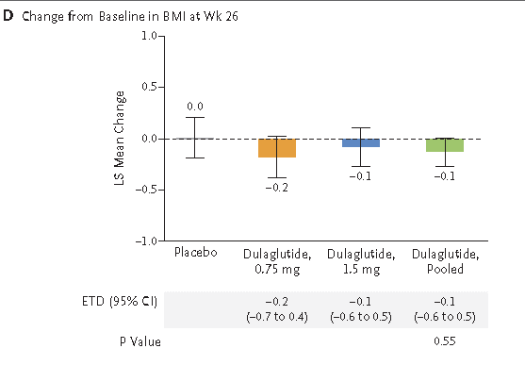
Once-Weekly Dulaglutide for the Treatment of Youths with Type 2 Diabetes Arslanian, et al - NEJM June 2022
No significant BMI change from baseline at week 26

Slide 27
GLP-1 RA
Longer-acting GLP-1 receptor agonists reduced A1C more than shorter-acting ones
Reduces HbA1c 1-2%
Weight loss (?)

Slide 28
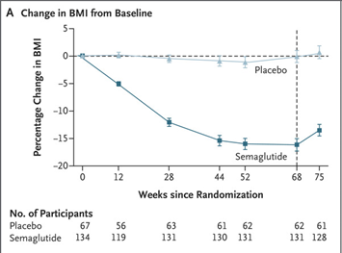
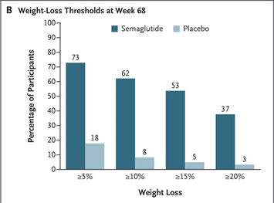
Once-Weekly Semaglutide in Adolescents with Obesity
Weghuber et al. N Engl J Med 2022; 387:2245-2257
Randomized, placebo-controlled trial
201 youth aged 12–17 y
Semaglutide 2.4 mg weekly for 68 weeks
Estimated difference of -16.7% in mean change in BMI from baseline compared to placebo

Slide 29
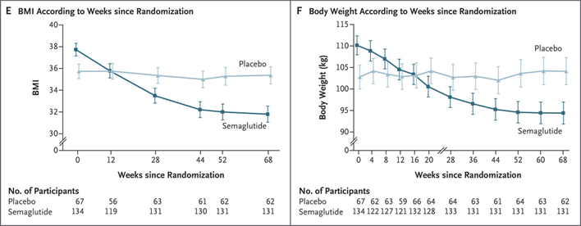
Once-Weekly Semaglutide in Adolescents with Obesity
Weghuber et al. N Engl J Med 2022; 387:2245-2257

Slide 30
GLP-1 RA - Side effects
Nausea
No adverse events leading to treatment discontinuation were reported during the open-label period through 52 weeks
No deaths were reported during the trial
Pancreatitis
post marketing reports of acute pancreatitis

Slide 31
Dual GIP/GLP-1 receptor agonist Tirzepatide (Mounjaro)
FDA approved in May 2022 for type 2 diabetes in adults
First in a new class of diabetes medications

Slide 32
Combined treatment with GLP-1 and GIP receptor agonists could result in additive effects on glucose and bodyweight regulation
Tirzepatide (Mounjaro) is a dual GIP–GLP-1 receptor agonist
Structure is primarily based on the GIP amino acid sequence and includes a C20 fatty diacid moiety
Half-life of approximately 5 days allows weekly administration

Slide 33
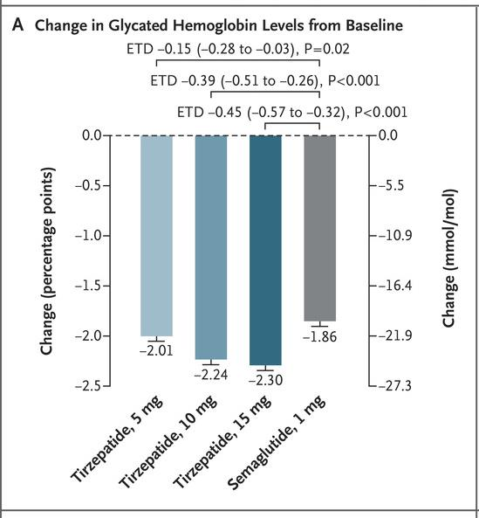
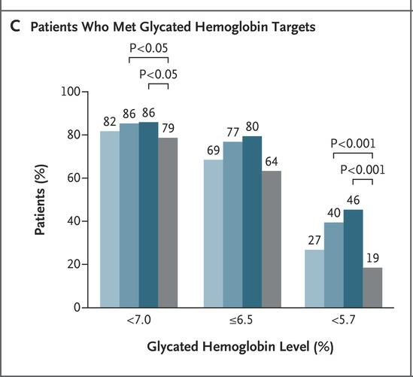
Frías et al. N Engl J Med 2021;385:503-515.

Slide 34
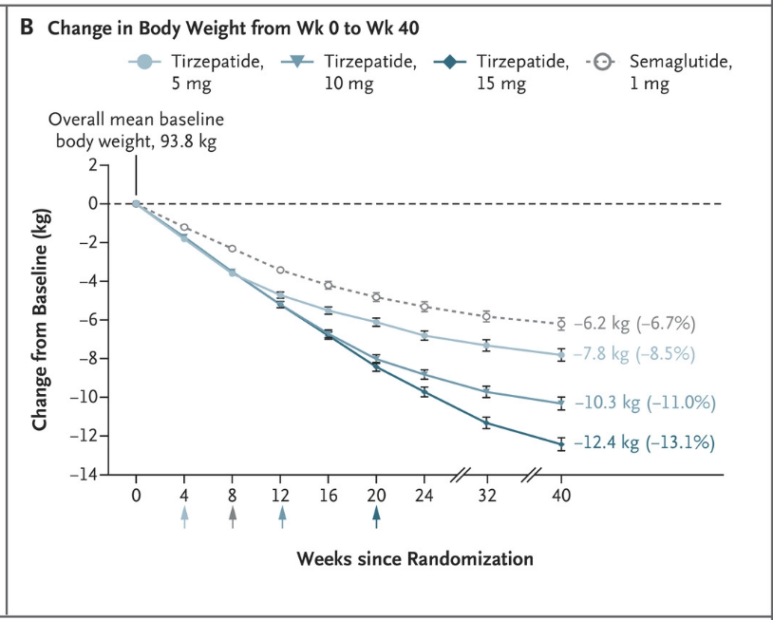
Weekly Tirzepatide Compared with Semaglutide on Body Weight Frias, NEJM 2022

Slide 35
Glycemic Control in Youth with Type 2 Diabetes
BG monitoring according to pharmacological treatment
No proven benefits of frequent BG testing in well controlled patients on no insulin treatment
HbA1c target
Oral agents: <7%
<6.5% on patients with recent onset, no hypoglycemia, improved BMI

Slide 36
Treatment: Bariatric Surgery

Slide 37
Bariatric Surgery
Roux-en-Y
Sleeve

Slide 38
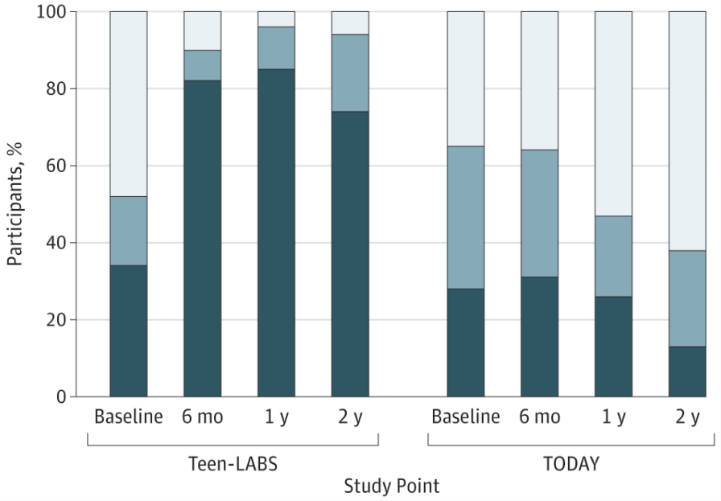
Changes in HbA₁c
JAMA Pediatr. 2018;172(5):452

Slide 39
Type 2 DIABETES: Complications

Slide 40
Type 2: Complications
Within 10 years, youth with type 2 diabetes:
>50% of individuals will have clustering of microvascular complications:
Hypertension
Nephropathy
Neuropathy
Excess standardized mortality ratios compared to their peers with type 1 diabetes

Slide 41
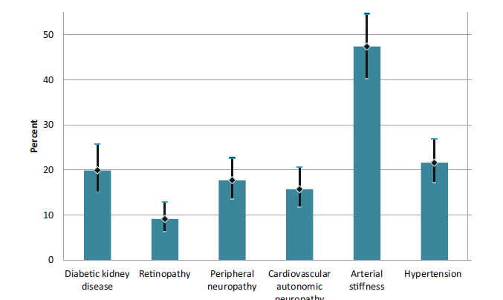
Diabetes Complications: Earlier than Adults
Prevalence of complications - Age 21
JAMA. 2017;317(8):825-835

Slide 42
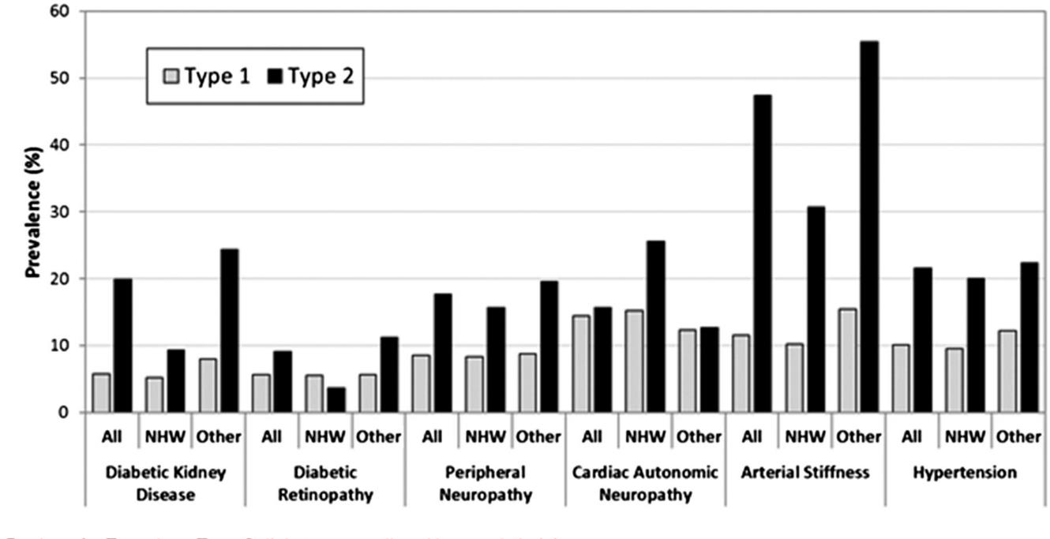
Prevalence of diabetes complications and comorbidities (adjusted to 21 years of age) – SEARCH Study
JAMA. 2017;317(8):825-835
All complications significantly higher in type 2, except cardiac autonomic neuropathy
Higher among minority youth
NHW = non-Hispanic White

Slide 43
Conclusions
Type 2 diabetes and prediabetes are increasing in children
Higher in Non-Hispanic Blacks, Hispanics
Risk-based screening for type 2 diabetes is indicated in obese youth
Type 2 diabetes is not the same in children and adults
β-cells failure happens early and is responsible for treatment failure

Slide 44
Conclusions
Rapid β-cells loss leads to high therapeutic failure in youth with type 2 diabetes
Recommended treatment of prediabetes is lifestyle modification
Type 2 diabetes in youth is associated complications. Earlier and more frequent than type 1
More research is needed to understand the role of bariatric surgery in treatment of type 2 diabetes and other obesity comorbidities

Slide 45
Type 2 Diabetes Clinic
Multidisciplinary
Endocrinologists
Diabetes educators
Nutritionists
Psychologists
Physical therapist
Social worker
Pharmacist
Patient navigator
Access
Referrals are reviewed by physician
Patients scheduled according to urgency, same day, 2-4 days, etc.
Multiple locations

Slide 46
Type 2 Diabetes Clinic - Referral Guidelines
Patients with HbA1c 5.7-6.0%
-Provide counseling for lifestyle changes. Refer to a nutritionist or the IDEAL program for weight management
-Repeat HbA1c in 2-3 months and refer to type 2 diabetes clinic if HbA1c is >6.0%
-Refer to type 2 diabetes clinic if the fasting glucose is >100 mg/dL or post-prandial >140 mg/dL
Patients with HbA1c >6.0%
-Refer to diabetes clinic.
-Provide counseling for lifestyle changes
Patients with blood glucose > 250 or HbA1c >9%
-Call the diabetes on-call physician at 202-476-5000 to review case and disposition
-Please do not fax urgent referrals

Slide 47
June 21, 2023

