Slide 1
Children’s National and the
Pediatric Health Network
Eight Great Questions re: Concussion Management in the Primary Care Setting
October 11, 2023

Slide 2
Introduction and Welcome
Claire Boogaard, M.D., M.P.H.
Pediatric Health Network
Community and Population Health Quality

Slide 3
Notes About Today’s Town Hall:
All lines are muted throughout the presentation.
Please use the Q&A to ask questions or make comments.
We will be recording the session.
Today’s recordings and materials will be posted to the Children’s National website and the Pediatric Health Network website following the presentation.
--ChildrensNational.org
--PediatricHealthNetwork.org

Slide 4
agenda

Slide 5
Eight Great Questions re: Concussion Management in the Primary Care Setting
Gerard A. Gioia, PhD
Pediatric Neuropsychologist
Director, Safe Concussion Outcome, Recovery & Education (SCORE) Program
Professor, Depts of Pediatrics and Psychiatry/Behavioral Sciences, GWU SOMHS

Slide 6
Objectives:
The learner will:
1. Name 3 “do’s” and “don’ts” in managing a concussion
2. Identify the 5 active recovery-promoting strategies
3. State 3 resources to assist patient management

Slide 7
Claiming CME Credit
The INOVA CME management system changed effective June 2023. What does this mean for you?
  All providers must create an account on the new platform, visit: cme.inova.org.
  Once you have an account, credit for this session can be claimed in one of two ways:
    Text today’s session code (“ZOYFOZ”) to 703-260-9391.
    Visit cme.inova.org/code to enter today’s session code (“ZOYFOZ”) on the website.
  CME credit must be claimed within 30 days of the presentation date.

Slide 8
Concussion/ mTBI Definition
An acute brain injury resulting from:
Mechanical energy to the head from external physical forces including:
  (1) 1 or more of the following: confusion or disorientation, loss of consciousness for 30 minutes or less, post-traumatic amnesia for less than 24 hours, and/or other transient neurological abnormalities such as focal signs, symptoms, or seizure;
  (2) Glasgow Coma Scale score of 13-15 after 30 minutes post-injury or later upon presentation for healthcare.

Slide 9
Concussion/ mTBI Definition
Disturbance of brain function is related to: neurometabolic dysfunction, rather than structural injury typically associated with normal structural neuroimaging findings (i.e., CT scan, MRI).
Concussion may or may not involve a loss of consciousness (LOC). (<10%)
“Software” Injury

Slide 10

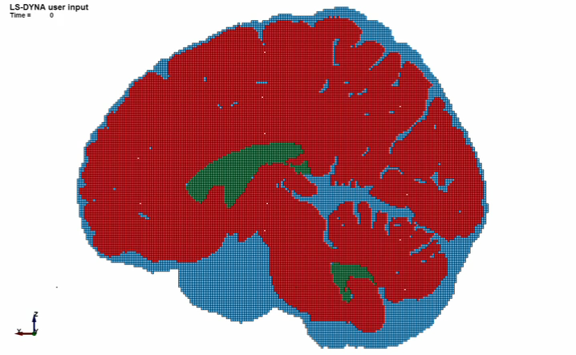
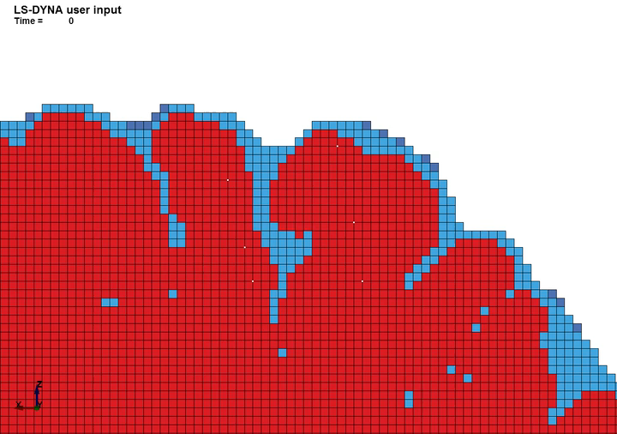
Brain Motion... (stretch/ strain)
Joel Stitzel, jstitzel@wakehealth.edu

Slide 11
Concussion/ mTBI Definition
Concussion results in a constellation of symptoms:
  physical, cognitive, emotional and fatigue/sleep-related.
Duration of symptoms are variable, may last for as short as several minutes and last as long as several days, weeks, months or even longer in some cases.

Slide 12
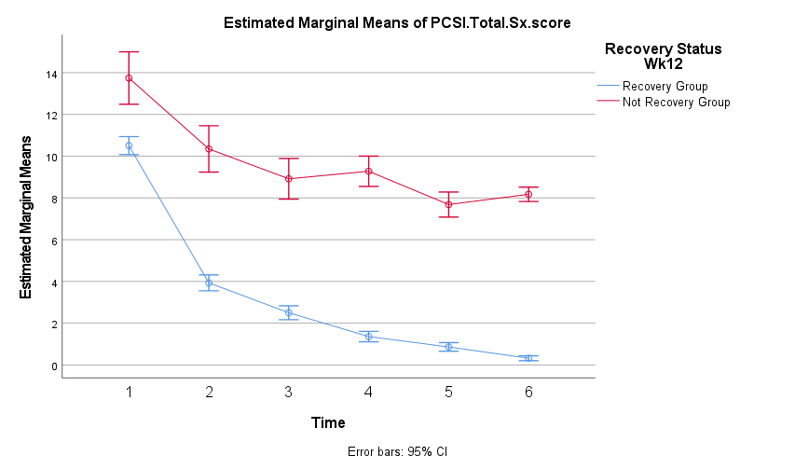
Recovery Curves by age group (8-12 years)*
Uses the PCSI-2 RAPID score methodology (post-pre)
PCSI -2 Total Score (0-34)
Age 8 – 12 N=815
89% recovered (12 weeks)
0 1 2 4 8 12
Week
*5P (Zemek et al., 2016)

Slide 13
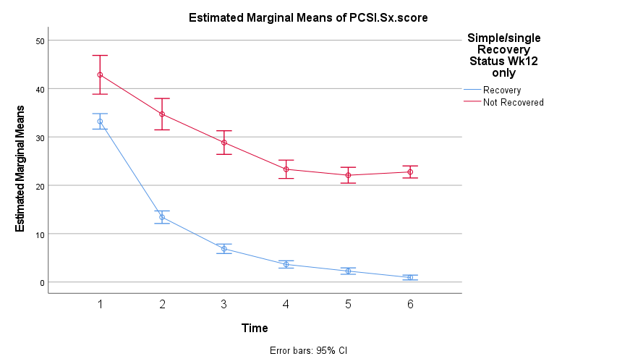
Recovery Curves by age group (13-18 years)*
Uses the PCSI-2 RAPID score methodology (post-pre)
PCSI Total Score (0-126)
Age 13 – 18 N=736
86% recovered (12 weeks)
0 1 2 4 8 12
Week
*5P (Zemek et al., 2016)

Slide 14
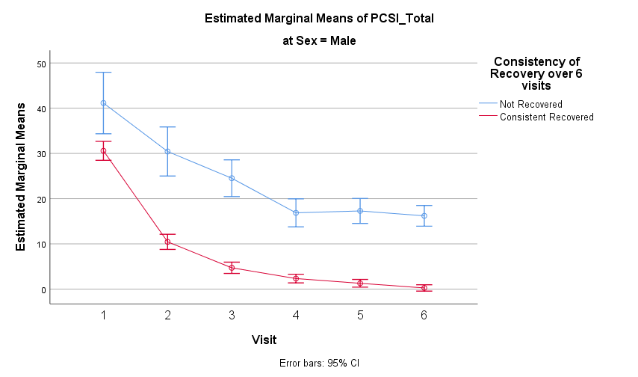
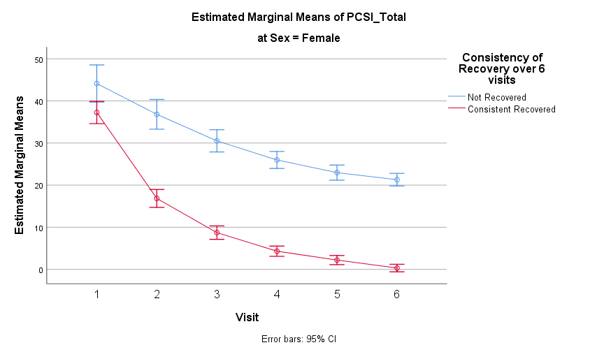
5P sample symptom trajectories by sex
0 1 2 4 8 12
Weeks

Slide 15
Current Available Guidelines for Concussion Management
CDC (2018)
Concussion in Sport Group (CISG) – 2023
Ontario Neurotrauma “Living Guidelines” (2018→2023)
6th
Amsterdam, October 2022

Slide 16
(2018)

Slide 18
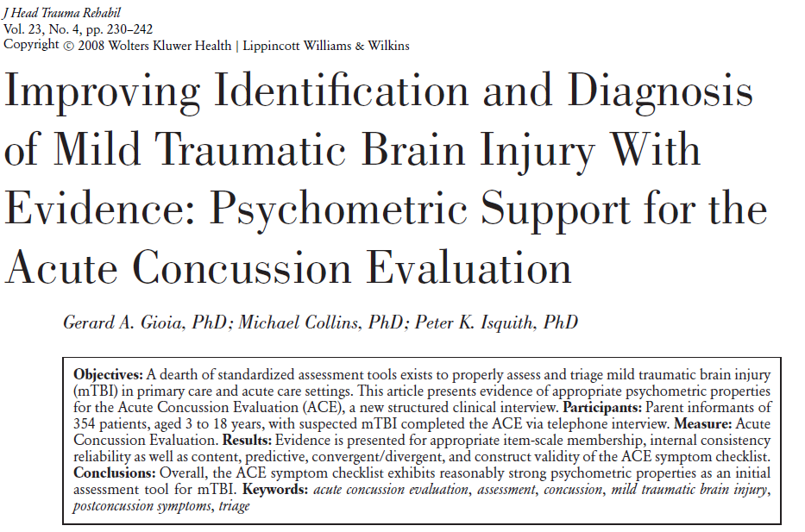
TEAM

Slide 19
Treatment based on Defining Symptom Status & Tracking Recovery Progress
Concussion treatment is based on the symptom profile of child/teen
Translate symptom assessments into individualized, symptom-targeted interventions

Slide 20
Recovery Enhancing Activities
Concussion Prescription for All
Good nighttime sleep (9+ hours), min. naps
Managing daytime activity
    Use symptoms as the guide
    Not too little, not too much
    Take the day in doses (activity-recharge)
Manage stress
  Focus on the positive
  Know and do what you can control)
Daily gradual physical activity/ exercise

Slide 21
Active Rehabilitation
Concussion care has been evolving over the past 20 years
More evidence-based tools are available to evaluate/ diagnose and treat
Active rehabilitation is now the predominant treatment approach, including returning kids to school, social and physical activity as early as they can safely tolerate it.
A variety of healthcare providers play a role in identifying, diagnosing, treating concussions
All need training and tools to learn and implement the latest guidelines

Slide 22
Eight Great Questions
To CT or not to CT?
To RTS or not to…?
To the Dark Room or not to…?
To Physical activity or not to… (and when)?
To “Screens” or not to…?
To (play) Contact Sports or not to…?
To (use) headache meds or not to…?
To Retire an athlete or not to…?

Slide 23
To CT or not to CT?
Child <2 yo
High risk criteria: CT recommended if any single criterion present. 4.4% risk ciTBI
GCS = 14
Altered mental status
Palpable skull fracture
Low risk criteria: Observation vs CT recommended if any single criterion present. 0.9% risk ciTBI
Non-frontal hematoma
Not acting normally per parent
Severe mechanism
  Fall >3 ft
  MVC with ejection, death of passenger, or rollover
  Unhelemeted pedestrian or bicyclist struck by vehicle
  Head struck by high impact object
Avoid CT if no criteria present. <0.02% risk ciTBI
Child >2 yo
High risk criteria: CT recommended if any single criterion present 4.3% risk ciTBI
GCS = 14
AMS
Signs of basilar skull fracture
Low risk criteria: Observation vs CT recommended if any single criterion present 0.9% risk ciTBI
History of LOC
History of vomiting
Severe headache
Severe mechanism
  Fall >5 ft
  MVC with ejection, death of passenger, or rollover
  Unhelemeted pedestrian or bicyclist struck by vehicle
  Head struck by high impact object
Avoid CT if no criteria present. <0.05% risk ciTBI
Purpose of CT: detect structural injury (bleed, contusion, edema) early post-injury
PECARN Head CT rule

Slide 24
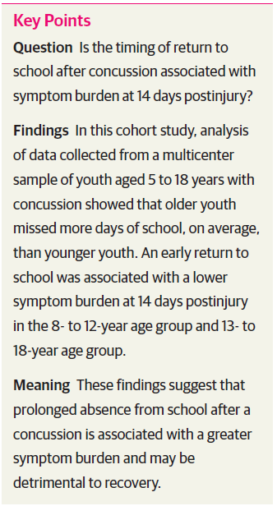
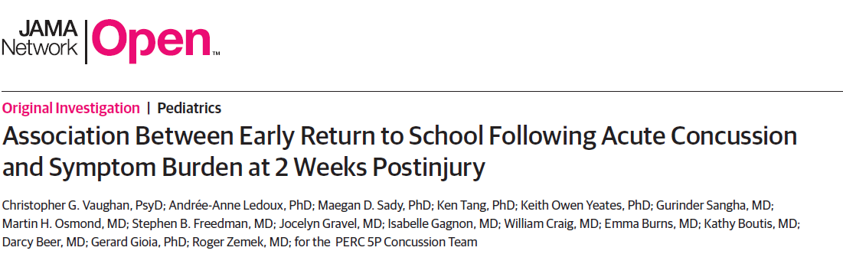
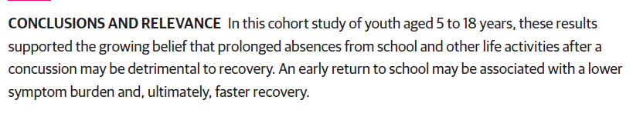
To RTS or not to…
Should the student go to school symptomatic?
Is it possible to benefit from attending school?
Are there risks to not attending school?
When should the student return?

Slide 25
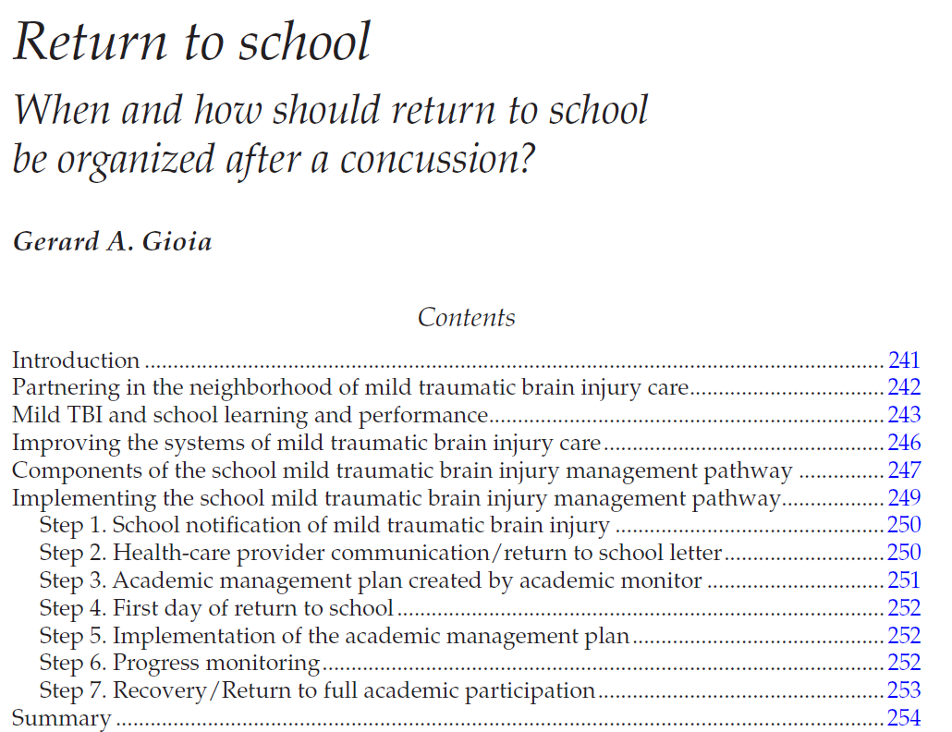
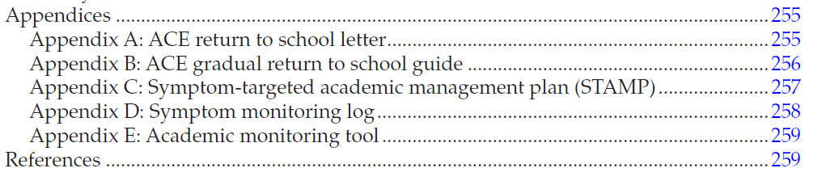

Slide 26
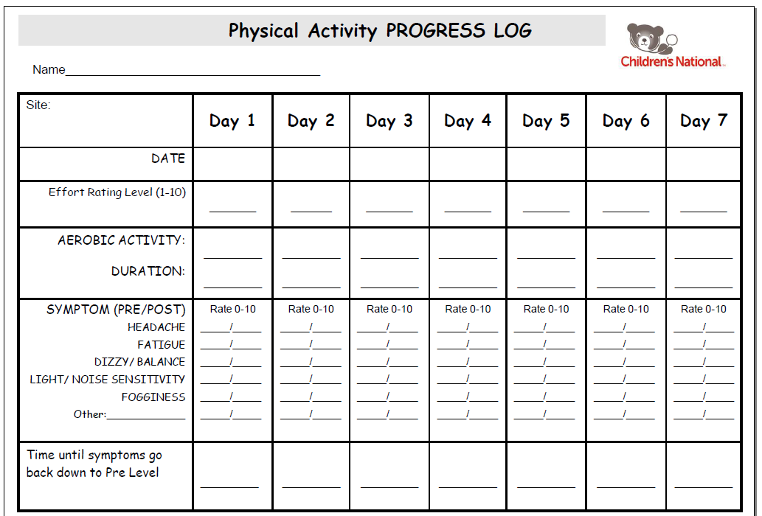
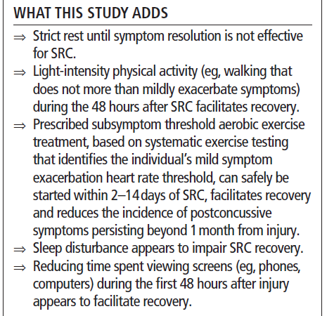
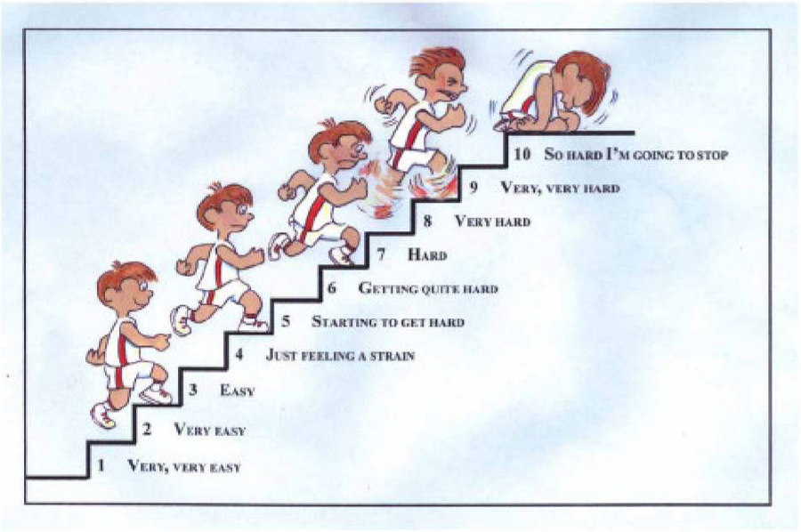
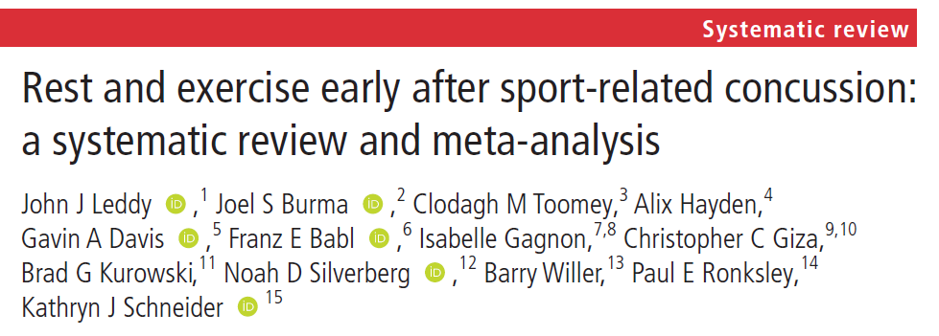
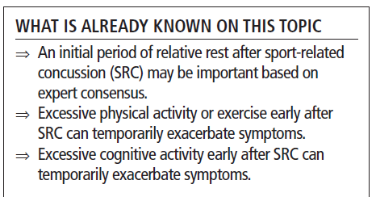
To Physical activity or not to… (and when)
Should patients with concussion engage in physical activity?
Are there benefits? Risks?
When should they start?
How should they gauge their level of activity?

Slide 27
Benefits of Physical Activity
for Recovery

Slide 28
Clinical Guidance

Slide 29
To the Dark Room or not to…
Sensitivity to light is a common symptom following concussion
Tends to initiate or worsen a headache
Should patients totally avoid light? Home? School? Outdoors?
Can light be managed effectively?
Risks vs. Benefits of avoiding light
Recommendation: Manage stimulation, don’t deprive (prolonged isolation is not recommended.
Prolonged white board/ Chromebook should be managed, use paper if possible.

Slide 30
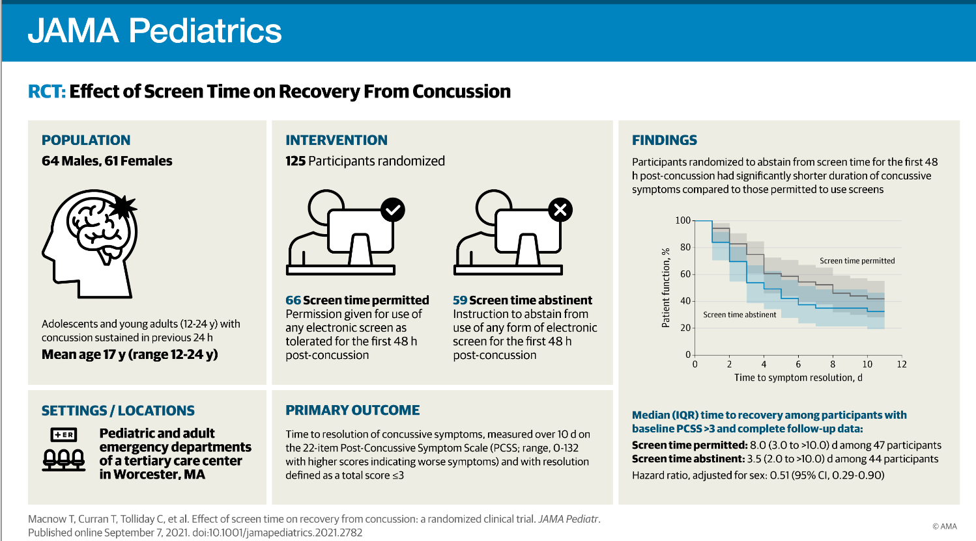
To “Screens” or not to…
Should patients with a concussion be using screens during recovery?
When should they start using screens?
For how long?

Slide 31
To (use) headache meds or not to…
Headache is the #1 symptom following a concussion
How should they be managed?
Is the use of Ibuprofen or Tylenol OK?
How much for how long?
Recommendation: Daily use for the first 1-2 weeks is allowed. After that, these medications should be used only 3-4x/ week.
Emphasize the recovery-enhancing activities: sleep, hydration, eating, stress management, exercise.

Slide 32
To (play) Contact Sports or not to…
What age should a child start playing a contact sport?
How do you know when they are ready?
  Physically?
  Cognitively, behaviorally, emotionally?
Are there risks of starting too early? Or starting too late?

Slide 33
Benefits & Positive Outcomes
Positive engagement in team sports:
Physical fitness & coordination & health
Cognitive → Academic → Vocational performance
Mental Health (reduced anxiety, depression)
Social relationships & teamwork
Maximize!!
Positive Youth Sports for a lifetime

Slide 34
Problem
70% Dropout between 11-13 years
Public perception of head injury risks, espec in contact sports
Efforts to limit/ eliminate contact sports prior to age …
Little valid research evidence to guide decisions regarding a child’s readiness to play contact sports
Tennis, hockey, soccer, football have developed American Development Model (ADM) programs
“How to” connect individual child’s developmental readiness to the youth sports ADMs
Positive Youth Sports for a lifetime

Slide 35
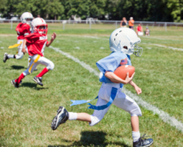
Solution – The “Right Fit”
Connecting Kids & Youth Sports Developmentally
Gear game at the individual child’s developmental level
Setting hard & fast age limits ignores variability in development
Promote competence at the child’s skill level and pace
Promote sustained lifetime sports & health (LTAD)
Youth sports needs a valid & reliable toolset to define a given child’s developmental readiness for their games
Positive Youth Sports for a lifetime

Slide 36
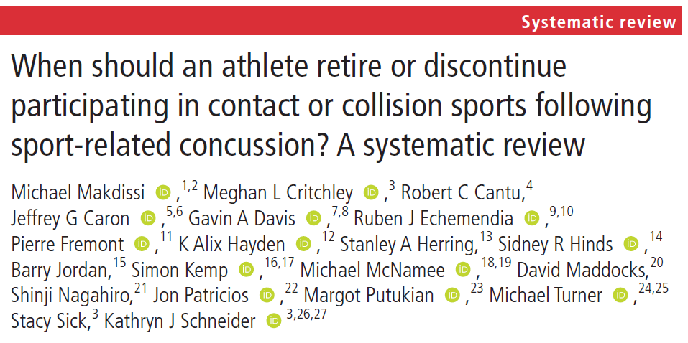
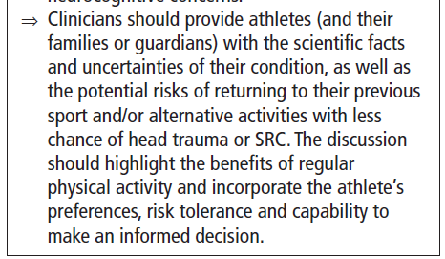
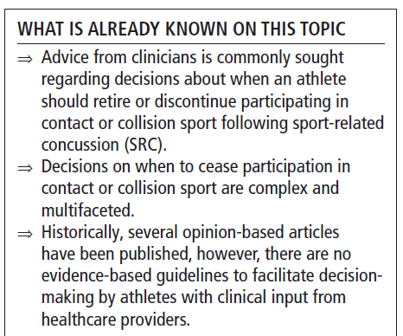
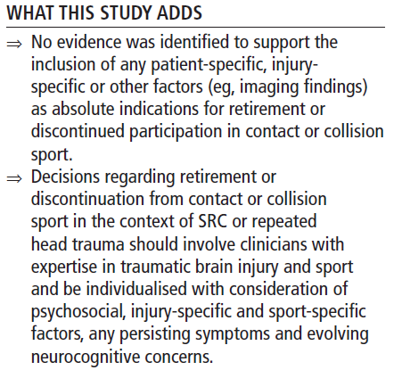
To Retire an athlete or not to…
Multiple concussions raises concerns about possible persisting or long-term effects
How many is too many?
When should an athlete retired from higher risk sports?
What criteria should one use?
Recommendation: Assess the following: (1) timing of injuries (shortening intervals?), (2) amount of force that produced the injuries (less required?), (3) lengths of recovery (longer?), (4) lingering/ persisting problems (present?), (5) athlete’s tolerance for being injured (tired of being injured/affecting life?).

Slide 37
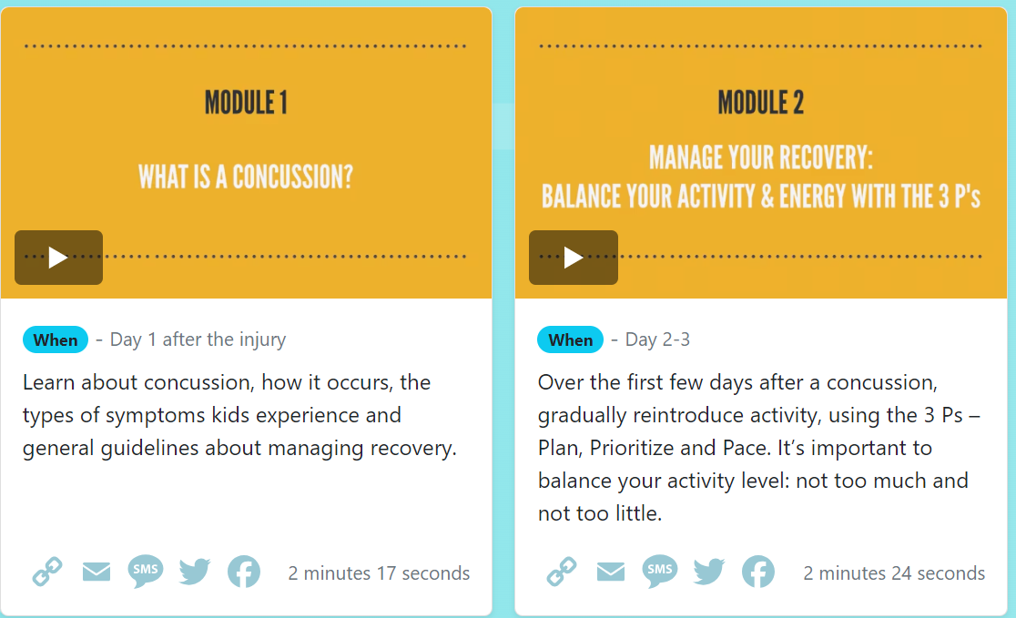
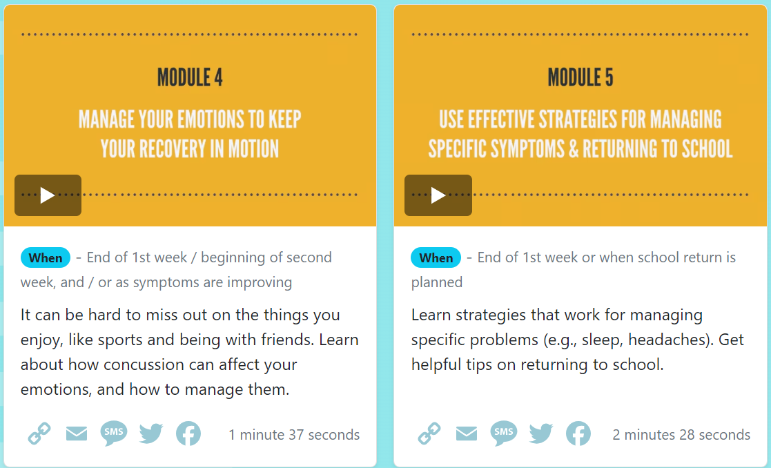
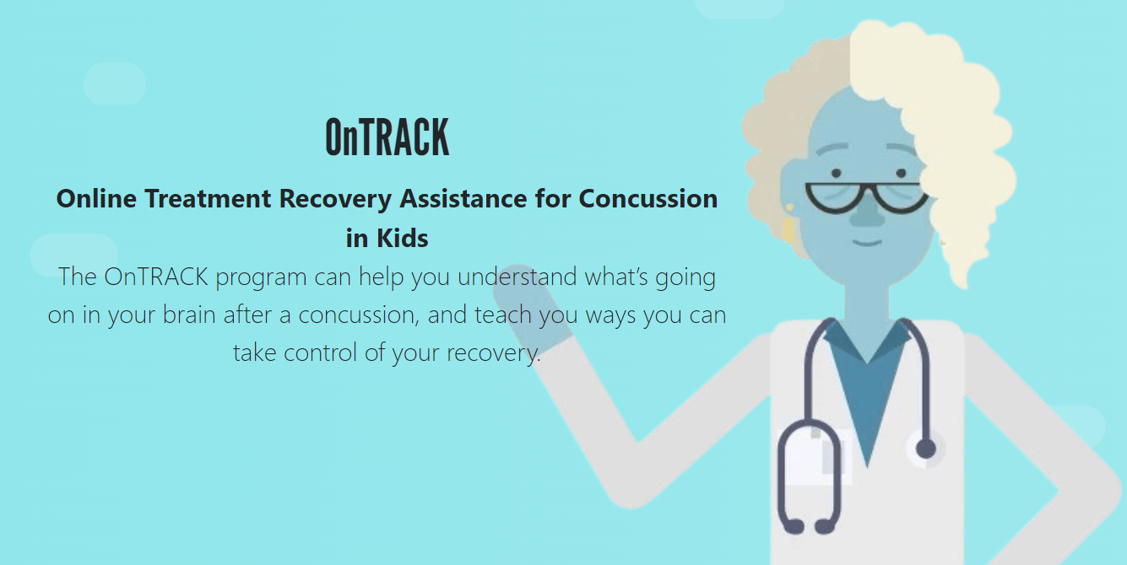
Video Education Study

Slide 38
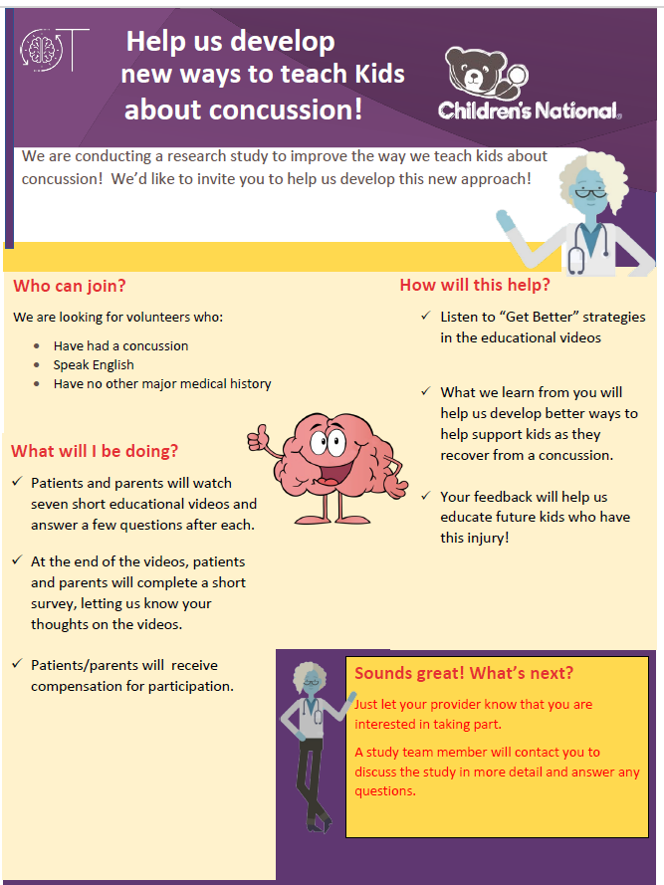
Concussion Video Study
Gathering anonymous feedback from patients, parents, providers on utility of the OnTRACK educational videos.
7 short videos addressing issues related to concussion recovery
If interested, we will send you an email with the Consent form.
Dean Allen, research coordinator will contact you with consent form and link to view videos and give feedback.
Or contact Dean: drallen@childrensnational.org
Time commitment: 25’
Get free access to videos and Tip Sheets

Slide 39
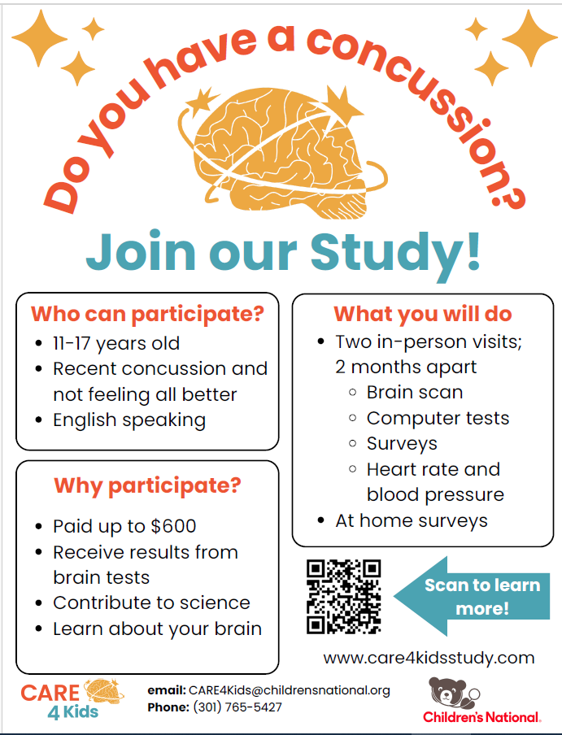
Studying Adolescents – Care4Kids
Understanding biological factors that relate to prolonged recovery in adolescents

Slide 40
Thank You!

Slide 41
Claiming CME Credit
The INOVA CME management system changed effective June 2023. What does this mean for you?
  All providers must create an account on the new platform, visit: cme.inova.org.
  Once you have an account, credit for this session can be claimed in one of two ways:
    Text today’s session code (“VECMAF”) to 703-260-9391.
    Visit cme.inova.org/code to enter today’s session code (“VECMAF”) on the website.
  CME credit must be claimed within 30 days of the presentation date.

Slide 42
We welcome your questions, feedback, suggestions: phn@childrensnational.org
THANK YOU!

