Slide 1
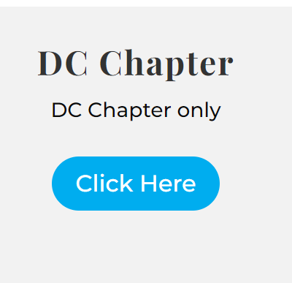
Join DCAAP Today!
As an American Academy of Pediatrics, DC Chapter member, you have the opportunity to:
Participate in chapter committees and projects in many areas of interest, including:
Adolescent Health,
Advocacy,
Breastfeeding,
Early Career Development,
Fetus and Newborn,
Immigrant Health, and
Introducing: Climate Change and Health, Building Community Resilience and more!
FREE! Network with fellow pediatricians at in-person chapter educational meetings and dinner events - free to members!
Develop your advocacy portfolio by representing DCAAP on city-wide committees, councils, and coalitions and testifying at DC Council hearings and government meetings.
Join us at our next board meeting - open to anyone (members and non-members) to learn about chapter activities - January 11th, 5:30-8 PM @ Children’s National Hospital
To join, visit our website:
·
Scan for more info:
You do NOT need to be a national AAP member!
DCAAP Fellow, Associate, Candidate, Affiliate: $150
Residents $15 and Medical Students: $0

