Slide 1
Thank you for taking care of OUR Maryland kids!
Please consider joining the Maryland Chapter, American Academy of Pediatrics!
www.mdaap.org
MDAAP’s Mission: “To support and encourage pediatricians in the promotion of optimal health for all of Maryland’s children and adolescents.”
73 Years of Caring for Children - 1950-2023 -
Questions? Contact Loretta I. Hoepfner, MSOD
MDAAP Executive Director
loretta@mdaap.org
Point your phone camera
⬅ here to link
to our social media!

Slide 2
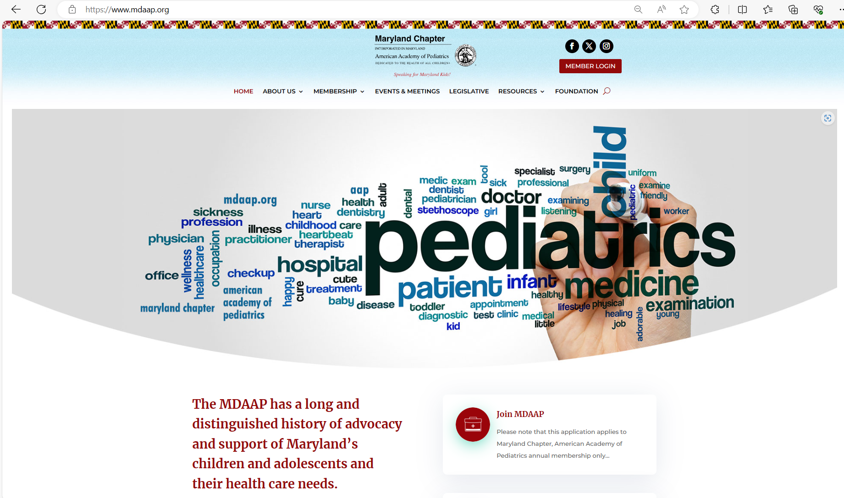
www.mdaap.org
Point your phone camera
⬅ here to link
to our social media!

